Slide 1

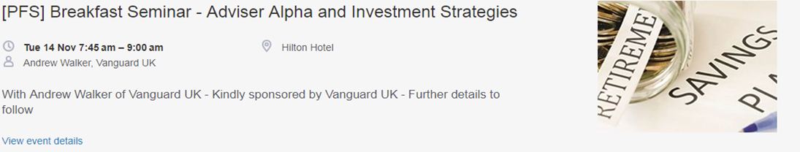
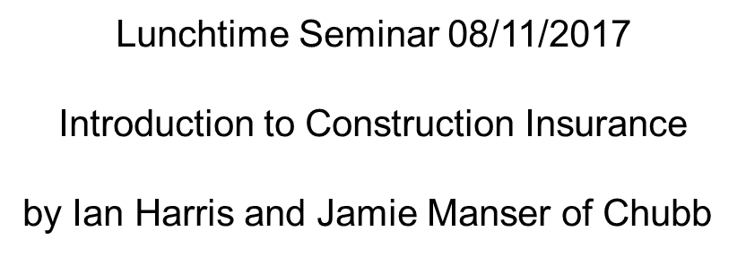


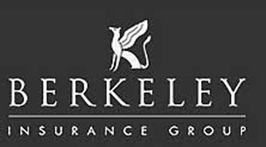
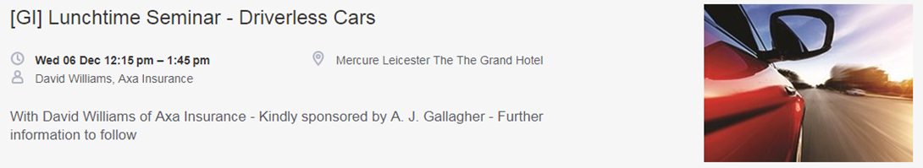

Slide 2
An Introduction to Construction Insurance
Presented by
Ian Harris
Senior Underwriter Technical Lines

Slide 3
What is Construction Insurance?
CAR & EAR
Single projects and annually renewable policies.
Rating
Extensions – testing & commissioning; maintenance; transit.
Additional Covers – owned & hired in plant; Employees Tools; DSU/ALOP; Public Liability; Existing structures.
Defective design
MATI – multiple insureds; overseas cover; plant hirers; speculative buildings/show houses; Environmental Liability.
Summary

Slide 4
CAR versus EAR
CAR
Bricks & mortar; concrete & metal.
Buildings, offices, civil engineering.
Environmental perils important; often an open site
Risk starts at nothing and increases to total value at risk.
Standard property all risks cover.
EAR
Electrical & mechanical plant installation.
Generally inside buildings so environmental perils less key.
Testing & commissioning is crucial to risk.
Risk starts at nothing and increases to total value at risk.
Standard property all risks cover.

Slide 5
CAR & EAR cover – Single Project or Annual
Property “All Risks” cover with Exclusions.
Unlike most property risks starts at nothing and increases to maximum value at risk at handover.
Annual policy covers all contracts undertaken within territorial limits in line with business
Single Project cover is restricted to a specific contract only.
Cover generally limited to the contract site only (often extended to include nearby storage areas).
Annual cover is on an “occurrence” basis. All loses occurring during the period of insurance.
50/50 rule

Slide 6
In the event of any of the Property Insured referred to below having sustained Damage not hereinafter excluded the Company will pay to the Insured the value of the Property Insured at the time of the Damage or at the option of the Company the amount of the Damage or at the option of the Company reinstate or replace such Property Insured or any part thereof provided that the liability of the Company under this Section (including extensions hereto) shall not exceed the appropriate Limit of Liability in respect of any one Contract at the time of the Damage
Property Insured
Contract Works means the permanent and temporary works carried out by or on behalf of the Insured at the Site of a Contract (See General Exclusion 1 – Excluded Work)
Materials means the materials for use in connection with a Contract at the Site thereof or in Transit thereto or therefrom including property supplied by the Principal for use in connection with a Contract

Slide 7
Rating for Single Project & Annual Construction Covers
Single Projects
Rating is specific to that contract and based on actual contract value.
The nature of the works and materials being used and the length of the contract forms the basis of the policy rate.
Contract Value multiplied by policy rate gives you the “base premium”.
A discount or load is applied to the base premium depending upon the excess required. Differential excesses may apply.
Additional premiums are added for extensions and additional covers to get to the final premium.
Annual Cover
Rating is based upon the business description and the total contracting turnover.
An average rate is applied based upon the average and maximum contract lengths disclosed.
Contracting turnover is multiplied by average rate to give you the “base premium”.
A discount or load is applied to the base premium depending upon the excess required. Differential excesses may apply.
Additional premiums are added for extensions and additional covers to get to the final premium.

Slide 8
Extensions – Testing & Commissioning
Generally only applies to EAR though there may well be some testing on a CAR policy as there is likely to be some electrical / mechanical installation on a CAR cover.
Testing is turning on of the completed plant to show / prove that it works. Will be for a period of time.
The riskiest part of the whole cover when the plant is first turned on. On an EAR risk this is often the first time that a fault or mistake becomes apparent.
Three outcomes:
Nothing happens
It works as expected
It breaks down or explodes or error become apparent.
Commissioning is testing the plant under actual working conditions to achieve its required output / production. Sometimes referred to as “hot testing”

Slide 9
Maintenance
Applies to both CAR & EAR.
Is for a period of time generally 12 months, though can be extended.
Three types of cover
Visits
Extended
Full or Guarantee
Rated by use of a “base rate” which is loaded for an extended maintenance period and depending on the insurer may involve base rates for each type of cover or a base rate for visits maintenance with loadings for Extended & Full Maintenance.

Slide 10
Types of Maintenance
Visits – cover for damage to the Contract Works whilst the contractor is carrying out operations required under the contract during the maintenance period.
Extended – Visits plus repairing or replacing damage that arose from a cause occurring on site prior to the handover.
Full or Guarantee – As the name suggest covers damage from any cause during the maintenance period. Insurer’s generally are very wary of giving this cover.

Slide 11
Transit
Some large items may be delivered direct to the site by the manufacturer / supplier but much of the materials will be delivered to the site by the contractor.
This is especially true for some types of contracts such as plumbers and electrical contractors.
The contractor generally won’t buy small and regularly used items on an individual basis but in large numbers to gain benefits of a scale purchase. They will generally be delivered to the contractors premises where they will be “stock” insured under a package or property policy until ready to be used.
Once ready to be used the items will cease to be stock and become contract materials and need to be taken to the site. They are then covered under the Transit extension.
Cover for transit is generally anywhere in the UK including by roll-on / roll-off ferry but excludes other sea and air transits subject to an any one accident limit.

Slide 12
Additional Covers – Owned & Hired in Plant & Employee Tools 1/2
The contractor will use plant and machinery to build or install the contract works. Common items include excavators; compressors, scaffolding, mixers; telehandlers and hand tools.
It is not economic for a contractor to buy all of the items they may use and they will generally only own items of plant they use regularly. For other items they will hire these in from specialist plant hire contractors on an as and when needed basis.
For some specialist contractors their employees will own their own tools that they use on site. This will be because they are comfortable with them and get used to them. Also then they know exactly what tool they will be using. The contractor will often insure the employees tools at the site and whilst in transit to the site.
Cover for owned plant is generally insured on a total value basis (either new replacement or current market) with an inner limit for any one item or any one accident.
Cover for employees tools is insured on a value basis often with an inner limit per employee.

Slide 13
Additional Covers – Owned & Hired in Plant & Employee Tools 2/2
Hired in Plant is insured on a Limit of Liability basis with either a single item or total limit basis.
Cover for Hired in Plant generally includes an additional Limit of Liability for continuing hire charges that they are liable to pay under the hire agreement.
Continuing hire charges are charged at 2/3 of the daily rate under the most common CPA hire conditions.
Owned Plant and Employees’ tools are rated on the value declared.
Hired in Plant is rated on the estimated hiring in charges to be paid. Plant is hired on a cost per day basis with the bigger more valuable items costing more per day to hire. As such the total hiring charges paid is the best estimate we can realistically get of the exposure we face from plant hired in.

Slide 14
Delay in Start Up (DSU) / Advanced Loss of Profits (ALOP)
Different insurers use different terms but same effect.
The cover indemnifies the Principal against lost profits or revenue following a delay in completion/handover due to an insured loss.
Can be extended to include funders though this will have to be endorsed on policy.
Has an indemnity period like any BI cover and generally a time excess.
For CAR can cover things such lost rental income or additional debt repayments.
For EAR generally covers lost production revenue / income.

Slide 15
Public Liability
Available as an additional cover on both CAR & EAR and Annual and Project Policies.
Generally only as a Primary GBP 1 million limit on works cover backed up by excess covers.
More common on project policies as Principal may not have a general PL policy unlike contractor
Can be extended to include all participants in the contract.
Benefit to Principal is they know there is cover & don’t have to rely on party at fault having cover

Slide 16
Existing Structures
Generally only available as part of a project CAR policy cover for rebuild of an empty property.
If it is an extension of an occupied property / premises will be covered under property policy.
Need for cover is often driven by contract conditions or continuing existence of high value building
Most insurers will place a limit of value of existing structure as a percentage of total works.

Slide 17
Defective Design
A short exclusion that often causes more trouble than the rest of the policy together.
Called defective design but is more fully “defective design, workmanship or materials”.
Standard wordings of DE clauses for CAR policies and LEG clauses for EAR policies.
Five DE clauses and three LEG clauses from total exclusion to full cover.
DE1 or LEG1 for total exclusion rarely used but can be used for a prototypical or unproven design
DE3 or LEG2 “consequences” wording. Excludes faulty item but insures consequences of failure.
DE5 or LEG3 full cover includes the faulty part.

Slide 18
Defective Design (continued)
 | CAR | EAR
Total Exclusion | DE1 | LEG1
 | DE2
“Consequences” standard cover | DE3 | LEG2
 | DE4
Full Cover | DE5 | LEG3

Slide 19
Mention And Then Ignore (MATI)
Multiple Insureds can be covered under a single policy & detailed in the wording or schedule.
Not all Insureds will be entitled to protection against all covers.
Overseas cover. Can cover EU contracts under Freedom of Services (FOS) EU regulations.
Contracts further overseas may require local policies and cover exclusions.
Plant hirers are a specific sub market & contract conditions are crucial to the cover/profitability.
CAR annual policies can extend cover for both speculative housebuilding & show houses/contents.
For single projects on previously used land a contractors pollution insurance policy is critical.

Slide 20
Summary & Questions
Thank you for your attention.

