Slide 1
Considerations When Placing BI Insurance
Thu 28th September 2017
Presenter
Rajen Rajput
rrajput@mdd.com

Slide 2
V
E
R
A
G
E
AICOW
DECLARATION LINKED
R
E
N
D
ROSS PROFIT
INDEMNITY PERIO

Slide 3
“Failure to properly advise, particularly in relation to:
  Limit of indemnity / sums insured
  Assessment and calculation of Business Interruption sums insured
  The application and meaning of Average”
BIBA’s Professional Indemnity Initiate – Claim types
“Eurokey sued the broker for the shortfall between the settlement and full recovery under the policy on the basis that it had negligently advised it as to how the sums insured should be calculated and negligently failed to arrange sufficient cover.”
Eurokey Recycling Ltd v Giles Insurance Brokers Ltd

Slide 4
“The plaintiff also contends that at the time when the levels of cover were being discussed Rossborough should have, but did not, explore with Mr Ruellan the appropriate figure to be placed on the building itself and the appropriate period of time for which business interruption cover should be arranged; and that if these matters had been the subject of proper discussion the building would have been insured for a far higher figure and business interruption cover would have been arranged for a period of three years rather than just one”
Café de Lecq Limited v R.A. Rossborough (Insurance Brokers) Limited
“Beware of the traps that lead to underinsurance, especially in valuations of property and in business interruption insurance calculations.”
BIBA’s Professional Indemnity Initiate - Tips

Slide 5
Firm Overview
& Areas of Expertise

Slide 6



Our History
1979
  Founded as Johnson Atwater & Co in Chicago
  Became Matson, Driscoll & Damico with 4 U.S. Offices
  MDD is a globally known & respected firm
1933
2017
43 Offices
5 Continents
250+ Employees
36 Language Fluencies

Slide 7
Who We Are
MDD’s forensic accountants specialize in a wide range of insurance and litigation matters
We are routinely retained for evaluations that require our extensive knowledge of accounting, business, operational and manufacturing processes across many industries
MDD’s exceptional dedication, singularly qualified experts and demonstrated results in this highly specialized area of accounting have long been the hallmark of our firm

Slide 8
Who We Are
MDD offers an unparalleled range of expertise in forensic accounting
For more than 80 years, our insurance, legal, government, corporate and small business clients have called on us to evaluate and determine insurance claims, quantify litigation damages and perform accurate business valuations
In addition, we have provided expert witness testimony in courts, arbitrations and mediations around the world

Slide 9
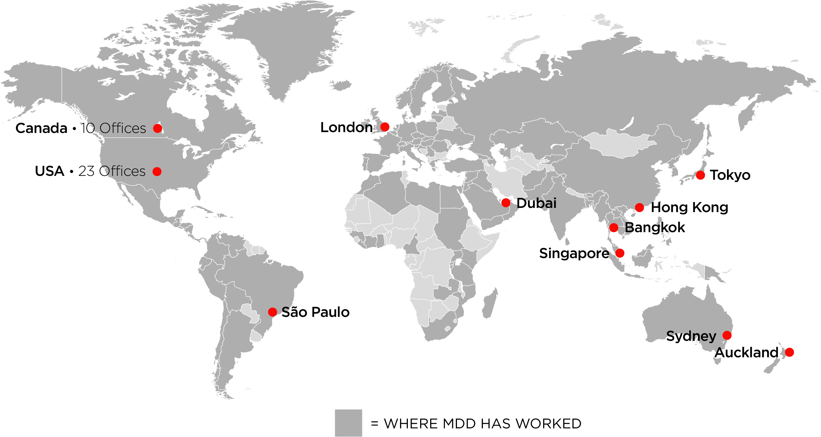
Global Footprint
42 Offices on 5 Continents

Slide 10
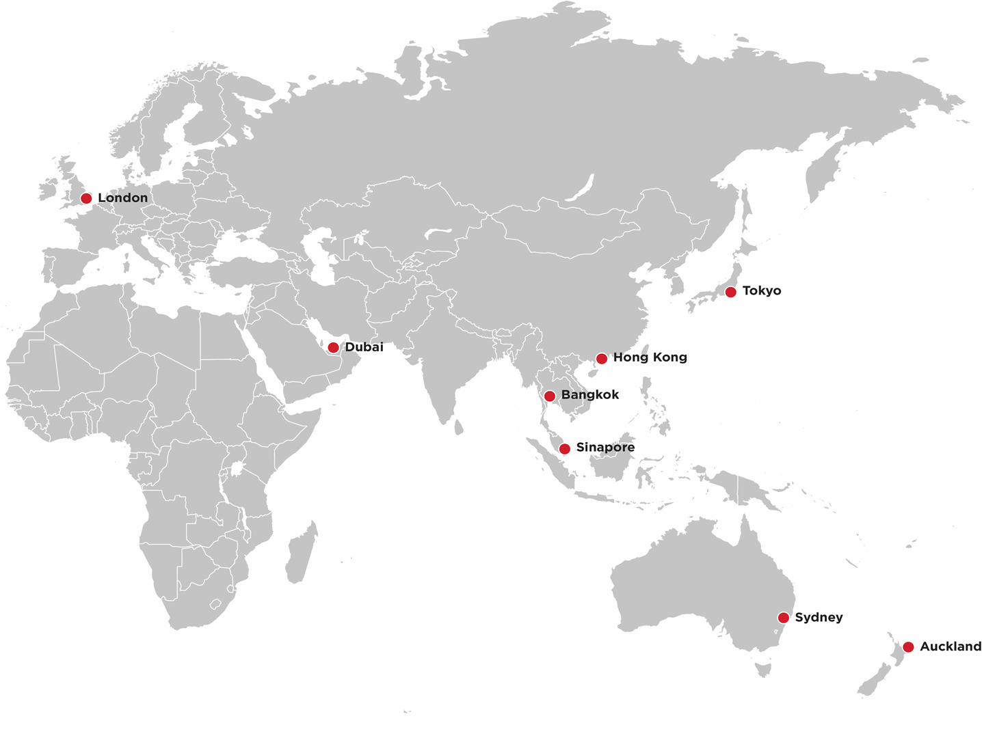
MDD Offices
8 EMEA & Asia Pacific Offices
42 Offices Worldwide

Slide 11
What is EDQ?
The practice of measuring, in financial terms, the value of harm or injury that has been inflicted on a person or property.

Slide 12

Partner & Staff Credentials
Partners and senior staff all hold at least one of the following:
Additional designations held by partners and staff:
ACMA
CA
CPA
CMA
CA•IFA/DIFA (Investigative & Forensic Accounting)
Certified Forensic Financial Analyst
Certified Fraud Deterrence Analyst
Certified Fraud Examiner
Certified in Financial Forensics
Certified Valuation Analyst
Chartered Business Valuator

Slide 13








Practice Areas
Builders’ Risk Claims
& Soft Costs Claims
Business Disputes &
Shareholder Disputes
Business Interruption
Business Valuations
Catastrophe Services
Class Actions
Contingency Claims &
Entertainment Claims
Cyber Risk

Slide 14








Practice Areas
Disability Insurance
Claims
Divorce &
Marital Disputes
Environmental
Damage Claims
Expropriation
Extra Expenses/
Increased Costs
Fidelity Claims
Fraud
& Investigations
Franchise Litigation

Slide 15








Practice Areas
Intellectual Property
Liability Losses
Litigation Support
Lost Profits
Mining Claims/
Refining Claims
Oil & Gas
Personal Injury &
Wrongful Death
Physical Damages

Slide 16







Practice Areas
Product Liability &
Product Recall
Power Generation
Reported Insurance
Values
Stock &
Contents Loss
Surety Bond & Funds
Control Services
Subrogation
Toxic Torts
Valuable Papers

Slide 17














Industry Experience
MDD offers an unparalleled range of forensic accounting services. Since 1933, our clients have called on us to provide our unsurpassed expertise across more than 800 industries.

Slide 18
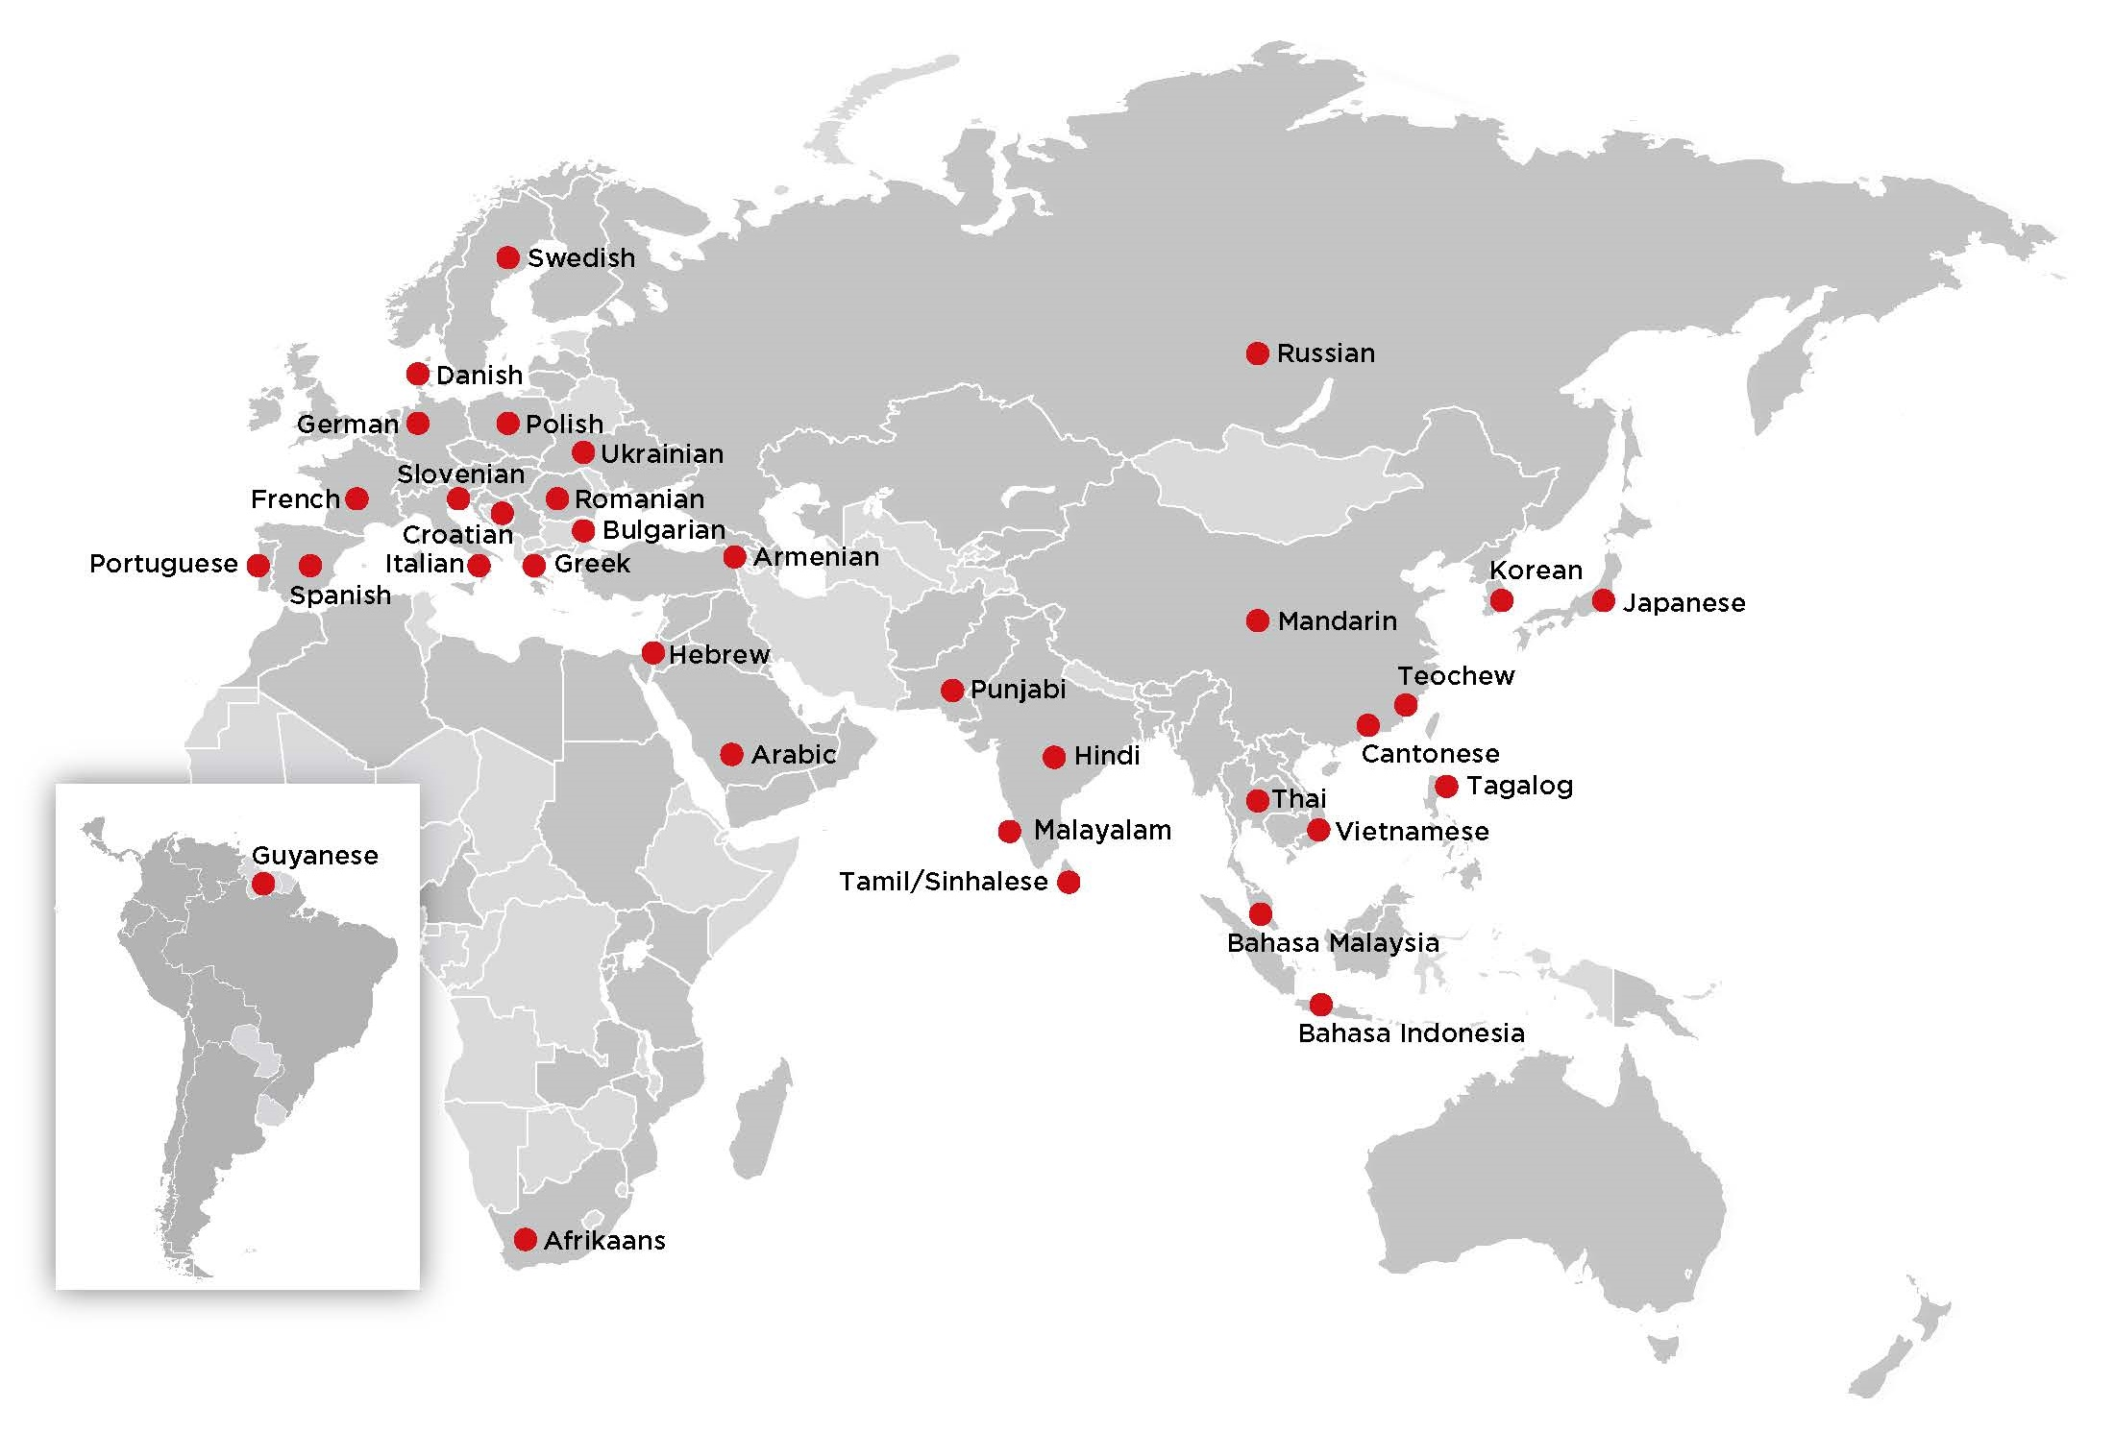
Language Capabilities

Slide 19
Language Capabilities
Afrikaans
Arabic
Armenian
Bahasa Indonesia
Bahasa Malaysia
Bulgarian
Cantonese
Croatian
Danish
French
German
Greek
Guyanese
Hebrew
Hindi
Italian
Japanese
Korean
Malayalam
Mandarin
Polish
Portuguese
Punjabi
Romanian
Russian
Slovenian
Spanish
Swedish
Tagalog
Tamil/Sinhalese
Teochew
Thai
Ukrainian
Vietnamese

Slide 20



Our Growth Strategy
Recruitment
Strategy
Training Strategy
Further Education
Recruitment & training of Young Talent
Focus on forensic accountancy, economic loss evaluation and litigation support
Acquisition of primary professional qualifications
On-the-job training
Global and local training programs for staff
Ongoing professional development
Acquisition of secondary professional qualifications
Continuing professional education

Slide 21
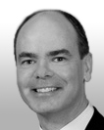


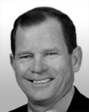


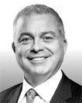


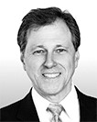
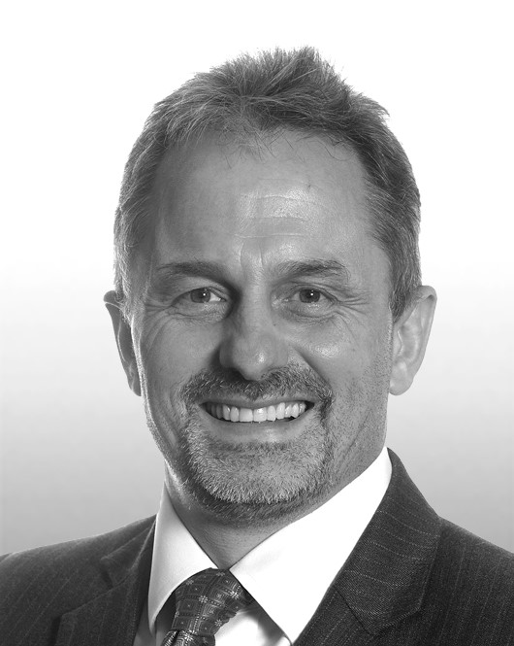
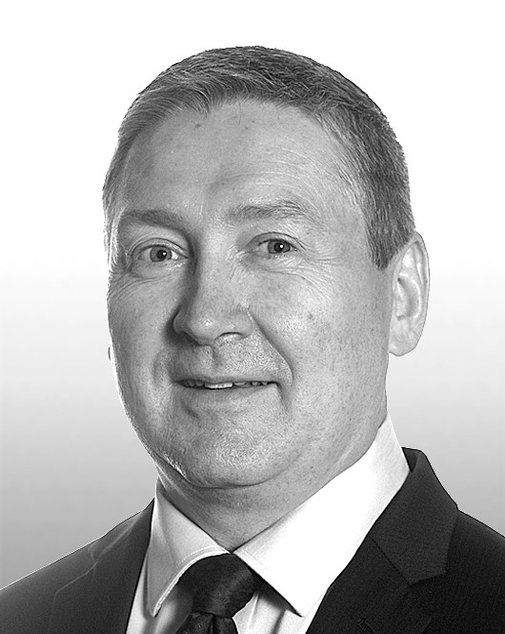

The Firm’s Global Leadership
Global Managing Partner
Paul McGowan
Global Executive Committee (GEC)
Gerry Bouwman, William Bradshaw, John Foley, Markus Heiss, Paul McGowan, Phillip Taylor
Canada
Brad Ebel
United States
Kevin Flaherty, Kent Bogdan & Peter Karutz
EMEA
Markus Heiss, Flemming Jensen & Phillip Taylor
Asia Pacific
Phillip Taylor
Latin America
Marcelo Fazio

Slide 22
Considerations When Placing BI Insurance
Thu 28th September 2017
Presenter
Rajen Rajput

Slide 23
Learning Objectives
By attending this event you will gain a further understanding of:
• the various items and cover within a Business Interruption policy wording
• how to mitigate the risks of underinsurance
• the economic limits of Increased Cost of Working
• the benefits of Additional ICOW
• the importance of adequate indemnity periods
• the significance of ‘know your customer’
• calculating an adequate sum insured with reference to company accounts

Slide 24

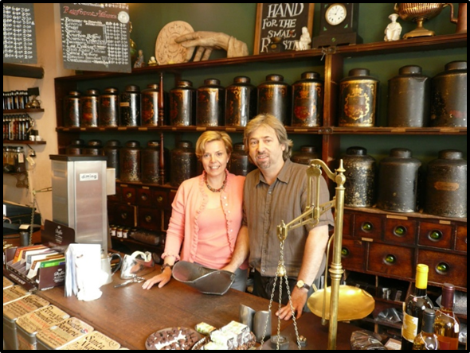
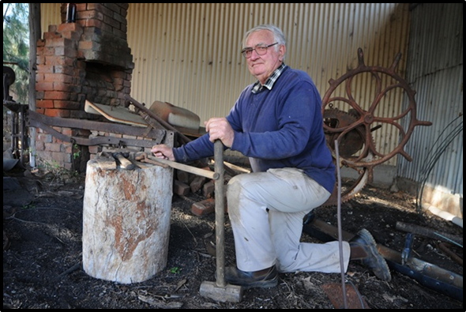
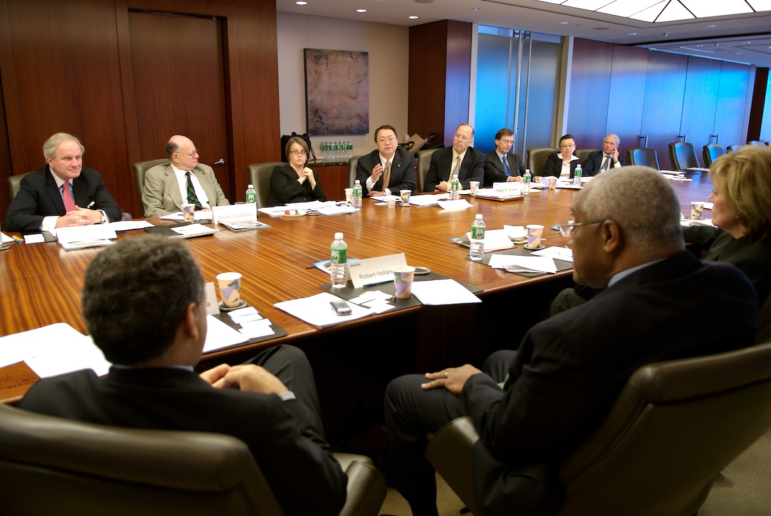
The Policyholder

Slide 25
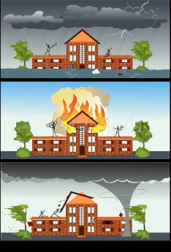


3 Main Attributes
Replace
Reduced
Business Profits
Have a Time Limit
(Indemnity Period)
Due to
Material Damage
(Usually)

Slide 26
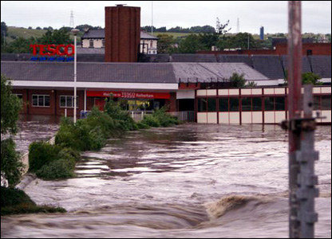
Examples of Material Damage

Slide 27
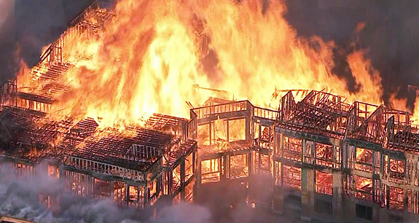
Examples of Material Damage

Slide 28
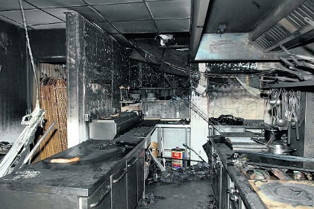
Examples of Material Damage

Slide 29
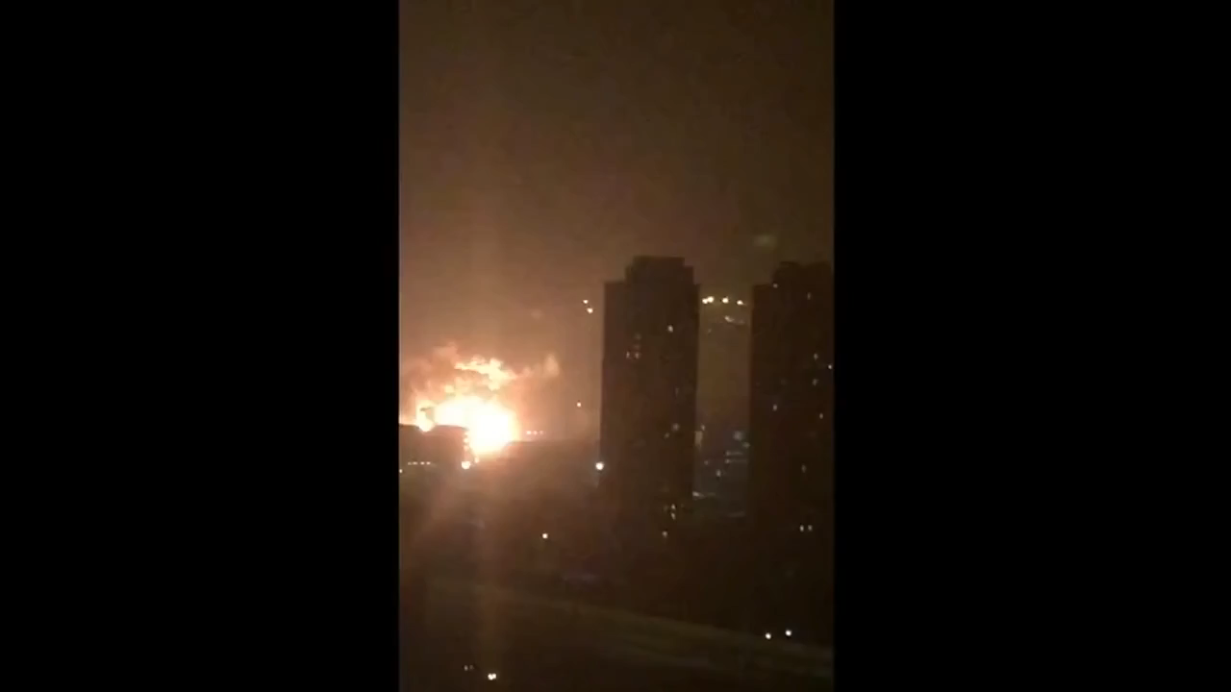
Examples of Material Damage

Slide 30

Components of a BI Claim
Additional
Increased
Costs of
Working
(AICW)
Increased
Costs of
Working
(ICW)
BUSINESS INTERRUPTION CLAIM
Savings
in
Overheads
(Savings)
Loss of
Gross Profit
(Loss of GP)

Slide 31
Placement Considerations
5
Placement Considerations

Slide 32
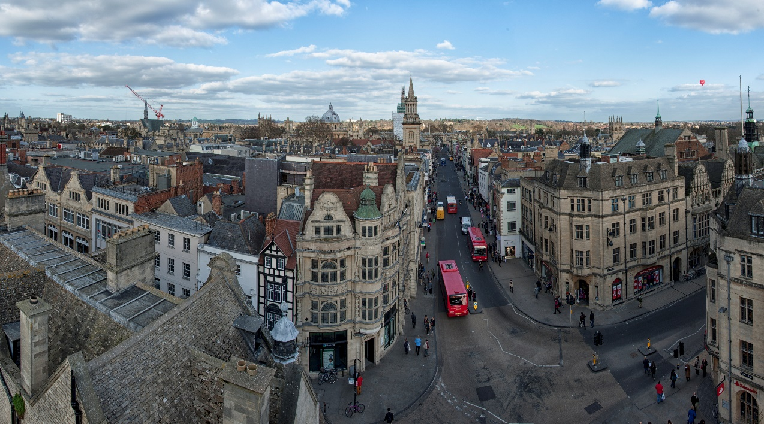
1. Maximum Indemnity Period
Type of building
Planning Permission
Machinery (or contents) removal method
Machinery lead times
Rebuild customer base

Slide 33
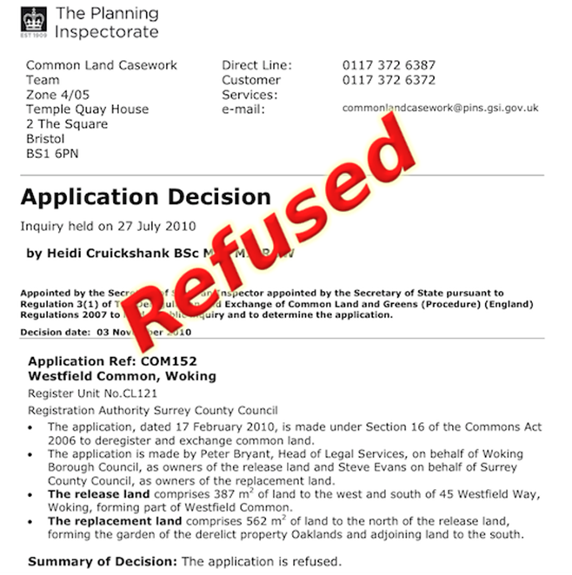
1. Maximum Indemnity Period
Type of building
Planning Permission
Machinery (or contents) removal method
Machinery lead times
Rebuild customer base

Slide 34
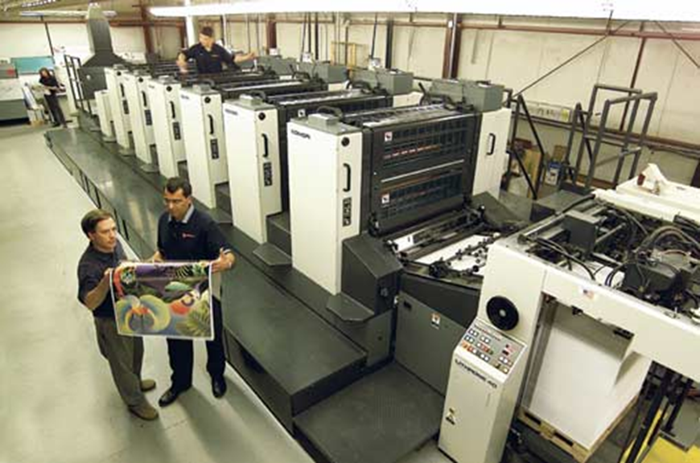
1. Maximum Indemnity Period
Type of building
Planning Permission
Machinery (or contents) removal method
Machinery lead times
Rebuild customer base

Slide 35

1. Maximum Indemnity Period
Type of building
Planning Permission
Machinery (or contents) removal method
Machinery lead times
Rebuild customer base

Slide 36

1. Maximum Indemnity Period
Type of building
Planning Permission
Machinery (or contents) removal method
Machinery lead times
Rebuild customer base

Slide 37


2. Additional ICOW Cover

Slide 38
2. Additional ICOW Cover
Month | Pre Loss Turnover (Ex VAT) 2016 | Rate of Gross Profit | Gross Profit Earned (Ex VAT) |  | Post Loss Turnover (Ex VAT) 2017 | Costs Paid to Subcontractors (Ex VAT) 2017
 | GBP |  | GBP |  | GBP | GBP
Jan | 150,000 | 80% | 120,000 |  | 150,000 | 190,000
Feb | 150,000 | 80% | 120,000 |  | 150,000 | 190,000
Mar | 200,000 | 80% | 160,000 |  | 200,000 | 255,000
Apr | 200,000 | 80% | 160,000 |  | 200,000 | 250,000
May | 250,000 | 80% | 200,000 |  | 250,000 | 310,000
Jun | 250,000 | 80% | 200,000 |  | 250,000 | 315,000
Jul | 350,000 | 80% | 280,000 |  | 350,000 | 440,000
Aug | 350,000 | 80% | 280,000 |  | 350,000 | 445,000
Sep | 300,000 | 80% | 240,000 |  | 300,000 | 380,000
Oct | 300,000 | 80% | 240,000 |  | 300,000 | 380,000
Nov | 250,000 | 80% | 200,000 |  | 250,000 | 315,000
Dec | 100,000 | 80% | 80,000 |  | 100,000 | 125,000
Total | 2,850,000 |  | 2,280,000 |  | 2,850,000 | 3,595,000
Amount recoverable under ICW = £2,280,000 [ saved Gross Profit (eco limit) ]
Amount not covered by policy = £745,000 !
£2,850 in from customers
£2,280 in from insurers
(£3,595) out to subcon
= £1,535 balance
but balance should have been £2,280 k
thus £745k shortfall

Slide 39
3. Performance Analysis
Policy Period:
01-Jan-18 to 31-Dec-18
Maximum Indemnity Period:
1 Year
Policy Period:
Potential BI Claim (Last day of policy):

Slide 40

4. Declaration Frequency
Declaration Linked Policies:
Give (usually) 33% margin of error on estimated gross profit
No underinsurance penalty
(if within reason)
Regular declarations are to be made to Insurers

Slide 41
5. Rate of GP Calculation
Definition of Rate of Gross Profit:
Gross Profit earned on the Turnover and expressed as a percentage of Turnover, during the financial year immediately before the date of the Damage.
Definition of Gross Profit:
The combined value of the Turnover, closing stock and work in progress, less the combined value of opening stock and work in progress and Uninsured Working Expenses.
Definition of Uninsured Working Expenses:
Purchases of materials for production or re-sale (less any discounts received), plus
discounts allowed, and any additional Uninsured Working Expenses stated in The Schedule.

Slide 42
5. Rate of GP Calculation
Definition of Rate of Gross Profit:
Gross Profit earned on the Turnover and expressed as a percentage of Turnover, during the financial year immediately before the date of the Damage.
Definition of Gross Profit:
The combined value of the Turnover, closing stock and work in progress, less the combined value of opening stock and work in progress and Uninsured Working Expenses.
Definition of Uninsured Working Expenses:
Purchases of materials for production or re-sale (less any discounts received), plus
discounts allowed, and any additional Uninsured Working Expenses stated in The Schedule.
Our Equation So Far
Rate of Gross Profit = Gross Profit
Turnover

Slide 43
5. Rate of GP Calculation
Definition of Rate of Gross Profit:
Gross Profit earned on the Turnover and expressed as a percentage of Turnover, during the financial year immediately before the date of the Damage.
Definition of Gross Profit:
The combined value of the Turnover, closing stock and work in progress, less the combined value of opening stock and work in progress and Uninsured Working Expenses.
Definition of Uninsured Working Expenses:
Purchases of materials for production or re-sale (less any discounts received), plus
discounts allowed, and any additional Uninsured Working Expenses stated in The Schedule.
Our Equation So Far
Rate of Gross Profit = (t/o + CS + WIP_{@cl}) – (OS + WIP_{@op} + UWE)
Turnover

Slide 44
5. Rate of GP Calculation
Definition of Rate of Gross Profit:
Gross Profit earned on the Turnover and expressed as a percentage of Turnover, during the financial year immediately before the date of the Damage.
Definition of Gross Profit:
The combined value of the Turnover, closing stock and work in progress, less the combined value of opening stock and work in progress and Uninsured Working Expenses.
Definition of Uninsured Working Expenses:
Purchases of materials for production or re-sale (less any discounts received), plus
discounts allowed, and any additional Uninsured Working Expenses stated in The Schedule.
Our Equation So Far
Rate of Gross Profit = (t/o + CS + WIP_{@cl}) – (OS + WIP_{@op} + [ Purchases – disc.rec + disc.allwd ])
Turnover

Slide 45
5. Rate of GP Calculation
Our Equation So Far
Rate of Gross Profit = (t/o + CS + WIP_{@cl}) – (OS + WIP_{@op} + [ Purchases – disc.rec + disc.allwd ])
Turnover
Turnover
Closing Stock
Work in Progress (@ closing)
Opening Stock
Work in Progress (@ opening)
Purchases
Discounts Received
Discounts Allowed

Slide 46
5. Rate of GP Calculation
Rate of Gross Profit (according to accounts): 38.6%

Slide 47
5. Rate of GP Calculation

Slide 48
5. Rate of GP Calculation
480,874
876,083
Rate of Gross Profit (according to policy): 64.6%

Slide 49
5. Rate of GP Calculation
Rate of Gross profit
(Accounting Method)
Rate of Gross profit
(Policy Method)
38.6%
64.6%
12m turnover:
Gross Profit at risk
according to method of
calculation:
Sum Insured on policy:
£1,400,000
£540,400
£600,000
12m turnover:
Gross Profit at risk
according to method of
calculation:
Sum Insured on policy:
Adequacy:
£1,400,000
£904,400
£600,000
66%
Policyholder will bear 34% of all losses

Slide 50
Summary
5 Placement Considerations
1. Maximum Indemnity Period
2. AICOW Cover
3. Performance Analysis
4. Declaration Frequency
5. Rate of GP Calculation

Slide 51
Learning Objectives
By attending this event you will gain a further understanding of:
• the various items and cover within a Business Interruption policy wording
• how to mitigate the risks of underinsurance
• the economic limits of Increased Cost of Working
• the benefits of Additional ICOW
• the importance of adequate indemnity periods
• the significance of ‘know your customer’
• calculating an adequate sum insured with reference to company accounts

Slide 52

Questions
Rajen Rajput
rrajput@mdd.com

Slide 53




Marlow House
1a Lloyds Avenue
London
EC3N 3AA
(T) +44 203 384 5499
(F) +44 203 384 5489
www.mdd.com
London’s Partners Contact Details
Flemming Jensen M +44 7711 416 462 fjensen@mdd.com | Markus Heiss M +44 7730 985 822 mheiss@mdd.com | Lee Swain M +44 7714 262 850 lswain@mdd.com | Paul Isaac M +44 7725 509 918 pisaac@mdd.com | Mark Mangan M +44 7760 424 660 mmangan@mdd.com
MDD Forensic Accountants
@mdd1933
MDD Forensic Accountants

Slide 54
Proprietary & Confidential
Proprietary and Confidential – This presentation contains information that is confidential and proprietary to MDD Forensic Accountants and may contain trade secrets. It is intended to be strictly confidential and is to be used solely for discussion purposes. No part of this presentation may be disclosed to any third party or reproduced by any means without the prior written consent of MDD Forensic Accountants. This presentation does not constitute work product, opinion or a deliverable.
This presentation contains information in summary form and is therefore intended for general guidance only. It is not intended to be a substitute for detailed research or the exercise
of professional judgment. MDD Forensic Accountants does not accept any responsibility for loss occasioned to any person acting or refraining from action as a result of any material in this presentation. On any specific matter, reference should be made to the appropriate advisor.
MDD Forensic Accountants refers to one or more of MDD International Limited, a UK private company limited by guarantee (“MDD-International”), its network of member firms, and their related entities. MDD International and each of its member firms are legally separate and independent entities. MDD International does not itself engage in the provision of services to clients.
© 2017 MDD Forensic Accountants. All rights reserved

Slide 55
Considerations When Placing BI Insurance
Thu 28th September 2017
Presenter
Rajen Rajput

