Slide 1
The Future of Surge Claims Handling
Malcolm Hyde BSc (Hons) Dip Fr FCII FCILA
Executive Director The Chartered Institute of Loss Adjusters

Slide 2
Content
History
Changes and its drivers
Now, the future and beyond

Slide 3
History
2nd September 1666
London 1941
East Coast Floods 1953
16th October 1987
25th January 1990
Carlisle
Cockermouth
Hull
Somerset
Cornwall
Riots
Etc, etc, etc

Slide 4
Changes and its drivers
Watch Dog
Money Box Live
That’s Life
Headlines such as:
  Ministers branded ‘plonkers’ after arriving late to meet flood-hit locals on the wrong side of collapsed bridge.
  Boris Johnson to fly to Caribbean amid criticism over UK response….
David Blunkett criticism of Insurers response to Hull Floods
HRH Prince of Wales
Pitt Report
Neil Kingham Home Office review of the Riot Damages Act 1886

Slide 5
Now
In our favour:
  Excellent liaison ABI, CILA, BDMA
  CII New Generation Riot Compensation Claims Guide
  Business in the Community BERG HRH Prince Charles
  Insurers ‘Battle Buses’
  British Standard for Damage Management BS12999
  Incredible dedication of Claims force
  Use of technology
  Attention to what matters:
    Time and cost
    Personal and social effects

Slide 6
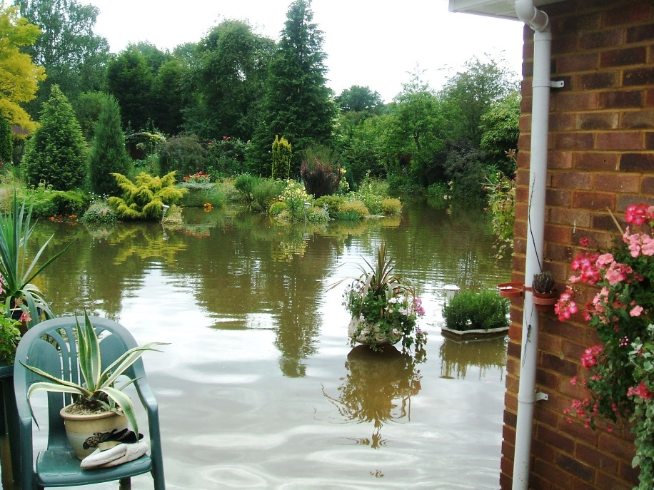
Now
Concerns?
  Resources and capacity
  Major terrorist attack
  Major Cyber event
  Increasing number and severity of events

Slide 7
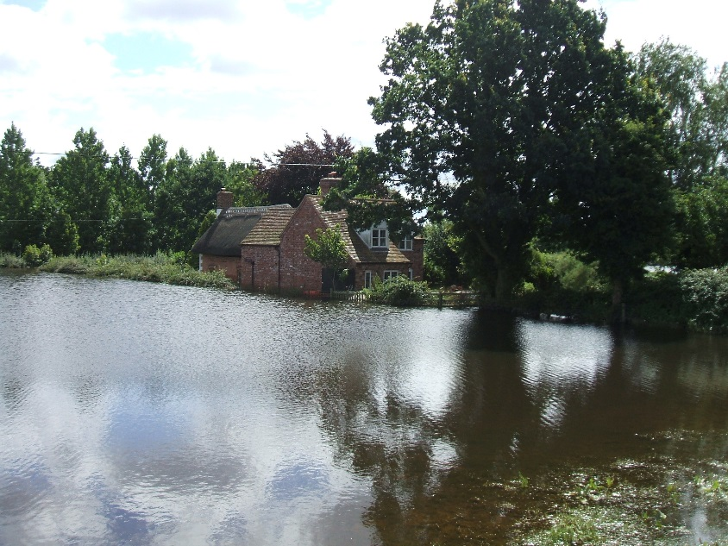
Ongoing and into the future
Greater attention to resilience
  Resilient repairs
  Prevent
  Technological advances
Collaboration
  Anti-Competitive –V-In public Interest
  BIBA Claims Workshop
  FCA Thematic reviews
Claims people and the Insurance industry

Slide 8
The Future of Surge Claims Handling
Malcolm Hyde BSc (Hons) Dip Fr FCII FCILA
Executive Director The Chartered Institute of Loss Adjusters

