Slide 1


CYBER CRIME & FRAUD:
The Insurance Sector & Beyond –
Managing The Threat Within
Edward Whittingham
MD & Founder
edward@thebfpp.org
Notes:
My background:
Former police officer (999 response, covert operations, serious crime investigation)
Qualified solicitor (international law firm, specialising in fraud and corporate crime)
Now:
Founder & MD of the BFPP
Help organisations deal with fraud and cyber-crime – all industries, all sizes
Focus on human element – will come on to that shortly

Slide 2
FLAVOUR OF MONTH OR THE REAL DEAL?
“Cyber-crime, cyber-security, data breaches, GDPR, information security…”
www.thebfpp.org

Slide 3
DUAL APPROACH:
1
Your internal
risk profile
2
Client
opportunity
www.thebfpp.org

Slide 4

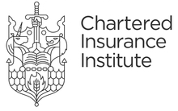
WHY TARGET BROKERS, UNDERWRITERS, ETC?
CLIENT DETAILS
PASSWORDS
PAYMENT INFO
ACCOUNT DETAILS
EMAIL ADDRESSES
TARGETTED ATTACKS
SUPPLIER DETAILS
DISRUPTION
www.thebfpp.org
Notes:
May think why would fraudsters target you for example?
Not typical image in media.
Organised crime – same as human traffickers, drugs, etc – less risk, greater reward
ALL industries targets. ALL sizes. We work with…
CLIENT DETAILS
Personal identifiable information of your clients – DATA is very valuable – commit further crimes, such as identity theft (big rise in recent years)
PAYMENT INFORMATION
Obviously process a lot of payment information within the practice
EMAIL ADDRESSES
Both yours, your patients etc – can be sold or used to further other attacks
SUPPLIER DETAILS
If they know this, they can perform other crimes – adopting yours or their identity
PASSWORDS
Goes without saying… how many people in here use the same password at work as you do at home? Get access to one… they’ve got access to both!
BANK ACCOUNT DETAILS
Speaks for itself
TARGETTED ATTACKS
Using data to further other attacks
DISRUPTION
Causing disruption to your practice for personal gain (ransomware, hacktivist, demonstrate power, etc)

Slide 5

BUT... IS THE INSURANCE SECTOR BEING TARGETED?
“113 targeted cyber attacks are directed at the average insurer ever year (over 2 a day!).”
Insuring Your Future, 2016
London insurance broker held for a ransom of £20,000.. unable to access their systems… for a week!
Undisclosed, 2017
48% of insurers say the greatest security impact comes from malicious insiders…
Accenture, 2017
www.thebfpp.org
Carefirst Blue Cross Breach Hits 1.1M in 2015
Notes:
So, I guess the question then is YES BUT ACTUALLY ARE YOU BEING TARGETTED.
Simply put, yes. As mentioned earlier, fraudsters will target anyone in any industry. We’re working with a number of charities at the moment, who are facing increased attacks.
Stat 1
Stat 2 – how much would that cost you?
Stat 3

Slide 6


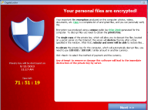
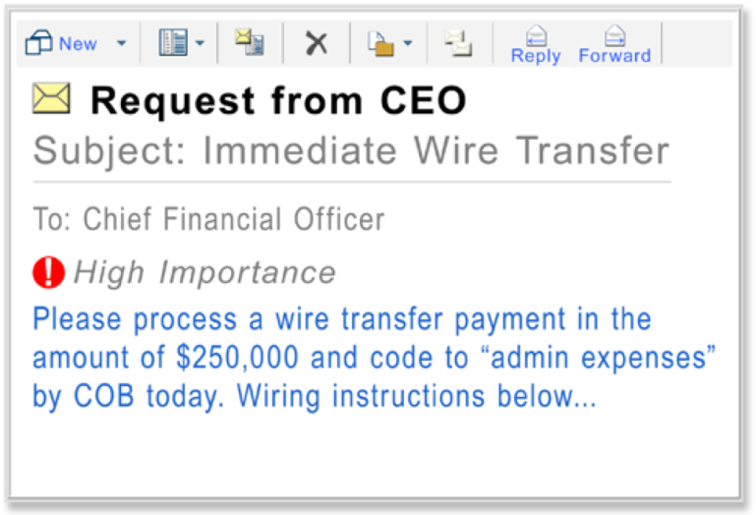

WHAT ARE THE BIGGEST RISKS?
PHISHING EMAILS
RANSOMWARE
BOGUS BOSS / SUPPLER FRAUD
SOCIAL ENGINEERING
www.thebfpp.org
Notes:
What are the biggest risk areas we’re seeing at the moment?
PHISHING EMAILS
These have come a long way from a long lost relative overseas wanting to share their million rupees with you, they’re now sophist acted and targeted – targeting passwords, banking information, all of the things we spoke about previously.
RANSOMWARE
Huge risk area at the moment, as I have mentioned just a moment ago.
UN said this is BIGGEST risk currently
Could your practice cope?
BOGUS BOSS / PATIENT / SUPPLIER FRAUD
These are TARGETTED attacks
Social media usage, including LinkedIn, our websites etc – copy email addresses, email signatures etc
SOCIAL ENGINEERING
Calling in to the practice fishing for information – know some security questions, use that to ascertain details
Prey on helpful, open staff

Slide 7
FCA OPINION:
“We need to empower staff to make secure decisions themselves…. Examples include:
EDUCATE STAFF
introducing fake phishing scams”
WHAT ARE YOU DOING INTERNALLY?
www.thebfpp.org
Notes:
What are the biggest risk areas we’re seeing at the moment?
PHISHING EMAILS
These have come a long way from a long lost relative overseas wanting to share their million rupees with you, they’re now sophist acted and targeted – targeting passwords, banking information, all of the things we spoke about previously.
RANSOMWARE
Huge risk area at the moment, as I have mentioned just a moment ago.
UN said this is BIGGEST risk currently
Could your practice cope?
BOGUS BOSS / PATIENT / SUPPLIER FRAUD
These are TARGETTED attacks
Social media usage, including LinkedIn, our websites etc – copy email addresses, email signatures etc
SOCIAL ENGINEERING
Calling in to the practice fishing for information – know some security questions, use that to ascertain details
Prey on helpful, open staff

Slide 8


REDUCING YOUR INTERNAL RISK
IT SOFTWARE / MEASURES
Over
90%
Firewalls, anti-virus, anti-malware, regular updates and patching, back up data, encryption
incidents involve
EMPLOYEE FOCUS
employee
Develop positive security culture with cyber training, simulated phishing and best practice
behaviour
www.thebfpp.org
Notes:
IT SOFTWARE / MEASURES
An absolute must
If you don’t have some of these basic measures already, then you really must as a matter of urgency
But there are a BASELINE – they’re not sufficient, they’re just the cyber security starter pack
Like the equivalent of locking your doors at night
STAT – astonishgly, over 90%!
But how many people focus on employee side of things?
HUGE risk area
EMPLOYEE FOCUS
Organisations need to address key risk area
Positive culture
Training
Phishing
Best practice

Slide 9




EMPLOYEE FOCUS
Disgruntled employee
Axe to grind
Bit of a rogue
Not malicious
Lacking guidance
Lacking training
Ignore guidance
Ignore training
Nightmare demographic
INTENTIONAL
RECKLESS
NEGLIGENT
www.thebfpp.org
Notes:
LOOKING AT THE TYPICAL EMPLOYEES
INTENTIONAL:
Hopefully won’t have too many of these. Hard to combat, but ensuring everyone knows best practice will reduce their operating
RECKLESS:
This is likely to be the bulk of workforce that would cause problems
Not malicious
Often problem lies with employer
What are you doing to help your employees understand and recognize these risks?
NEGLIGENT:
Nightmare demographic
BUT if you have given training, you can take suitable next steps with them
Can calculate your risk
Build risk profile
Currently… without… just guessing where problems may occur

Slide 10

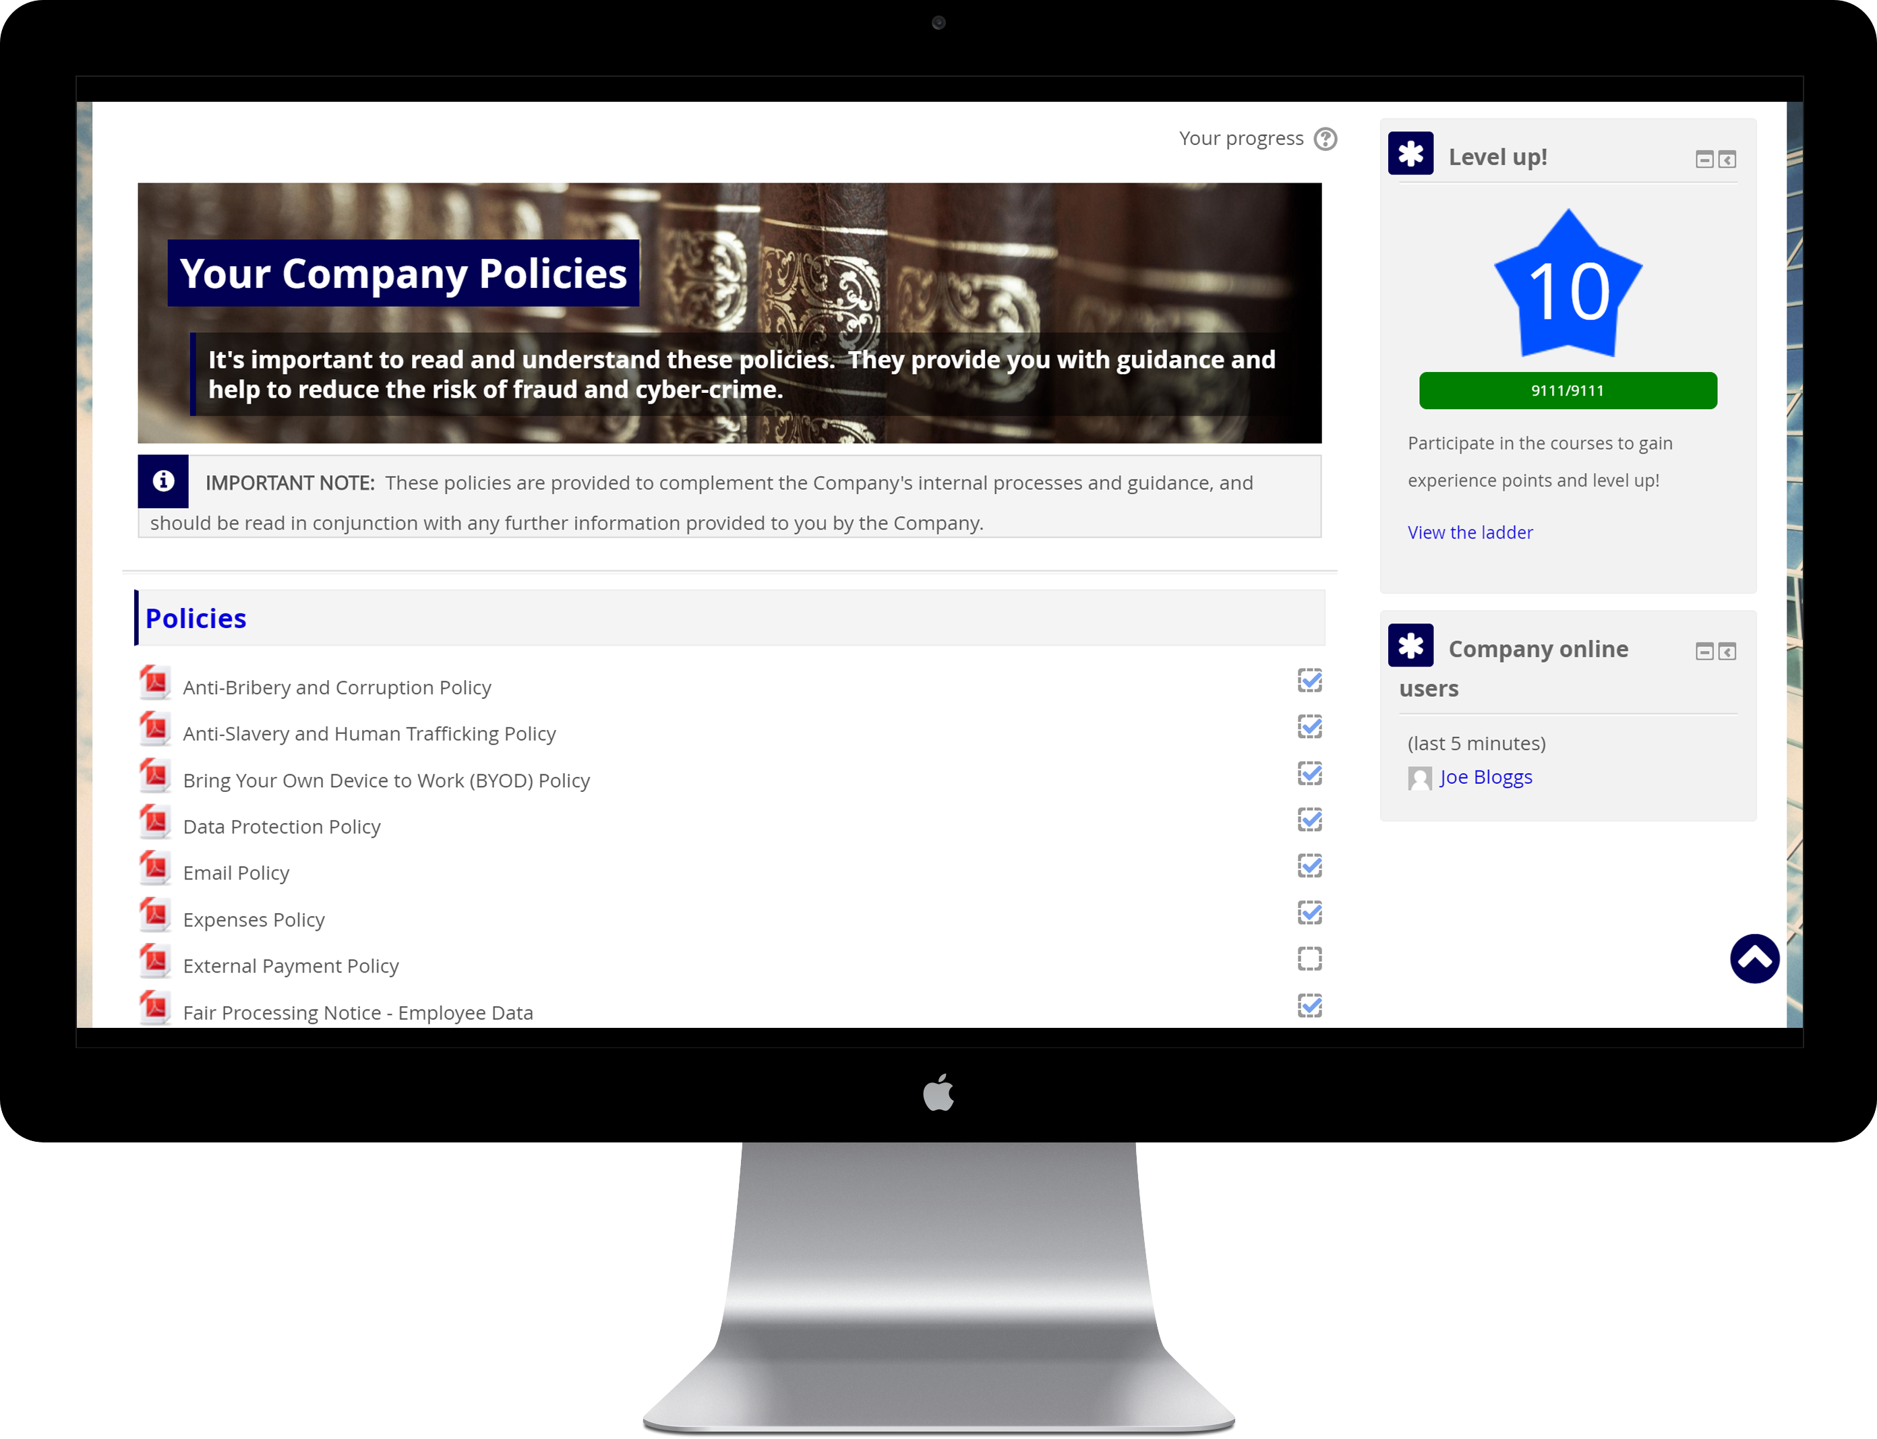
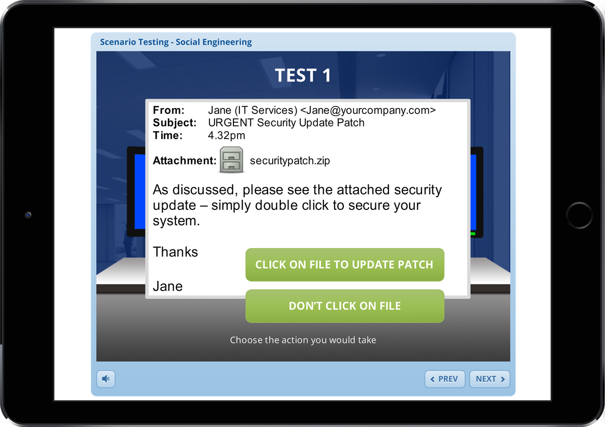
HOW TO LIMIT EMPLOYEE RISK
SECURITY AWARENESS TRAINING
SIMULATED PHISHING EMAILS
BEST
PRACTICE MANAGEMENT
Notes:
SECURITY AWARENESS TRAINING
To develop understanding
Maintain heightened security awareness
Prevent attacks
SIMULATED PHISHING
Real life threats
Risk profile
Improvement
BEST PRACTICE
e.g. policies
You have to set the boundaries and the basic rules
Without them, how do people know?
Are employees allowed to use social media (big risk area) – if so, what for?
Are employees able to use their own devices (client data risk) – if so, what are the limitations? Can they email info to themselves.
NEED TO BENCHMARK

Slide 11
OPPORTUNITY?
INTERNAL UNDERSTANDING OF RISKS
TRUSTED ADVISOR RELATIONSHIPS
DEVELOPING MARKETPLACE
MAKE YOUR LIFE EASIER

Slide 12

UNDERSTAND, ENGAGE.
INTERNAL
EDUCATING STAFF
SIMULATED PHISHING
POLICY MANAGEMENT
EXTERNAL
VALUE ADD RELATIONSHIP
INCREASED CLIENT UNDERSTANDING
BETTER ENGAGEMENT WITH CYBER PRODUCTS

Slide 13

AND THE WINNER IS….
Edward Whittingham
MD & Founder
edward@thebfpp.org
Notes:
Any questions?

Slide 14

DEVELOP A POSITIVE
SECURITY CULTURE
Over
Security
Training
90%
incidents involve
Positive
change
Regular
Testing
employee
behaviour
Best Practice
Policies
www.thebfpp.org

Slide 15
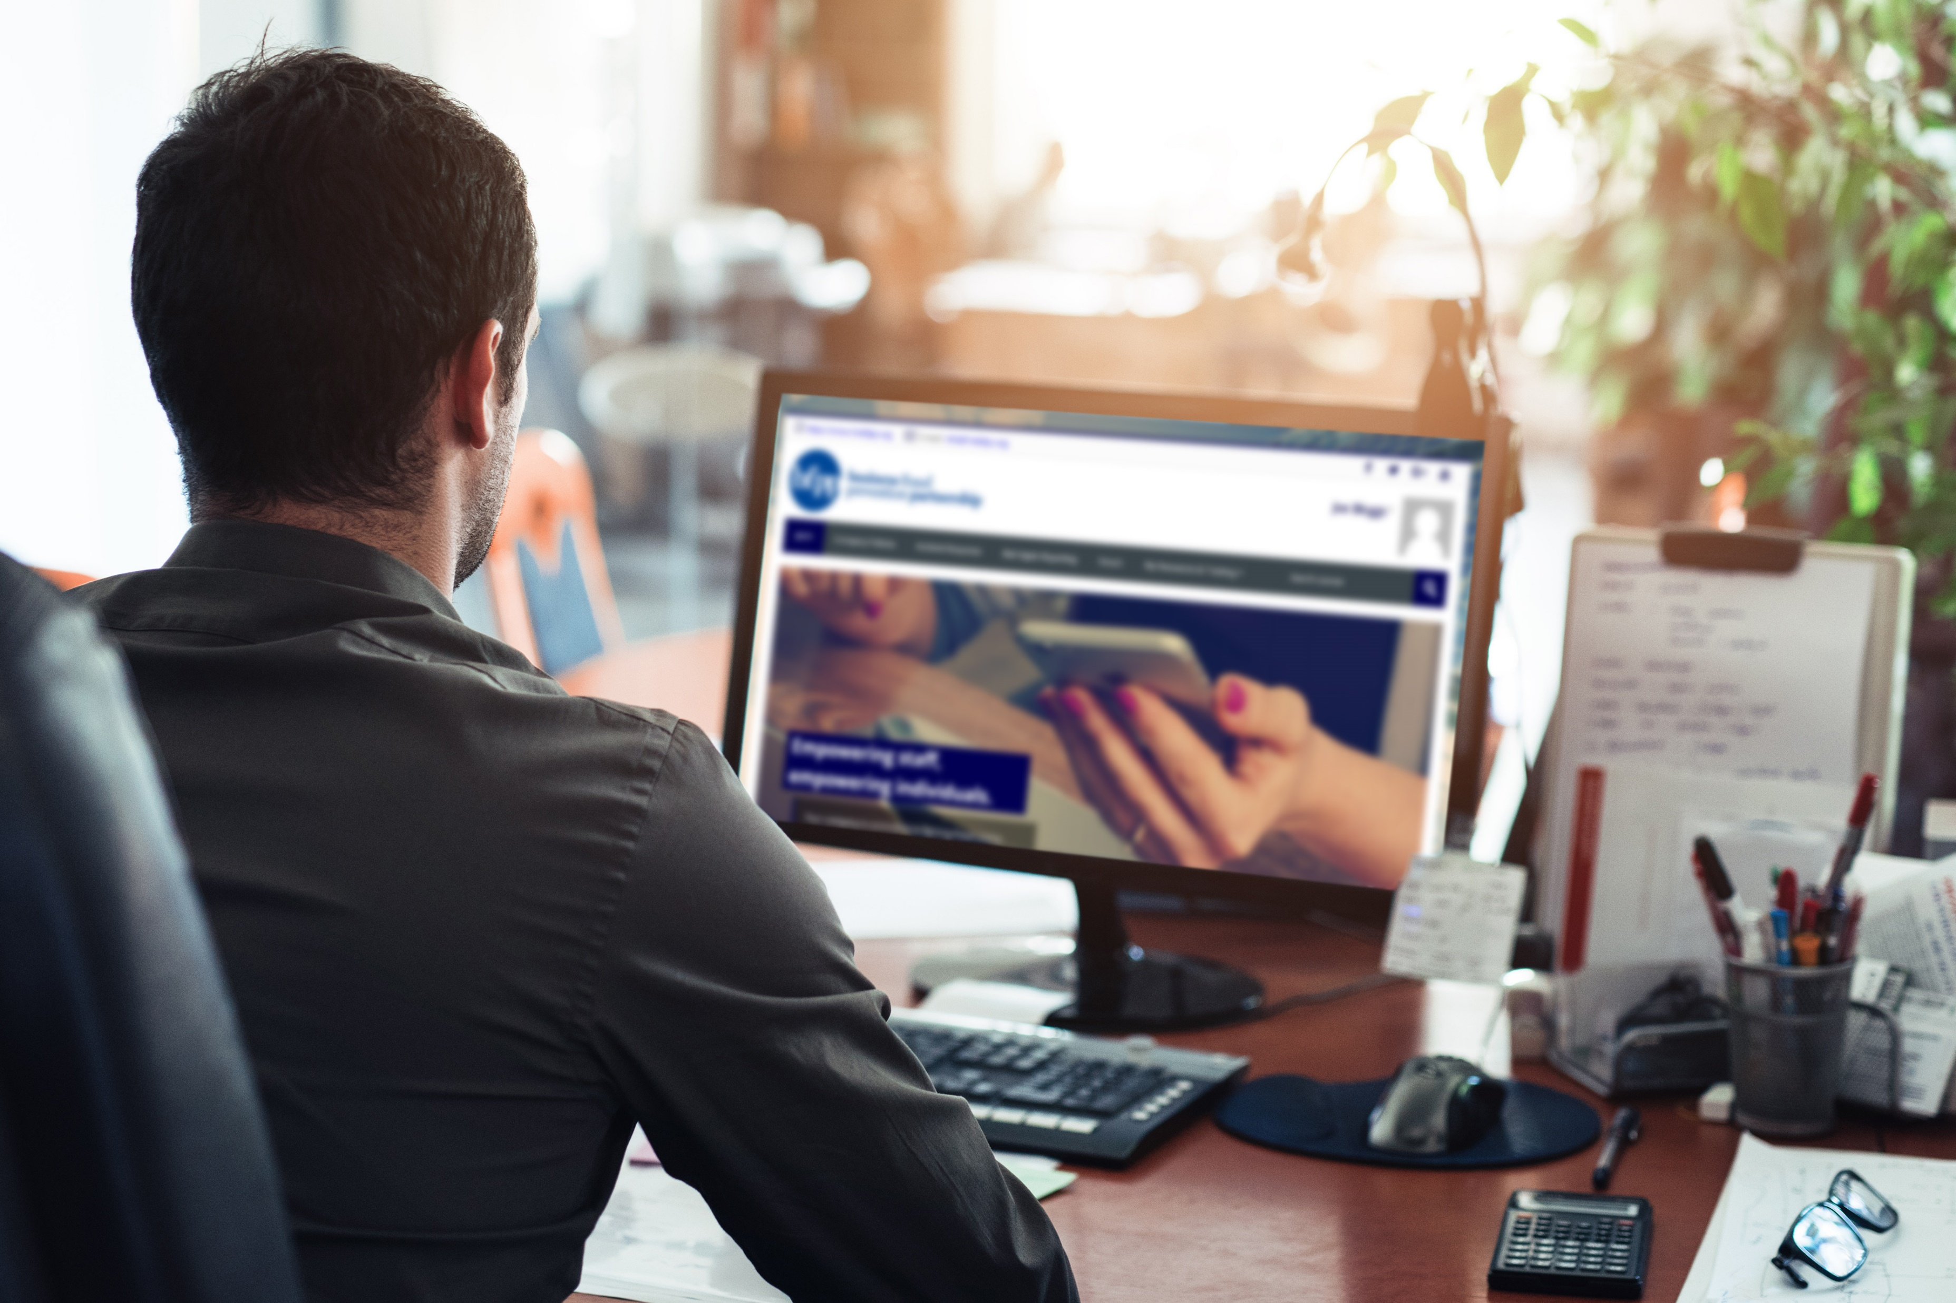
Any questions?
Find out how we can help you:
Protect your organisation
Add value to your client relationship
Drop me an email – edward@thebfpp.org
Edward Whittingham
MD & Founder
edward@thebfpp.org
Notes:
Any questions?

