Slide 1


Tackling Cyber threats together
Sean O’Neil

Slide 2
Areas of discussion (in brief)
What is Cyber Crime?
Possible threats
Police response
Recent intelligence and events
Advice on how to protect yourselves with CE, ISO, basic steps.

Slide 3
What is Cyber Crime?
The adopted definition of Cyber Crime is:
Cyber Dependent Crimes, where a digital system is the target as well as the means of attack. These include attacks on computer systems to disrupt IT infrastructure, and stealing data over a network using malware (the purpose of the data theft is usually to commit further crime).
Cyber Enabled Crimes. ‘Existing’ crimes that have been transformed in scale or form by their use of the Internet. The growth of the Internet has allowed these crimes to be carried out on an industrial scale.
The use of the Internet to facilitate drug dealing, people smuggling and many other 'traditional' crime types.
Notes:
Recent survey of reported crime had 96% as cyber element – either computers used to facilitate or used in commission.
Consdier the number of times, telephones/computers are used to research, facilitate crimes or used as a means of communication.

Slide 4


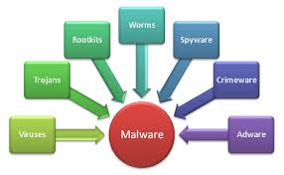
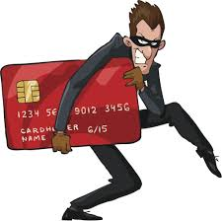

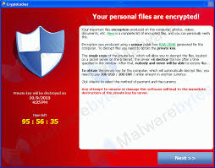


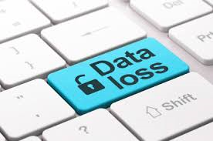



What is Cyber Crime?

Slide 5
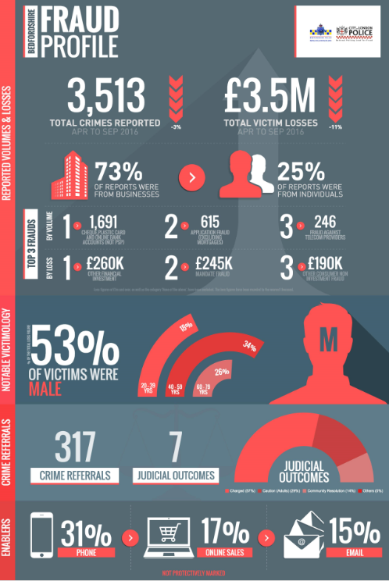
Crimes
42615 crimes recorded
2986 Burglary offences
688 Robbery offences
8900 Cyber/fraud reports (10% of reality).
Statistics therefore may suggest Cyber crime/frauds are largest number of crime in society
Highest reported incidents
Online fraud
Mandate
Ransomware
Romance frauds.
Simply not being reported:
Phishing emails / data loss/ DDOS /
internal loss by theft/fraud

Slide 6

Theft triangle

Slide 7

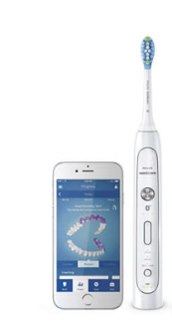
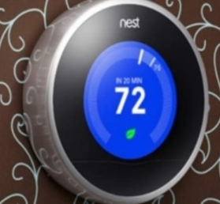
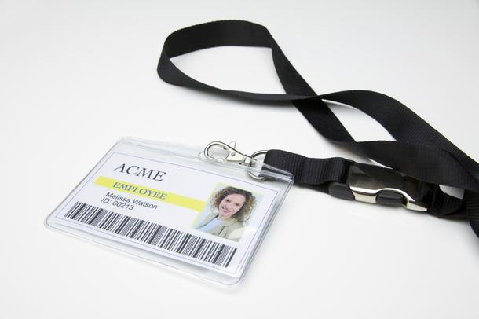





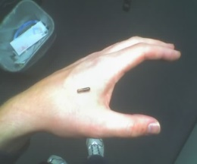
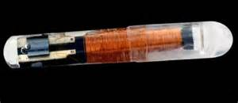
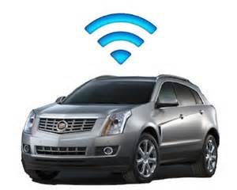
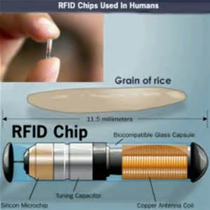
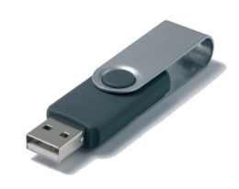

Which of these is a cyber threat?
POTENTIALLY ALL OF THEM!
Notes:
Smart fridge anecdote…
Own staff/insider
Chip in hand
Social engineering.
Frying pan
USB stick in car park

Slide 8
Law enforcement response
Obtain relevant evidence & statements from Victim (company)
Obtain server event & team viewer logs (which show who logged into server upon which data was deleted/stolen).
Obtain 3rd party data, using relevant legislation to locate IP addresses.
Execute search warrant at suspects addresses, resulting in the seizure of source devices.
Conduct examination of exhibits leading to identification of evidence which supports prosecution.
Interview suspect under caution

Slide 9
Typical Scene visit
Identification & prioritisation of devices.
Preservation & capture of volatile data.
Router examination to ID network devices.
Forensic triage of devices.
Forensic examination of mobile devices.
Hard drive imagery.

Slide 10
learning's
Need for Business BCP to include ICT/data loss.
Need for forensic recovery plan in disaster recovery plan.
Do not turn off devices; but remove from network (i.e. disconnect).
Do not delay response to LE, IT recovery company.
Have more than 1 ICT manager (build ICT team)
Back up key corporate and customer data.
Instigate Recovery plan & major incident processes.
Plan for such an event with Cyber essentials or
ISO 270001
Do not fail GDPR

Slide 11
But what are some of the biggest threats?
•Insider Threat (theft/fraud/data breach)
•Malware by phishing attacks
•Data Breach
DDoS
•Social Engineering leading to scams
Theft/fraud by Customers or vendors.
Ultimately it depends on the business, how it is set up, the infrastructure and the policies and procedures, and protect mechanisms in place.
Does your BCP include no use of IT or loss of data!

Slide 12
Current Scams
Invoice emails – i.e. new vendors, changes to current vendors, Apple [little mix]
Vouchers - Supermarkets, on line stores
Account updates – amazon, Sky, Virgin, Utilities.
Advice – any unsolicited emails. Do not press that link; simply delete. Go via normal website. Send to phishing email address for company
Microsoft/BT router/system faults – Dunstable case £4500
Advice – Do not engage, go via normal website.
Mandate fraud – Bedford company lost £100K put 27 staff at risk. £1M in Luton in September. Bedford company had windows 365 compromised with poor PW. L/Buzzard company 17 fake invoices by post in Jan17.
Solicitor companies being targeted – Luton March 2017, Bedford Dec
Advice - Slow down, check via second source. Get copy of our advice.
Ransomware – Luton Hotel attacked over New year – pay and enter suckers list
Advice - Plan with 2x back ups, have details of local IT repair company

Slide 13

And now for some good news!!
GCHQ reported in 2014 that in terms of Cyber Crime…
80% is easily preventable
Notes:
23 in a Million phishing emails are successful
5.5 Billion in 2011 attacks world wide
42% increase in a year to £7.8 Billion in 2012
People don’t rob banks with shotguns, they now hire a hacker – lower risk and jail time if caught
Peelian Principle – First duty of any Constable is to Prevent Crime

Slide 14
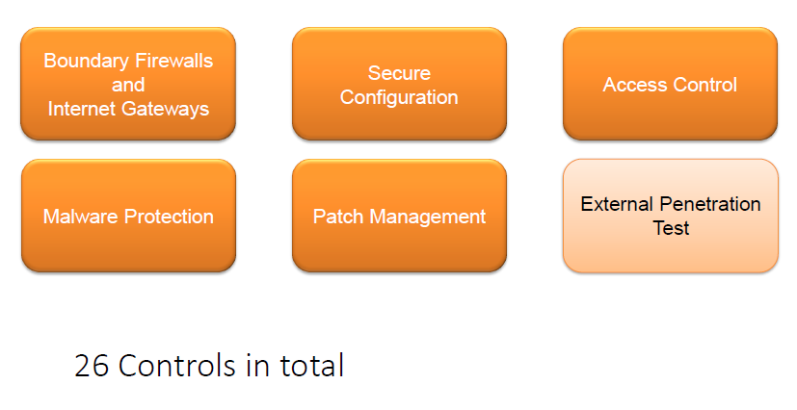
Cyber essentials (plus)

Slide 15
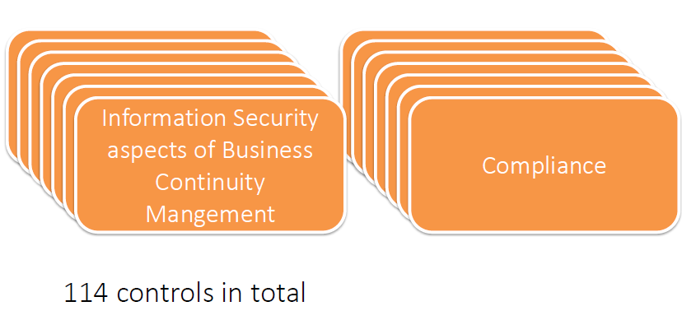
ISO27001

Slide 16
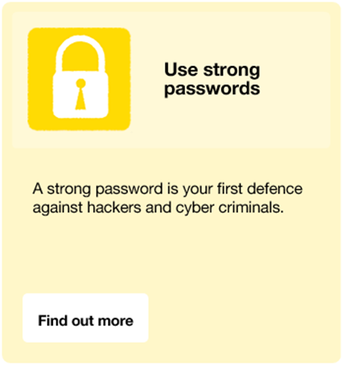

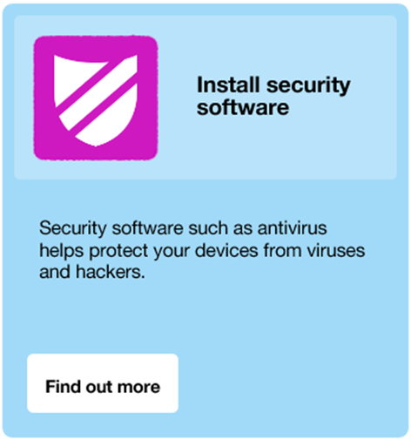


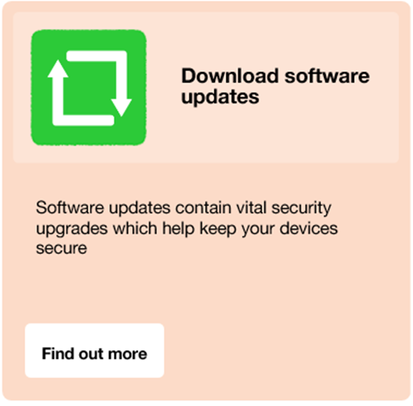

Slide 17

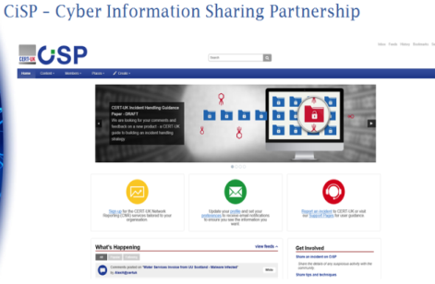
Thank you!
CBR - Free service to all local businesses, organisations, charities, vulnerable people
Offering a review of current practices
Suggesting improvements to ICT/physical security
Leading to greater ability to reach ‘cyber essentials’ accreditation - Minimum standard suggested for government contracts in the future.
CiSP
POC
Sean O’Neil
Cyber Security Advisor (2219)
Bedfordshire Police Headquarters,
Woburn Road, Kempston, Bedfordshire, MK43 9AX
(+44) 7720204358
sean.oneil@bedfordshire.pnn.police.uk
cyberprotect@bedfordshire.pnn.police.uk
http://www.omic.pub/cybercrime (free electronic book giving basic advice)

