Slide 1
De-Resking Retirement
John Hiew
Chief Executive
Assured Retirement

Slide 2
Agenda
“I've got all the money I'll ever need, if I die by four o'clock.”
Henny Youngman

Slide 3
About Assured Retirement
Created to provide a new range of simplified pension products
Designed for those who wish to access their pension in a flexible and low cost manner.
Different because our products are specifically designed for low risk investors.
Assured Retirement, established in 2014,
John Hiew – Chief Executive
Previously Managing Director, Clerical Medical
Tim Ashfield – Managing Director
Previously Director of Employee Benefits, Clerical Medical
Keith McGeoch – Actuarial Director
Previously Group Actuary, Marlborough Stirling
Bob Pandya – Business Development Director
Previously Product Research Manager, Clerical Medical

Slide 4
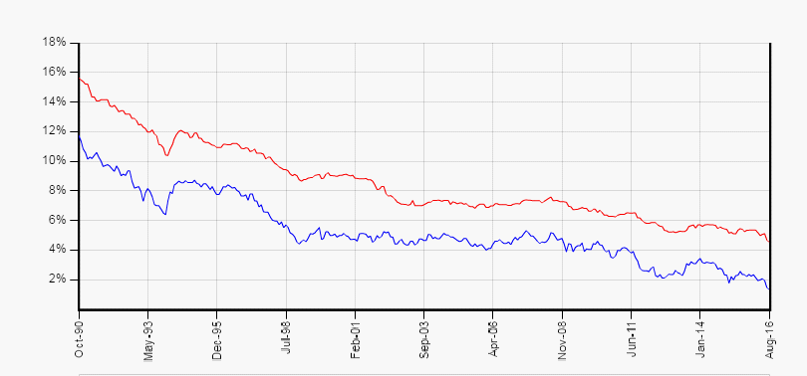
Lifetime annuities - Is today the right time to buy?

Slide 5
Lifetime annuities – do they offer value for money?
Male aged 60, £100,000 purchase price
10 Year guarantee period, no spouse
£4,363.09 p.a. paid monthly (best in market rate)
Worst case investment return - minus 13.62% p.a.
Live to age 82.5 (UK male average) - minus 0.13% p.a.
Live to age 90 – to get money back (assuming 2% inflation p.a.)
Live to 115 – return 1.9% p.a. (assuming 2% inflation p.a.)
Source – AMS 13/03/2017, single life, monthly in advance, 10 year guarantee period, 2.5% adviser fee
Longevity – Gerontology Research Group, Verified Supercentenarians, 2014

Slide 6
Lifetime annuities – risk free?
Client’s health could deteriorate
Client could qualify for an enhanced annuity
Spouse could pre-decease the client meaning spouses benefits not needed
Client’s marital situation could change
Client’s personal/financial situation could change
New products could be launched offering options not available today

Slide 7
Drawdown – an example of Sequence of Returns Risk
 |  | FTSE 100
Indicative bid-offer spread |  | 0.00%
Gross annual dividend yield |  | 3.14%
Ongoing charge per annum |  | 0.80%
Net annual dividend yield |  | 2.56%
Annual return since 02/01/1996 |  | 5.41%
Fund at retirement | £100,000
Monthly Income | £500
Term | 19Y 7M
 | Client A | Client B
Start date | 01/01/1997 | 01/01/2000
Fund at end of term | £75,491 | £0 Jan 2016
Both clients experience the same investment performance from 2000 to 2016
Client A had 3 years of growth at outset and still has a fund of £75,491
Client B had 3 years of losses at outset and exhausted the fund in January 2016
Early investment losses combined with ongoing income can devastate a portfolio
Year | Client A Investment Return | Client B Investment Return
1997 | 31.0 % | N/A
1998 | 15.8 % | N/A
1999 | 16.0 % | N/A
2000 | -5.2 % | -5.2 %
2001 | -13.5 % | -13.5 %
2002 | -21.4 % | -21.4 %

Slide 8
Drawdown – Money market funds offer negative returns
Advisers will seek to address sequence of returns risk by maintaining say 2 years’ income in cash.
Cash would normally be held in the SIPP bank account or in a money market fund.
SIPP bank accounts normally pay little or no interest to the client.
Money market funds produce close to zero returns after charges.
Morningstar data shows that for 2017 YTD 59/139 Short Term Money Market funds have produced zero or negative returns after charges.
Blackrock Cash Fund, £2,295m, Ongoing Charge 0.32%, YTD client return 0.04%
Add a typical platform charge of 0.30% p.a. clients now face a future average return of minus 0.3% p.a.

Slide 9
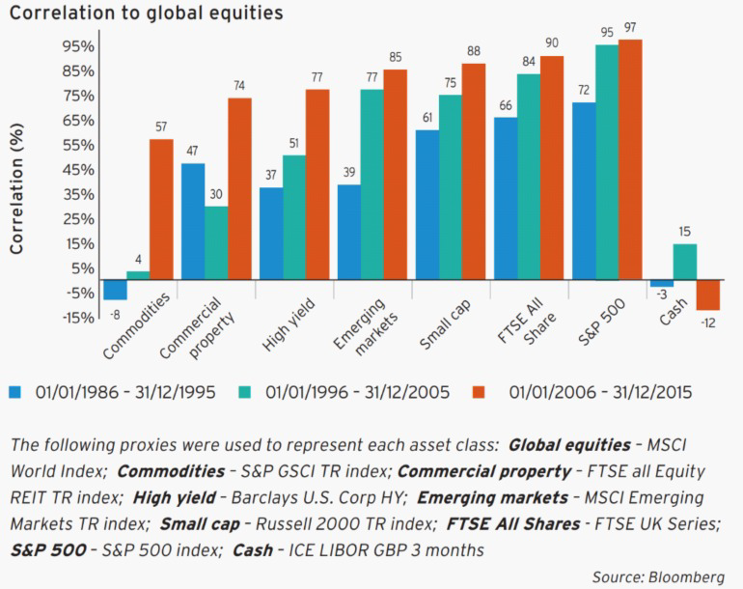
Drawdown – will diversification protect future portfolio losses?
Over the past thirty years, there's been a much higher correlation between different asset classes and it’s a well-known fact that major asset classes become even more correlated during market crises.

Slide 10
A solution - the Cash Retirement Account
Cash based Drawdown
Invests in a mixture of fixed term and instant access deposit accounts
Panel of 10 banks with exposure limited to £85k per bank – 100% FSCS cover
Any term from 12 to 60 months
Ability to tailor any shape of income at outset
Ability to earmark funds for an instant access account
All inclusive annual charge and ROI disclosed on every quotation
AND
Market leading rates
Modern technology

Slide 11
A solution - how could our product be used?
An alternative to a lifetime annuity
providing the same certainty as a lifetime annuity but over a fixed term and with future flexibility
In conjunction with asset backed drawdown
providing the certainty that only cash can provide as a means to fund a client’s short term income requirements and acting as a ‘shock absorber’

Slide 12
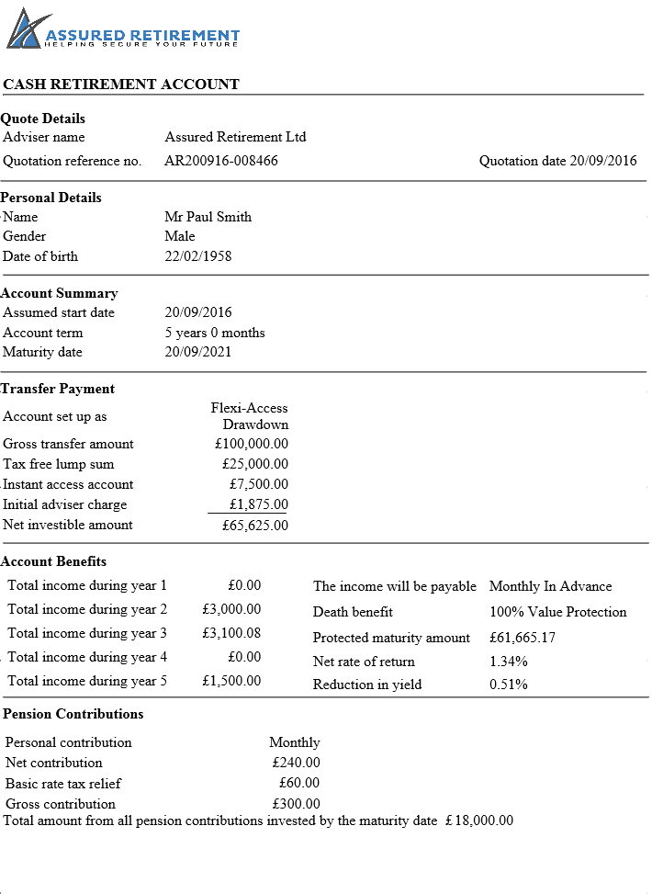
Cash Retirement Account as an annuity substitute - £100k fund
£100,000 is transferred to a 5 year Cash Retirement Account. We pay PCLS and earmark £7.5k in an instant access account. Initial and/or ongoing adviser charge facilitated if required.
Assured Retirement Ltd
AR070317-010156
Quotation Date 07/03/2017
In this example, the account pays a variable income, specified at outset as required by the client. We can facilitate any shape of income.
Mr Paul Smith
Male
22/02/1958
07/03/2017
5 years 0 months
07/03/2022
We offer 100% Value Protection death benefit as standard on all cases.
Flexi-Access Drawdown
£ 100,000.00
£ 25,000.00
£ 7,500.00
£ 1,875.00
£ 65,625.00
Maturity amount, net return and charges are all fixed and known at outset.
£ 0.00
£ 3,000.00
£ 3,100.08
£ 0.00
£ 1,500.00
Monthly in advance
100% Value Protection
£61,993.18
1.25% p.a.
0.48% p.a.
We offer the option for the client to pay pension contributions. Contributions create an uncrystallised fund and are held in an instant access account, available for crystallisation and withdrawal at any time on request.
Monthly
£ 240.00
£ 60.00
£ 300.00

Slide 13
Cash Retirement Account alongside drawdown - £500k fund
£100,000 (20%) of a client’s portfolio is transferred to a 4 year Cash Retirement Account. £10,000 is held in an instant access account for future flexibility.
Assured Retirement Ltd
AR070317-010156
Quotation Date 07/03/2017
The account pays an income of £15,000 per annum, paid monthly in advance for 4 years.
Mr Paul Smith
Male
22/02/1958
07/03/2017
4 years 0 months
07/03/2021
The balance provides a Protected Maturity Amount of £29,953.26. This may be used to start a new Cash Retirement Account or transfer back to main SIPP.
Flexi-Access Drawdown
£ 100,000.00
£ 10,000.00
£ 1,000.00
£ 89,000.00
Flexi-Access Drawdown
£ 100,000.00
£ 25,000.00
£ 7,500.00
£ 1,875.00
£ 65,625.00
£ 15,000.00
£ 15,000.00
£ 15,000.00
£ 15,000.00
Monthly in advance
100% Value Protection
£29,953.26
0.41% p.a.
The Cash Retirement Account provides a positive return of 0.41% p.a. compared to what could be a typical return of minus 0.3% using money market funds.
Monthly
£ 240.00
£ 60.00
£ 300.00

Slide 14
Trustee Cash Account and Select Retirement Account
Planning for launch at the end of March and April 2017.
Our Cash solution as a TIP and also combined with a choice of leading third party platform links.
Trustee Cash Account will enable Assured Retirement’s Cash Management within an existing SIPP.
Select Retirement Account will enable combination of your existing investment process with Assured Retirement’s Cash Management within a single SIPP wrapper.

Slide 15
A solution - The Cash Retirement Account
A packaged cash management solution that maximises a client’s return
The absolute certainty of known income, charges and maturity amount
Any mixture of increasing, reducing or nil income over any term from 12 to 60 months
100% of a client’s cash and future interest protected by the FSCS

Slide 16
“Money is better than poverty, if only for financial reasons.”
Woody Allen
www.assuredretirement.co.uk
John@assuredretirement.co.uk
07867 908631

Slide 17
Important Notes
Assured Retirement Ltd is registered in England with company number 9265346 and has its registered office at 23 Westfield Park, Redland, Bristol, BS6 6LT.
Assured Retirement Limited is authorised and regulated by the Financial Conduct Authority.
References to the Cash Retirement Account are not intended to be a comprehensive description of the product and should be read in conjunction with the Customer Guide and Key Features of the Cash Retirement Account.
The information contained within this presentation is for guidance only and does not constitute advice or a specific recommendation in relation to any aspect of investment or retirement planning. This presentation is for Professional Advisers and not for use by private investors or the general public.

