Slide 1
Insurance for Consenting Adults
An Introduction to Reinsurance for the Insurance Institute of Leicester
Mercure Grand Hotel, 8 February 2017
Ian Plumley, Partner, Clyde & Co LLP

Slide 2
Agenda/Learning Objectives
    What reinsurance is and why it is needed.
    The different kinds of reinsurance available and how they work:
      Facultative v Obligatory;
      Proportional v Non-Proportional; and
      Application to a simple loss example.
    Considerations when buying and selling reinsurance.
    An overview of the reinsurance market and who offers reinsurance.
    Questions.

Slide 3

Introduction to Reinsurance

Slide 4
What is Reinsurance?
    “…the transfer of part of the hazards or risks that a direct insurer assumes by way of insurance contract or legal provision on behalf of an insured, to a second insurance carrier, the reinsurer, who has no direct contractual relationship with the insured.”
    (M Grossmann, Reinsurance - An introduction)
    “The business of insuring an insurance company or underwriter against suffering too great a loss from their insurance operations.”
    (Robert & Stephen Kiln, Reinsurance in Practice)
Slightly less long-windedly:
  The backbone of the insurance industry (premium being the lifeblood).
  A contract between two insurers: the insurance of insurance!
  “Insurance between consenting adults” (© Rob Merkin).
  Ultimately, a means by which risk is spread across the financial system.

Slide 5
Why is there a need for reinsurance?
    Two main reasons why a direct insurer needs reinsurance:
      To limit annual fluctuation in loss it must bear for its own account; and
      To be protected in case of catastrophe.
    However, broader function (from reinsured’s perspective) is as follows:
      Capacity Relief: Allows underwriting of larger amounts of insurance.
      Catastrophe Protection: Protects against a large single, catastrophic loss or multiple large losses.
      Stabilisation: Helps smooth overall operating results.
      Surplus Relief: Eases strain on surplus during rapid premium growth.
      Market Withdrawal: Provides a means to withdraw from line of business or geographic area or production source.
      Market Entrance: Spreads risk on new lines of business until premium volume matures; add confidence when coverage areas unfamiliar.
      Expertise/Experience: Source of u/w information when developing new products and/or entering new line of insurance or new market.

Slide 6
Some basic terminology
Insured
Insurer / Cedant
Reinsurer / Retrocedant
Retrocessionaire
Contract of Insurance
Insurance of Insurance = Reinsurance
Reinsurance of Reinsurance = retrocession

Slide 7

Different kinds of reinsurance and how they work

Slide 8
The Reinsurance Family Tree
REINSURANCE
FACULTATIVE
PROP
NON- PROP
TREATY
PROP
NON PROP
QUOTA SHARE
EXCESS OF LOSS
QUOTA SHARE
SURPLUS
EXCESS OF LOSS
STOP LOSS

Slide 9
Basic forms of reinsurance: Introduction
  Three forms of reinsurance arrangements:
    Facultative Reinsurance;
    Treaty Reinsurance; and
    Facultative Obligatory.

Slide 10
Forms of Reinsurance
Facultative Reinsurance
    Oldest form of reinsurance.
    Direct insurer chooses freely which individual risks he wants to offer to a reinsurer. Ideally preserved for individual reinsurance of large or hazardous single risks, ceded on original terms.
    Reinsurer is free either to accept or refuse any risk offered to him.
    Today, facultative reinsurance used mainly as a complement to treaty reinsurance, in which entire portfolios of risks are ceded.
    A direct insurer will most often turn to facultative reinsurance in two cases:
      when he is left with a sum he still needs to reinsure after he has exhausted both retention and reinsurance capacity provided by treaty; or
      when he has sold a policy containing risks that are excluded from his obligatory reinsurance cover.
    Traditionally placed on proportional basis but non-proportional now more common.
Reinsurance for individual risks

Slide 11
Forms of Reinsurance
Benefits v Disadvantages of Fac R/I
BENEFITS OF FAC | DISADVANTAGES OF FAC
Freedom on whether or not to offer risk to a reinsurer of choice. | Insurer can’t be certain of placement if there is no automatic over. There can be delays in confirming cover until placement is complete.
Opportunity for reinsurer and cedant to build a relationship and understand each other’s underwriting styles. | Reinsurer may acquire too much detail where if they are a competitor, insurer may be uncomfortable.
Insurer may gain expertise on underwriting particular risks. | Labour intensive & high administration costs - Errors (you may forget to place risk).
Protects treaty performance. | Reinsurer may take over control of underwriting and claims processes. Warranties, surveys, appointment of assessors etc.
Fac reinsurer may eventually get accepted as a treaty security. | Reinsurer may exercise influence on the insurer’s standard assessment of risk (e.g. Insurer rates Motor 3% but reinsurer rates it 10%).

Slide 12
Forms of Reinsurance
Treaty reinsurance
    Treaty reinsurance is obligatory in nature for both parties to contract:
      Direct insurer is obliged to cede to reinsurer a contractually agreed share of the risks defined in reinsurance treaty; and
      Reinsurer is obliged to accept that share.
    Reinsurer cannot therefore refuse to provide insurance protection for an individual risk falling within scope of treaty, nor may direct insurer decide not to cede such a risk to the reinsurer.
    Limits, terms and conditions are agreed in advance usually at beginning of year and are set for all cessions.
    Insurers use treaty when:
      Risks are homogenous or have similar exposures.
      There is a large volume of such risks.
Obligatory reinsurance for entire portfolios

Slide 13
Forms of Reinsurance
Fac v Treaty
Facultative (Individual Risk) | Treaty (Book of Business)
Individual risk review. Right to accept or reject each risk on its own merit. A profit is expected by reinsurer in the short and long term, and depends primarily on reinsurer’s risk selection process. Adapts to short-term ceding philosophy of insurer. A facultative certificate is written to confirm each transaction. Can reinsure a risk that is otherwise excluded from a treaty. Can protect a treaty from adverse underwriting results. | No individual risk acceptance by reinsurer. Obligatory acceptance by reinsurer of covered business. A long-term relationship in which reinsurer’s profitability is expected, but measured and adjusted over an extended period of time. Less costly than “per risk” reinsurance. One treaty contract encompasses all subject risks.

Slide 14
Forms of Reinsurance
Facultative Obligatory
    Form of proportional reinsurance which entitles reinsured to decide what risks (and amount) he wishes to cede to reinsurers:
      Facultative means that reinsured has option to cede on risk by risk basis.
      Obligatory means that reinsurer is obliged to accept each cession or risk.
    Usual for reinsurer to require reinsured to retain a minimum retention to ensure that reinsured maintains interest at risk at all times (prevents anti-selection).
    Example:
      Insurer insures an Airbus A380. 100% exposure under policy is £100million.
      Insurer writes 1% but wants to limit its liability to £500,000. Insurer therefore buys a 50% facultative proportional reinsurance.
      Aircraft is damaged with loss of £20million.
      Insurer will have an exposure of £200,000, of which £100,000 will be covered by fac oblig reinsurance.

Slide 15
Placing of Reinsurance
Proportional v Non-Proportional
    Facultative and treaty reinsurance can be placed/underwritten on either:
      Proportional/Pro Rata basis; or
      Non-Proportional basis.

Slide 16
Placing of Reinsurance
Proportional (aka pro rata) reinsurance
    Describes reinsurance in which:
      reinsurer accepts a pre-determined fixed portion of business accepted by ceding company;
      intention (generally) is that reinsurers follow and share in fortunes of reinsured on substantially similar terms to ceding reinsured.
    Along with sharing proportionally in premium and losses, reinsurer typically pays a ceding commission to ceding company to reimburse for expenses associated with issuing underlying policy.
    Advantages:
      Easy to administer.
      Good protection against frequency/severity potential.
      Protection of net retention on first-dollar basis.
      Permits recovery on smaller losses.
    Two main types in use are Quota Share and Surplus.

Slide 17
Placing of Reinsurance
Quota Share
    Risk, premiums, and losses are allocated between cedant and reinsurer in same fixed share.
    Reinsurer participates in every risk and loss.
    A quota share is usually named by the amount ceded (i.e. a 60% quota share means 60% has been ceded and 40% retained).
    Mostly used when sums insured in a portfolio are relatively uniform (e.g. motor or household).
    Quota shares carry highest ceding commissions.
    More ideal when fronting, entering new lines or territory.
    Most ideal for reciprocal business.
    Ideal example of follow the fortunes.

Slide 18
Placing of Reinsurance
Quota Share
Quota share is probably most common type of proportional reinsurance. Under a quota share, reinsurer accepts a fixed proportion of all original risks within particular portfolio or class.
80% Quota Share Treaty
  £400,000 any one risk
£400,000
20%
80%

Slide 19
Placing of Reinsurance
Surplus
    Distinguishing characteristic is that when an underlying policy’s total amount of insurance exceeds a stipulated dollar amount or line, reinsurer assumes surplus share of the amount of insurance (difference between primary insurer’s line and total amount of insurance).
    Insurer and reinsurer share policy premiums and loses proportionately.
    Primary insurer’s share of policy premiums and losses is proportion that line bears to total amount of insurance.
    Reinsurer’s share of premiums and losses is proportion that amount ceded bears to total.
    Typically used with property insurance and ideal when portfolio contains a mixture of large, medium and small size risks.
    Cedant retains more premium than under Quota Share.
    Risk of unbalanced treaty is high.

Slide 20
Placing of Reinsurance
Surplus
Surplus reinsurance is a further type of proportional reinsurance. In surplus reinsurance, reinsurers’ share is fixed by reference to ceding company’s retention.
3 line surplus treaty
Each line - £100,000 any one risk
If line is £100k, and amount ceded is £300k, insurer receives 25% or premium and 25% of losses, while reinsurer would receive 75% of premium and 75% of losses
£100k
£100k
£100k
£100k

Slide 21
Placing of Reinsurance
Comparison of Quota Share & Surplus
    Quota Share generally has higher commissions.
    More premium is usually ceded under Quota Share.
    You cannot vary percentage retention on a Quota Share.
    Reinsurer & cedant’s fortunes are similar under Quota Share but may be different under Surplus (i.e. one can make profit while the other makes a loss).
    Surplus treaty has better cat protection.
    With surplus, insurer either stands or falls by retention level chosen.

Slide 22
Placing of Reinsurance
Non Proportional (Excess of Loss)
    Reinsurance transaction that, subject to a specified limit, indemnifies a ceding company against amount of loss in excess of a specified retention.
    In excess of loss reinsurance, premiums are typically negotiated as a percentage of primary insurer’s premium charge and are not proportionally related to risk carried.
    Premiums usually paid in advance as Minimum and/or Deposit Premium. There is no cession per risk rather the premium is for the whole portfolio.
    Distribution of Liabilities is based on losses rather than sum insured and losses only get paid once they exceed the excess point/deductible.
    Advantages:
      Good protection against frequency or severity potential, depending upon retention level.
      Allows a greater net premium retention.
      More economical in terms of reinsurance premium and cost of administration.

Slide 23
Placing of Reinsurance
Excess of Loss
£100,000 xs £300,000 any one loss
£100,000 xs £200,000 any one loss
£100,000 xs £100,000 any one loss
Deductible - £100,000 any one loss
£100,000
£100,000
£100,000
£100,000

Slide 24
Placing of Reinsurance
Excess of Loss
    Excess of loss can be used to protect the following:
      Risk Exposure;
      Estimated Maximum Loss error exposure;
      Catastrophe Exposure; and
      Clash Exposure - Accumulation of different risk classes in one event.
    One program may offer all this protection.

Slide 25
Placing of Reinsurance
Stop Loss & Aggregate XL
    Stop Loss operates on pre agreed percentage while Aggregate XL cover is expressed as fixed limits.
    They are used to protect losses in a particular class or an aggregation of an event. Insurer’s loss ratio is limited to a particular level and reinsurer will kick in up to agreed limit.
    Most suitable in businesses where losses can have unpredictable spikes e.g. in weather related covers like Hail insurance.
    Losses are only recoverable when the aggregate exceeds the deductible.

Slide 26

Application of Loss Example
The Reinsured Property
Commercial Property with an (re)insured value of £400,000…

Slide 27

Application of Loss Example
The Loss
…is badly damaged by fire causing total losses of £250,000

Slide 28
Application of loss example
Under a Quota Share
Building worth £400,000
Loss of £250,000
Quota Share reinsurance
    £50,000 retained by reinsured
    £200,000 paid by reinsurers
£400,000
20%
80%

Slide 29
Application of loss example
Under Surplus
Building worth £400,000
Loss of £250,000
Surplus reinsurance (remember reinsurer’s share of loses is in proportion that the amount ceded bears to the total (i.e. 25% per line))
    Reinsured retains £62,500
    Each line bears £62,500
    Reinsurers bear £187,500 in total
£100k
£100k
£100k
£100k

Slide 30
Application of loss example
Under Excess of Loss
Building worth £400,000
Loss of £250,000
Excess of loss reinsurance
    £100,000 retained by reinsured
    £100,000 paid by first layer
    £50,000 paid by second layer
    £0 paid by third layer
£100,000
£100,000
£100,000
£100,000

Slide 31

Buying and selling reinsurance

Slide 32
Considerations when buying reinsurance
    Capacity required - Do you really need it? Is there automatic reinsurance capacity for your risks? A treaty should at least cover the majority of risks written.
    Retention - your capital and risk appetite can determine this. Market norms can be a guide. No retention at all poses moral hazard.
    Reinsurance costs - For XL you pay upfront, for prop you may cede more premiums.
    How claims will be shared.
    Exposure to accumulations.
    Loss experience.
    Cost of operating reinsurance program.

Slide 33
Considerations when structuring a reinsurance program
    You want to determine whether you buy fac, prop or non prop treaty or a combination of all. Look at:
      Nature of the portfolio.
      Volume - Do you have sufficient numbers to have a treaty?
      Mix - Is there homogeneous exposure in your book? It may all be motor but 50% could be excluded risks in your treaty.
      Size - Can you chose XL or quota share? Are the sums insured within same range or vary significantly?
      Are there policies with unlimited Liability?
      Is portfolio subject to wide fluctuations in its annual results?

Slide 34
Considerations when underwriting reinsurance
    Reinsurers will require following information to make a judgment on required cover as well as to price it:
      Risk profiles.
      Five year loss statistics.
      Required capacity/ Cat Limits.
      Estimated Income.
      Desired retention level by cedant.
      Classes of business covered.
      Potential accumulation for Reinsurer - Fac Inwards.
    Reinsurer will also make a judgment on:
      Standard of Management style.
      Experience of underwriters.
      Geographical distribution of business written.
      Financial standing of cedant.
      Past underwriting results.
      Exclusions, terms and conditions on required treaty.

Slide 35

The reinsurance market

Slide 36
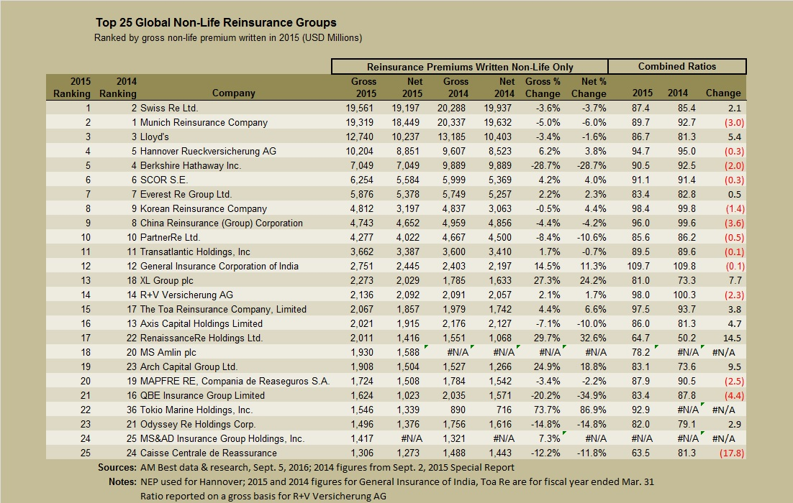
Top 25 Global Non-Life Reinsurance Groups

Slide 37
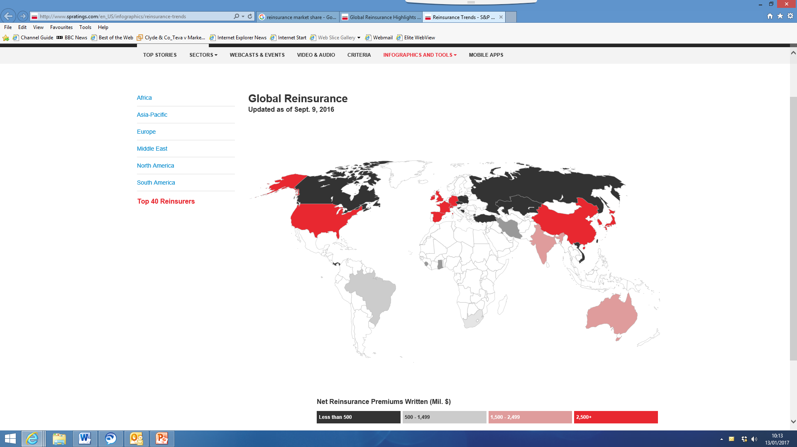
Global Reinsurance (S&P infographic)

Slide 38
Drivers of Business Conditions for Global Reinsurers
Potential driver | Trend | Observations
Pricing | Negative | Pricing continues to decline although declines have slowed.
Loosening of terms and conditions | Neutral to negative | Large reinsurers pushed back on wider T&Cs, with some loosening experienced.
M&A activity | Neutral | M&A wave of 2015 appears to have stalled.
ILS capacity | Neutral to negative | Influx of ILS capacity due to low prices in trad market.
Cedant demand | Neutral | Drop in reinsurance demand plateaued - no increase in sight.
Low investment returns | Negative | Lower for longer a reality - rates remain paltry.
Organic growth | Negative | Opportunities for organic growth limited.

Slide 39
Any Questions?

Slide 40

Speaker
Insert photograph here and delete this box
Ian Plumley
Partner
Ian is a litigation partner with extensive commercial, insurance and reinsurance experience, specialising in complex international coverage, defence and subrogation disputes in England & Wales, Bermuda, the US, the Caribbean and Europe.
Ian’s practice is varied and, specialising in complex international coverage, defence and subrogation disputes, he has assisted blue-chip corporates, insurers, reinsurers, intermediaries and business recovery specialists in a range of arbitration and litigation in England & Wales, Bermuda, the US, the Caribbean and Europe. He also regularly assists clients in drafting and reviewing policy wordings.
In addition to his experience in all classes of reinsurance business, Ian advises on product liability & recall, US excess casualty (including disputes on the ‘Bermuda Form’), property, construction & engineering, industrials & power, specialty, and professional liability business across business sectors including, in particular, automotive, pharmaceutical, medical devices, food production, utilities and heavy industrials.
A co-author of “Reinsurance Practice and the Law” (Informa) and a contributor to Tottel’s Insurance Handbook, Ian has also written numerous articles for market publications.
T: +44 (0)20 7876 6184
E: ian.plumley@clydeco.com

Slide 41
375 | 2000 | 3300 | 46
Partners | Legal professionals | Total staff | Offices and associated offices in 18 countries
Clyde & Co LLP accepts no responsibility for loss occasioned to any person acting or refraining from acting as a result of material contained in this summary. No part of this summary may be used, reproduced, stored in a retrieval system or transmitted in any form or by any means, electronic, mechanical, photocopying, reading or otherwise without the prior permission of Clyde & Co LLP. © Clyde & Co LLP 2017

