Slide 1
Insurance Institute of Manchester
Flood master class, Part 2
Wednesday 26 October 2016.

Slide 2
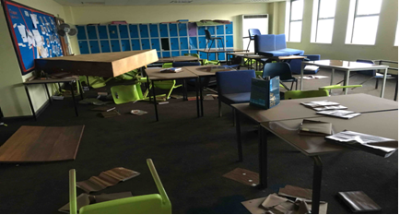
Secondary school – typical classroom
Notes:
Huge disruption to everyday school life.
Study work lost, familiar surroundings gone and routines changed
Likely the school will be abandoned and a new school built elsewhere
Very time consuming – our team has spent over 1700 hours on this claim so far.
THIS IS THE LAST OF THIS SECTION – NEXT UP IS ESTIMATING LARGE LOSSES
THIS IS THE LAST SLIDE ON THIS TOPIC – NEXT UP – ESTIMATING LARGE LOSSES

Slide 3
Estimating a large property loss - material damage
Generally
  Basis of material damage cover
  Intentions of the policyholder
  Underinsurance
  Professional fees
  Buildings
  Access
  Ownership
  Professional fees
  Listed buildings/Conservation Officer
  Emergency stabilisation works
  Scoping the damage including drying and local authorities requirements
  Procurement - availability, quality and cost of the suppliers - the surge factor!
  Value at risk
Notes:
Buildings:
Access – the difficulty of estimating damage when access is limited or denied. If theres a fatality, access may be denied for weeks.
Ownership – obviously important we understand who owns the assets and who has the insurable interest
Professional involvement retained by the insured such as project managers – can add 10/12% to the reinstatement sum. Structural engineers, damage mitigation experts, architects, VAT experts etc
Listed buildings/Conservation officer - materials such as LIMECRETE useful for compliance with the Conservation Officer
THE OXFORD UNI WROUGHT IRON FENCE /LOCAL APPROVED BLACKSMITH/THE COST OF HERITAGE TRADESMEN
Emergency works on a time and materials basis
Scoping the damage – recent advances in speed drying and accurate testing for moisture help with predicting the extent of reinstatement.
Procurement – the importance of the supply chain – availability, quality and cost of suppliers – increased cost and decreased resource!

Slide 4
Estimating a large property loss – material damage
  Machinery, plant and all other contents
  Access
  Ownership
  Assessing the damage
  Salvaging machinery and contents
  Stabilising machinery
  Emergency repairs and restoration
  Nursing machinery
  Value at risk
Notes:
Machinery, plant and all other contents
As with the buildings, access to the damage and understanding the ownership are where it all starts.
Assessing the damage – can vary depending upon who is giving the advice – the manufacturer will be wary of guarantees in a repair and may have a motive to sell a new machine. Some repairers are over confident in what they can achieve - in cost, reliability and time.
Salvaging machinery and contents
Stabilising machinery
Emergency repairs and restoration – back to the supply chain and its worth – competence and availability
Nursing machinery
Value at risk

Slide 5
Estimating a major loss – material damage
    Stock
    Controlled disposal of debris
    Use of residual stock (check accumulated stock clause on policy)
    Accelerated procurement of replacement stocks (incentives to suppliers, air freight etc)
    Transfer production to other factories within group
    Sub contract production externally (subject to commercial sensitivities)
    Salvage sale of damaged stock at cost or reduced margin whilst replacement stocks sourced

Slide 6
Estimating a major loss – business interruption
  Policy cover – MIP
  Underinsurance
  Length of the interruption
  Wide area damage
  Customers
  Competitors
  Availability of suppliers
  Availability and suitability of other locations
  Framework contractors
  Planning consents
  Usage of premises and sitting tenants
  The procurement process and construction phase
  Jumping the queue
  Force majeure
  Savings
  Claim preparation – evidencing expenditure and the day job

Slide 7
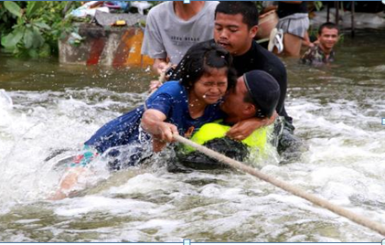
Flooding as a global issue
Notes:
Its not just the UK
Natural disasters are common around the world– Haiti this month
Bangkok ,Thailand ,October 2011 – supply chain for the IT industry- stable workforce but unstable weather.
Thailand five years ago – 800 people dead and 13 million people affected. Economic losses estimated at $<50 billion
Tropical Storm in the north swelled the river network
The Thai Government protected Bangkok which resulted in an area of flooding the size of Lake Michigan, including an industrial park - home to a quarter of the world’s manufacture of hard disk drives.

Slide 8
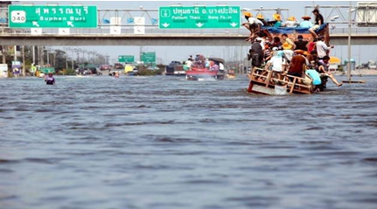
Bangkok, Thailand, October 2011
Notes:
This is the six lane highway from Bangkok to the north of the country.
Imagine if the M60 looked like this
Thailand has become a world manufacturing centre for electronics, automotive components, cars, foods and pharmaceuticals
Thailand offers a skilled and committed workforce combined with the low cost of living. Minimum wages are £170/month (2012)
Major companies include Honda, Mitsubishi, Nikon and Sony
Manufacturing is centred on industrial parks north of Bangkok

Slide 9
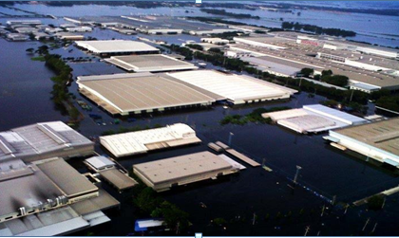
Navanakorn Industrial Park, October 2011
Notes:
100km square submerged under 3-4 metres of water
Brown sludge everywhere
Smell indescribable – dairy factories lost power and were standing in stagnant water for weeks.

Slide 10
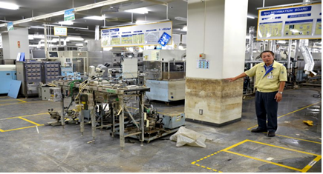
Navanakorn Industrial Park – typical damage
Notes:
The water mark on the wall
Water in situ for three weeks in warm temperatures

Slide 11
The electronic components marketplace in Thailand – eggs in one basket
  Network of sub suppliers. Hundreds of them, many employing a small workforce
  A major industry is manufacturing Hard Disk Drives (HDDs) for the likes of HP
  An interconnected network but with an unexplored supply chain
  The Equator has some of the most volatile weather patterns in the world and the scale of an incident can be felt all around the world

Slide 12
Loss adjusting in catastrophic situations
  Access
  Flood waters slow to recede
  Access even to inspect was difficult (boats!)
  Humidity lead to deterioration of machinery and plant
  Local Infrastructure
  Local roads washed away or inaccessible
  Employees unable to attend work place
  Some employees affected in their homes
  Risk of disease
  Power interruptions (even if no damage to own property)
  Supply chain
  Exposed to extended supply chain
  Tend to know first tier suppliers
  Extended to impact 60% of world supply
  Limited influence over second tier and beyond
  Market price
  Shortage impacted the open market price of components
  Suppliers invoked force majeure
  Price rises for ANY available units
  Customers on fixed price contracts
  Immediate reduction to margins

Slide 13
Particular issues relating to the supply chain
Knowledge of immediate supply chain and dependencies
  Direct influence can be used
Limited knowledge of next layer dependencies
  No knowledge of location
  No knowledge of vulnerabilities
  Little influence on recovery or alternatives
No direct purchasing links
  Out of touch
  Lower priority depending on their other customers
Contingent BI
  May have lower sub-limits
  Geographic restrictions
  Shorter indemnity periods

Slide 14
Supply chain – things to think about
  Global supply chain – elastic band syndrome. First it stretches, then it extends, then it snaps!
  Vulnerabilities
  Known supply chain and dependencies
  Unknown supply chain dependencies
  Influence when issues arise
  Business continuity the goal
  Insurance – other risk controls

Slide 15
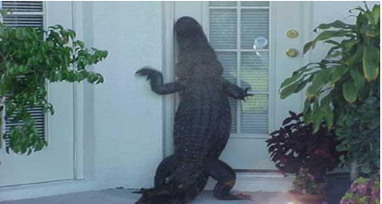
An unexpected visitor…
Notes:
There’s the risk to human health and not just the one this croc represents!
A feature of the Thai floods was the time it took for the water to drain away - weeks. A perfect breeding ground for mosquitoes. There are 400 different species of mosquito in Thailand.
They transmit diseases like malaria and dengue fever.

Slide 16
The future – building a better customer experience
  Today’s tools
  Communication is visual and verbal
  It’s immediate, bite-size and instantly-transferable
  iPads – portable, practical with apps like Measure Map
  Drones – a whole new dimension
  Experiments in talking heads instead of traditional reports
  Quality decision making
  Fact-based, delivered quickly, with confidence
  Meaningful communication
  It underpins all we do
  Every stakeholder has a part to play
Notes:
Communication is increasingly visual and verbal
It’s immediate, bite-size and transferable
FCA Thematic Review 2015 – improving the claim service for SMEs
Quick exchange of information reduces the period of uncertainty around coverage
Good decision-making is based on facts, delivered promptly and in a form which is accessible (format and content!)
Using iPads – portable and practical with tools like Measure Map
Using drones – a whole new dimension

Slide 17
Managing commercial property flood claims – a summary
We have looked at:
  Planning for a flood event and delivering it on the ground
  Flooding in northern England in December 2015
  Estimating a large property flood loss
  Flooding as a global issue
  Building a better customer experience

Slide 18
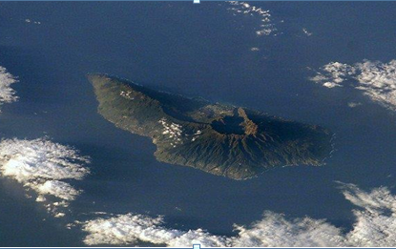
And finally… the geological time bomb
Notes:
La Palma, Canary Islands
Predicted collapse of a volcano - a piece of the island the size of the Isle of Man may slide into the sea
If it does, it may create the mother of all waves – a Mega Tsunami.

Slide 19
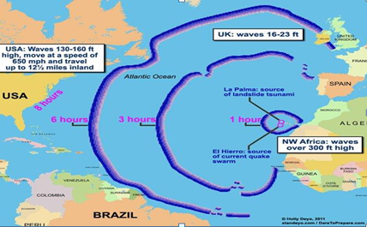
Mega Tsunami
Notes:
The bad news:
Wave 50 metres high with the power of a nuclear explosion and travelling at the speed of a jumbo jet.
The theory is disputed but it may have happened in the past.
What isn't disputed is that no one can control nature but we can influence it.
The good news:
Manchester is 35 miles from Liverpool and about 40 metres above sea level.

Slide 20
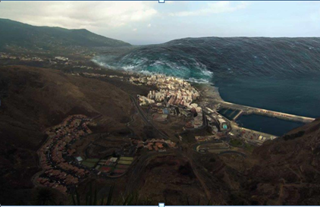
Still fancy a holiday in Tenerife?

Slide 21
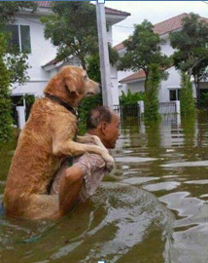
Discussion

