Slide 1
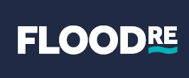

26th October 2016
Insurance Institute of Manchester
Andrew Creedon, Head of Client Relationships, Flood Re

Slide 2
Contents
1. Reminder of the need for Flood Re
2. What is Flood Re
3. How is Flood Re funded
4. Overview of how Flood Re operates
5. What property does Flood Re cover
6. Initial results since introduction of Flood Re for customer
7. Ceding to Flood Re - Factors to consider for underwriters

Slide 3
1. Reminder of the need for Flood Re - Scale of Flood Risk in England
2.4m properties at risk of river and coastal flooding
3.8m properties at risk of surface water flooding
1m properties at risk from river, coastal and surface water flooding
Environment Agency 2014

Slide 4
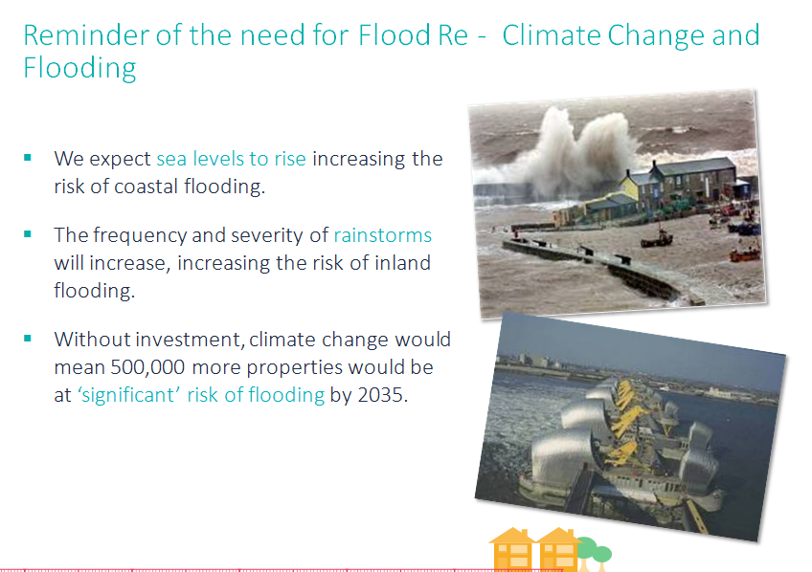
Notes:
4
4

Slide 5
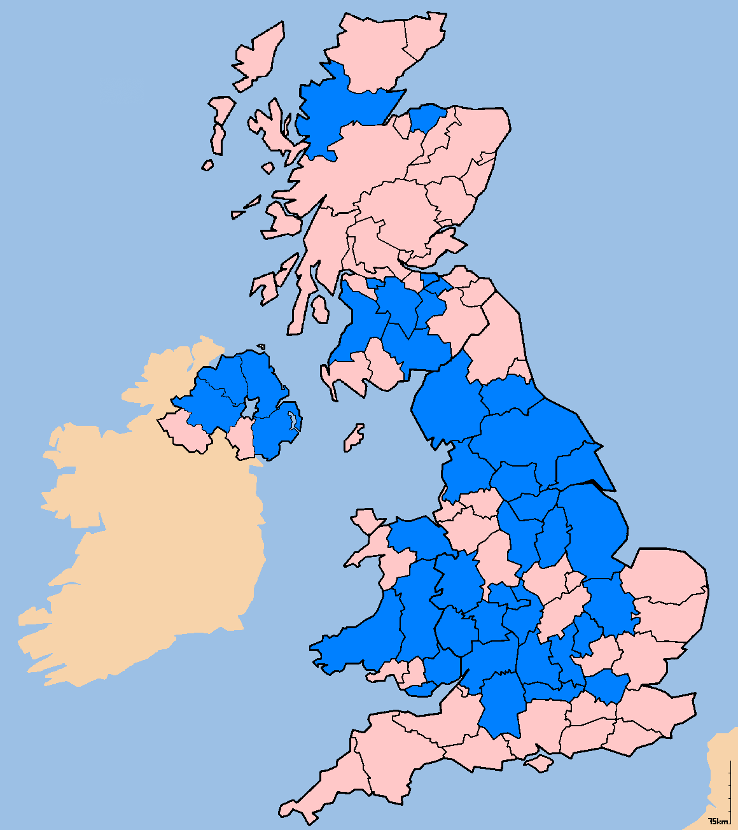
Reminder of the need for Flood Re - Flooding in recent years
2007 floods
Total insurance claims cost: estimated at £3bn
Total number of claims: around 185,000
Total domestic claims: around 130,000 (50,000 major)
17,000 insured households into alternative accommodation
Total commercial claims: around 35,000
Total motor claims: around 20,000
2009 Cumbrian floods
Total insurance claims costs of around £200m
2012 floods
Total insurance claims costs of £594m
2013/14 floods
Total insurance claims costs of £450m
18,700 flood claims
2015/16 floods
22,000 total flood claims
£1.3bn estimate to be paid by insurers
Notes:
5
5

Slide 6
2. What is Flood Re
Solution to a long standing problem relating to the availability and affordability of flood insurance for private residential property
Likely to benefit up to 350,000 households
Special Purpose Vehicle designed to create a reinsurance/ pool solution across the industry
Flood Re is a Reinsurer, authorised by the UK regulators in the same way other reinsurers are
Owned and operated by the insurance industry with public accountability to Parliament – therefore needing Government support and involvement
Life span of 25 years
What Flood Re is not
Will not cause any change to customer experience at point of sale or claim journey
Not tasked with paying for property level resilience or resistance
Is not a primary response to climate change adaptation
A reinsurer of business premises
6

Slide 7
3. How is Flood Re funded
A) Relevant Insurers writing UK household business:
Will pay Levy 1 of £180m p.a. first instalment paid 1 April 2016
Flood Re has capacity to call a second Levy from UK household insurers if required (Levy 2)
B) Relevant Insurers using the scheme for each policy to be ceded to Flood Re:
Insurers set retail prices – not Flood Re
Ceded risk premium charged to insurers at a fixed price according to council tax bands:
Council Tax Band | A, B | C | D | E | F | G | H
Buildings Policy | 132 | 148 | 168 | 199 | 260 | 334 | 800
Contents Policy | 78 | 98 | 108 | 131 | 148 | 206 | 400
Combined Policy | 210 | 246 | 276 | 330 | 408 | 540 | 1200

Slide 8
4. Overview of how will Flood Re will operate
Customer
Customer experience is unaffected and they purchase insurance as usual
Customers receive flood risk information from insurers
Insurer
Insurers set customer prices, not Flood Re
Insurers base the flood risk element of the premium on council tax bands
Insurers decide what risks to cede to FR
Insurers pay customer who make valid claim, and recover cost from FR
Flood
Re
Collect annual levy of £180m from relevant insurers
Ability to raise additional capital through Levy 2
Flood Re will accept eligible risks
Flood Re has annual liability limit of £2.1BN
FR pays Reinsurance claims to the insurer
FR is privately owned and operated, publicly accountable
8

Slide 9
5. What property does Flood Re cover
Eligible Properties:
  Out of scope:
  Held for private residential use
  Insured in the name of individuals [not companies]
  Must have a Council tax band (All Council Tax bands covered)
  Insured on individual basis or separately identifiable premium
  Occupied by policy holder or immediate family, some of the time or unoccupied
  More detail on this later
  Homes built on or after 01 January 2009
  Small businesses (premises that is business rated)
  Properties 4+ residential units, although contents cover is eligible
  Buildings cover for leasehold premises 2 or more units

Slide 10
6. Initial results since introduction of Flood Re for customers
Results from a benchmarking exercise of the insurance market prior to Flood Re launch
High risk of flooding with a flood claim
Very little market available
High risk of flooding but no recent flood claim
Significantly less of market available
Significantly higher premium
compared to non-flood risk customers
Availability post launch
High risk of flooding with a
flood claim
1o+ brands available via PCW and more in other channels
even for the highest risks with flood claims
  Full results of benchmarking exercise
  expected later in the year

Slide 11
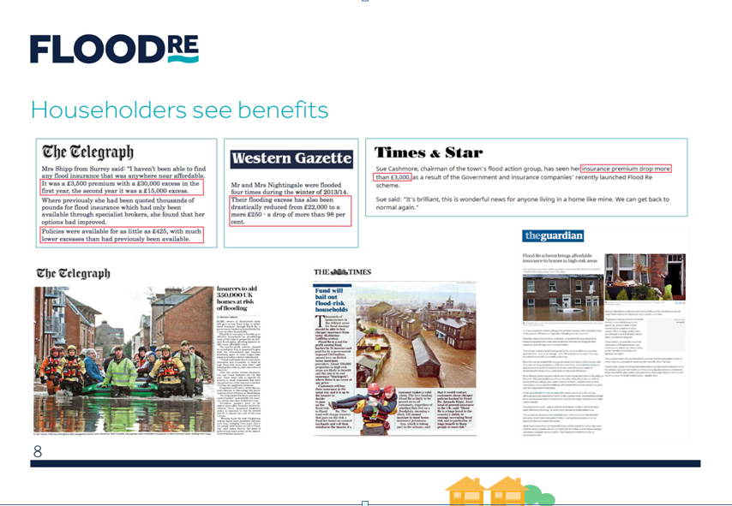

Slide 12
7. Ceding to Flood Re - Factors to consider for underwriting

Slide 13
Principles of underwriting eligibility
Flood Re’s policy objective is to help those private residential households who live in a flood risk area find more affordable home insurance
The Scheme should not be used as an incentive for irresponsible planning decisions
Flood Re’s policy is to be ‘back-to-back’ with the insurers’ standard policies. We do not expect policies to be gold plated as a response to Flood Re
Fundamental underwriting principle: there should not be an increase in the number of residential properties as a result of Flood Re’s existence
13

Slide 14
Eligibility criteria
Properties will be eligible only if they meet all of the following criteria:
1. They are covered by an insurance contract which is held in the name of, or on trust for, one or more individuals or by the personal representative of an individual (ie policies in name of a business wont be eligible)
2. The holder of the policy, or their immediate family, must live in the property for some or all of the time or the property must be unoccupied;
3. They have a domestic Council Tax band A to H (or equivalent);
4. They are used for private, residential purposes;
5. They are a single residential unit or a building comprising of two or three residential units (no restriction for contents only cover);
6. They are insured on an individual basis or have an individual premium;
7. They were built before 1st January 2009
8. They are located within the UK comprising England, Wales, Scotland and Northern Ireland (excluding the Isle of Man and the Channel Islands)
14

Slide 15

Change of use from commercial to residential
Conversion completed post 2009
1
Office block
Residential property
Example: If a barn or similar non-residential (commercial) building is converted to a dwelling post-2009
Decision: Property is not eligible for ceding to Flood Re
Rationale: This would effectively increase the number of residential properties in high flood risk areas which was not the intention of the legislation

Slide 16

Change of use from commercial to residential
Conversion completed pre 2009
1
Example: If a barn or similar non-residential (commercial) building is converted to a dwelling before 2009
Decision: To be eligible a property has to have been a household premises or built as that premises pre-2009
Rationale: This does not effectively increase the number of residential properties in high flood risk areas

Slide 17


Property mixed used
Flood Re accepts that certain business enterprises have live-in occupiers, and therefore only part of the premises is used for private residential use
This means that the residential aspect of criteria for Flood Re cover as set out in statute is met
Flood Re allows ceding of eligible properties which are used for both domestic and business purposes provided that the property ONLY pays Council Tax and does not attract Business Rates.
Examples of mixed use properties are:
Farmhouses and Bed and breakfast establishments not
Paying business rates
Eligible if above and other criteria met
1

Slide 18

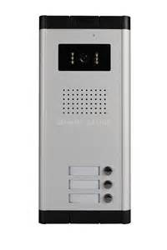


Multiple building occupancy
Flood Re will cover the flood risk for properties split into individual apartments. A limit of three apartments in a building is set out in the Flood Re Regulations for buildings cover
Flood Re will cover a single building risk with up to three apartments in that building on the condition that the freeholder lives in the block and the insurance is in their name and our premium will be based on their property’s council tax band.
ii) Flood Re will take on the risk even if underwritten on a Commercial policy (provided the eligibility criteria are met).
iii) Flood Re will cover these risks on a buildings only policy. Any contents cover must be insured on separate contents only policies for each individual unit.
Contents only policies are still available to tenants
1

Slide 19
Holiday homes / second homes
A number of insurers allow the addition of secondary / holiday homes on the same policy, as well as on separate policies.
Flood Re will accept these risks
  if the home has its own property Council Tax band and has an identifiable separate premium
  if the policyholder or immediate family lives in the property some of the time
  The main purpose of the second property is not commercial
  and they meet the normal eligibility criteria
Caravans are only eligible if they are the primary home and meet all the other eligibility criteria. They can not be considered as second homes as they would not be the primary home
1

Slide 20
Rebuilt properties and acceptable evidence
Example: A property is demolished and rebuilt or substantially improved which results in a Council Tax revaluation
Decision: Flood Re will cover rebuilt properties provided it is presented with sufficient proof of a pre-2009 build date. The footprint of the rebuilt property must at least overlap with the original footprint and it must be a like for like property, eg 1 unit to 1 unit. There is no requirement that the replacement property be the same Council Tax band.
Rationale: Flood Re wants to fulfil the policy intention of the Scheme by accepting rebuilt properties, however, reasonable restrictions have to be put in place to ensure that new developments are not inadvertently covered
1

Slide 21
Fine art definition
Contents Cover covered by the Flood Re Scheme
It is a Condition for Cover that Contents included in any Flood Cover are limited to the following: household goods and personal possessions, which may include valuables (except Fine Art), clothes, sports equipment and bicycles, camping equipment, money, satellite dishes, aerials and other articles, which belong to persons who live in the Dwelling or for which they are responsible, or which belong to guests in the Dwelling (except paying guests).
2.2.4.1 Definition of Fine Art
“Fine Art” means individual items valued above £25,000 that are of artistic merit, historical value, novel, rare and/or unique including, but not limited to:
a) antique and designer-made furniture, paintings, drawings, etchings, prints, photographs;
b) tapestries, carpets, rugs, books and manuscripts;
c) sculptures (inside or outside the home), ornaments, porcelain and glass;
d) clocks, barometers, mechanical art and objets d'art;
e) musical instruments; and
f) those made of precious metals or precious stones including gold, silver, platinum, pewter and plate and collections, insured as such in the Original Policy, valued above £25,000 that are of artistic merit, historical value, novel, rare and/or unique, including, but not limited to stamp and coin collections, wines, memorabilia and other collectibles such as medals, dolls and guns.
1

Slide 22

Policy term coverage
Flood Re will only accept policies originally underwritten on an annual basis. That is it will not accept short period policies (term < 1 year) or long term policies (term > 1 year).
As a concession Flood Re will accept a risk which changes during the course of a term which will bring the risk within the scope and eligibility of the Scheme. The policy must be ceded to Flood Re showing that the underlying policy is on an annual basis (start and end dates of the term), and the effective start date for the ceded risk.
For example, a risk may be eligible for the Scheme because of a change of risk address, or a tenant moves out and a member of immediate family moves in. Pro-rata premium will be charged for the ‘at risk’ period.
1

