Slide 1


Tackling Cyber threats together
Sean O’Neil

Slide 2
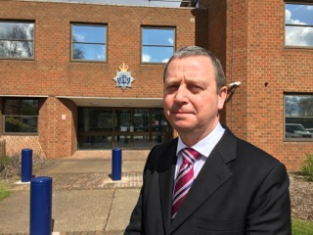
Cyber security advisor
Sean O’Neil; Over 30 years experience in the Police
Previous role was Detective Chief Inspector with regional major crime unit.
Senior Investigating Officer (SIO) for Murder, kidnap, extortion and product contamination; and wider reputational incidents such as Slavery, Large scale frauds and internal matters.
He carried out investigations in several other countries and also prosecuted overseas; by assisting foreign Courts and Governmental bodies.
Red centre commander (Kidnap/tiger kidnap negotiations)
Covered Bedfordshire, Hertfordshire, & Cambridgeshire.
3 years in private industry, ecommerce company investigation serious and organised crime on company. On-line frauds by vendors/customers, serious thefts by employees. Organised on-line attacks.
Physical security auditor.

Slide 3
Areas of discussion (in brief)
What is Cyber Crime?
Recent intelligence and current threats
Advice on how to protect yourselves
Ways you may choose to protect yourselves, with CBR, CisP, POC.

Slide 4
What is Cyber Crime?
The adopted definition of Cyber Crime is:
Cyber Dependent Crimes, where a digital system is the target as well as the means of attack. These include attacks on computer systems to disrupt IT infrastructure, and stealing data over a network using malware (the purpose of the data theft is usually to commit further crime).
Cyber Enabled Crimes. ‘Existing’ crimes that have been transformed in scale or form by their use of the Internet. The growth of the Internet has allowed these crimes to be carried out on an industrial scale.
The use of the Internet to facilitate drug dealing, people smuggling and many other 'traditional' crime types.
Notes:
Recent survey of reported crime had 96% as cyber element – either computers used to facilitate or used in commission.
Consider the number of times, telephones/computers are used to research, facilitate crimes or used as a means of communication.

Slide 5

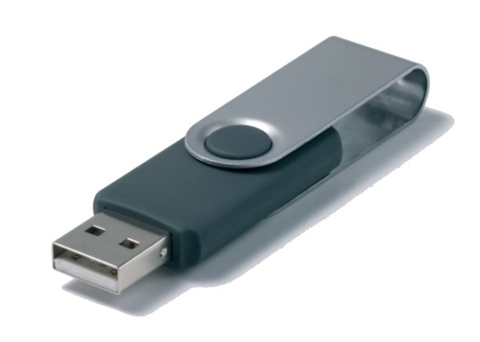

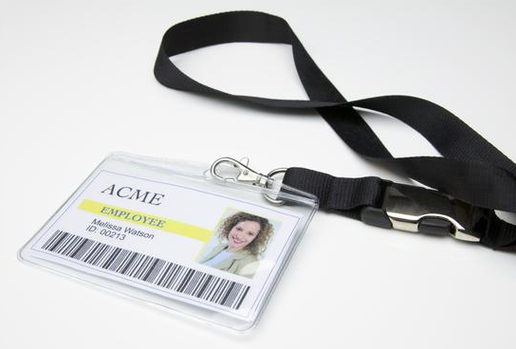




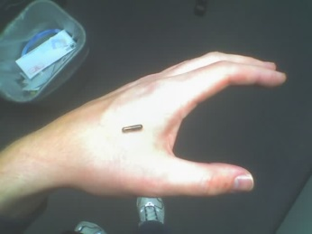
Which of these is a cyber threat?
POTENTIALLY ALL OF THEM!
Notes:
Smart fridge anecdote…
Own staff/insider
Chip in hand
Social engineering.
Frying pan
USB stick in car park

Slide 6
But what are some of the biggest threats?
•Insider Threat (theft/fraud/data breach)
•Malware by phishing attacks
•Data Breach
DDoS
•Social Engineering leading to scams
Theft/fraud by Customers or vendors.
Ultimately it depends on the business, how it is set up, the infrastructure and the policies and procedures, and protect mechanisms in place.
Does your BCP include no use of IT or loss of data!

Slide 7

And now for some good news!!
GCHQ reported in 2014 that in terms of Cyber Crime…
80% is easily preventable
Notes:
23 in a Million phishing emails are successful
5.5 Billion in 2011 attacks world wide
42% increase in a year to £7.8 Billion in 2012
People don’t rob banks with shotguns, they now hire a hacker – lower risk and jail time if caught
Peelian Principle – First duty of any Constable is to Prevent Crime

Slide 8

What do you think?
The 2015 Information Breaches Survey reported that 90% of large organisations and 74% of small businesses had security breaches.
1) What is the cost of an attack on a SME? – Repair, return to normality and compensation. What about loss of trade/reputation!
£75k - £311k
(Up from £65k - £115k in 2014)
2) What is cost on a large businesses?
£1.46m - £3.14m
(Up from £600k - £1.5m in 2014)
Could your company cope with this cost.
The cost of security is always too much until it is not enough!
Protection is cheaper then recovery
Notes:
2014 Information breaches survey found that: -
81% of large organisations & 60% of small businesses had security breaches. Average loss £600k to £1.15 million to large business and £65 -£115 k for small businesses.

Slide 9
Intelligence & current threats
Advice on how to protect yourselves
Notes:
Fraudsters targeting senior Executives.
Fraudsters target residential premises specifically in affluent areas and steal post to identify senior executives within companies and organisations. Once the fraudster has stolen the mail, open source research is conducted to identify if the victim works within a suitable position to ultimately become a target. The fraudster uses social engineering to gather information on them and their employer and then contacts the organisation (purporting to be the victim) to carry out mandate and payment diversion fraud on the company.
Fraudsters target letterboxes at residential addresses that lack security and CCTV to steal victims‘ mail, specifically banking documentation and personal correspondence.
Tactical advice: Check your mailbox on a regular basis, personally assess where your mail is deposited for vulnerabilities and consider added security measures. Dispose of confidential mail securely i.e. shredding. Place bins in locked location, consider CCTV coverage. To reduce social engineering consider what information you place on social networking sites regarding you, your home and place of employment. Put in place company procedures to challenge/double check any attempt to change payment details.
Online extortion demand affecting UK businesses
A number of businesses throughout the UK have received extortion demands from a group calling themselves 'Lizard Squad'.
Method of Attack: The group have sent emails demanding payment of 5 Bitcoins, to be paid by a certain time and date. The email states that this demand will increase by 5 Bitcoins for each day that it goes unpaid. If their demand is not met, they have threatened to launch a Denial of Service attack against the businesses' websites and networks, taking them offline until payment is made. The demand states that once their actions have started, they cannot be undone.
Tactical advice on what to do if you've received one of these demands:
Report it to Law Enforcement (LE); via Action Fraud by calling 0300 123 2040 or by using the online reporting tool, in addition email cyberprotect@bedfordshire.pnn.police.uk
Do not pay the demand
Retain the original emails (with headers)
Maintain a timeline of the attack, recording all times, type and content of the contact
If you are experiencing a DDoS right now you should:
Report it to LE; via Action Fraud by calling 0300 123 2040 or by using the online reporting tool, in addition email cyberprotect@bedfordshire.pnn.police.uk
Call your Internet Service Provider (ISP) (or hosting provider if you do not host your own Web server), tell them you are under attack and ask for help.
Keep a timeline of events and save server logs, web logs, email logs, any packet capture, network graphs, reports etc.
Get Safe Online top tips for protecting your business from a DDoS:
Consider the likelihood and risks to your organisation of a DDoS attack, and put appropriate threat reduction/mitigation measures in place.
If you consider that protection is necessary, speak to a DDoS prevention specialist.
Whether you are at risk of a DDoS attack or not, you should have the hosting facilities in place to handle large, unexpected volumes of website hits.
Examples of Cyber-crime: Malware attacks
Malware, which is short for malicious software, refers to any software that’s designed to disrupt or damage a system, and cause harm to the user (you). Viruses, trojans and worms are a few of the most common types of malware. Banking malware is specifically designed to intercept and steal a user's financial details. There are many ways malware can infect a device, whether it be a link to a malicious website in an unsolicited email, or installing an app from an unofficial app store.
Stats:
1 - 390,000 - The number of new malicious software programs detected every single day - (https://www.av-test.org/en/statistics/malware/)
2 - 1,966,324 - Attempted malware infections that aimed to steal money via online access to bank accounts. (https://securelist.com/analysis/kaspersky-security-bulletin/73038/kaspersky-security-bulletin-2015-overall-statistics-for-2015/)
3 - £20m - The estimated financial loss to the UK from just one piece of banking malware (Dridex) - http://www.nationalcrimeagency.gov.uk/news/723-uk-internet-users-potential-victims-of-serious-cyber-attack
Tactical advice:
Don’t click on links you receive in unsolicited emails or SMS messages. The links may lead to malicious websites, and any attachments could be infected with malware.
Only install apps from official app stores, such as Google’s Play Store, or Apple’s App Store.
When logging in to your online banking account, be extremely cautious if you’re asked for details such as the 3 digit (CVV) number on the back of your card, the long number on the front of the card, your card’s expiry date, or the 4 digit PIN for your card. If the online banking login page you’re on does ask for these details, then don’t login until you’ve called your bank to verify that you're logging in to a genuine web page.
Your bank will never ask you to transfer money out of your account and into another. If you receive messages, browser pop ups or calls asking you to do this, then don’t respond to them. Call your bank immediately.
EXAMPLES OF CYBER ENABLED CRIME:
Account take overs /compromised accounts
Compromised accounts caused by poor PW protocol in some businesses, have led changes being made to credit card details [stolen/obtained on dark web added], and delivery addresses changed; Purchases are then made on customer accounts without their knowledge; leading to very high loss due to credit card charge backs. Plus reduced customer confidence. Causes high loss to the company and need for increased fraud management
Tactical advice: Increase PW protocol. Contact customer if unusual orders are placed, double check new delivery addresses. Report incidents to LE.
Merchant risk/ vendor fraud
Supply chain vendor supplies counterfeit goods mixed with authentic products; company fails to complete due diligence checks on vendor and their supply chain. Products then sold to customers. Company handles complaints from customer, loss, and reputational impact. LE has difficulty in proving intent, due to mix of counterfeit/authentic products.
Supply chain vendor supplies low risk products and gains trusted status with company. Vendor then switches product to high risk items. Uses company/platform to sell goods and disburses before delivery. Company handles complaints from customer, loss, and reputational impact. LE has difficulty if vendors are overseas.
Tactical advice: Do not allow vendors to have multiple accounts, carry out due diligence of supply chain companies, products and accounts; do not disburse funds to supply chain until products & invoices checked and products delivered. Report all fraudulent activity to LE.
Buyer risk / organised crime / customer fraud
Company is subject to on-line chat room discussion about how to defraud. Criminals talk to each other and advise on how to place fraudulent orders to drop off address, and then contact customer service (CS) claiming did not receive (DNR). Customer says he no longer wishes the product and cancels the order or asks for another product. Losses often individually less than £1000 but aggravated by number of linked cases. Company handles complaints from customer, loss, and reputational impact. LE has difficulty due to low value of individual loss and need to show on-line links.
Tactical advice: Company may consider using experienced third party investigators to monitor internet; to gain intelligence of possible threats, detect attempts to defraud and provide evidence to LE.

Slide 10
Insider threat
Theft/fraud by employee
Data breach (increased threat when leaving – take to new employment, sell).
Tactical advice
NDA (visitors & employees)
ICT group permissions
account closure process.

Slide 11
Social engineering by Dodgey Sean (outsider threat)
Visit your house (on street view & in person). Check letterboxes and enter your garden! Look in waste bins to steal mail, specifically banking documentation and personal correspondence. What security do you have (CCTV!)
Scan your Wi-Fi
View uploaded photo’s. all about you & family
fb, LinkedIn, Twitter,
Visit place of work. Penetration test (physical security/reception visitor policy.
Research on internet. (what does Google or company website say about you)
Dark web (underground websites; purchase CC, bank details, accounts & passwords).

Slide 12
Mandate fraud / CEO fraud/ payment diversion
Fraudsters targeting senior Executives.
Typically starts with a “spoof” email being sent from a fraudster to a member of staff in a company’s finance department, but may be sent to the procurement or other account holder. The member of staff will be told by the fraudster who is purporting to be a company director or CEO/CFO, that they need to quickly transfer to a certain bank account for a specific reason. The member of staff will do as their boss has instructed, only to find that they have sent money to a fraudster’s bank account.
There have been many other versions that include requesting payment details changed on existing vendors accounts. The fraudster will normally redistribute this money into other mule accounts and then close down the bank account to make it untraceable. Very little of the funds are ever recovered.
Tactical advice: Check mailbox regularly, assess where mail is deposited for vulnerabilities. Consider security measures. Dispose of confidential mail securely i.e. shredding. Place bins in locked location, consider CCTV coverage.
To reduce social engineering consider what information you place on social networking sites regarding you, your home, and place of employment.
Put in place company procedures to challenge/double check any attempt to change any payment details.

Slide 13
Online extortion demand affecting UK businesses
Ransome ware threats: extortion demands from a group calling themselves 'Lizard Squad'.
Method of Attack: The group have sent emails demanding payment of 5 Bitcoins, to be paid by a certain time and date. The email states that this demand will increase by 5 Bitcoins for each day that it goes unpaid. If their demand is not met, they have threatened to launch a Denial of Service attack (DDoS) against the businesses' websites and networks, taking them offline until payment is made. The demand states that once their actions have started, they cannot be undone.

Slide 14
Tactical advice :
Report to Law Enforcement (LE); via AF, 101, + cyberprotect@bedfordshire.pnn.police.uk
Do not pay the demand. You will be highlighted as a payer and get more ransoms.
Retain the original emails (with headers),
Maintain a timeline of the attack, recording all times, type and content of the contact.
Highlight on CisP.
If you are experiencing a DDoS
as above.
Call your Internet Service Provider (ISP) (or hosting provider/Web server) inform under attack and ask for help.
Keep a timeline of events and save server logs, web logs, email logs, any packet capture,
network graphs, reports etc.
Consider the likelihood and risks to your organisation of a DDoS attack, and put appropriate threat reduction/mitigation measures in place, ie second server/gateway. speak to a DDoS prevention specialist.
you should have the hosting facilities in place to handle large, unexpected volumes
of website hits.

Slide 15
Malware attacks
Malware, which is short for malicious software, refers to any software that’s designed to disrupt or damage a system, and cause harm to the user (you). Viruses, trojans and worms are a few of the most common types of malware. Banking malware is specifically designed to intercept and steal a user's financial details. There are many ways malware can infect a device, whether it be a link to a malicious website in an unsolicited email, or installing an app from an unofficial app store.
Stats:
1 - 390,000 - The number of new malicious software programs detected every single day - (https://www.av-test.org/en/statistics/malware/)
2 - 1,966,324 - Attempted malware infections that aimed to steal money via online access to bank accounts. (https://securelist.com/analysis/kaspersky-security-bulletin/73038/kaspersky-security-bulletin-2015-overall-statistics-for-2015/)
3 - £20m - The estimated financial loss to the UK from just one piece of banking malware (Dridex) - http://www.nationalcrimeagency.gov.uk/news/723-uk-internet-users-potential-victims-of-serious-cyber-attack

Slide 16
Tactical advice:
Don’t click on links you receive in unsolicited emails or SMS messages. The links may lead to malicious websites, and any attachments could be infected with malware.
Only install apps from official app stores, such as Google’s Play Store, or Apple’s App Store.
When logging in to your online banking account, be extremely cautious if you’re asked for details such as the 3 digit (CVV) number on the back of your card, the long number on the front of the card, your card’s expiry date, or the 4 digit PIN for your card. If the online banking login page you’re on does ask for these details, then don’t login until you’ve called your bank to verify that you're logging in to a genuine web page.
Your bank will never ask you to transfer money out of your account and into another. If you receive messages, browser pop ups or calls asking you to do this, then don’t respond to them. Call your bank immediately.

Slide 17
Account take overs /compromised accounts
Compromised accounts caused by poor PW protocol
in some businesses, have led changes being made to credit card details [stolen/obtained on dark web added], and delivery addresses changed
Purchases are then made on customer accounts without their knowledge; leading to very high loss due to credit card charge backs. Plus reduced customer confidence. Causes high loss to the company and need for increased fraud management
Tactical advice: Increase PW protocol. Contact customer if unusual orders are placed, double check new delivery addresses. Report incidents to LE.

Slide 18
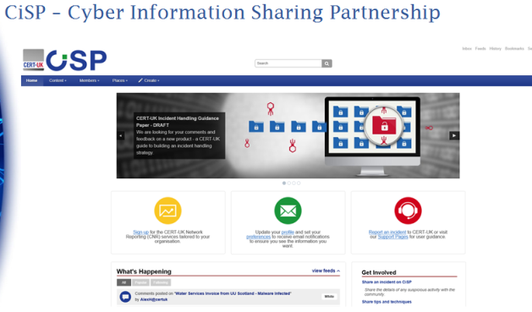
Ways you may choose to protect yourselves:
CBR - Free service to all local businesses, organisations, charities, vulnerable people
Offering a review of current practices
Suggesting improvements to ICT/physical security
Leading to greater ability to reach ‘cyber essentials’ accreditation - Minimum standard suggested for government contracts in the future.
CisP
POC

Slide 19
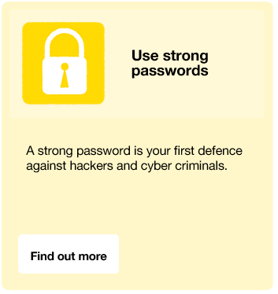
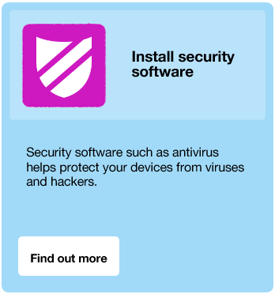
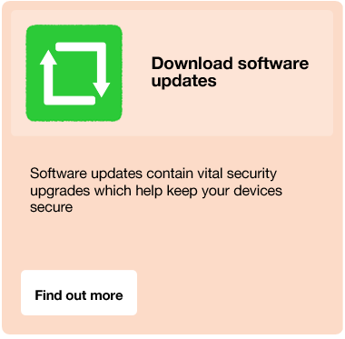
Let’s Finish on Three Simple Pieces of Advice…
Screen clippings taken from www.cyberstreetwise.com

Slide 20
POC: Who do I contact and how?
Action Fraud – 0300 123 2040
Urgent Incidents – 999 or 101 (local Force response)
Non urgent incidents – 101 / Action Fraud
Non urgent in office hours – Local Force Cyber Crime Unit
cyberprotect@bedfordshire.pnn.police.uk
Regional Unit will pick up incidents/cases through a tasking process that local Forces initiate. To prevent loss of data, contact local force or security advisor.
Action Fraud will disseminate cases and investigations across to Forces following research and analysis of information provided

Slide 21

Thank you!
Sean O’Neil
Cyber Security Advisor (2219)
Bedfordshire Police Headquarters,
Woburn Road, Kempston, Bedfordshire, MK43 9AX
(+44) 7720204358
sean.oneil@bedfordshire.pnn.police.uk
cyberprotect@bedfordshire.pnn.police.uk

