Slide 1
FARM INSURANCE CLAIMS AGRICAL PRESENTATION TO LEICESTER INSURANCE INSTITUTE

Slide 2
Notes:
Good afternoon,
Thank you to Leicester Insurance Institute for giving me an opportunity to speak.
I hope my presentation, using studies of real cases, will highlight practical issues that could be easily overcome with better understanding of policy cover and the client’s needs.
My intention is to discuss farming claims at a practical level. I hope to:
Highlight reasons for difficulties in arranging settlement that is satisfactory to policyholders and how those problems can be prevented.
Talk about Revenue cover and how it works in practice
Touch on Farm Liability insurance issues
Unusual cases to get us all thinking
Starting with the bad news first………………………………In practice, difficulties that face the loss adjuster tend to arise from one of three basic problem areas, which can largely be avoided if cover is set up correctly:

Slide 3
PROBLEM AREAS
No cover!
Notes:
The dread scenario!
Can be very basic, such as there simply being no cover for a shed that’s burned down or been blown over.
However, the claim I will run through in a moment shows how a lack of detailed understanding of the policyholder’s business can result in a significant part of a loss not being covered

Slide 4
Notes:
Set scene -
Friendly cooperation – “Mates rates”. Would have charged neighbour for planting potatoes. Later in season, neighbour to harvest Insured’s potatoes and charge for service.
Fire destroyed tractor and potato planter as Insured arrived at neighbour’s to plant seed potatoes.

Slide 5
The cover:
REVENUE
Cereal/Arable £200,000
Potatoes in store £108,000
Notes:
Claim for Loss of Revenue and ICOW

Slide 6
The claim
Increase in Cost of Working
Contractor planting potatoes for 3 farmers £8,983.92
Loss of Revenue
Income from planting neighbours’ potatoes £4,837.68
Total claimed £13,821.60
Notes:
Insured engaged a contractor to plant his potato crop and his neighbours’ crops in good faith. He wanted to “do his bit” for his friends and expected his policy to meet the cost of planting potatoes for all three farmers. He also expected to recover the income he would have derived from planting his neighbours’ potatoes - £1,156.35 Gross Revenue

Slide 7
The problems:
No Revenue cover for Contracting Income
No cover for neighbours’ ICOW’s
Notes:
Also, as the Insured did not have to run his own machinery, to plant any of the crops there were modest savings to take into consideration when calculating the loss under the policy – net ICOW

Slide 8
The settlement:
Increase in Cost of Working
Contractor planting potatoes for Insured £876.35
Loss of Revenue
Income from planting neighbours’ potatoes £0.00
Total settlement £876.35
Notes:
ICOW only covered for Insured’s business – neighbours ICOW’s have to be considered under neighbours’ policies
No cover for Contracting income, so no payment could be made for the lost contracting income

Slide 9
Reasons for policyholder’s dissatisfaction
Broker assumed income from contract planting of potatoes would be picked up as Revenue from “Potatoes in store”.
However, cover related only to the Revenue generated from policyholder’s own crop and ICOW’s incurred to protect that Revenue.
Broker had not made allowance/arrangement for Contracting Revenue to be covered.
Notes:
Broker knew that his client derived an income stream from the contract planting of potatoes, as this work was included in the description of the business and assumed that it would be picked up as Revenue from “Potatoes in store”.
However, he hadn’t thought things through and realised that the Revenue protected by this item related only to the Revenue generated from the sale of the policyholder’s own crop and ICOW’s incurred to protect that Revenue. Had not made allowance/arrangement for Contracting Revenue to be covered.

Slide 10
The Solution
Ensure you understand all the enterprises by which the policyholder makes a living

Slide 11
PROBLEM AREAS
Insufficient cover
Notes:
In reality, it’s often easier for an adjuster to say to a policyholder that a claim is simply not covered, than to adjust a claim to account for under insurance. Although we are always mindful of protecting commercial relationships, while negotiating a fair settlement under the policy, this is sometimes very difficult.
In this section, I will focus on Buildings claims, but the same principles apply to all Material Damage covers.
Would anybody like to suggest a rate per square metre to allow for the demolition, clearance and rebuild of a conventional Dutch barn?

Slide 12
Dutch barn - £80 to £110/square metre
Notes:
Mention CE marking of structural steelwork – recent requirement – added approx. 5% to typical costs
What about a rate for a traditional brick and tile cowshed?

Slide 13
General purpose store £170 to £200/square metre
Notes:
Mention CE marking of structural steelwork – recent requirement – added approx. 5% to typical costs
What about a rate for a traditional brick and tile cowshed?

Slide 14
Modern grain store £250 - £300/square metre
Notes:
Mention ventilated slatted drive-on floor, grain walling, fans, possibly heaters, etc that add to the cost
What about traditional buildings – what would they be likely to cost to reinstate?

Slide 15
Rebuilding Costs; Traditional Farm Buildings
£1,000/m2 Single Storey Brick/Slate/Tile (2/3 cost of private dwelling).
£1,400m2 Single Storey Stone/Slate/Tile (As above ` with 40% loading for stone).
Add 35 % loading for lofted buildings.
Double these rates for two storey.

Slide 16
Is cover on a “Modern Materials” basis the answer to this problem?
Notes:
Yes and No………..

Slide 17
PROBLEM AREAS
Inappropriate cover
Notes:
Any reasons why a policyholder may have to reinstate in a traditional manner, or wish to do so?

Slide 18
Is cover on a “Modern Materials” basis the best answer?
What happens when the insured has to reinstate with traditional materials?
Notes:
Question – where would this be likely to occur?
Listed Structure
National Park of Conservation Area
Development potential
In the curtilage of the house

Slide 19
Listed Status,
National Park/Conservation Area.
Buildings with development potential.
When insured wishes to put back ‘as was’.
Notes:
The onus is on the insured to insure at the correct figure, but the broker needs to understand the situation on the ground and guide to ensure the cover arranged is appropriate for the client’s needs.
If in doubt obtain an independent valuation.

Slide 20
Things to consider:

Slide 21
Have you allowed for………………..?
All fixtures and fittings?
Concrete floors
Electrical connection to the grid?
Three-phase electricity supply to workshop?
Drains?
Water supply pipes from meter to buildings?
Notes:
Concrete floors - £70/sq metre?

Slide 22
More pitfalls
Concrete yard surfaces?
Walls around a yard?
Tennis court?
Access roads?
Polytunnels – are these covered?
Calf huts – Buildings or Machinery?
Non-standard construction?

Slide 23
How much to repair this bridge?
Notes:
The brook rose 12 ft in about an hour and flood debris impacted with the sandstone carved parapet wall, causing serious damage
Repair cost were circa ………………………………………..next slide

Slide 24
£125,000

Slide 25
Other Factors Affecting Rebuilding Costs
VAT Status
Remote location
Poor access
Uncommon materials
Notes:
Salcombe tower crane case – virtually exhausted cover getting crane on site

Slide 26
Farm Revenue cover
Notes:
There has been a welcome trend in recent years for farmers insurances for arable and livestock enterprises to be covered on a Revenue basis.
This provides much wider and more flexible cover. If it’s set up correctly, revenue cover enables the loss adjuster to negotiate a settlement that properly protects the policyholder’s business

Slide 27
What are the benefits?
Where is BI cover suitable in agriculture?
How is cover arranged?
Claim examples – how it works in practice
What to consider when arranging cover

Slide 28
The fundamental intention of Revenue cover
Protect the income stream of the business following an insured event
Notes:
Traditional method is to insure agricultural produce, deadstock & livestock on a material damage basis.
Farm Revenue policies generally cover:
Loss of Revenue + Increased Cost of Working

Slide 29
FARM REVENUE INSURANCE COVERS:
Farm income streams
AND
Inputs that are consumed to generate the Revenue
Notes:
Essential for intensive farm risks
Extremely suitable for arable farms
Significant advantages for dairy farms (ICOW essential)
Livestock farms
Rental properties
Other business enterprises – own-produce farm shops, bio-diversification, renewable energies

Slide 30
Advantages over traditional cover:
Cover for sale value of outputs of the enterprise:
Arable crops, including by-products such as straw
Vegetable crops
Fattened beef cattle, pigs, lambs, etc.
Broiler chickens
Eggs
Notes:
Not necessarily the market value of products on the date of the loss –help farmers who would conventionally store their crops to take advantage of seasonal market uplifts

Slide 31
Advantages over traditional cover:
Includes cover for inputs such as:
Fertilizer and spray chemicals
Seeds
Feeds
Fuels
Packaging materials
Notes:
Wider and more flexible cover
Increased costs of working cover
Claim assessment based on selling price rather value at time of loss
Simpler to set sums insured
Extensions for customers/suppliers etc

Slide 32
Advantages over traditional cover:
Cover for Increased Costs of Working
Incurred to sustain the business and support income
Notes:
Combine harvester hire, engage contractor to finish a job, etc

Slide 33
Optional Extensions
Increase in cost of working – stand alone
Gross rentals/Estimated gross rentals
Forced Sale of Dairy Cows
Notes:
Stand alone” ICOW cover
“Increase in Cost of Working”
We will cover you for the increased cost of working and the amount payable will be the additional expenditure necessarily and reasonably incurred by you as a result of the incident in order to prevent or minimise the interruption of the business during the indemnity period at a level not exceeding that immediately before the incident

Slide 34
Key points
Perils follow material damage covers
Material Damage Proviso – none in relation to Growing crops, Deadstock and Livestock for sale
Notes:
There is still a material damage proviso but NOT in relation to agricultural produce, deadstock or livestock for sale where Revenue is for such production is insured (avoids dual insurance)
Perils will follow material damage covers
Storm/flood excludes moveable property in the open, fences, gates, growing crops or fruits (as it would for MD cover)
Sums Insured can be set in a variety of ways:-
Sum Insured – Work out total revenues from the business, adjust for trends/planned changes to business/anticipated market fluctuation – Mention Graves case
Declaration-linked basis – discuss benefits – essentially guarantees that Average will not be a problem – acknowledge extra work for broker at point of sale.

Slide 35
ORGANISING POLICY COVER
Identify relevant revenue figures and account for trends
Material damage/Revenue split
Notes:
Best shown by working examples:

Slide 36
Arable Farmer
Material Damage based cover | Material Damage & Revenue Farm Buildings £250,000 Machinery £ 50,000 Revenue £160,000
Farm Buildings £250,000
Machinery £50,000
Straw £10,000
Growing Crops £100,000
Grain in Store £50,000
Deadstock/fert./chemicals £15,000

Slide 37
Dairy Farmer
Material Damage based | Material Damage & Revenue
Buildings & parlour £500,000
Milking Herd £250,000
Machinery £50,000
Silage £30,000
Hay & Straw £ 40,000
Seed, feeds oils & fertiliser £ 20,000
Milk sales £250,000
Cull cows £10,000
Beef cattle sales £25,000
Buildings £500,000
Milking Herd £250,000
Machinery £ 50,000
Dairy Revenue £250,000
Beef Revenue £35,000

Slide 38
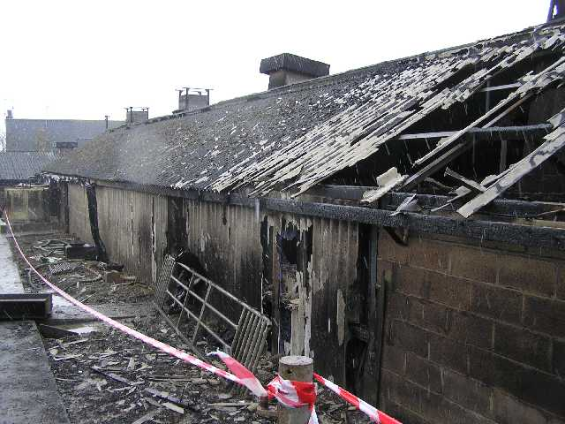
Claim Scenario – Pig Farm Fire
The Event
Fire 24 December destroyed 90 of 108 farrowing positions
50 of the farms 500 breeding sows perish
“Closed” high health herd
No alternative premises available

Slide 39
The Problems
25 sows farrow every week
No alternative farrowing accommodation available
Notes:
Outside arcs - too cold for pigs in herd
Hired in mobile farrowing house – nothing available for the size of operation
Move to nearby farm – serious disease risk
Cull sows until farrowing house repaired – creates large hole in breeding her

Slide 40
The Solution
Emergency temporary repairs to existing farrowing house at a cost of £35,000; considered as ICW
Build new farrowing house
Compared the time and revenue implications for homebred replacements
Consider the health risk of bringing in inoculated replacement gilts (young female pigs)
Agreed cash settlement. Insured decided to re-stock entire herd

Slide 41
ASSESSMENT – Material Damage
Building repairs £65,000
50 breeding animals £10,000
£75,000

Slide 42
ASSESSMENT – WITH REVENUE COVER
Permanent repairs to fire damaged shed £65,000
Temporary repairs to original shed (ICOW) £35,000
Assessment of revenue loss £500,000 £600,000
An extra £525,000!

Slide 43
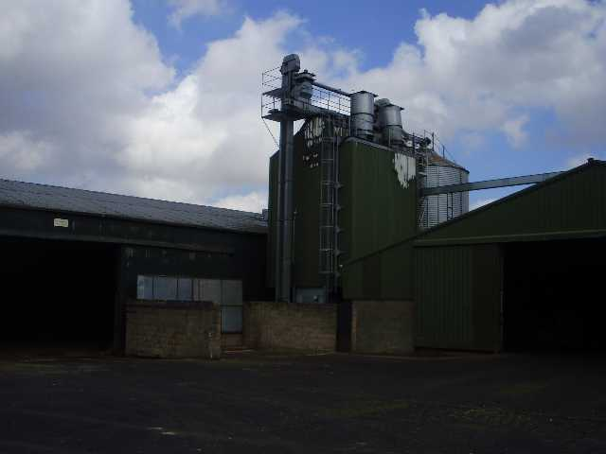
Claim Scenario - Grain Dryer Fire
Relatively small grain dryer fire towards end of a wet harvest
Grain dryer repair cost £10,500
Grain damaged in dryer £2,000 (value at time of loss)
Material damage settlement £12,500

Slide 44
The Problems
12 week repair time for dryer
By which time 6000 tonnes of wet grain in shed or awaiting combining
Wet Grain will spoil in store if not dried adequately
No temporary dryers available
Potential revenue loss - £1,200,000

Slide 45
The Settlement
Dryer repairs £10,500
Revenue loss (actual selling price) £2,400
Increased drying cost £120,000
£132,900
Difference £120,400

Slide 46
Pitfalls – What to avoid
Indemnity period is too short –
Consider length of indemnity periods.
Is 12, 24, 36 months sufficient?
Notes:
Discuss inputs, such as fertiliser in stock, that will be used in the following growing season, but not generate Revenue within 12 months of the loss – are these covered?

Slide 47
Pitfalls – What to avoid
Inappropriate sums insured figure
Ensure sum insured is set to reflect Gross Revenue not Gross Profit

Slide 48
Pitfalls – What to avoid
Ensure all income streams are covered
Review business accounts
Adjust for changes to enterprise

Slide 49
Pitfalls – What to avoid
Material damage cover is still needed on Breeding Livestock!
Notes:
Unsure how to set cover?

Slide 50
Understand how the whole business works to see where income is achieved
Make sure all income streams are protected
Notes:
Refer to case involving burned tractor and potato planter

Slide 51
Farm Liability cover
Notes:
There has been a welcome trend in recent years for farmers insurances for arable and livestock enterprises to be covered on a Revenue basis.
This provides much wider and more flexible cover. If it’s set up correctly, revenue cover enables the loss adjuster to negotiate a settlement that properly protects the policyholder’s business

Slide 52
Spray drift
Notes:
Field of sugar beet damaged by spray drifting from Insured’s field. Liability attached in negligence – prima facie evidence of not adequately discharging a duty of care to neighbour.
Mention “reasonable care” – reckless disregard for consequences could result in claim being declined

Slide 53
Livestock Trespass
Notes:
Cattle escaped from field into neighbour’s garden.
Strict liability attaches to KEEPER of animals – Section 4 of Animals Act 1971. In England and Wales there is no duty on a property owner to fence to keep animals out. Saying someone else must have left a gate open is no defence!

Slide 54
Failure to germinate
Notes:
This is a crop of Ritz spring-sown oilseed rape, photographed in June 2009, when the crop should have been knee high.
The variety completely failed in the UK in 2009. We acted for Products Liability insurers of a small seed company. Many thousands of acres affected in the UK.
Liability attached under sale of Goods Act – seed not fit for purpose. No damage though to TP property, so had to be Financial Loss Extension to cover in place. This proved to be insufficient in the case we handled – customers’ financial losses circa £250k – cover limited to £50k

Slide 55
Glyphosate in seed potatoes
Notes:
Glyphosate = “Roundup” readily available chemical
We acted for the insurers of the seed grower.
Hundreds of acres affected. Loss of yield.
Liability attached under sale of Goods Act – seed not fit for purpose. No damage though to TP property, so had to be Financial Loss cover in place.

Slide 56
Environmental Impairment
Notes:
Fortunately, most Farm policies now provide cover – Explain case involving Omex fert. that escaped – no cover & £70,000 loss
Explain scenario – Very unfortunate Insured. Power temp off to farm. Driver of farm lorry not aware. Attempted to fill up with diesel. Pump didn’t work. Nozzle returned to holster while still latched open. Power supply restored early evening. Pump operated and emptied diesel tank – approx. 5000 litres
Liability attached under Water Resources Act under “Polluter pays” principle. No defence to say that policyholder not negligent. Clean up cost approx. £40,000.

Slide 57
What about………

Slide 58
Is this malicious damage?
Steel bar cable-tied to maize stem
Notes:
Explain about 50 acres of maize in three fields.
Approx 30 steel bars found strapped to individual plants in two of three fields
Concern that harvesting could be dangerous to employees and equipment
Have tried to check manually – spotted about 50%
Invite discussion – has the plant actually been damaged?
If the plant has been damaged, is the whole crop maliciously damaged

Slide 59
Is this impact?
Notes:
Explain RH’s case involving a cow that clambered onto a roof off a bank and fell through into the house

Slide 60
Questions?

Slide 61
Thank you.

