Slide 1
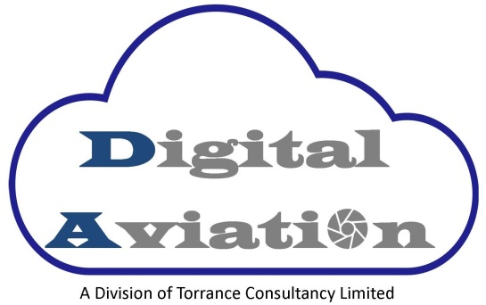
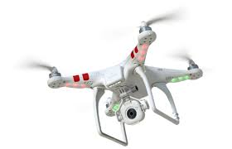
Drones – Heaven’s Above!
The rules and risks of operating unmanned aerial vehicles
Manchester Liability Society – 5 October 2016
Bruce Torrance Peter Forshaw
Pilot in Command, Digital Aviation Partner, Weightmans LLP
07903 431953 0151 242 7935
bruce@digitalaviation.co.uk peter.forshaw@weightmans.com

Slide 2
Drones……?

Slide 3
Drones

Slide 4
Drones

Slide 5
Outline
Uses & benefits
Rules
Operations - Myths & Reality – how they look & operate
Risks
Insurance considerations

Slide 6
Straw Poll
Have you ever operated or had experience of a UAV?
Do you understand drones and their uses?
A ‘phase’ or the future? – do you anticipate the widespread use of drones in your neighbourhood in the next 5-10 years?
Are you concerned about the present use, and future potential, of drones?

Slide 7
The Market
“Global market for commercial applications of drone technology valued at over $127bn”

Slide 8
Industries
Predicted value of drone powered solutions in key industries – global overview ($bn)
Infrastructure 42.2
Agriculture 32.4
Transport 13
Security 10
Media & Entertainment 8.8
Insurance 6.8
Telecommunications 6.3
Mining 4.4
Total 127.3

Slide 9
Industries
Telecommunications
$6.3bn
Mining $4.4bn
Media & Entertainment
$8.8bn
Security
$10bn
Transport
$13bn
Agriculture $32.4bn

Slide 10
Infrastructure
Digital terrain models
Survey of sites / 3D mapping
Identifying discrepancies to 1cm
Crossing of site borders monitoring
Investors monitoring of contractor engagement
Positioning of steel
Depth of pipelines
Final work assessment
Environmental impact
Maintenance, monitoring & stocktaking
Visualisation (e.g Balfour Beatty)

Slide 11
Agriculture
Crop supervision
Analysing soil and fields
Seed and nutrient plantation
Hyperspectral, multispectral or thermal imaging – e.g to assess lack of water, land quality
Keeping plants alive in latter stages of development
Crop spraying

Slide 12
Transport & Warehousing
Deliveries of Parcels (Amazon $3-$8 Vs 10cents)
Spare Parts – see Maersk savings of $3-9K per boat
Google’s project Wing – using solar-powered drones in conjunction with mobile deliver receptacles
Medical logistics – Flirty, NASA, Virginia Tech – see https://www.youtube.com/watch?v=y-rE14bezWc
Warehousing – scanning, packaging

Slide 13
Security & Safety
Highway, coastal and border surveillance e.g Channel Tunnel
Smuggling monitoring
Monitoring for wild animal trafficking poaching
Autonomous sentinel duties
Biometric based behaviour analysis
Facial recognition (Zero Zero’s Hover Camera)
Search and rescue/emergency services
Safety inspections – e.g Easyjet

Slide 14
Media, Entertainment & Leisure
Aerial photography & filming
Advertising / Promotions
Special effects - pyrotechnics
Entertainment – The drone racing league
Theatre – Marionettes, Pixel screens
Restaurants – e.g. Yo Sushi!

Slide 15
Insurance
The main issues in insurance lie in increasing levels of fraud and damage from natural disasters.
Risk monitoring
Risk assessment
Claims management and fraud prevention
Surveys - Checking the initial state of property – no need for cherry pickers/cranes
Speeding up of compensation/remedy = positive customer service – Aviva use of drones in flooding
Prediction modelling / underwriting tool

Slide 16
Telecommuncations
Maintenance
Optimisation including white spots
Radio Towers Loss of service (LOS)
Electromagnets visualisation
Cell on wheels technology
Facebook’s linked network initiative for rural and deprived areas.

Slide 17
Mining
The mining industry is one of the sectors where drone usage has untapped potential to deliver significant value for businesses
Planning in open cast mines
Area mapping to optimise hauling routes
Monitor potential storm damage
Monitor surface stability
Track changes in vegetation that may make a mine unstable
Early detection of deviations and threats

Slide 18
Legislation & Regulations
Is there governing legislation?
What is the legislation
Who enforces the legislation?

Slide 19
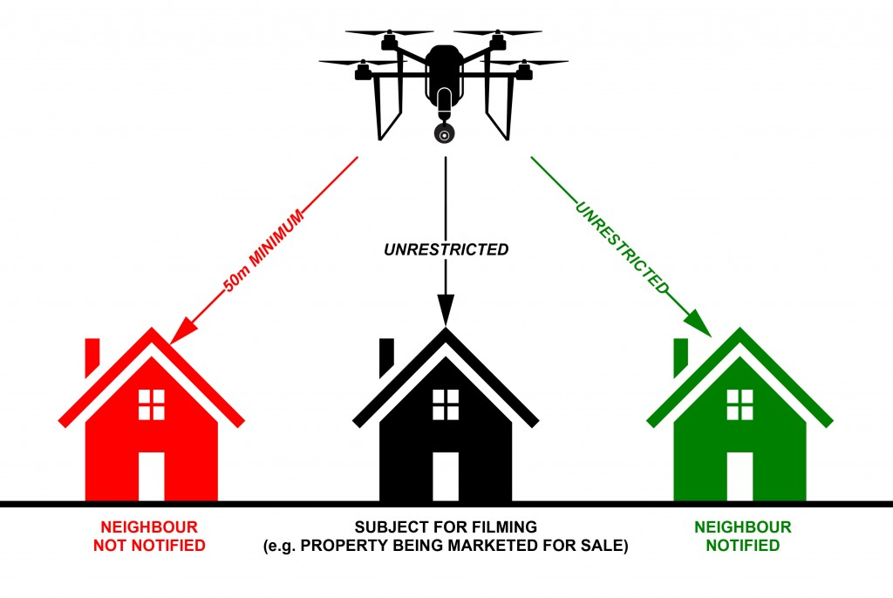
Rule example 1

Slide 20
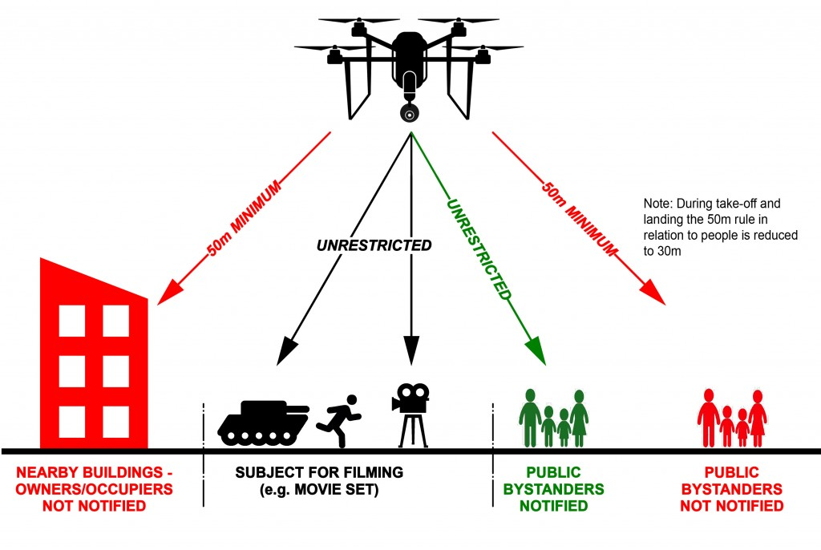
Rule example 2

Slide 21
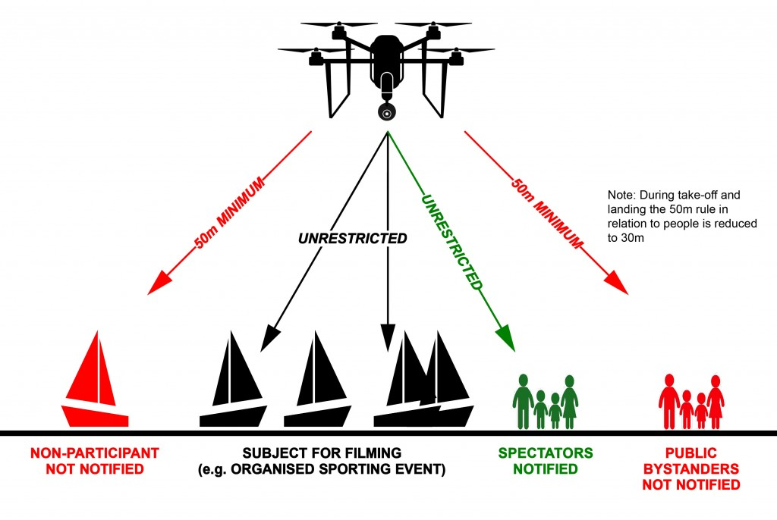
Rule example 3

Slide 22
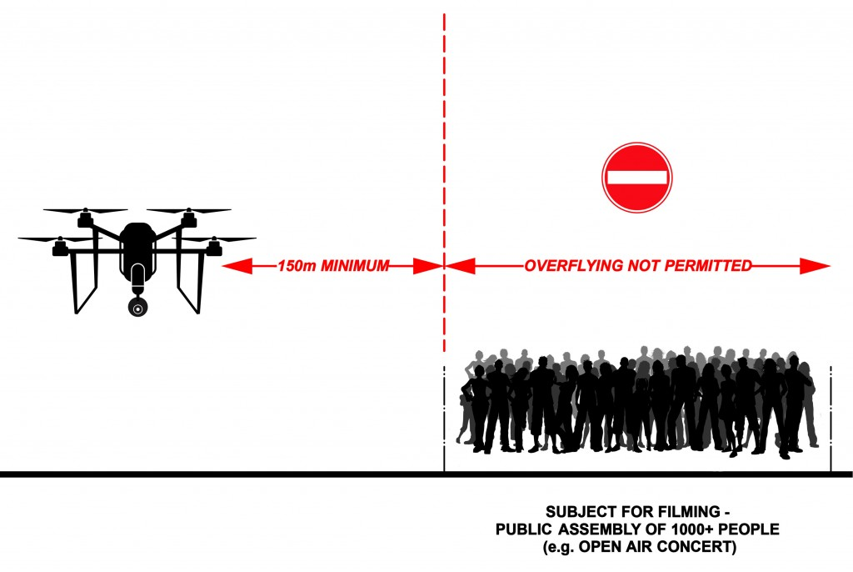
Rule example 4

Slide 23
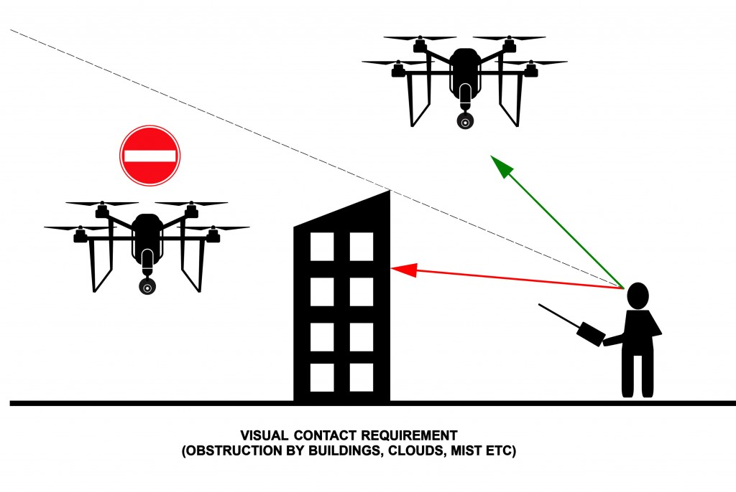
Rule example 5

Slide 24
Additional regulation provisions
The relevant law is contained in the Air Navigation Order, paragraphs 166 & 167
You must not fly within 2 miles of the runway of a major airport
Must not fly higher that 400ft (120m) above ground level, further than 500m or out of sight
Must not fly within 150m of, or over, a congested area, or a crowd of 1,000 people or more

Slide 25
Commercial Operation
In order to operate commercially a PFAW- Permission For Aerial Works (now changed to PFCO – Permission For Commercial Operations) is required from CAA
Examinations both theory and practical must be completed
Appropriate aviation insurance is required
Operation Manual procedure to be followed
Safety is paramount
Flight records must be documented
Ongoing renewal every 12 months

Slide 26
Flight operations
Before Flight:
Pre flight survey – can the UAV be flown at the location safely ?
On site survey – can the UAV be flown at the location safely ?
Local ATC – They are to be informed before and on completion of flight
Safety procedures – Signs, cones, fire extinguishers Etc. as per Ops manual
Ongoing:
Looking for possible problems…..Public, vehicles, birds, trees, aircraft Etc.
Weather Conditions – UK weather is changeable!

Slide 27
Operating FAQs
Can you fly in the rain or in wind ?
Can you fly over other persons property ?
How fast can a drone travel ?
How high can a drone fly ?
How long can a drone fly for ?
How heavy is a drone ?
Have you ever crashed a drone ?

Slide 28
Risks
“Toddler's eyeball sliced in half by drone propeller”
November 2015
“Drone injury grounds Enrique Iglesias for longer than expected” June 2015
“Newquay Airport drone incident: Passenger plane carrying 62 people involved in near-miss with airborne device” April 2016
“London woman dies in possibly the first drone-related accidental death” August 2016

Slide 29
Risks
Personal injury – operator and third parties
Property damage/loss/theft/interception – first and third party
Product liability – malfunction, recall
Cyber attack – disablement and data protection
Privacy
Nuisance - private and public - trespass

Slide 30
Sanctions & implications
Fine – CAA, Information Commissioner
Imprisonment
Damages – PI claims, property damage
Policy pay out
Recall process
Brand and reputation

Slide 31
Underwriting considerations
Awareness of drone existence? Disclosure
Awareness of intended uses?
Commercial vs hobbyist?
Which policy – commercial / household? Exclude?
Type of drone – different risks
weight
attachments e.g camera
power
storage capacity
hired in equipment
weather
What types of cover – PL, cyber, product

Slide 32
Further underwriting considerations
Blanket exclusion?
Financial restrictions
Geographic restrictions – flight coverage, jurisdiction
Restricted In-Training/assessment cover?
Restrictions on weight – of drone, carriage
Use restrictions
Conditions – testing, CAA compliance, operator manual compliance
Multi-pilot? Single?

Slide 33
The Future?
‘Pie in the Sky’?
Modern Transport Bill – “Legislation that will put the UK at the forefront of safe technology in the autonomous vehicles industry, such as drones, and spaceplanes…paving the way for commercial spaceflight and drone operations in the UK.”
Advances in technology – necessary & inevitable
Compulsory drone registration? Traceable flight paths?
Personal use increase?
Mandatory insurance?
Amazon Prime Air – the beginning of legislative relaxation?

Slide 34
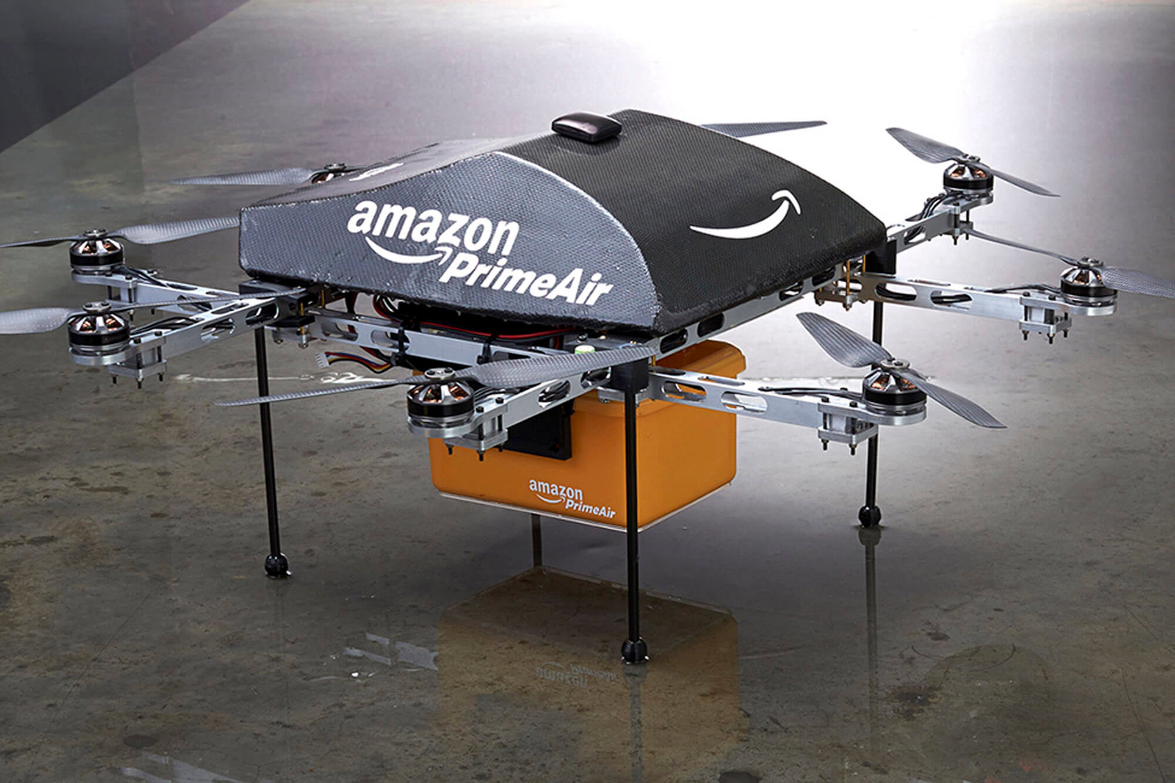
Amazon Prime

Slide 35
And finally
A ‘phase’ or the future? – do you anticipate the widespread use of drones in your neighbourhood in the next 5-10 years?
Are you concerned about the present use, and future potential, of drones?
Any questions?

