Slide 1

Flood Forum -16 September 2016
What can be done to minimise future economic and social harm caused by flooding and improve resilience

Slide 2
The Insurance Institute of Perth & Dundee
Flood Forum
Mike Still
Chair, The Prince’s Business Emergency Resilience Group

Slide 3
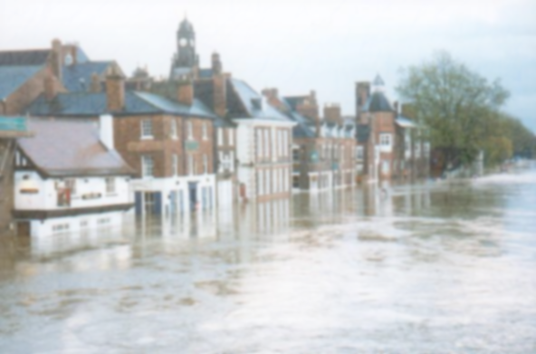
Outline
The Prince’s Business Emergency Resilience Group
BERG focus areas
Practical examples and lessons learned
Empathy
Resilience

Slide 4
Business Emergency Resilience Group (BERG)
The Prince’s Business Emergency Resilience Group

Slide 5


Slide 6
Business Emergency Resilience Group (BERG)
The Business Emergency Resilience Group helps businesses prepare for, respond to and recover from emergencies.
Initiated by His Royal Highness The Prince of Wales to help businesses and communities across the UK
Part of Business in the Community – The Prince’s Responsible Business Network
Helps small business owners and householders
plan for significant risks and sign-post to support from larger organisations, helping them to recover more quickly following an emergency.
Led by business for business

Slide 7
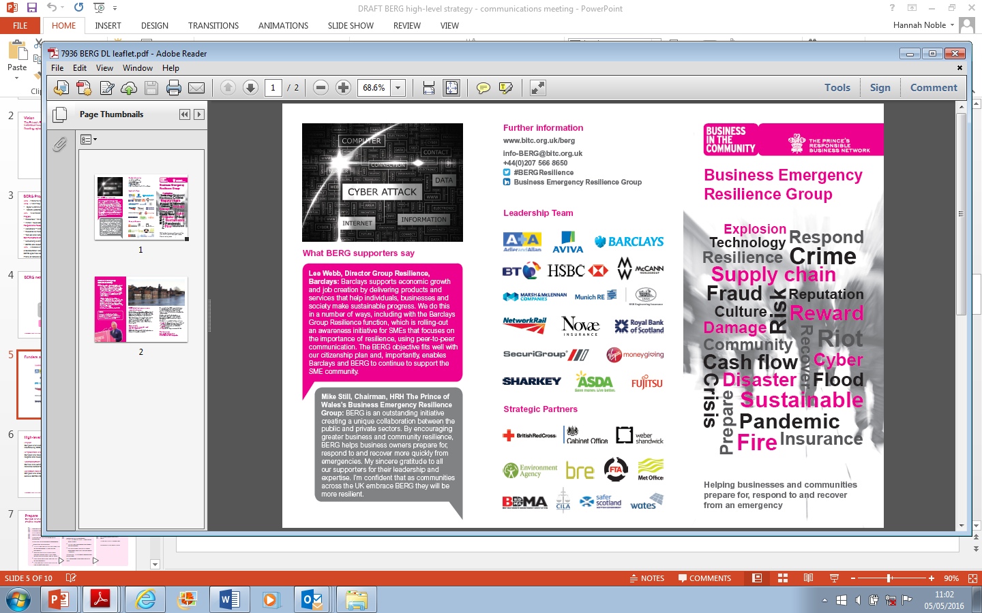
Business Emergency Resilience Group (BERG)

Slide 8
Business Emergency Resilience Group (BERG)
BERG focus areas

Slide 9
Mike.Still@marsh.com
www.bitc.org.uk/berg
Business in the Community
137 Shepherdess Walk
London N1 7RQ
T: +44(0) 207 566 8650
E: information@bitc.org.uk

