Slide 1
The Chartered Insurance Institute of Perth and Dundee
Flood Re: Enabling affordable cover for the UK’s homes
Brendan McCafferty, Chief Executive Officer, Flood Re
16th September 2016

Slide 2
What is Flood Re
Solution to a long standing problem relating to the availability and affordability of flood insurance
Likely to benefit up to 500,000 households over time
Special Purpose Vehicle designed to create a reinsurance/ pool solution
Authorised by the UK regulators in the same way other reinsurers are
Owned and operated by the insurance industry with public accountability to Parliament – therefore needing Government involvement
Life span of 25 years
What Flood Re is not
Causing any change to customer experience – Point of Sale and claims
Tasked with paying for property level resilience
A primary response to climate change adaptation
2

Slide 3
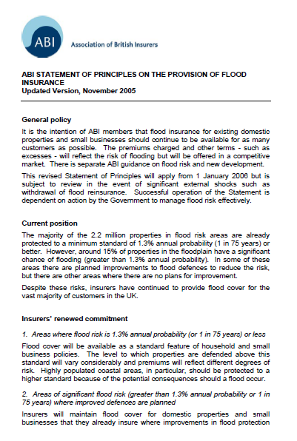
Statement of Principles
An agreement with Government, in place between 2000 and 2013 – the ‘Statement of Principles’:
Insurers continued to offer cover (i.e. offer renewals)
Government managed flood risk effectively
Applied to both household and SME policies, for properties built before 2009. Larger commercial properties not covered
Separate (but virtually identical) agreements for England, Scotland, Wales and Northern Ireland
All four expired on 30th June 2013

Slide 4
How Flood Re operates
Customer
Customer experience is unaffected and purchases insurance as usual
Customers receive flood risk information from insurers
Insurer
Insurers set prices, not Flood Re
Tax raising powers with public accountability allowing insurers to base the flood risk element of the premium on local tax bands, established in legislation
Insurers decide what risks to cede
Insurers pay out when customer makes valid claim
Flood Re
Collects a levy of £180m every April from all relevant insurers
Ability to raise additional capital through Levy 2 (treated as capital expenditure by insurers)
Flood Re will accept all eligible risks
Flood Re has a liability limit in excess of 1/200
Flood Re pays all flood claims direct to the insurer
Privately owned and operated, publicly accountable.
4

Slide 5
How Flood Re is funded
A) For each policy to be ceded to Flood Re:
Ceded risk premium charged to insurers at a fixed price according to council tax bands:
B) All insurers writing UK household business:
Levy 1 of £180m p.a.
Capacity to call a second Levy from UK household insurers if required
Insurers set retail prices – not Flood Re
Council Tax Band | A, B | C | D | E | F | G | H
Buildings Policy | 132 | 148 | 168 | 199 | 260 | 334 | 800
Contents Policy | 78 | 98 | 108 | 131 | 148 | 206 | 400
Combined Policy | 210 | 246 | 276 | 330 | 408 | 540 | 1200

Slide 6
What property does Flood Re cover
Eligible Properties:
Out of scope:
Insured in the name of individuals
Must have a Council tax band (All Council Tax bands covered)
Held for residential use
Insured on individual basis
Occupied by policy holder or immediate family some of the time or unoccupied
Homes built on or after 01 January 2009
Small businesses (business rated)
Properties (4+ residential units)
Buildings cover for leasehold premises 2 or more units

Slide 7
What does Flood Re mean for customers?
Flood Re makes no difference to the way customers buy home insurance
Any claims made will continue to be handled by the insurance company
With Flood Re in place customers have greater choice of insurance policies and they should be more competitively priced
Insurance company will continue to be responsible for setting the retail premiums

Slide 8
THE NEED FOR
FLOOD RE ESTABLISHED
- INCREASED INCIDENTS OF FLOODING IN THE UK
State Aid Ruling
Flood Re legal documents published
First systems build completed
Transition Plan Published
FLOOD RE
REINSURANCE PROCURED
Data Sharing
Insurers Accredited as ready
Agreements
published
FLOOD RE DESIGN AND ROLL OUT PLAN AGREED
Industry systems
REINSURANCE PROCURED
LAUNCH 4/4
specifications published
REINSURANCE PROCURED
LAUNCH 4/4
Flood Re
i See page 6
“Established”
i See page 5
2013/14
JAN 15
APRIL 15
JULY 15
OCT 15
JAN 16
APRIL 16
Guy Carpenter and Capita outsourcing Contracts agreed
PRA/FCA
Property Data Agreement
Levy approach Published
Live Systems (Testing Ends)
Authorisation
Agreement with HMG to use council tax data
Flood Re Designated by parliament
HOUSEHOLDERS
HOUSEHOLDERS SEE BENEFITS
PRA/FCA
Application
SEE BENEFITS
i See page 8
Regulations laid in Parliament
Industry Testing Open
Insurers Accredited as ready

Slide 9
Launch Campaign
PROGRAMME
Sky News
PROGRAMME
ITV News
PROGRAMME
Channel 4 News
Flood Re’s launch in numbers 1-4 April 2016
COVERAGE
NATIONAL COVERAGE
ADWORDS
SOCIAL MEDIA (1-4 APRIL)
TOTAL CIRCULATION
LOCAL AND REGIONAL
Diana Johnson MP
Brandon Lewis MP
Andrew Percy MP
Rachael Maskell MP
Kevin Hollinrake MP
Philip Davies MP
Harriett Baldwin MP
Guy Opperman MP
Philip Hammond MP
Dr James Davies MP
TRADE TITLES
WEBSITE

Slide 10
Outward Reinsurance Programme
Flood Re Reinsurance procured
5TH
£2.1 BN
3
LARGEST
NATURAL CATASTROPHE
PROGRAMME IN THE WORLD
47
PLACEMENT
YEAR STRUCTURE
REINSURERS
Flood Re’s Outwards Reinsurance
Structure schematic
£2.1bn 100%
Manage each & every loss volatility on high value losses
Three XOL layers over a Flood Re retention
Aggregate XOL layer 3
Risk XL
Financial Stop Loss
3 XOL layers
Aggregate XOL layer 2
Stop loss layer
Aggregate XOL layer 1
Flood Re retention
Flood Re retention
Flood Re retention
Quota Share 50%
Aggregate XOL - 50%
Reinsurers share pool performance Flood re protects results volatility
Reinsurers take pure catastrophic exposures Flood Re protects extreme volitility

Slide 11
Why does Flood Re have an end date of 2039?
Flood Re was set up to correct a market failure in the home insurance market but this level of intervention can not be a long-term solution
By 2039 premiums and excesses for high flood risk properties should be priced to reflect the cost of flooding
Households will lose the benefit that the levy provides of subsidising prices
Flood Re has the statutory objective to transition to a market with risk-reflective pricing and produce a plan outlining how this can happen
Potential market outcomes from transition to risk-reflective pricing

Slide 12
Transition Plan
First plan published in February 2016 with future versions published as our knowledge of cutting the cost of flooding develops by:
Understanding affordability and availability
Incentivising action through Flood Re’s data asset
Incentivising action from households and insurers

Slide 13
Our team is completing the Land’s End to John O’Groats bike challenge and will arrive in Perth on Wednesday, 21st September. The cyclists are meeting with local Councillors, homeowners and community groups at the Perth Museum, 78 George St, Perth, PH1 5LB at 18:45 that day – please come along.
Please visit our fundraising page – http://uk.virginmoneygiving.com/FloodRe where you can make a donation and track our latest fundraising total for the British Red Cross, the National Flood Forum and the Scottish Flood Forum.
Our team will be blogging live from the tour – check out their progress on our website along the way (www.floodre.co.uk). We’ll also be posting on Twitter and Facebook, so use #FloodReTour to join the conversation!
Thank you for your support!

