Slide 1


Rebuilding from Adversity
Paul Hannam, International Motivational Speaker
Learning objectives
By the end of this presentation, delegates will be able to:
shift their mindset to a positive learning experience
cope more effectively with challenge
use adversity to become stronger and more effective
apply powerful strategies for being more resilient
SPONSORED BY:

Slide 2
Mastering the
Art of Everyday Resilience

Slide 3
What is Resilience?

Slide 4
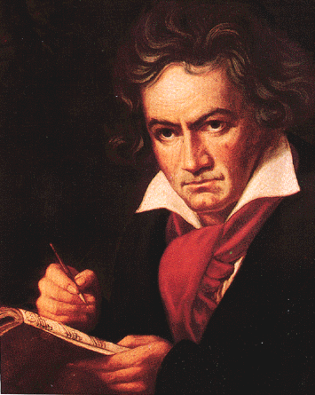
The Capacity to recover quickly from difficulties. Toughness.

Slide 5
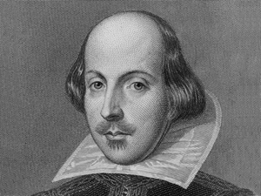
There is nothing either good or bad but thinking makes it so

Slide 6
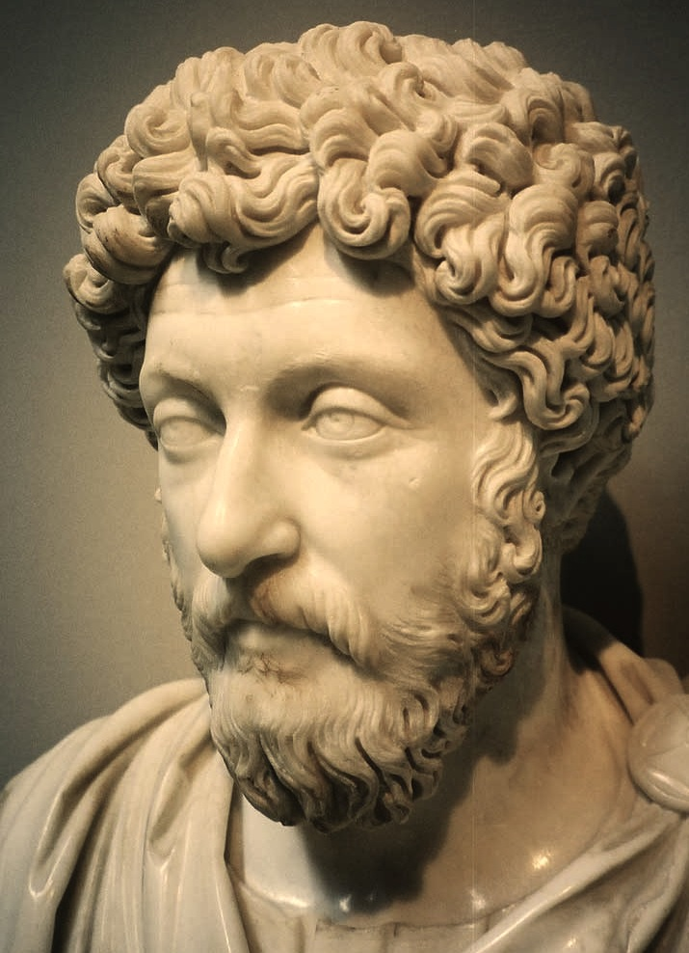
You have Power over your mind – not outside events. Realize this and you will find strength.

Slide 7
Resilience is a Mindset that Everyone can Build

Slide 8
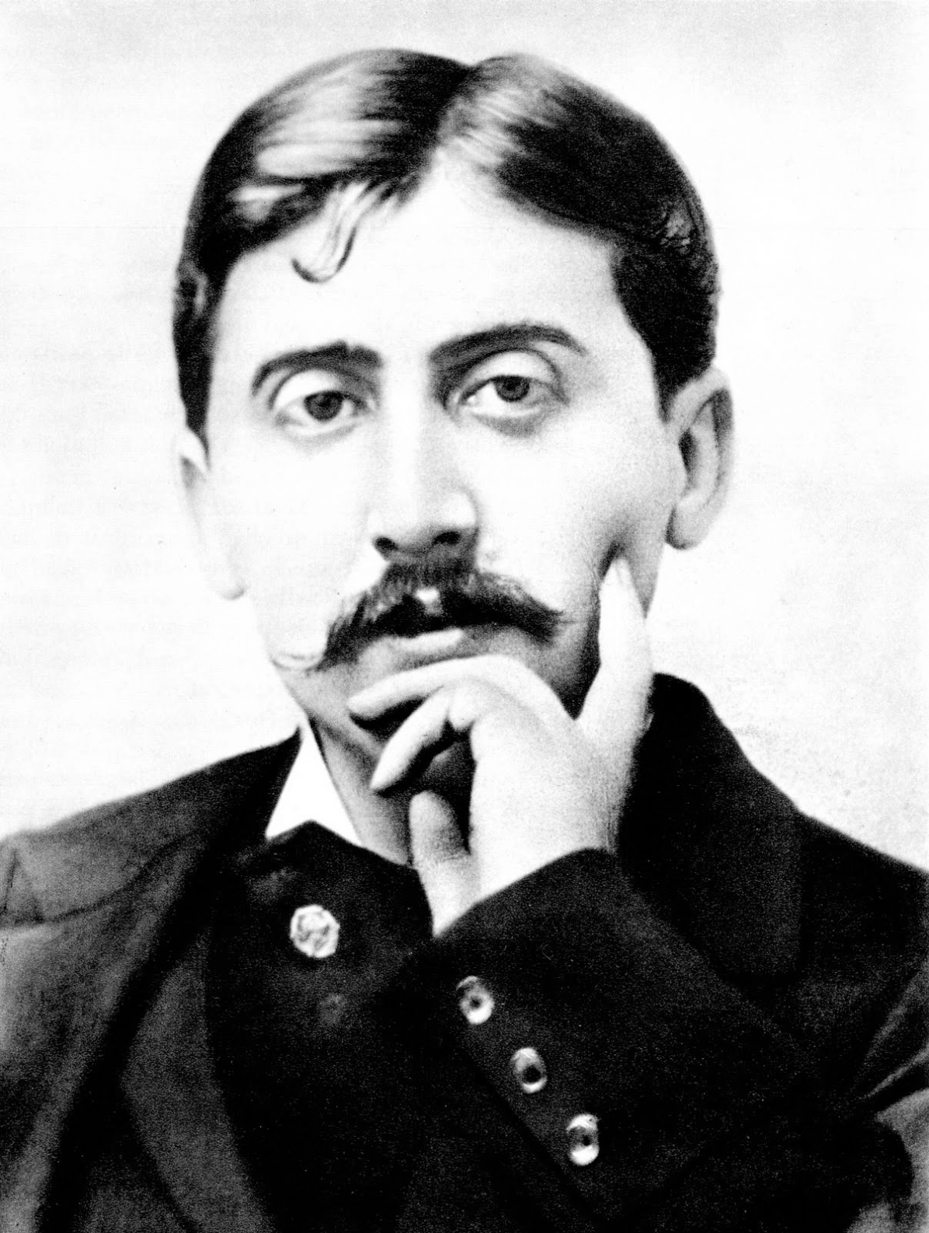
MARCEL PROUST
The real voyage of discovery consists not in seeking new landscapes, but in having new eyes.

Slide 9
Why is Resilience so Important?

Slide 10

Increases Productivity

Slide 11
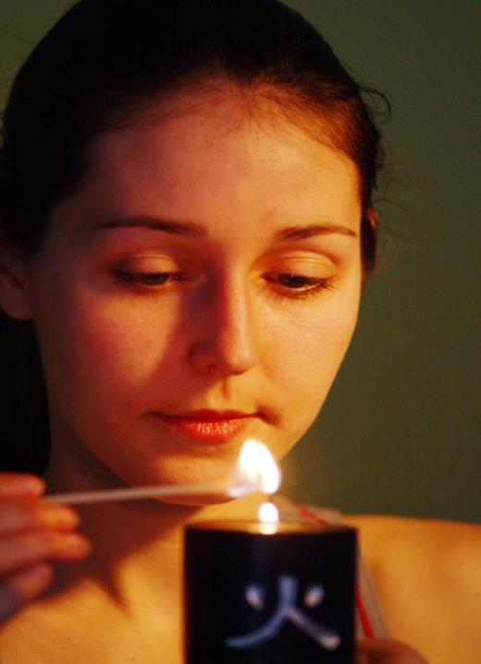
Reduces Stress

Slide 12

Helps you Flourish in periods of Change

Slide 13
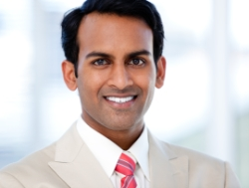
Boosts Engagement & Retention

Slide 14
How do we Build a Resilient Mindset?

Slide 15
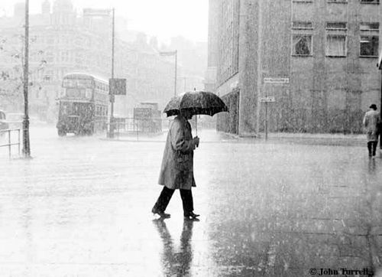
1
Accept that
Life is Hard

Slide 16
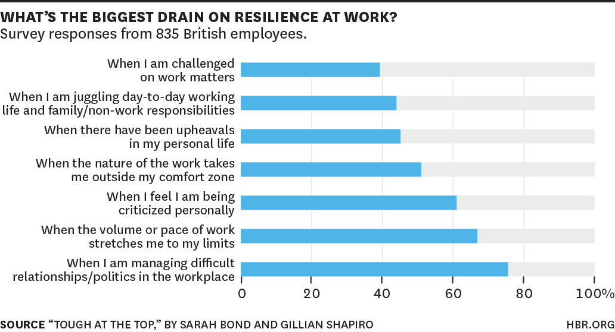

Slide 17
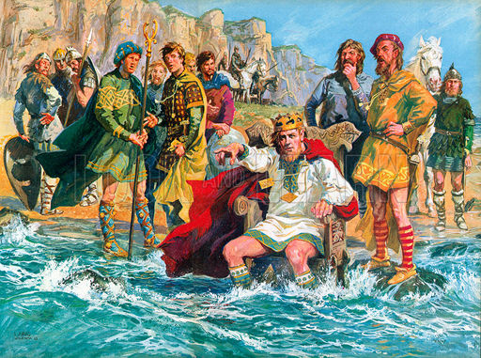
We can’t stop the Waves

Slide 18
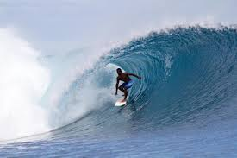
But we can learn to
Surf them

Slide 19
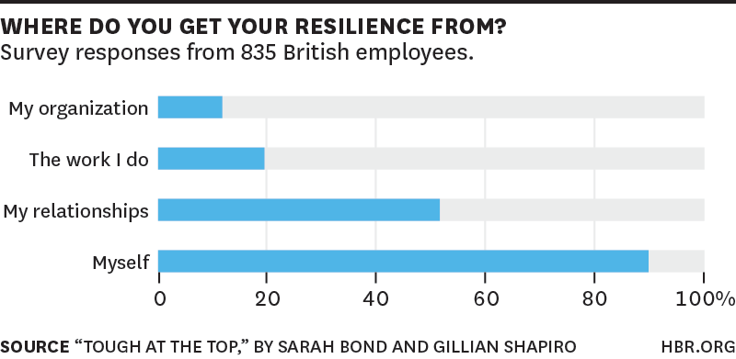

Slide 20
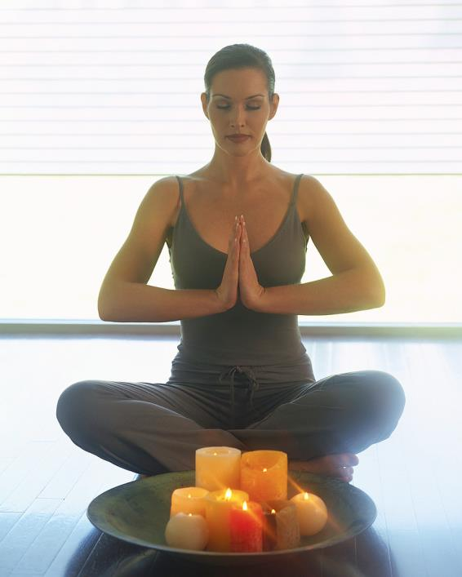
2
Stay Calm

Slide 21

3
Don’t Take it
Personally

Slide 22

4
Gain
Perspective

Slide 23

5
Choose the
Right
Response
Notes:
So start this week- I promise you it is worth it. I have learned these strategies and I have become far more resilient. In many ways this has changed my life for the better, and it can do the same for you too!
How do you become more Resilient?
http://www.resiliencycenter.com/bkstore/ResAdv-chap1.shtml
pros and cons – how would your hero act. The Buddha, Phil in Groundhog Day?

Slide 24

6
Take Action

Slide 25

7
Learn the
Lesson

Slide 26

The 7 Practices
1 Accept that Life is Hard
2 Stay Calm
3 Don’t Take it Personally
4 Gain Perspective
5 Choose the Right Response
6 Take Action
7 Learn the Lesson

Slide 27
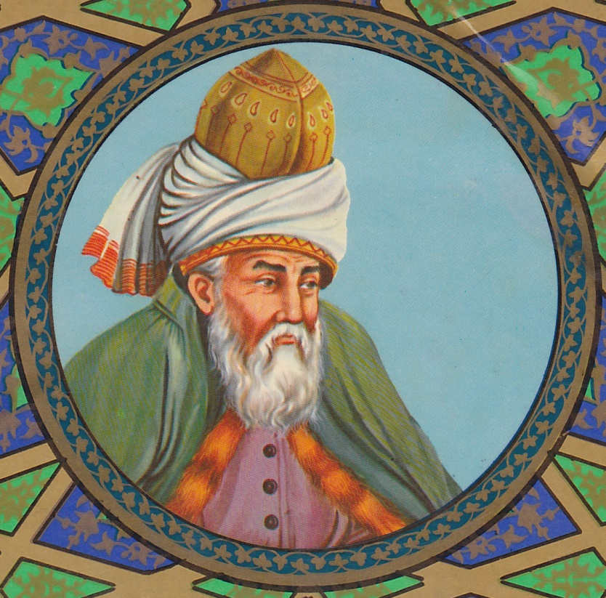
Live life as if everything is
rigged in your favour
RUMI

Slide 28
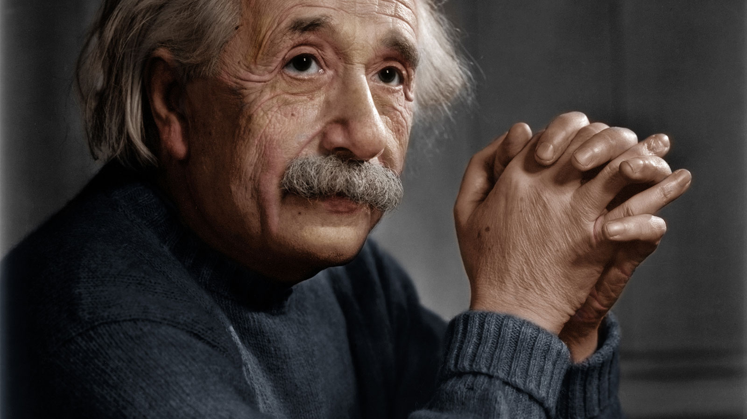

Slide 29
There are only two ways to live your life

Slide 30
One is as though nothing is a miracle

Slide 31
The other is as though everything is a miracle

