Slide 1

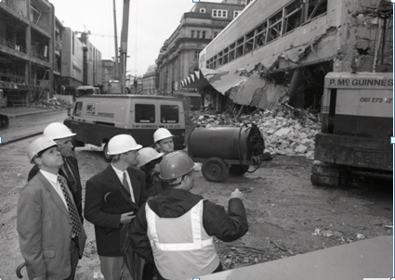


The Loss Adjuster’s Perspective
Phil Hill - Cunningham Lindsey
Major Loss Specialist
SPONSORED BY:

Slide 2
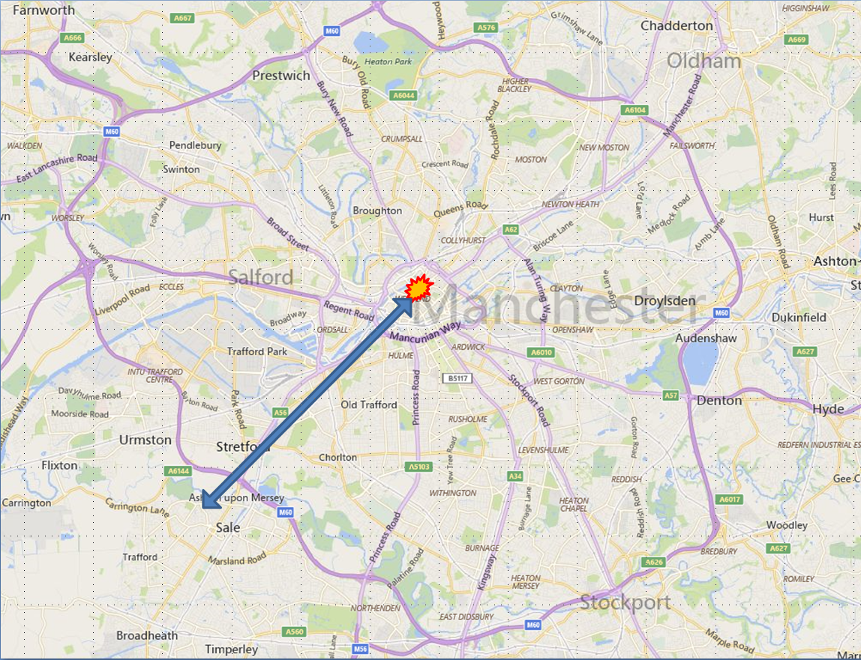
First alert & Initial Response
Saturday 15 June 1996
How we were alerted
Insurers’ response
Access through the cordon

Slide 3
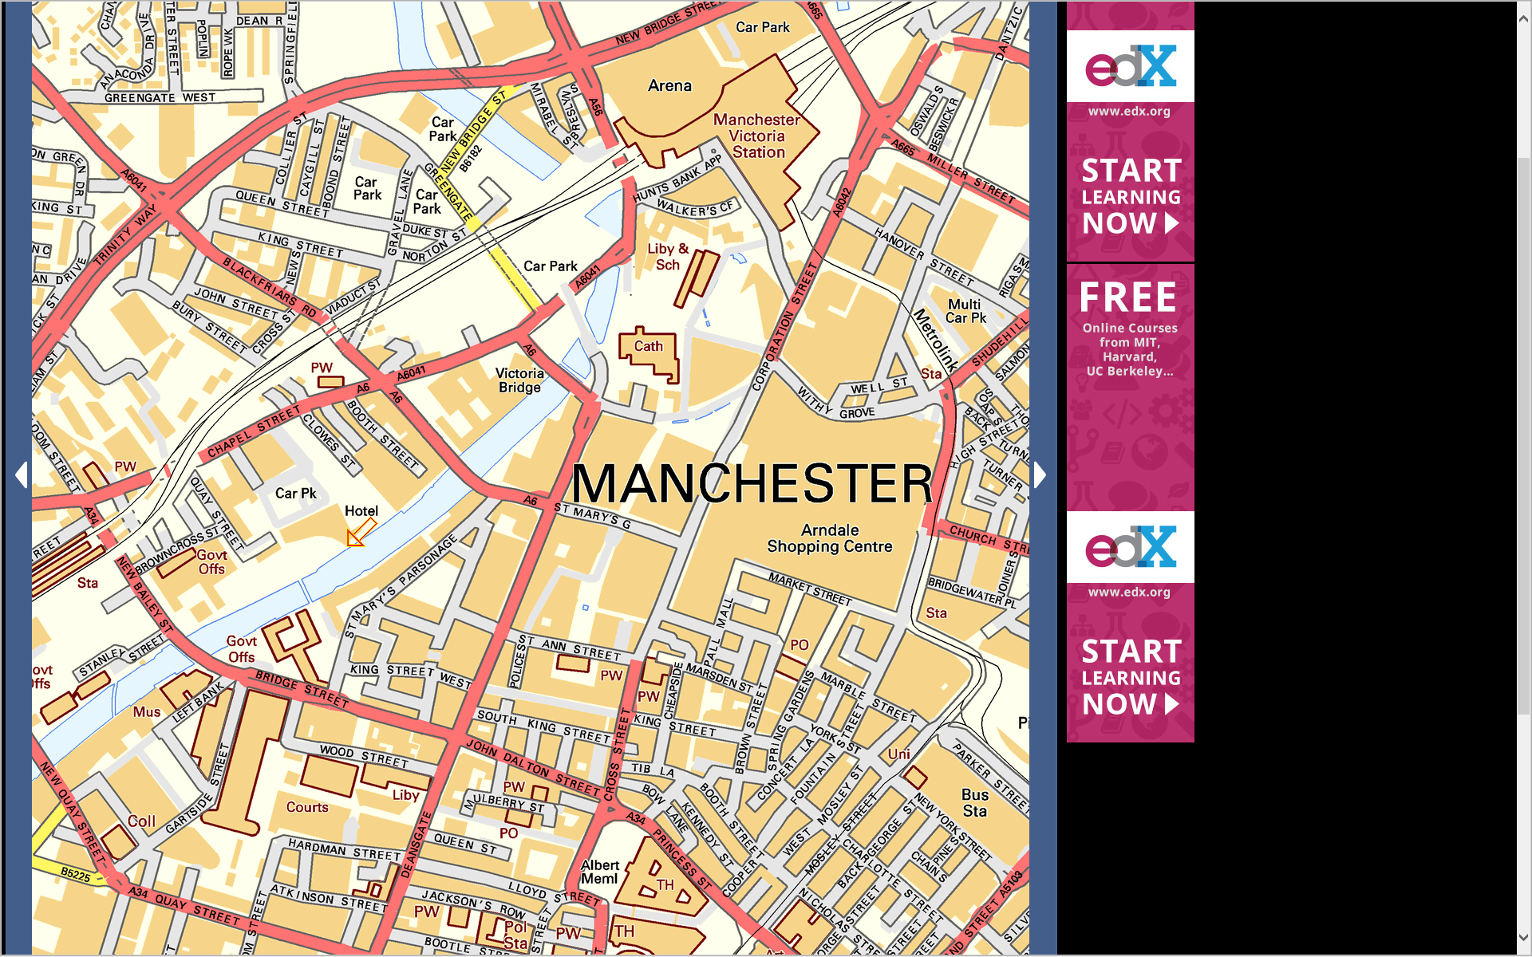
Video of the perimeter

Slide 4
Video of the perimeter
Click to run video

Slide 5
The Loss Adjuster’s Perspective
Damage and the fear of it
Variety of damage
Glass everywhere
Bomb blast effects
Invisible damage
Loss of market value
R
Photograph attributed to City Life magazine

Slide 6
The Loss Adjuster’s Perspective
Pragmatic solutions
Business Interruption
  Premises damaged
  Limited access
  Reduced footfall
CILA’s solution
R
Photograph attributed to City Life magazine

Slide 7
Damage at your premises
Consequential Loss shall mean loss resulting
from interruption of or interference with the
Business carried on by the Insured at the
Premises in consequence of loss of or physical damage to the Property Insured or property used by the Insured at the Premises for the purpose of the
Business.
INSURANCE COVER ONLY IF THERE IS DAMAGE AT YOUR PREMISES

Slide 8
Limited access
Denial of Access Extension - The insurance extends to include interruption of or interference with the Business in consequence of loss destruction or damage – to property in the vicinity of the Premises which prevents or hinders the use or access to the Premises whether the Premises or property of the Insured is lost destroyed or damaged or not
INSURANCE COVER EVEN IF NO DAMAGE AT YOUR PREMISES BUT ACCESS IS DENIED OR HINDERED BY DAMAGE TO NEAR BY PREMISES

Slide 9
Reduced footfall only
Loss of Attraction Extension - The insurance extends to include interruption of or interference with the Business in consequence of loss destruction or damage – to property in the vicinity of the Premises which prevents or hinders the use or access to the Premises whether the Premises or property of the Insured is lost destroyed or damaged or not
INSURANCE COVER IF SHOPPERS STAY AWAY DUE TO DAMAGE IN THE AREA

Slide 10
CILA’s pragmatic solution
Feedback from adjusters

Slide 11
The Loss Adjuster’s Perspective
Lessons for the future
Communication
Response
Information
Think the unthinkable
Changing attitudes
R
Photograph attributed to City Life magazine

