Slide 1

Creating a family office offering
Graeme Price
Head of Strategic Partnerships Group
09 June 2016

Slide 2
Learning Objectives
At the end of this event, the delegate will be able to identify:
all of the possible facets within a multi-family office offering
current best practice in this sector of the advice market
the benefits and pitfalls of adopting such a strategy

Slide 3
Is there a need?
If committed to life planning why wouldn't you want to create a
"Family Office" style offering, or have access to one?
You are travelling with your clients on their journey, and you want to
help them get to their destination
Are you going to be able to accompany them every step of the way, with
your current proposition?

Slide 4
Some definitions
Wealth management is a distinct practice
$5m is the minimum net worth a client must possess to be considered a HNW
Knowledge required for competent wealth plan covers 169 topics within 4 knowledge domains:
  Human Dynamics
  Wealth Management Strategies
  Client Specialisation
  Legacy Planning
Fundamental tasks & processes similar to financial planning
Source: Investment Management Consultants Association, November 2012

Slide 5
The landscape for Family Offices
Single - £100m +
Multi - £50m with typically 2 or 3 lead families
A la carte menu of services - £10m +

Slide 6
Creating a family office offering – key questions to consider
How do you preserve your clients existing wealth?
How does a Family Office protect their clients wealth?
What services do you need to access?

Slide 7
Services needed
Family Governance
Reporting
Wealth Management

Slide 8
Family Governance
The more you invest in a governance structure the more you communicate
and interact with family members
The more you invest in the next generation the greater the overall outcome
will be
The greater the understanding of the family framework and purpose, the
greater the chances of preservation and longevity of wealth

Slide 9
Why do you need a family governance document?
Ensure adherence to the family value system
Agree overall purpose
Ensure successful trans-generational transference
Easier in a single family rather than a multi family offering, hence growth
in a la carte approach

Slide 10
Specialist services
High value/specialist general insurance
Art lending/investment
Wine
Concierge
Philanthropy
Property management covering residential, commercial, UK and overseas
Specialist tax advice and structuring (eg Family Investment Company and personalised OEICs)*
Specialist legal services*
*UBS does not give tax or legal advice
Not all of the above are provided by UBS

Slide 11
What level of legal expertise is required?
Will vary depending upon:
  Frequency
  Variety & complexity of advice
  Complexity of circumstance and activity

Slide 12
In house counsel or outsource?
7 key roles in house
1) Policing & oversight of day to day activities
2) Legal input into all aspects of family strategy objectives and detailed plans
3) Early involvement in significant decisions with legal implications
4) Source of in house advice on routine matters
5) Finding, selecting, briefing external lawyers where specialist advice is required
6) Assessing advice received, debating alternatives
7) Implementation

Slide 13
Reporting
Requirements include:
  Efficient investment administration
  Accurate record keeping
  Timely customer reporting
The Issues are:
  Delivering comprehensive consolidated reports where you have a variety of client
  and accounts layers; both new and legacy providers; various asset owners across
  numerous types of structures; and specialist advisers

Slide 14
What about wealth management?
The specialist services complement the wealth management
What is wealth management?
It is not investment management – that is just part of wealth management

Slide 15
What a Wealth Management platform may look like
Wealth Management Platform
Liquidity
Cash
Mandated
Advisory
Execution
only
Charity
GBP
EUR
USD
Asset backed lending
Mortgages
Structured finance
Charge cards
Deposits
Money Market funds
Cash instruments
Cash management
Dual currency investments
Segregated
Managed
Unitised
Private Equity
Hedge Funds
VCT/EIS
Structured Products
Thematic
Foreign currency
Targeted Return
Real Estate
Custody
Execution
Client Foundation

Slide 16
The Trusted Team
Other Professionals
Financial Planner
Client
Private Bank
Lawyer
Accountant
Notes:
15

Slide 17
The trusted team approach
Working in collaboration for benefit of the family
Separation of disciplines key
Identification and communication of where the PI risks sit

Slide 18
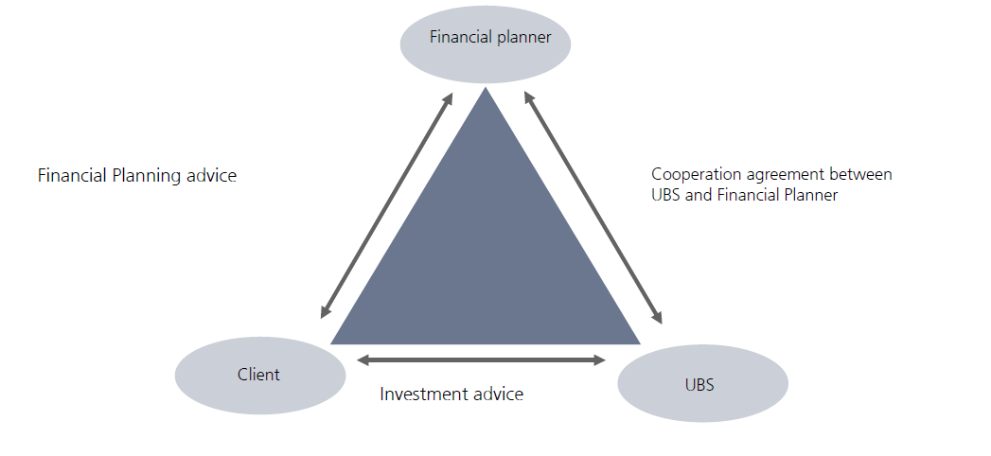
How UBS work with financial planners
The financial planner can provide the client with access to the whole of market as UBS
only offers restricted advice
The financial planner will provide an independent opinion of UBS' service
The financial planner can provide the client with access to a wide range of services on
the UBS Wealth Management Platform

Slide 19
Problems to address
Big business sale – the business kept the family together. Much harder
via wealth management where no single focus
Families have more fragmented profiles so need to cater for a wider
range of risk profiles and aims

Slide 20
Conclusion
How do you preserve your clients existing wealth?
How do Family Office protect their clients wealth?
What services do you need to access?
Answer
At the point at which a liquidity need arises, and assuming that this is in line
with their requirements, you must do everything within your powers to give
your clients the option to protect their capital base so it is not eroded and their
long term financial planning remains intact

Slide 21
Learning Objectives
At the end of this event, the delegate will be able to identify:
all of the possible facets within a multi-family office offering
current best practice in this sector of the advice market
the benefits and pitfalls of adopting such a strategy

Slide 22
Disclaimer
This document is issued by UBS Wealth Management, a division of UBS AG which is authorised and regulated by the Financial Market Supervisory Authority in Switzerland. In the United Kingdom, UBS AG is authorised by the Prudential Regulation Authority and is subject to regulation by the Financial Conduct Authority and limited regulation by the Prudential Regulation Authority. Details about the extent of our regulation by the Prudential Regulation Authority are available from us on request.
For the sole purpose of financial intermediaries only and is therefore not suitable for private clients and as such should not be relied upon by them.
Some figures may refer to the past or simulated past performance and past performance is not a reliable indicator of future performance. Some figures may be forecasts only and forecasts are not a reliable indicator of future performance. Some charts and/or performance figures may not be based on complete 12-month periods which may reduce their comparability and significance. If the currency of a financial product or financial service is different from the currency of your home country, the return may increase or decrease as a result of currency fluctuations.
Although all information and opinions expressed in this document were obtained from sources believed to be reliable and in good faith, no representation or warranty, express or implied, is made as to its accuracy or completeness.
The information contained herein is purely indicative and subject to the status and credit approval process of UBS and do not represent a commitment to lend on the terms or structures outlined. Borrowing to invest can increase both the yield and risk. Where money has been borrowed to invest in the product, the investor could also lose this borrowed money. In this case the investor will still be required to pay back the borrowed amount and therefore should be able to withstand the loss of this borrowed money and meet their debt obligations.
UBS Wealth Management is a restricted advisor in respect of Retail Investment products such as life contracts, pensions, regulated collective investment schemes and some structured investments. This means that UBS Wealth Management is not tied to one product provider or marketing group but selects products from a limited number of companies whose products we have carefully selected as suitable for our client’s needs.
UBS does not provide legal or tax advice. You should consult your legal and tax advisors regarding the legal and tax implications of borrowing using securities as collateral for a loan. This brochure may not be reproduced or copies circulated without prior authority of UBS. This brochure is not intended for distribution into the US and/or to US persons or in jurisdictions where its distribution by us would be restricted.
© UBS 2015. The key symbol and UBS are registered and/or unregistered trademarks of UBS. All rights reserved..

