Slide 1
BUSINESS INTERRUPTION
A PROBLEM? …………

Slide 2
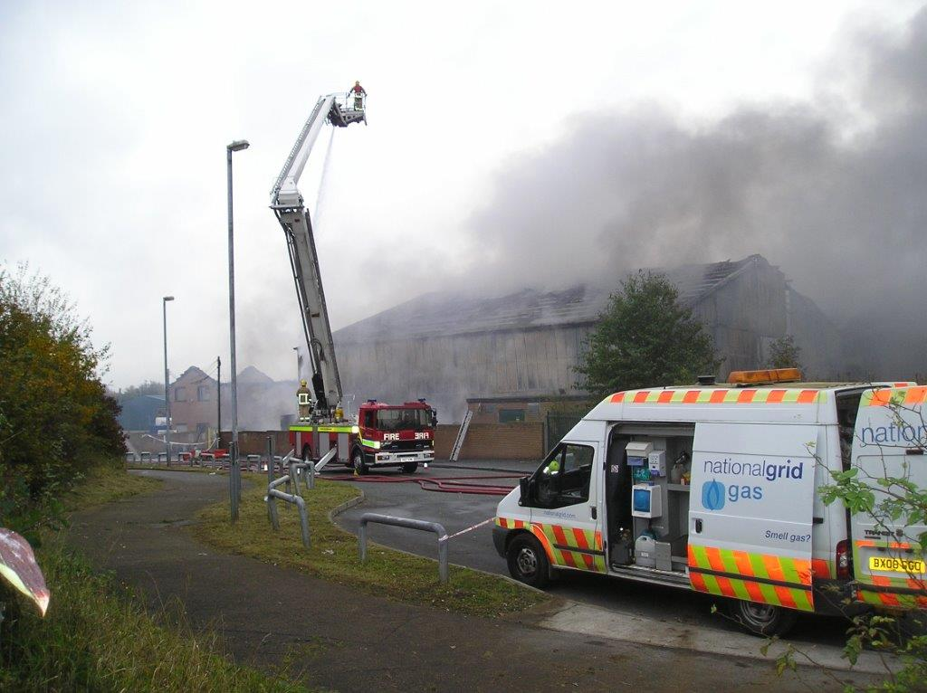

Slide 5
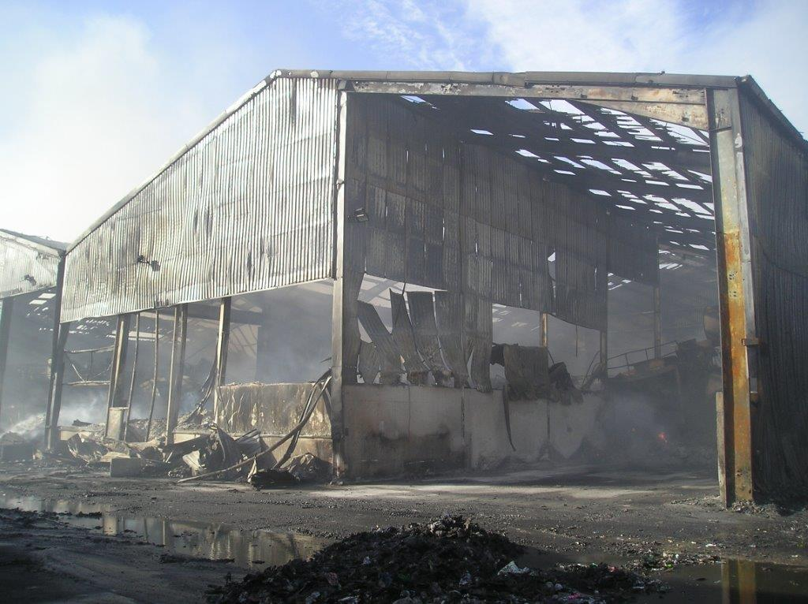

Slide 6
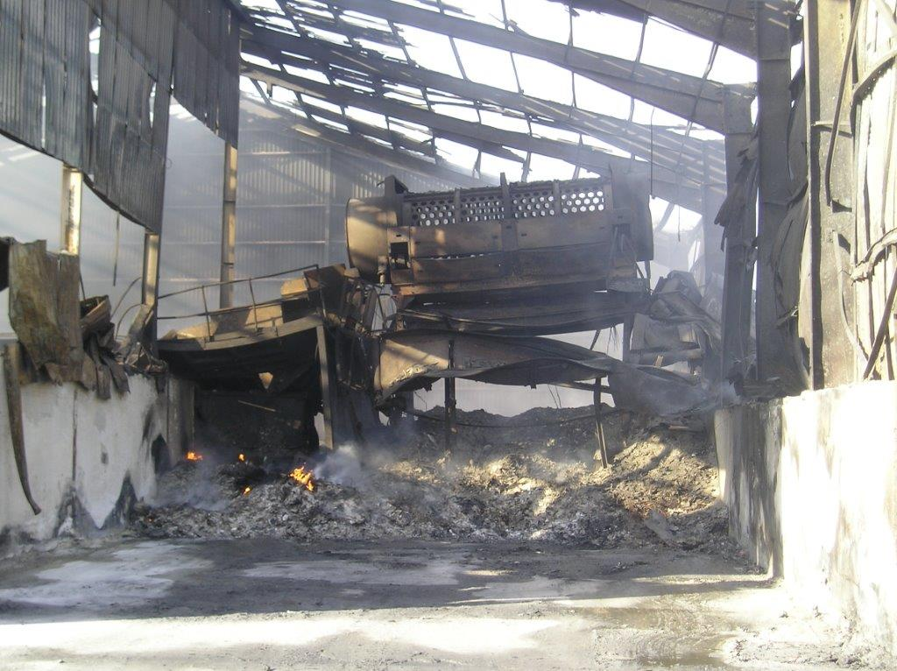

Slide 7
1.Know the Policyholder’s
Business

Slide 8
2.Know the Policyholder’s
Business

Slide 9
3. Know the Policyholder’s
Business

Slide 10
What does the Policyholder do?
Describe the Business
Obtain as much information as possible about the different products
they sell.
Other income streams – Rent?

Slide 11
Manufacturing Process
Again what does the Insured actually do?
What do they make?
What is the process from start to finish?
This will give you an indication of any problems which may occur in the manufacturing process that leads to a loss.
How does the Policyholder generate their business?
Do they sell to the distributors, wholesalers?
Do they sell direct to the public via the internet, or catalogues?

Slide 12
Other Branches
Associated Companies
Interdependency
Capacity
Look at dependency, other non-associated companies

Slide 13
If a Loss occurs. How long will it take the
Insured to recover?
Maximum indemnity period.
Points to Consider
Lead time for replacement buildings
Machinery and Plant
Stock
Identifying Trends
The direction the Business is going, which may include the production
of new products.

Slide 14
Customers
Numbers
Percentage of the business per customer.
Customers
Extensions to the Business Interruption policy.
Contracts
Suppliers, numbers
Suppliers extension contracts

Slide 15
Penalties
How are these incurred. Is it purely on a lead time for supplying the product?

Slide 16
Competitors
Examine the competitive nature of the Insured’s business.
Who are their competitors?
Local?
Ensure the Sum Insured is correct on Material Damage as well as the BI.
The effect of underinsurance on Material Damage can cause problems, but can be devastating to the Business Interruption loss.
With the Utilities Extension, be careful of the policy limit.
£50,000 – Enough?

Slide 17
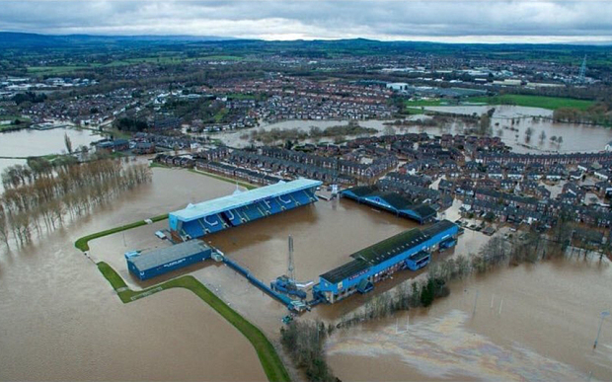

Slide 18
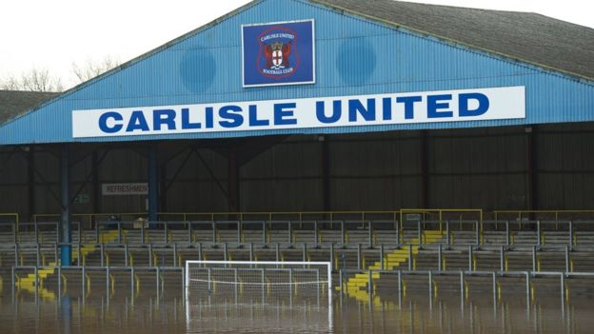

Slide 19
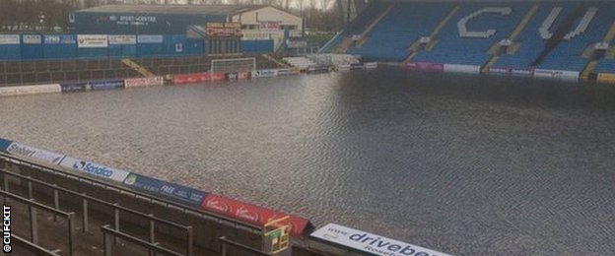

Slide 20
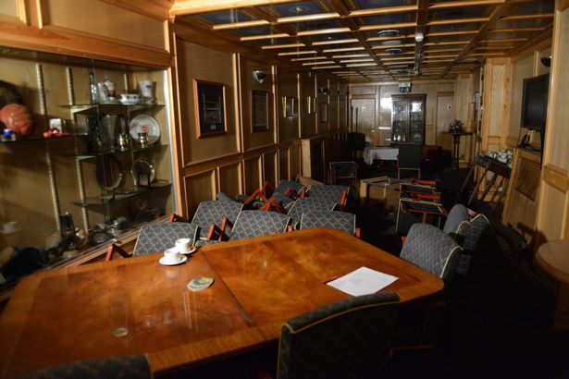

Slide 21
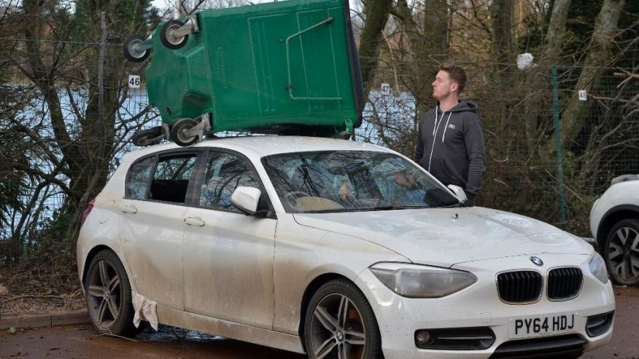

Slide 22
FOOTBALL STADIUM
RUGBY CLUB
RESTAURANTS
HOTELS
NIGHT CLUBS
PUBS
QUAKER MEETING HOUSE
SHOPPING CENTRE
DELICATESSEN

Slide 23
LAWNMOWER SALES AND REPAIRS
WHOLESALE PLUMBING SUPPLIERS
HAULAGE COMPANY
BUILDERS MERCHANT
COLD MEAT PRODUCERS
INDUSTRIAL ESTATE OWNERS
MOTOR PARTS MANUFACTURER
HOUSING ASSOCIATIONS

Slide 24
HAIR SALON
BAKERY
WHOLESALE BUTCHERS
KITCHEN INSTALLATION COMPANY
FLOOR COVERING RETAILER
PACKAGING MANUFACTURER
DAIRY
BUILDERS MERCHANT
COLD MEAT PRODUCERS

Slide 25
THE MAXIMUM AMOUNT YOUR INSURANCE COMPANY WILL PAY IN THE EVENT THAT YOUR PROPERTY IS TOTALLY DESTROYED
THE MAXIMUM AMOUNT THAT AN INSURANCE COMPANY WILL PAY TO SOMEONE WHO MAKES A CLAIM
THE MAXIMUM AMOUNT THAT AN INSURANCE COMPANY WILL HAVE TO PAY ACCORDING TO AN INSURANCE CONTRACT

Slide 26
SUM INSURED £500000 x LOSS £750000
VALUE AT RISK £750000
= £500000

Slide 27
AGREED LOSS OF GP £750000
LESS SAVINGS £100000
LOSS £650000
SUM INSURED £500000 x LOSS £650000
VALUE AT RISK £750000
= £433333

Slide 28
GROSS PROFIT
THE AMOUNT BY WHICH THE TURNOVER, CLOSING STOCK AND WORK IN PROGRESS EXCEEDS THE TOTAL OF THE OPENING STOCK, WORK IN PROGRESS, PURCHASES AND OTHER UNINSURED WORKING EXPENSES.

Slide 29
FYE 31ST DECEMBER
RENEWAL DATE 1ST JANUARY
2014 GROSS PROFIT £500000
2105 GROSS PROFIT £550000 (+10%)
ADVISE INSURED TO INSURE FOR £605000
LOSS 30 DECEMBER 2016 – PROJECTED GROSS PROFIT WILL BE £665500

Slide 30
FYE 30TH JUNE
RENEWAL DATE 1ST JULY
2014 GROSS PROFIT £300000
2105 GROSS PROFIT £305000
ADVISE INSURED TO INSURE FOR £320000
NEW EXTRA SALESMAN FROM 31ST JULY
GROSS PROFIT SEPT TO NOV £120000
ANTICIPATED GROSS PROFIT £500000

Slide 31
BUSINESS INTERRUPTION
A PROBLEM? …………

