Slide 1


Marine Cargo Insurance
Plymouth & Cornwall
Insurance Institute
23rd March 2016
Adrian Bowen
&
Darren Edkins
Marine Trading Underwriters
3rd May 2011
Notes:
1

Slide 2
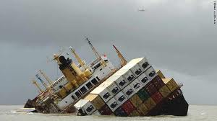
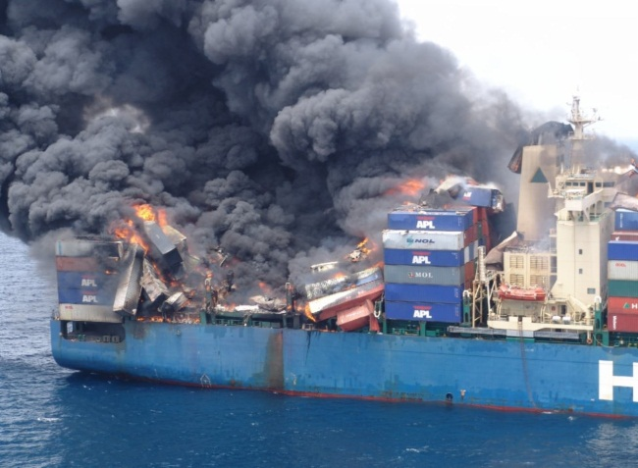
What is Marine Insurance?
Marine Insurance is the oldest Insurance in the World
Marine Insurance Act 1906 - sets out the Insured, the Brokers and the Insurers Responsibilities and Duties.
But more importantly sets out the fact of Insurable Interest! Without an Insurable Interest there can be no contract of Insurance.

Slide 3
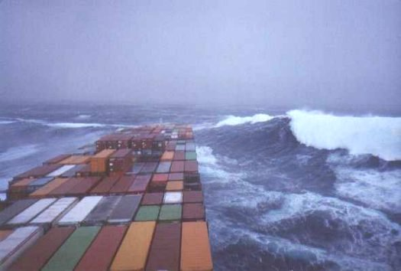
Marine Cargo
Cargo can be anything – the chairs and tables around you to the Ferrari you drive to and from work…..
It can be International or Domestic
Container Ships/Aircraft/Trucks/Rail
Everything you see has been Cargo at some point of its life
Marine Cargo Products:
          Annual Cargo Policy
          Stockthroughput
          Single Voyage Policies – General Goods, Motor Vehicles

Slide 4
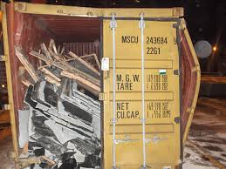
Institute Cargo Clauses (ICC)
ICC Clauses are the basis of the Cover Marine Insurance give to a risk
ICC Clauses come in 3 types – A, B and C
In Terms of Cover think of the ICC Clauses like Motor Insurance:
ICC A - being Fully Comp
ICC B - being Third Party, Fire and Theft
ICC C - Being Third Party Only
Additional Clauses
Institute Frozen Food / Meat Clauses

Slide 5
ICC A, B and C – Comparison
Risks Covered and the exclusions
 | A | B | C
Fire or Explosion | X | X | X
Vessel or craft stranded, sunk, burnt or capsized | X | X | X
Land conveyance overturned or derailed | X | X | X
Collision or contract of vessel | X | X | X
Discharge or Cargo at Port of Distress | X | X | X
Earthquake, Lightning or Volcanic Eruption | X | X
Malicious Damage | X
Theft | X
General Average Sacrifice | X | X | X
Jettison | X | X | X
Washing Overboard | X | X
Entry of Sea/River or Lake water into vessel, craft, conveyance, container or place of storage | X | X
Total loss of any package lost overboard or dropped whilst loading onto, or unloading from vessel or craft | X
Piracy | X

Slide 6
Marine Cargo - Exclusions
4.1 Wilful Misconduct
4.2 Ordinary leakage or ordinary loss of weight /volume: e.g. moisture in grain and ordinary wear and tear
4.3 Unsuitability of Packing – unless packed by an outside contractor or prior to the attachment of the insurance
4.4 Inherent Vice – i.e. goods that naturally decay etc.
4.5 Delay – even if the delay is caused by an insured peril
4.6 Insolvency/financial default of the owners/managers/charterers or operators of the vessel when at the time of loading the insured is aware that this could affect the voyage. However this wont apply when the contract of insurance has been assigned to the party claiming under a binding contract i.e. Importing under CIF terms!
4.7 B and C Clauses only – Deliberate Damage/Destruction of the goods by ANY person
4.8 Use of Atomic/Nuclear Fission device

Slide 7
Marine Cargo - Exclusions
5 Unseaworthiness of vessel where the insured are aware and unfitness of container again where the insured is aware but just like the 4.3 if carried out before the insurance takes place or loading of container executed by a third party there is cover
6 WAR
6.1 War, Civil War, Revolution, Rebellion, hostile act by a belligerent power
6.2 Capture, seizure, restraint, detainment
6.3 derelict mines, torpedoes etc
(This cover is written back into Marine policies with the Institute War Clauses (Cargo) and Institute War Clauses (Air Cargo) and is usually industry standard to give the cover outside the London Market (i.e. Lloyds).)
7 Strikes, Riots, Civil Commotion and Terrorism
(Again with Exclusion 6 it is now common practice to write the above back in under the Institute Strikes Clauses (Cargo) and Institute Strikes Clauses (Air Cargo) but the Lloyds market may differ.)

Slide 8
Where does cover start and end?
Where does it start? (as per the Duration Clause)
When the goods are first moved in the Warehouse or place of storage (named in the contract of insurance) for the purpose of immediate loading on to the conveyance
And End’s whichever of the following shall occur first:
    8.1.1 completion of unloading at final warehouse or place of storage named in the contract of insurance
    8.1.2 completion of unloading at any other warehouse or place of storage whether prior to or at the destination which the assured elect to use for storage outside the ordinary course of transit
    8.1.3 When the assured elect to use any carrying vehicle or other conveyance or any container for storage other than the ordinary course of transit
    8.1.4 On the expiry of 60 days after completion of discharge over side from the oversea vessel at the final port of discharge
    BUT CAN ALSO DEPEND ON THE INCOTERM USED…

Slide 9
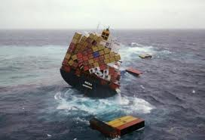
Incoterms
INCOTERMS set out to establish the responsibilities and obligations of both the buyer and the seller when they become involved in an international commercial transaction.
The purpose of International Commercial Terms is to provide a set of common international rules for the interpretation of the most commonly used trade terms in international trade
Helps avoid differing interpretations and problems with language barriers
They are not compulsory
4 out of the 11 Incoterms are specifically designed for Marine Transits

Slide 10
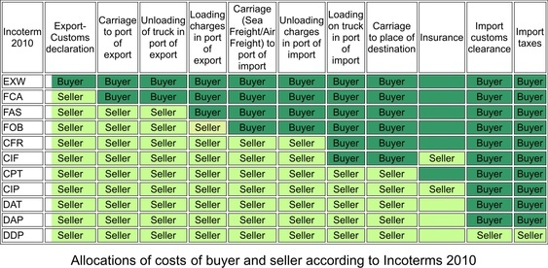
Incoterms

Slide 11
Most common Incoterms used
Ex-Works (EXW) – Good for a company new to exporting
The seller ‘delivers’ the goods at the disposal of the buyer, at the seller’s premises (or other named place of delivery) with the goods not cleared for export
Free on Board (FOB)
The Seller is responsible for delivering the goods to the named port, export customs clearance and load them onto the vessel
Cost Insurance Freight (CIF)
The Seller is responsible for delivering the goods to the named port, export customs clearance, load them onto the vessel, the freight charges, unloading charges and the insurance costs until port

Slide 12
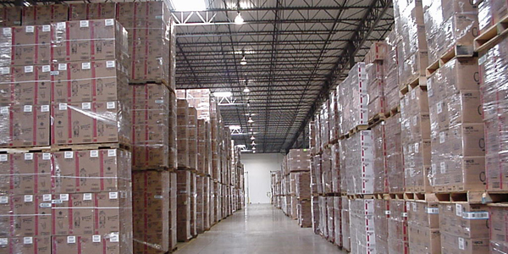
Stockthroughput
As well as transit cover, we can extend our annual policy to cover storage
This can be at the assured’s own warehouse or a third party warehouse
As well as limits for individual locations, we can offer a floating limit across several locations
Information required for a stock presentation is the same as you would present to a property underwriter

Slide 13
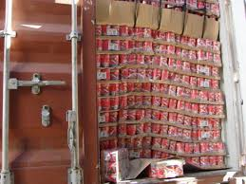
Other Extensions to Cargo Products
As well as transits and storage, we can offer the following:
        Exhibition Cover
        Reps Vehicles
        Engineers Tools and Samples
        Goods carried in Own Vehicles

Slide 14
Why Insure Cargo?
Overcoming obstacles
“I can claim off the Carrier”
A carriers liability:-
May only provide limited protection as liability is restricted to a monetary amount per kilo or tonne by statute
e.g. RHA conditions £1300 per tonne
e.g. BIFA conditions £2,000 per tonne
Relies on the carrier having his own insurance and that he does not breach any conditions, otherwise it could involve a long drawn out court case
Relies on the Carrier being legally liable for the loss or damage
Has gaps in cover, such as general Average Cover which leaves potential for a massive loss

Slide 15
Why Insure Cargo?
Overcoming obstacles
What is General Average
Imagine a situation at sea like a fire or severe storm or any other life threatening situation.. Under such circumstances, the master of the ship (as a last resort) might be forced to jettison (throw overboard) some or all cargoes that are on the ship in order to save part or whole of the ship..
When such situation occurs, the ship declares a legal principle of Maritime Law termed “General average”.. Under this principle, all parties who are involved in that voyage, shall be asked to proportionally share the losses resulting from such sacrifice.. All parties including all merchants whose cargo landed safely would also be called to contribute a portion, based upon a share or percentage, to the merchant or merchants whose goods had been jettisoned in order to avert danger to the whole ship/crew

Slide 16
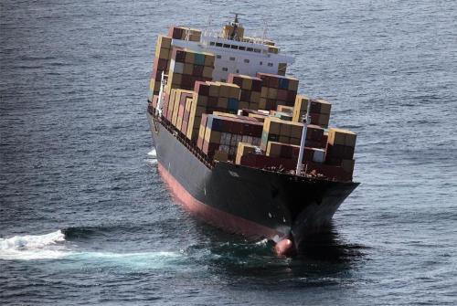

Slide 17
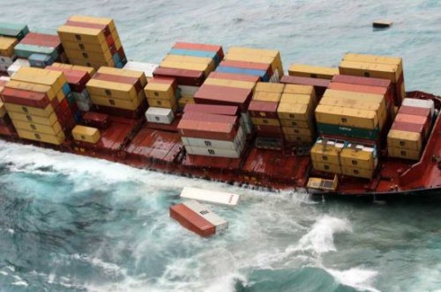

Slide 18
What information do you require to receive the most competitive terms for marine cargo policies?
Business Description:
Subject matter Insured: Type of goods requiring cover
POLICY LIMITS
Any one vessel / Aircraft / Road and /or Rail Conveyance £
Any one exhibition – (split per territory & number of exhibitions) £
Any one Engineers and or Sales representative’s vehicles
Tools and/or samples and/or equipment £
Any one Postal Sending £
This is sendings by royal mail – not by couriers
Any one location and or /loss and or series of losses in the
Ordinary course of transit £

Slide 19
What information do you require to receive the most competitive terms for marine cargo policies?
Estimated Sendings: United Kingdom to and from
United Kingdom
European Union
Europe excluding EU
USA / Canada (North America)
Far East
Indian Sub-continent and Australasia
Middle East
Rest of World
Cross Voyages: Transits whereby they do not come to and from the United Kingdom
The better split you can provide the more competitive premiums you will be able to obtain

Slide 20
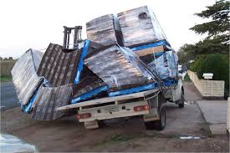
Marine Haulage and Freight
Freight or Haulage is the Carriage of goods for hire and reward.
        i.e. the Haulier doesn’t own the goods themselves they are just offering a service to get the Cargo from A to B
Because a Haulier will get paid an amount which will be substantially less than the worth of the goods it is in their own interest to limit their liability in case of any claims
If you were getting paid £100.00 to move a £1m piece of machinery from Liverpool to Cornwall could you afford to pay out £1m if there was a total loss?
A haulier can carry goods under a number of conditions, each determining their limit of liability through specific terms and conditions
Most common conditions are ‘All Risks’, ‘RHA’, ‘CMR’, and ‘UKWA’
We only offer annual Freight policies – no single voyages

Slide 21
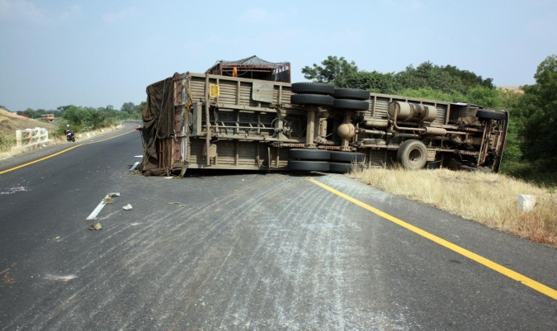
All Risks Cover
Exactly what it says – the haulier could be responsible for the full value stated on the policy
Main points to note are – this leaves the Haulier open to a lot of potential claims and as there is no time limits on the claims (unlike all the other conditions) they could get a claim in years down the line.
Also worth noting that if a claim comes in for consequential/financial loss under All Risks then they are NOT covered under our policy wording.
If the Haulier has a consequential loss claim they would have to front the bill themselves which could end up making them bankrupt.
All Risks cover is UK/UK only (Aviva Stance)

Slide 22
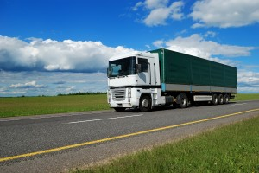
RHA Conditions
RHA stands for the ‘Road Haulage Association’ and is a Haulier’s contracted conditions that the cargo owner accepts prior to the Haulier taking control of their goods
The Conditions sets out the Owner’s and Haulier’s responsibilities and also sets out the Hauliers Liabilities in the event of a claim.
These conditions apply to all movements of goods under RHA regardless of the limits – standard £1,300 per tonne up to…..
Hauliers Liability is calculated on the weight of the goods. As a rule, the maximum tonnage an Artic truck can carry is 30 tonnes, so under RHA @ £1,300, the limit of liability would be £39,000.
UK/UK Only

Slide 23
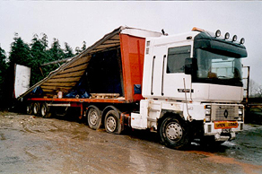
CMR Conditions
Convention relative au contrat de transport international de marchandises par route’ - Convention on the Contract for the International Carriage of Goods by Road.
Unlike the other sets of contract conditions CMR is different because it is a statute Law and will apply regardless of the contract in place between Haulier and Cargo Owner.
CMR supersedes anything the Haulier has contracted under
Only goods that do not apply under CMR are – Postal Sendings, Furniture Removal and Funeral Consignments, Livestock
CMR applies when the goods pass over an international boundary and at least one of the countries is a signed up member.

Slide 24

BIFA
British International Freight Association
Exclusive for BIFA members, much like RHA
Aviva will not write business under BIFA conditions unless they are a member of BIFA
Prime UK Trade Association for UK Freight Forwarders
Limit of Liability – value of any loss or damage or 2 SDR per Kilo (whichever is lower) limited to £75,000 SDR in respect of any one transaction
Despite these conditions applying internationally, they are governed by English Law
General Average is Excluded
BIFA doesn’t override CMR or any other law

Slide 25
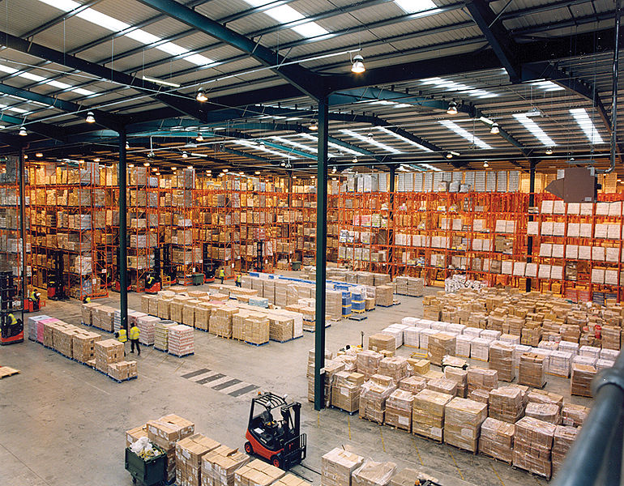
UKWA
United Kingdom Warehousing Association
These are in relation to storage of third party goods i.e. warehouse keepers,
Limit of liability is calculated based on weight, standard condition are £100 per tonne
Again you must be a member to trade under these conditions

Slide 26
Added Extras
Automatic cover up to £75,000 in respect of Theft Attractive Goods
Cover for Own Goods
  - Unlimited cover for ropes, sheets, toggles and dunnage
  - Other property belonging to the insured up to £25,000
Cover for the Insured’s drivers personal effects up to £250
Reasonable Costs for Debris removal, site clearance, transhipment & recovery costs
Temporary housing / storage on or off vehicles during the normal course of transit
Contingent liability for goods sub-contracted
Automatic substitution of specified Vehicles
Automatic Unwitting CMR cover
Cover for Trailer curtains damaged during a theft –
- £250 Any One Occurrence,
- £500 Any one Period

Slide 27
Exclusions
Deterioration or variation in temperature, unless caused by an accident
Storage for a fee or rental (30 days non fee automatic)
Certain liabilities under CMR – items 24 (Inner Limit deleted)
Damages for Delay or late delivery where time contractually agreed
Confiscation, destruction etc by government or the like
War and radioactivity

Slide 28
Any Questions?
Thank you

