Slide 1

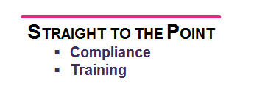
The Insurance Act 2015
Prepared for the New Class Group
of the Insurance Institute of Manchester

Slide 2
Contents
Some History and background to the duty of disclosure
The Insurance Act 2015
What, When , How and the effects on the market

Slide 3
Background
Utmost Good Faith

Slide 4
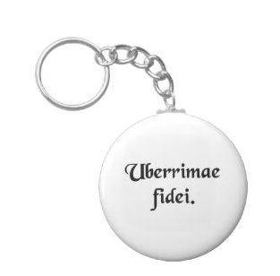
Utmost Good Faith
Utmost Good Faith is the Insurance Principle that applies to Disclosure (how the Customer shares their details with the Insurer)
However as the modern industry and legislation have evolved it now no longer applies to all contracts of Insurance

Slide 5
Utmost Good Faith
Normal contracts require good faith
This means both parties must not deceive each other
But they need only answer questions honestly and do not have to volunteer information
This principle is “let the buyer beware” (caveat emptor)

Slide 6
Utmost Good Faith
‘Let the buyer beware’ means each party must check very carefully
For example, if you buy something from a shop, take care to make sure it is what you want
If you ask the shopkeeper about the item, he must tell you the truth, but if you don’t ask he is not bound to tell you
Don’t confuse this with Guarantees, Contractual Right and Returns policies operated by retail organisations

Slide 7

Utmost Good Faith
The Principle of Utmost Good Faith was described in the Marine Insurance Act 1906 and has dominated how Insurance has operated worldwide for the 20th century
The Principle brings about a duty on the Customer to disclose all Material Facts, and the Insurer must do likewise in the context of Cover and rating of the Risk

Slide 8
A quick look at
The Duty of Disclosure
& Material Facts
What do they mean?

Slide 9

BUT - Changes to the Law
However, recent Acts of Parliament have led to there being significant changes in the way Disclosure is dealt with – these Acts being:
Consumer Insurance (Disclosure & Representations) Act 2012
The Insurance Act 2015

Slide 10
Changes to the Law
In April 2013 the Consumer Insurance (Disclosure & Representations) Act 2012 (also known as CIDRA) meant that Consumers were exempt from the duty of disclosure
Commercial Customers were not exempt, and the principle of Utmost Good Faith continued to apply for these contracts

Slide 11
Changes to the Law
From August 2016 the Insurance Act 2015 affects disclosure for Commercial Customers
It brings in a new duty which is “the duty of fair presentation”
But the duty of disclosure still applies to Commercial Insurance
The implications of the Insurance Act will be dealt with later
It also affects other areas of Insurance such as Warranties & Fraud

Slide 12
The Insurance Act 2015
The Duty of Fair Presentation
Breaches of the Duty
Warranties
Fraud

Slide 13

The Duty of Fair Presentation
Coming into force on 12th August 2016, the Insurance Act introduces a new duty for Commercial Customers that extends the Duty of Disclosure
This new duty is known as the Duty of Fair Presentation

Slide 14

The Duty of Fair Presentation
A fair presentation is one:
Which makes that disclosure in a manner which would be reasonably clear and accessible to a prudent insurer, and
In which every material representation as to a matter of fact is substantially correct, and every material representation as to a matter of expectation or belief is made in good faith

Slide 15

The Duty of Fair Presentation
What this means is that when providing information to the Insurer, the obligation is to present it is a clear way, neither failing to disclose nor hiding within the information anything that should brought to their attention
It is a new obligation and it does not just apply to the Customer

Slide 16

The Duty of Fair Presentation
The duty extends to an Intermediary also, as they will be making the presentation to the Insurer – and should take greater care to ensure its fairness
What makes up the Knowledge of the Insured is all material facts which should be known to the Senior Management of the Customer firm, and it also includes information in the public domain

Slide 17

Breaches of the Duty
The Insurance Act also affects how an Insurer can treat the contract of Insurance in the event that the duty of a fair is presentation is breached – such as a non-disclosure
There are four remedies that an Insurer can use, which are as follows:

Slide 18

Breaches of the Duty
If a Customer makes a “deliberate or reckless” breach, the Insurer can:
void the policy,
not pay a claim,
but can keep the premium

Slide 19

Breaches of the Duty
If a Customer breaches the duty in a way that is not deliberate or reckless (such as by mistake), and the Insurer can prove it would not have taken on the business, the Insurer can:
void the policy
not pay a claim
but must refund the premium

Slide 20

Breaches of the Duty
If a Customer breaches the duty in a way that is not deliberate or reckless, but the Insurer would have incepted on different terms, then:
those terms should apply to any claim

Slide 21

Breaches of the Duty
If a Customer breaches the duty in a way that is not deliberate or reckless, but the Insurer would have incepted at a higher premium, then:
the Insurer can use average to reduce the claim payment

Slide 22

Warranties
The Insurance Act also contains new legislation concerning Insurance Warranties
It applies to both Consumer (Retail) and Commercial contracts of Insurance

Slide 23

Warranties
An example of an Insurance Warranty is the requirement that in order for cover to be in force under a shop policy, the Insured must make sure it abides by the minimum security required, and that is it is in force when the property is unoccupied
A breach of this warranty would be leaving the front door open when the shop is left empty

Slide 24
Warranties
The Insurer has the right to repudiate a claim for a breach of warranty unless:
The warranty is irrelevant due to change in circumstances
The warranty is deemed unlawful for a specific reason
The Insurer waives its right
The breach occurs after the claim (claims before the breach must be paid)
The breach is remedied (i.e. leaving the front door unlocked does not automatically void any subsequent theft claim, if it is locked in future)
The breach is unrelated to the loss (a fire claim unrelated to the front door being unlocked)

Slide 25
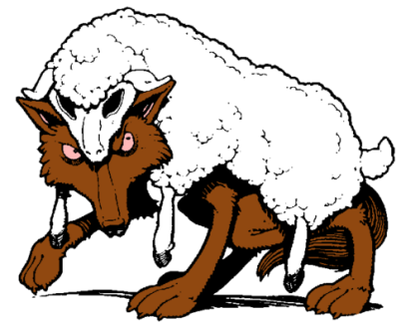
Fraud
There has been some confusion in the market place over how to deal with fraudulent claims, disparity in how firms deal with such claims, and this section of the legislation entitled Remedies for fraudulent claims codifies best practice
It applies to both Consumer (Retail) and Commercial contracts of Insurance

Slide 26
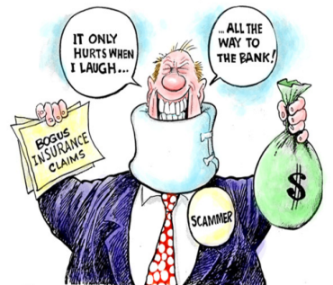
Fraud
It clearly states that for fraudulent claims:
The Insurer is not liable to pay the claim
The Insurer may recover from the Insured any sums paid by the Insurer to the Insured in respect of the Claim
The Insurer may void the policy from the time of the fraudulent act (but not inception), which would mean any subsequent claims were not to be covered, and would not have to refund the premium

Slide 27
Fraud
This last point has implications as the Insurer would still need to indemnify the Insured in respect of a valid claim prior to the fraud (if still outstanding for example) and not simply class it as repudiated also
These rules apply whether the fraudulent claim is made by the Insured or another party who alleges to have suffered a loss

Slide 28
The Insurance Act 2015
Prepared for the New Class Group
of the Insurance Institute of Manchester

