Slide 1

Regional Cyber Crime Unit
DCI Steve Thomas

Slide 2
The Situation
Tier 1 threat to UK infrastructure
Cost to UK economy over £400bn per annum (Lloyds Ins)
150,000 jobs lost across Europe
Greater global cost than heroin, cocaine and cannabis
83% of UK population have internet access
No deaths?

Slide 3

Daniel Perry 17yrs

Slide 4











It won’t
happen to
us !!

Slide 5
YaTH Business Impact
In 2014 estimated 65% of all SME’s attacked.
Average impact between £65k -£115k for SME, £600k - £1.5m Large
Commercial sensitivity/Reputational costs
Information Commissioners Office = £000,000’s in fines
European Network & Info Sec (NIS) Directive = £millions in fines
Average time to detect intrusion/infection190 days.
9 out 10 Preventable !!

Slide 6
Threats/Attacks
DDOS (Distributed Denial of Service)
Phishing, Spear, Whale, Smish, Vish = Social Eng
Data loss/corruption (worms, virus, malware, Trojan)
Data loss – Conventional
Hacking – Network, Servers, Wifi, Foodchain
Rogue Insider – PICNIC/BYOD

Slide 7

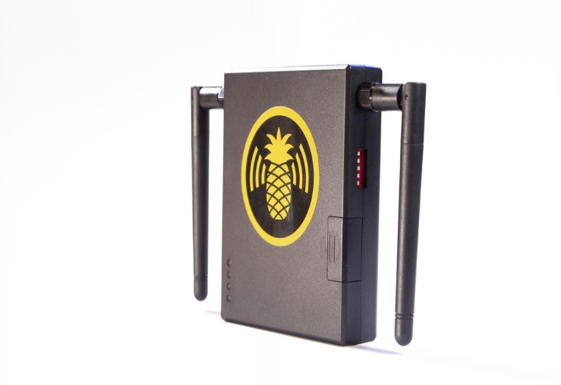
Disaster Examples
+
= Disaster
+ your WiFi = Disaster

Slide 8

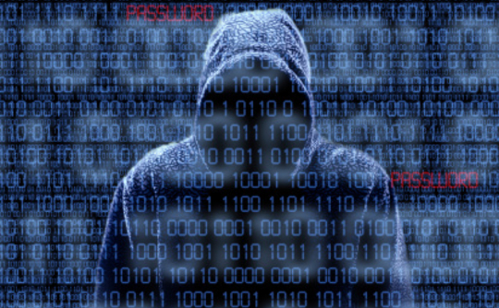
Social media : Business Asset or Threat
Social Media used to target an organisation?
Usually well considered weak points -
Perimeter measures, firewall, IDS, IPS, Email scanning.
        Security architecture and policies, staff training.
        Access Control,and data encryption.
But What about your staff?
Activities seen as private and not in the course of the business
Individuals use of social media –
Can these be leveraged against the organisation as a part of targeted social Engineering attack targeting company assets/security.

Slide 9
Example !
Staff member 18-29 = Facebook 500+ Contacts
Tweets at work with location enabled
Works in data centre, gym member, h/a locus, pictures
Meta Data (photos), partners home, car reg, D.O.B
www.echosec.com
www.wigle.com
Are the employers happy with this?

Slide 10
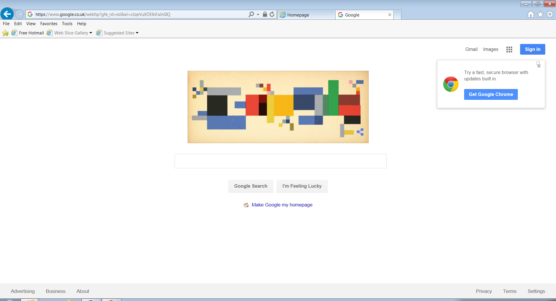
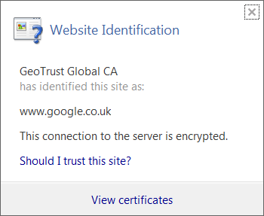

Slide 11
The Attraction
Traditional
Physical presence at the crime scene
One offence at a time
High risk/low reward
Local enquiries
Victim reports to police
Cyber
Remote from the crime scene
Multiple offences at once
Low risk/high reward
International enquiries
Victim reputation

Slide 12
10 Steps to Protection
Training/User Awareness (PICNIC)
Network Security
Malware Protection – Scanning
Monitoring – Log analysis
Incident Management
Manage User Privileges (admin)
Removable Media – BYOD
Secure Configuration – Patching/Passwords
Home/Mobile Working – VPN’s (encrypt)
Test it all works !!

Slide 13
Responsibility
Q, Where should responsibility sit?
A, Data owner/pays the fines !!
CEO

Slide 14



Support
https://www.cert.gov.uk/cisp
https://www.getsafeonline.org/business/
https://www.gov.uk/government/.../cyber-essentials-scheme-overview

Slide 15
Funding for SME’s
https://interact.innovateuk.org

Slide 16
LE Structure
National Crime Agency
Regional Cyber Crime Unit
Force Cyber Crime Units
District Policing

Slide 17
Our Capabilities

Slide 18
Pursue
Reactive investigation
Cyber advice and strategy for SIOs
Cyber CSI
Digital forensics
UK and International partners
Proactive investigation
Intelligence gathering and analysis
Covert Digital Operations

Slide 19
Prevent
Protect
Profiling of potential Cyber criminals
University liaison
Industrial liaison
Intelligence requirement to Forces and partners
Identification of targets
Infrastructure protection
Cyber Threat Reduction Group
Cyber Information Sharing Partnership

Slide 20
Prepare
Penetration testing and security advice
Cyber Attack Response Plans - Exercising
Virtual Task Force - Cyber Specials
Student placements

Slide 21
How prepared are you ?

Slide 22
All your servers are going under DDoS attack unless you pay 25 Bitcoin. You have 24hrs.

Slide 23


Slide 24
regional.cyber@westyorkshire.pnn.police.uk
0113 397 0702
07595 009 790

