Slide 1
The Insurance Act
Insurance Institute of Southampton
14 January 2016
Michael Howard FCII

Slide 2
Content
Understand the changes to the statutory framework
Understand the remedies available to insurers
Identify potential problem areas
Practical considerations at policy renewal

Slide 3
Background
Most insurance contract law dates back to Marine Insurance Act 1906
Case law has modernised but reform has been in the air in recent years
Recent consultations have been ongoing since 2011
Consumer Insurance (Disclosure and Representations) Act 2012 – came into force April 2013

Slide 4
Why reform?
The Law Commission’s stated aims;
  ensure better exchange of information between insurer and insured
  reduce the number of disputes, saving legal costs and avoiding “disruption for both insurer and insured”
  reduce the number of claims rejected
  increase confidence in the insurance sector domestically and internationally
  Impact Assessment, Law Commissions, June 2012

Slide 5
The Insurance Act 2015
Duty of Fair Presentation
Removal of the Duty of Utmost Good Faith
Warranties
Contracting out
Fraud

Slide 6
Duty of utmost good faith
Carter v Boehm (1766)
“Good faith forbids either party by concealing what he privately knows, to draw the other into a bargain from his ignorance of that fact, and his believing the contrary” (Lord Mansfield)
The new act removes insurers’ rights to rely on a breach of the duty of utmost good faith to avoid a policy.

Slide 7
Duty of Fair Presentation (1)
Current position:
  Insured must disclose “every material circumstance” which it ought to know “in the ordinary course of business”
  A material circumstance is one which “would influence the judgement of a prudent insurer in fixing the premium, or determining whether he will take the risk” Section 18 (2) Marine Insurance Act
  Insurers’ remedy is avoidance

Slide 8
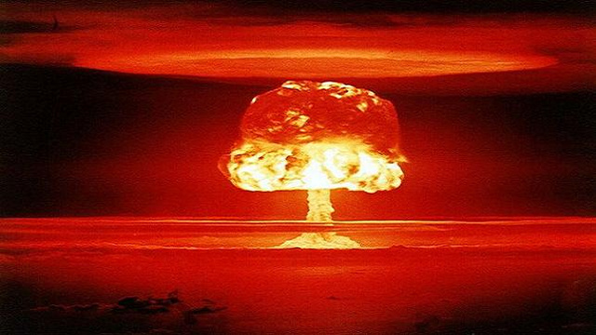

Slide 9
Duty of Fair Presentation (2)
  A fair presentation discloses every material circumstance which is known or ought to be known by senior management, or those responsible for arranging the insurance, following a reasonable search
  A circumstance is material if it would influence the judgement of a prudent insurer in determining whether to take the risk and, if so, on what terms
  Presentation must be made in a way that is reasonably clear and accessible
  A fair presentation can also include a presentation which puts the insurer on notice that it needs to make further enquiries

Slide 10
Unfair Presentation - Remedies
Designed to place insured at risk of losing premium if fraudulent presentation
Where simply negligent – proportionate remedies will apply
  If different premium, claim reduced proportionately
  If different terms, claim considered against those terms
If insurer can demonstrate it would not have underwritten, then policy avoided and premium returned

Slide 11
Unfair Presentation – Remedies
Avoid contract
and retain
premiums
Deliberate or reckless
breach of duty of
fair presentation?
Yes
No
Would contract
still have been
entered
into, had the duty
been complied with?
Yes
If different terms,
treat the policy
as if it had been
entered into on those
terms
If a higher premium
would have been charged,
insurer can proportionately
reduce the claim
No
Avoid contract
and return premiums

Slide 12
Remedies - impact
Proportionate remedies – likely to see less avoidance – possible retrospective underwriting?
The absolute right of avoidance has been watered down (although not extinguished)
Unclear whether subsequent claims also affected

Slide 13
Possible Issues (1)
Fair presentation needs to be clear and accessible
Too much information could result in argument presentation was unfair – no data dumping
Need to consider information being provided – difficult for SME work

Slide 14
Possible Issues (2)
Term “reasonable search” is not defined.
Senior management is not defined.
Clients should be aware of different remedies – in particular over proportionate claim reduction – could have huge impact on large claim
Insurers may be inclined to take more coverage points

Slide 15

Case study 1
ABC Limited buys PPL insurance with Large Insurance Co(“LIC”). ABC says its turnover is £20m. A premium of £20,000 is charged.
Third party claim is made. Liability established at £500,000. During investigations it is found that ABC’s turnover was in fact £40m.
What happens next?

Slide 16
Case study 1
Under the new Act, insurers will have to consider what would have happened had ABC given a fair presentation of the risk, including the correct turnover.
It is likely that had the duty been complied with, insurers would have increased the premium to £40,000 (assuming a flat rate). Proportionate remedies under the act would allow LIC to discount the payment made on the claim by 50% i.e. to £250,000.

Slide 17
Issues with the Case Study
ABC has another claim in the same policy year assessed at £100,000. What happens next?
What if the policy contained a condition of average?

Slide 18
Basis of Contract Clauses
Previously allowed – converted information provided by insureds into warranties
Now abolished (same as for consumer contracts)

Slide 19
Warranties
Currently – breach of warranty = insurer can avoid all claims from date of breach, even if breach irrelevant or immaterial to the loss
Under Act warranties = suspensive conditions
Liability suspended until breach remedied
BUT some breaches cannot be remedied
Will insurers and the courts seek to apply remedies strictly?

Slide 20
Fraudulent Claims
No definition of fraud in the Act
No claim in relation to claim arising out of fraudulent act
But claims arising from a pre-fraud event would be payable
Effectively codification

Slide 21
Contracting out – the basics
Will only apply for business insureds
The disadvantageous term must be clear and unambiguous
Must be drawn to the insured’s attention (sliding scale depending on sophistication of insured) before the contract is entered into
Applies to all disadvantageous terms however small

Slide 22
Contracting out – the pitfalls
Brokers need to be careful in checking policy terms and conditions
If broker has actual knowledge of the term then could be liable if insured not advised
Insurers need to adequately flag up the policy terms and conditions where they seek to contract out (although it need not be explicitly stated)

Slide 23

Presentation
Available on
Michael Howard

