Slide 1
Better off dead? Preparing families for the unthinkable
Rob Carr
Head of Adviser Development
For advisers only

Slide 2
Learning Objectives
By the end of this session, attendees will be able to describe: -what happens in the aftermath of the death of a breadwinner -what State benefits are available to people losing a spouse or civil partner -what Statutory Sick Pay and Employment and Support Allowance provide to someone with a long-term illness or disability -the statistics underlying the chances of dying or becoming seriously ill during your working lifetime -what protection products people typically buy in the UK -how a modern menu plan can provide a holistic protection solution even to those on a limited budget

Slide 3
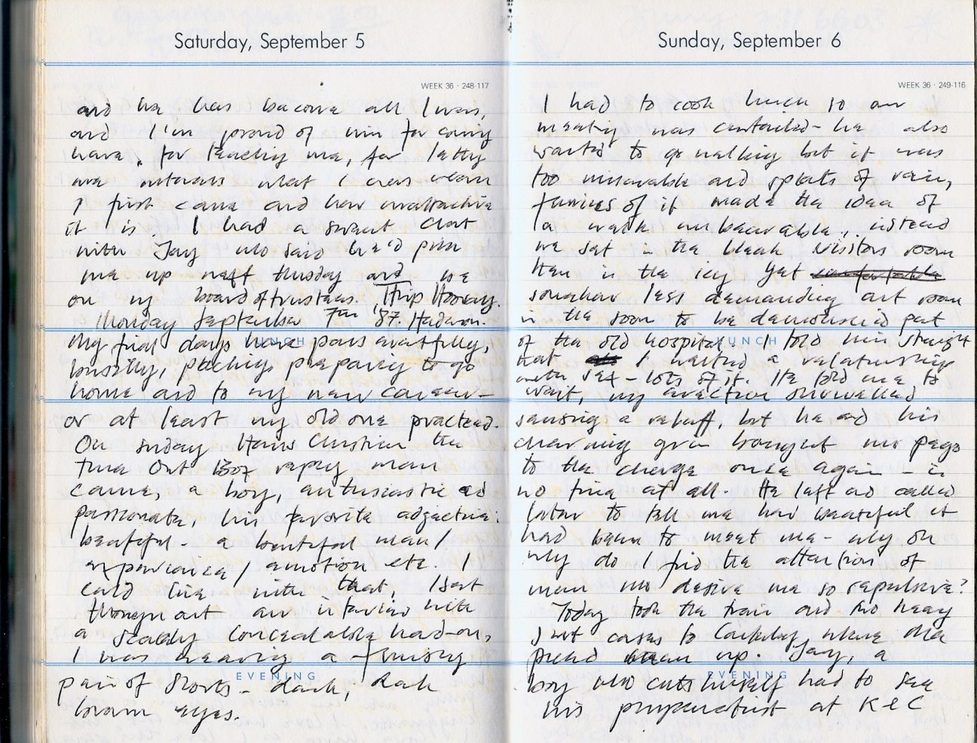

Slide 4
Problems on death
What they may have to face
State support for widows/widowers
Tax-free bereavement payment of £2,000
Bereavement allowance of between £33.77 a week and £112.55 a week (depending on age) for 52 weeks
Widowed parent allowance is a maximum of £112.55 a week payable while receiving child benefit
Unmarried couples?
Sources:
Benefits & credits, www.gov.uk, March 2015 (with effect from 6 April 2015).

Slide 5
Might it have been even worse?
What if the policeman had told my mother that my dad had been run over and was now paralysed?

Slide 6
Marius Barnard
Co-inventor of critical illness cover

Slide 7
What are the risks?
Example
The risks for a 30-year-old non-smoker planning to retire at 65
8% risk of death
16% risk of suffering a serious illness
32% risk of being unable to work for 2 months or more
Source:
Risk Reality Calculator, LV=, January 2015.

Slide 8
The hard truths
Who has what?
People don’t understand what protection is and don’t think they need it
37% of adults say they have a life policy
11% say they have critical illness cover
7% say they have income protection.
Source:
YouGov SixthSense Life and Health Protection survey, 2014.

Slide 9
Statutory Sick Pay (SSP)
Minimum employer obligation
SSP amounts to £88.45 a week¹
SSP is payable for a maximum of 28 weeks
Paid by employer
What does this mean for a client on £40,000 a year?
Income drops by nearly 85% if reliant on SSP²
Source:
1 Benefits & credits, www.gov.uk, March 2015 (with effect from 6 April 2015).
2 Salary calculator, Moneysavingexpert.com, March 2015.

Slide 10
What happens then
Do things get better?
After 28 weeks, switches to Employment & Support Allowance
Claim form is 52 pages long!
If the claim is accepted, the claimant goes into the ‘assessment phase’ lasting 13 weeks
Benefit during the 13 weeks is £73.10 a week for over 25s
Once assessment has taken place, the claimant will fall into one of three groups…
Source:
Benefits & credits, www.gov.uk, March 2015 (with effect from 6 April 2015).

Slide 11
After assessment phase
3 possible outcomes
Fit for work
Placed in Work Related Activity Group
£102.15 a week
Placed in Support Group
£109.30 a week
Source:
Benefits & credits, www.gov.uk, March 2015 (with effect from 6 April 2015).
Notes:
Slide used for Simply Biz events July 2014

Slide 12
Treating the customer fairly
Holistic protection advice
The job of the adviser:
Establish the protection needs
Establish a reasonable budget
Create a tailored solution
Treat the customer fairly.

Slide 13
Protection on a budget
An example
Mark 34
Lucy 30
Both non-smokers
Have just started a family
Mortgage £120,000 over 23 years
Mark is main breadwinner on £40,000 a year
Budget for protection is around £60 a month.

Slide 14
Protection on a budget
Protection menu
Joint cover
Life Cover
£120,000
decreasing 23 years
Cost £12.31
Source: Bright Grey Personal Protection Menu, March 2015, couple aged 35 and 31 next birthday, both non-smokers. Cost includes £2.60 plan charge and is based on cover that includes the mortgage repayment guarantee. Critical Illness Cover, Income Cover for Sickness and Payment Cover for Sickness assume own occupation basis.

Slide 15
Protection on a budget
Protection menu
Joint cover
Life Cover
£120,000
decreasing 23 years
And
double Children’s Critical Illness Cover!
Mark
Life or CI cover
£25,000
RPI indexed 25 years
Lucy
Life or CI cover
£25,000
RPI indexed 25 years
Cost £30.51
Source: Bright Grey Personal Protection Menu, March 2015, couple aged 35 and 31 next birthday, both non-smokers. Cost includes £2.60 plan charge and is based on cover that includes the mortgage repayment guarantee. Critical Illness Cover, Income Cover for Sickness and Payment Cover for Sickness assume own occupation basis.

Slide 16
Protection on a budget
Protection menu
Joint cover
Life Cover
£120,000
decreasing 23 years
Mark
Life or CI cover
£25,000
RPI indexed 25 years
Mark
Family income benefit
£10,000 a year Life Cover
RPI indexed 25 years
Lucy
Life or CI cover
£25,000
RPI indexed 25 years
Lucy
Family income benefit
£10,000 a year Life Cover
RPI indexed 25 years
Cost £45.07
Source: Bright Grey Personal Protection Menu, March 2015, couple aged 35 and 31 next birthday, both non-smokers. Cost includes £2.60 plan charge and is based on cover that includes the mortgage repayment guarantee. Critical Illness Cover, Income Cover for Sickness and Payment Cover for Sickness assume own occupation basis.

Slide 17
Income protection
How much could Mark have?
Term
Cost?
£73.86
a month
Max to age 65
30 years
Amount
Max 50% of earnings
£1,666 a month
Level/increasing
Level/increasing
RPI increases
Deferred period
4/13/26/52 weeks
4 weeks
Payment period
Full term/2 year/1 year
Full term
Source: Bright Grey Personal Protection Menu, March 2015, male aged 35 next birthday, non-smoker. Cost excludes plan charge. Quoted on own occupation basis.

Slide 18
Income protection
How much could Mark have?
Term
Cost?
£9.95
a month
Max to age 65
30 years
Amount
Max 50% of earnings
£1,000 a month
£1,666 per month
Level/increasing
Level/increasing
RPI increases
Deferred period
4/13/26/52 weeks
4 weeks
26 weeks
Payment period
Full term/2 year/1 year
Full term
2 year
Source: Bright Grey Personal Protection Menu, March 2015, male aged 35 next birthday, non-smokers. Cost excludes plan charge. Quoted on own occupation basis.

Slide 19
Protection on a budget
Protection menu
1 quote
1 application
1 plan fee
1 DDM
Joint cover
Life Cover
£120,000
decreasing 23 years
Joint cover
Payment Cover
for Sickness,
30 years, deferred 26 weeks
Mark
Life or CI cover
£25,000
RPI indexed 25 years
Mark
Family income benefit
£10,000 a year Life Cover
RPI indexed 25 years
Mark
Income Cover for Sickness
£1,000 a month indexed
2 year payment period
30 years, deferred 26 weeks
Lucy
Life or CI cover
£25,000
RPI indexed 25 years
Lucy
Family income benefit
£10,000 a year Life Cover
RPI indexed 25 years
Cost £60.38
Source: Bright Grey Personal Protection Menu, March 2015, couple aged 35 and 31 next birthday, both non-smokers. Cost includes £2.60 plan charge and is based on cover that includes the mortgage repayment guarantee. Critical Illness Cover, Income Cover for Sickness and Payment Cover for Sickness assume own occupation basis.

Slide 20
Learning Objectives
You should now be able to describe: -what happens in the aftermath of the death of a breadwinner -what State benefits are available to people losing a spouse or civil partner -what Statutory Sick Pay and Employment and Support Allowance provide to someone with a long-term illness or disability -the statistics underlying the chances of dying or becoming seriously ill during your working lifetime -what protection products people typically buy in the UK -how a modern menu plan can provide a holistic protection solution even to those on a limited budget

Slide 21
Thank you
www.brightadviser.co.uk

