Slide 1

Insurance of the risk
Policy covers & underwriting issues
Stephen Ridley, Senior Development Underwriter

Slide 2
Insurance of the risk
Agenda
What is ‘cyber’?
Policy cover
Claim response
Underwriting information
Risk management
Summary

Slide 3
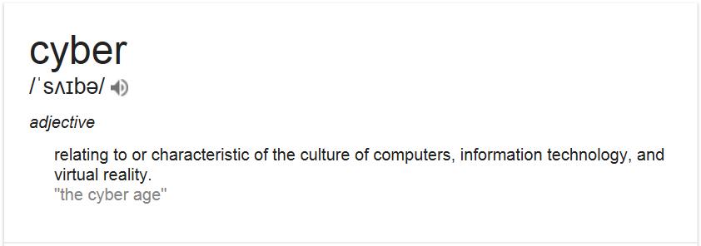
Insurance of the risk
Policy covers – what is cyber?

Slide 4
Insurance of the risk
Policy covers – what is cyber?
Data
  Personal or Commercial
  Tangible or intangible
  Loss or misuse
  Negligence or malice
Cyber
  Hacks
  Viruses
  Denial of service attacks
  Liability for online presence/activities

Slide 5
Insurance of the risk
Policy covers – ‘First party’
 | Cover overview | Main areas
Breach costs | Costs incurred in responding to an actual or suspected data breach | Legal fees IT forensics Notification costs Credit monitoring services Call centre set up
Cyber business interruption | Business interruption following cyber incident, including as a result of reputational damage | Loss of income Increased costs of working
Hacker damage | Costs incurred in replacing/repairing damage caused by a hacker | Computer systems Computer programmes Data held electronically
Cyber extortion | Costs incurred in the event of a threat to damage or disrupt computer systems, or publish information | Ransom payment Consultant to handle negotiation
Notes:
‘Hacker’ may or may not include employees
Where does data have to be held? Insured’s own systems only, or are OSPs covered?

Slide 6
Insurance of the risk
Policy covers – ‘Third party’
 | Cover overview | Main areas
Privacy protection | Defence costs and awards / settlements made following legal action or investigation as a result of a data breach, invasion of privacy, or breach of confidentiality | Any breach of Data Protection Act Breach of confidence Regulatory fines / awards PCI charges Claims by employees
Media liability | Defence costs and awards / settlements made following legal action as a result of a company’s online presence | Breach of intellectual property Defamation Transmission of a virus

Slide 7


It’s not just about the policy cover

Slide 8
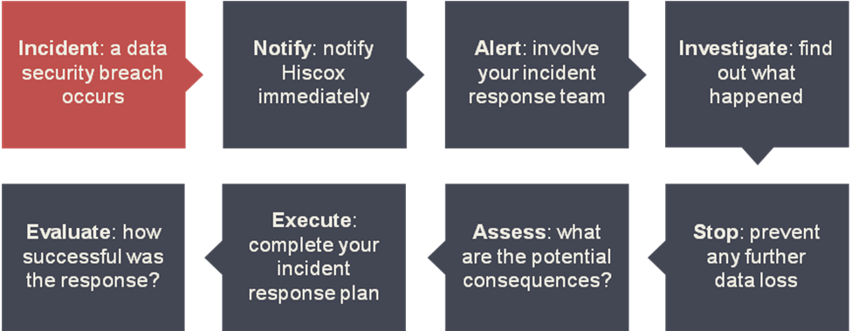
Insurance of the risk
Claim response
Time is of the essence when it comes to responding to an incident
Structure enables rapid, expert response
Provides access to expert partners to effectively manage an incident
Insured is able to continue with running their business

Slide 9

What is the killer underwriting information?

Slide 10
Insurance of the risk
Underwriting issues - data
What?
How much?
Where?
Why?
How long?
What protections?
Previous breaches / investigations / complaints
Breach preparedness

Slide 11
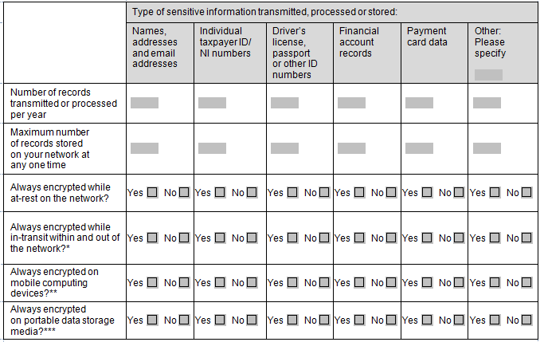
Insurance of the risk
Underwriting issues - data

Slide 12
Insurance of the risk
Underwriting issues - cyber
Industry
Controversiality
Size / complexity of network
Reliance on website / network
Disaster recovery plan
Remote access

Slide 13
Insurance of the risk
Underwriting issues – risk management
The basics
Regular mandatory password updates
Anti-virus software
Defined process to patch systems
Configured firewall
Procedures to revoke access
Compliance with DPA and PCI-DSS (if applicable)
Written data security policy in place
Notes:
DPA: 1. fair and lawful processing; 2. obtained for specific purpose; 3. adequate, relevant and not excessive; 4. accurate and kept up to date; 5. retained no longer than necessary; 6. rights of data subject (access, prevention of processing); 7. Appropriate steps taken to secure data; 8. Transfer outside of EEA

Slide 14
Insurance of the risk
Underwriting issues – risk management
Intermediate / advanced
Regular network scans
Track, monitor and restrict access to personal data
Data retention / purge policy
CISO (or equivalent) in place
Third party audit of privacy practices/network security
Full data breach incident response plan in place
Intrusion detection systems
End-to-end encryption

Slide 15
Insurance of the risk
Summary
It’s not just about IT risk
Claim response is even more important than underlying policy cover
Turnover isn’t an adequate indicator of risk
Basic steps can significantly reduce the risk

Slide 16
Thank you

