Slide 1
Reading, Understanding & Applying Laws
by
Jeff Heasman MABP, PGCert CELTA, LL.B (Hons), LL.M
Certified Practitioner Member of the Academy of Modern Applied Psychology
Member of the Association for Business Psychology
linkedin.com/in/jeffheasman

Slide 2
Learning objectives
By the end of the webinar, participants will be able to:
identify key skills in reading and understanding laws.
recognise how to assimilate the knowledge gained and apply the law to a case study or provide advice to a client in a logical and clear way.
implement a strategy to read, understand and apply law more quickly and effectively.

Slide 3
How to find laws
Statutes:
www.legislation.gov.uk
Case law:
www.supremecourt.gov.uk/decided-cases/index.shtml (press summary and judgments available)
www.bailii.org
www.iclr.co.uk – The Incorporated Council of Law Reporting for England & Wales (has the latest case summaries and an alert subscription)

Slide 4
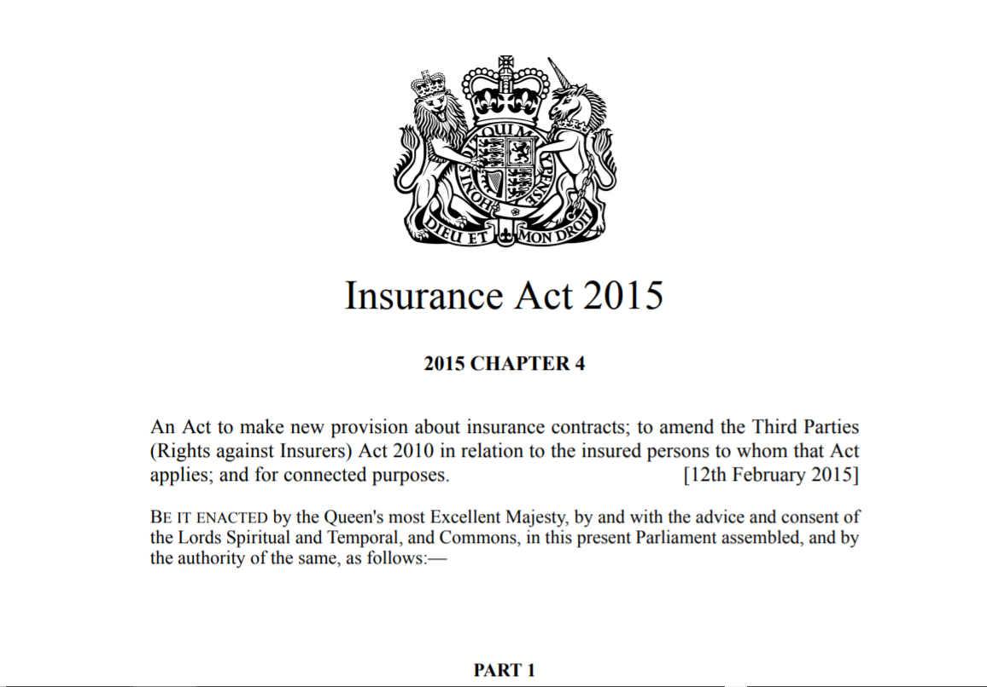
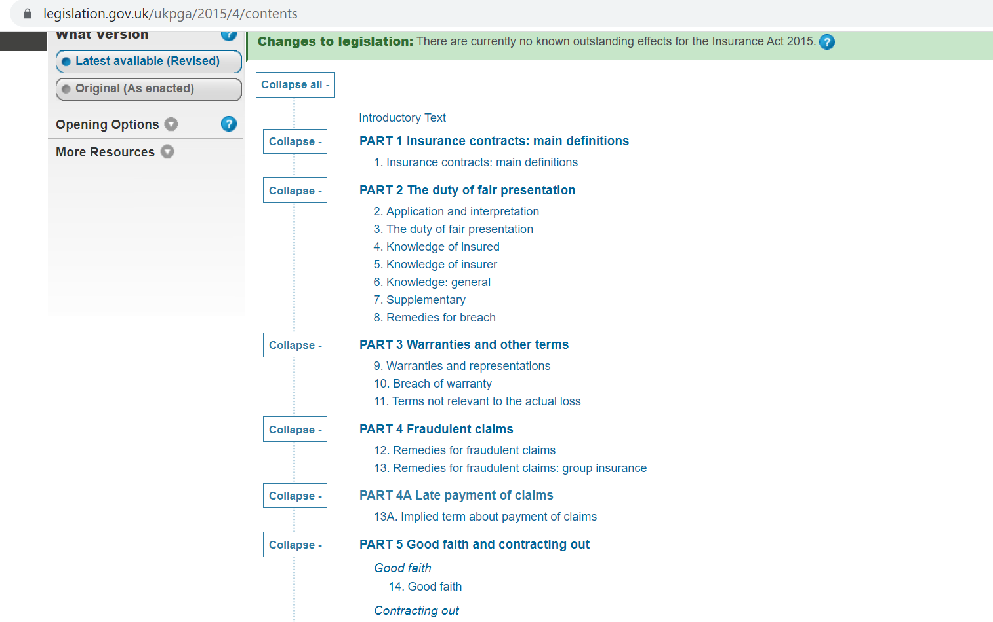
Tip 2 – Selective skimming
Use reading lists wisely.
Narrative to opinion/analysis.
Read topic sentences.
Only read for detail when you are sure you have the right text for you.
Organise your notes (highlighting is the biggest illusion of learning). Issue / Detail / Source.

Slide 5
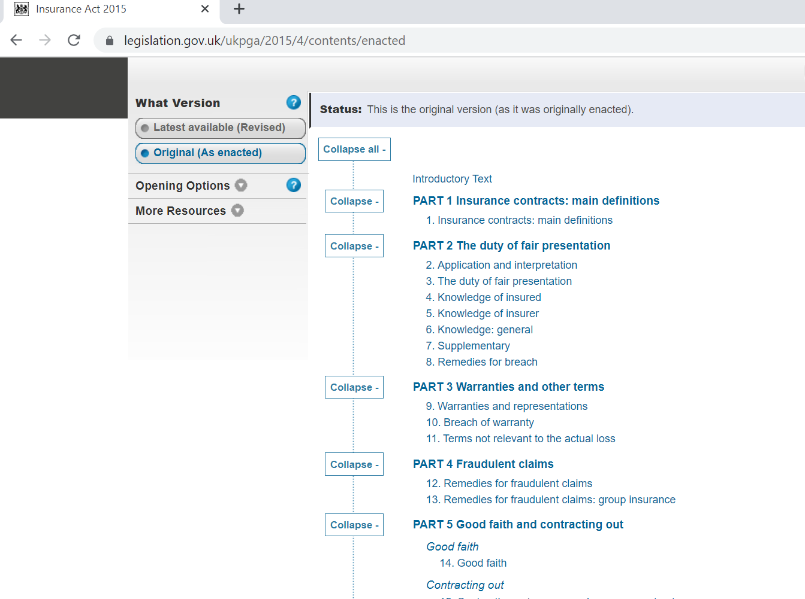
How to find laws
Statutes:
www.legislation.gov.uk
Case law:
www.supremecourt.gov.uk/decided-cases/index.shtml (press summary and judgments available)
www.bailii.org
www.iclr.co.uk – The Incorporated Council of Law Reporting for England & Wales (has the latest case summaries and an alert subscription)

Slide 6
Tip 2 – Selective skimming
Use reading lists wisely.
Narrative to opinion/analysis.
Read topic sentences.
Only read for detail when you are sure you have the right text for you.
Organise your notes (highlighting is the biggest illusion of learning). Issue / Detail / Source.

Slide 7
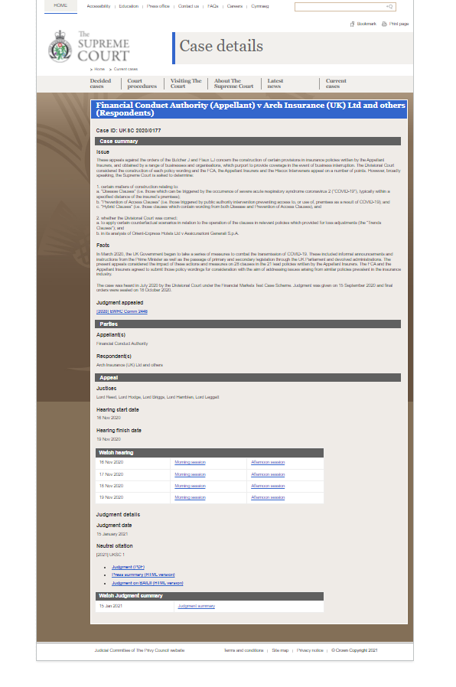

Slide 8
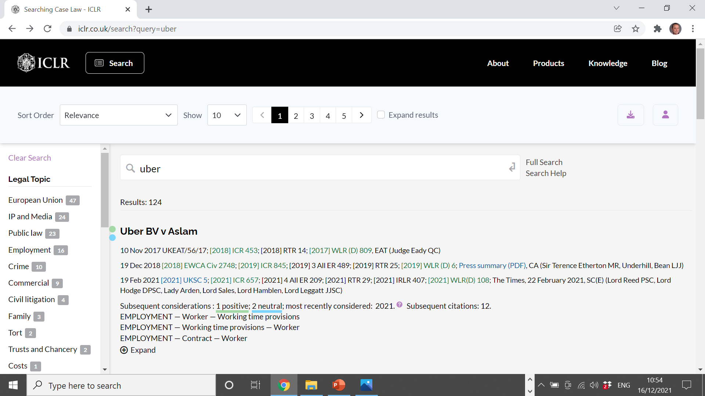

Slide 9
Reading law textbooks
Be very careful when choosing texts.
Begin with overviews, then delve deeper.
Don´t be tempted to go direct to articles / opinion pieces.
Have a system for taking notes.

Slide 10
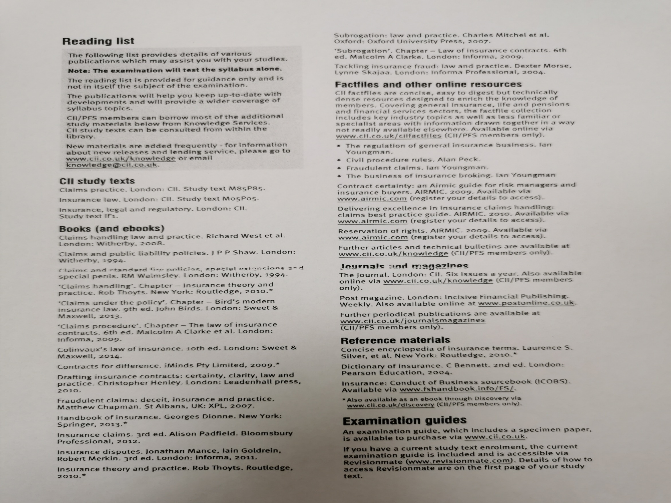

Slide 11
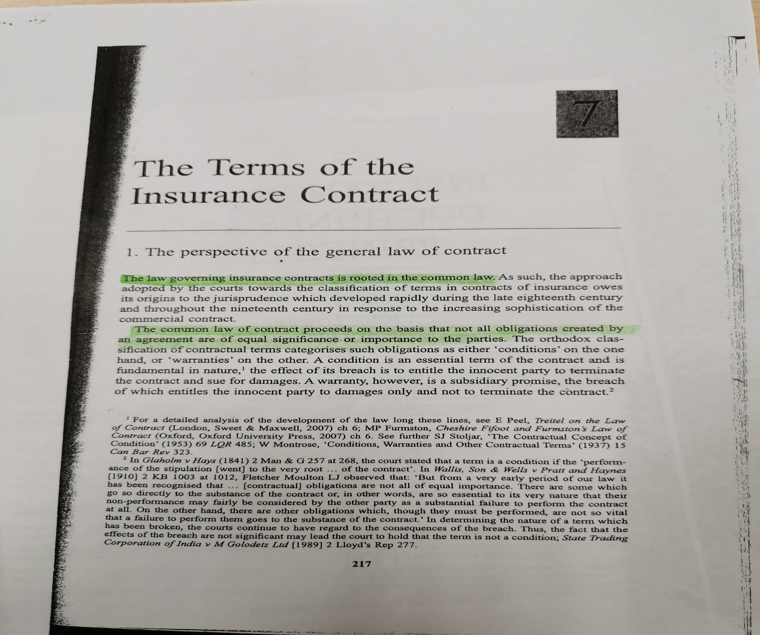

Slide 12
Issue | Detail | Source
Classification of terms in a contract of insurance | There are two types of terms in the contract – conditions and warranties. | Doctrines and Principles of Insurance Law p.217

Slide 13
Applying the law
Issue Claim
Rule Law
or
Analysis Evaluation
Conclusion Outcome

Slide 14
An example
Section 13A
(1)It is an implied term of every contract of insurance that if the insured makes a claim under the contract, the insurer must pay any sums due in respect of the claim within a reasonable time.
(2)A reasonable time includes a reasonable time to investigate and assess the claim.
(3)What is reasonable will depend on all the relevant circumstances, but the following are examples of things which may need to be taken into account—
(a)the type of insurance,
(b)the size and complexity of the claim,
(c)compliance with any relevant statutory or regulatory rules or guidance,
(d)factors outside the insurer's control.

Slide 15
John has contacted you for advice. He has lost a contract because he has been unable to afford to replace the machinery that is the subject of his claim. The insurer confirmed that the policy would respond over a year ago but they have delayed in assessing quantum because they have been overwhelmed with work as a result of the Covid BI claims. John is furious and wants your advice on whether he can make a claim against the insurer for their delays.
Advise John.

Slide 16
Your claim is for damages for late payment of an insurance claim. (C)
The law states that the insurer should investigate, assess and make payments in a reasonable time, subject to any factors that may be outside their control. (L)
Your claim is not complex and you have supplied all information requested by the insurer promptly and in sufficient detail to enable them to make an assessment. I do not consider that their excuse of being overwhelmed with work is likely to be a reasonable excuse for the delay. (E)
Based on the information currently available, my opinion is that your claim for damages for late payment of your insurance claim will be successful. (O)

Slide 17
Restatement of learning objectives
By the end of the webinar, participants will be able to:
identify key skills in reading and understanding laws.
recognise how to assimilate the knowledge gained and apply the law to a case study or provide advice to a client in a logical and clear way.
implement a strategy to read, understand and apply law more quickly and effectively.

