Slide 1
The Five Key Habits of a Trusted Adviser
by
Jeff Heasman MABP, PGCert CELTA, LL.B (Hons), LL.M
Certified Practitioner Member of the Academy of Modern Applied Psychology
Member of the Association for Business Psychology
linkedin.com/in/jeffheasman

Slide 2
Learning objectives
By the end of the session, participants will be able to:
identify how trust is formed in the professional relationship between client and adviser.
explain the 5 key habits of a trusted adviser.
implement a strategy to build and maintain the status of a trusted adviser.

Slide 3
What is trust?

Slide 4
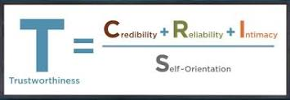
What is trust?
It´s a choice!
It occurs on a rational and emotional level.
It is a psychological state and it is relational.
Denise Rousseau emphasises the concept of vulnerability.
The trust equation:

Slide 5
Credibility:
on a rational level this is expertise.
on an emotional level it is the lived experience.
Reliability:
on a rational level it is the link between promises made and actions performed.
on an emotional level it is the observed repeated fulfilment of expectations.
Intimacy:
very much an emotional level and critical in financial services. It manifests when the client begins to confide. This is really about who you are as an adviser. When we are discreet, empathetic and human.
Self-orientation:
on a rational and emotional level this is a pre-occupation with your own agenda. Advice not sales!

Slide 6
The link to the Consumer Duty
Would you recommend your products and services to family members?
Understanding expectations.
Facilitating informed decision-making.
Switching channels where necessary to be confident the client is making an informed decision.
Clearly set out procedures / terms of engagement.

Slide 7
The 5 Habits

Slide 8
Trusted advisers always:
1. Focus on job essence as well as job function.
2. Empower the client to make the decisions.
3. Ensure asymmetry of information.
4. Seek disconfirmation and not confirmation.
5. Consciously consider self-orientation at each step.

Slide 9
Habit 1 – focus on job essence
The focus is on the overall relationship and not just the transactions.
Service and needs are job function.
Relationship and trust are job essence.
Remember the importance of intimacy/warmth, particularly where credibility and reliability cannot be tested early on.

Slide 10
Habit 2 – empower the client
Engage (let´s talk about …)
Listen (tell me more …)
Frame (so the issue is …)
Envision (let´s imagine …)
Commit (I suggest we …)
Utilise MESOs (Multiple Equivalent Simultaneous Offers) if it is relevant.

Slide 11
Habit 3 – information asymmetry
Plain language is crucial but it goes deeper.
The Keats heuristic – the harder something is to pronounce or understand, the greater the perceived risk!
The more difficult something is to read, the harder the task is perceived to be.
People misattribute the experienced ease or difficulty based on what is the focus of their attention at the time.

Slide 12
Habit 4 – disconfirmation not confirmation
If you hear yourself thinking to yourself, “what my clients wants is ….” it is time to think about your biases!
Reactance. When people feel their autonomy is under threat, they push for the freedom.
Questions are powerful (be careful how you use them).
The deeper the power imbalance the more likelihood of reactance (think how information asymmetry impacts this).
Emphasise freedom of choice! Think about habit 2 (empowering).

Slide 13
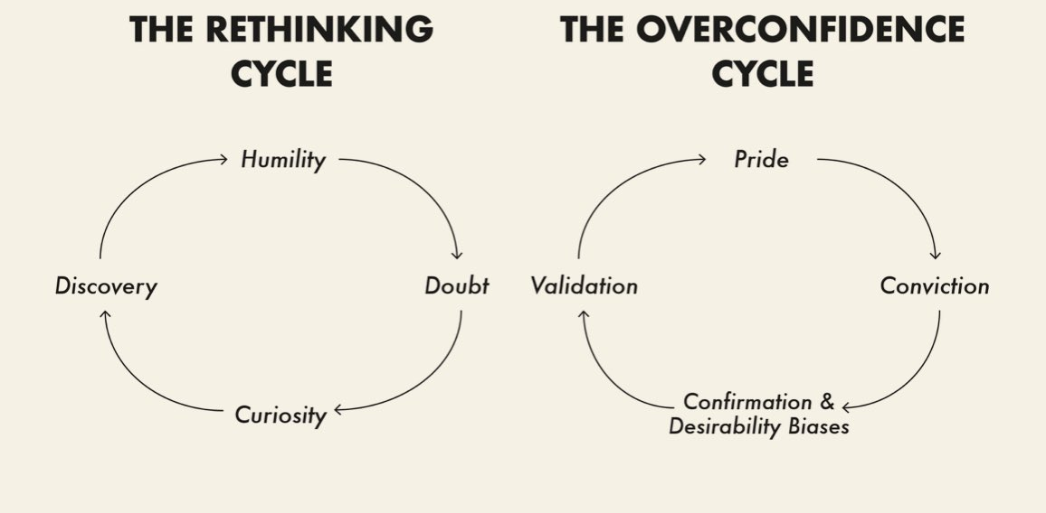
Source: Think Again, Adam Grant

Slide 14
Habit 4 – disconfirmation not confirmation
If you hear yourself thinking to yourself, “what my clients wants is ….” it is time to think about your biases!
Reactance. When people feel their autonomy is under threat, they push for the freedom.
Questions are powerful (be careful how you use them).
The deeper the power imbalance the more likelihood of reactance (think how information asymmetry impacts this).
Emphasise freedom of choice! Think about habit 2 (empowering).

Slide 15
Habit 5 – self-orientation
The client will ultimately make their decision based on how you make them feel.
Self-orientation can destroy trust without you realising.
All of habits 1 to 4 lead to ensuring self-orientation is kept in check:
job essence
client empowerment
information asymmetry
avoiding confirmation bias

Slide 16
When things go wrong

Slide 17
When things go wrong!
Apologise! Quickly! Openly! Nothing is a “slight” problem.
A shared endeavour. Remember vulnerability!
You need to decide if the loss of trust is based on rational or emotive reasoning and fix that aspect.

Slide 18
The 5 habits are:
1. Focus on job essence as well as job function.
2. Empower the client to make the decisions.
3. Ensure asymmetry of information.
4. Seek disconfirmation and not confirmation.
5. Consciously consider self-orientation at each step.

Slide 19
Restatement of learning objectives
During this session, we have:
identified how trust is formed in the professional relationship between client and adviser.
explained the 5 key habits of a trusted adviser.
learnt how to implement a strategy to build and maintain the status of a trusted adviser.

Slide 20
Sources
The Trusted Advisor by D. Maister, C. Green and R. Galford
The Role of Trust in Consumer Relationships, ESCP Europe
Public Trust in Insurance, Chartered Insurance Institute
The Role of “trust” in Building Customer Loyalty in Insurance, Journal of Business & Management
Trust: what it is and what it is not, International Business & Economics Research Journal
Trust in Insurance: the importance of experiences, Journal of Risk and Insurance

