Slide 1
Getting to know your inner critic
Powered by
Steve Heath, Co-Founder,
Mental Health in Business Ltd

Slide 2
Steve Heath
Co-founder and Director, Mental Health in Business
Website: http://www.mhib.co.uk/
Email: steve@mhib.co.uk
Mobile: 0781 403 1793

Slide 3
Session Objectives
The aims of this session are:
To help attendees understand ‘The Inner Critic’ – what it is, & where it comes from
To give attendees some practical ways to manage their Inner Critic
To help attendees to reduce the negative impact of their Inner Critic and improve wellbeing

Slide 4
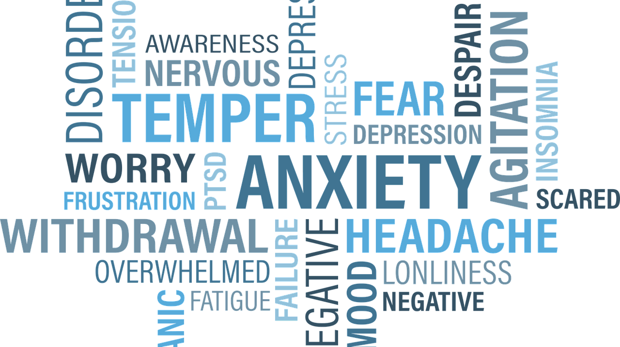

Slide 5
About Yourself…
At Work…
“You’re so unattractive”
“You’re under so much pressure”
“You’re getting fat”
“You’ll never get everything done”
“Look at all those wrinkles”
“You're not good enough”
Relationships…
“He/she doesn’t really love you”
“Your don’t deserve to be loved”
“You are just going to end up hurt”

Slide 6
Where does our inner critic come from?

Slide 7
The Inner Critic
The Inner Critic’s job is to keep you safe.
Your Inner Critic is always acting from a place of fear.
The Inner Critic it is part of you and may never go away.
The Inner Critic may sound like an authority figure.
The Inner Critic can be your friend.
The Inner Critic changes all the time.

Slide 8
What do you think are some of the ways that we could start changing our relationship to our Inner Critic?

Slide 9
The Six Keys to Changing Your Relationship to Your Inner Critic
Notice what happens/what triggers your Inner Critic.
See your Inner Critic as a child to be treated with care.
Decide what truth is present in the Inner Critic’s messages.
Consider other perspectives.
Decide how you want to respond.
Find / create tools and techniques to support your choices.

Slide 11
What can you do today to show yourself kindness?

Slide 12
Session Objectives
The aims of this session are:
To help attendees understand ‘The Inner Critic’ – what it is, & where it comes from
To give attendees some practical ways to manage their Inner Critic
To help attendees to reduce the negative impact of their Inner Critic and improve wellbeing

Slide 13
Steve Heath
Co-founder and Director, Mental Health in Business
Website: http://www.mhib.co.uk/
Email: steve@mhib.co.uk
Mobile: 0781 403 1793

