Slide 1


Men’s Mental Health Month
Presented by Steve Heath, Co-Founder
and Director, Mental Health in Business

Slide 2
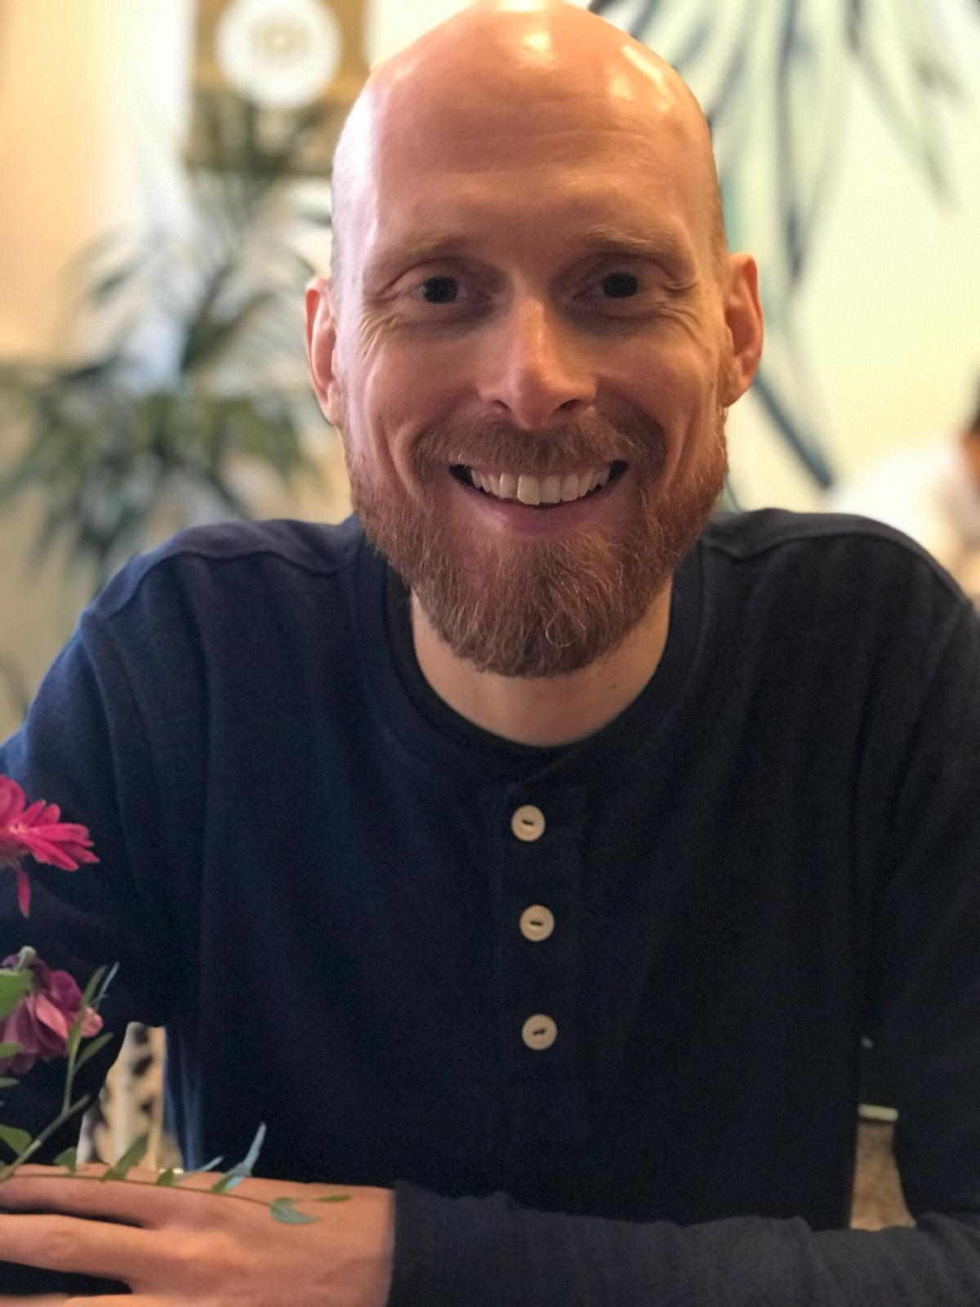

Steve Heath
Co-founder and Director,
Mental Health in Business
Website: http://www.mhib.co.uk/
Email: steve@mhib.co.uk
Mobile: 07814031793

Slide 3
Session Objectives
By the end of the session you will be able to:
Identify the early signs of mental ill-health in men and boys.
Understand how to start a conversation about mental health.
Support men and boys to access appropriate help and support.
Understand the importance of helping men and boys to stay mentally healthy, build strong connections and take action early when times are tough.
Be a part of the conversation on men's mental health.

Slide 4

Men are nearly three times more likely than women to become alcohol dependant.
Just over three out of four suicides (76%) are by men.
Men are more likely to use (and die from) illegal drugs.
12.5% of men in the UK are suffering from one of the common mental health disorders.
Men are less likely to access psychological therapies than women.
Source: Mental Health Foundation

Slide 5

Why do men find it hard to talk about mental health?

Slide 6
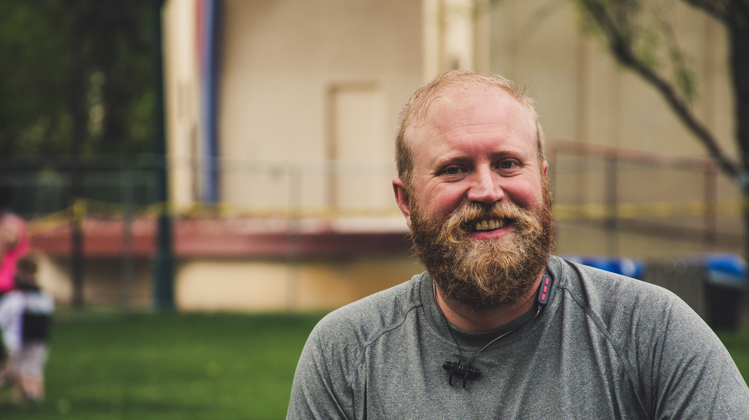
Stigma
Traditional Gender Roles
Expectations
Isolation
Big boys don’t cry
Loneliness
Strong / Aggressive
Stoic

Slide 7
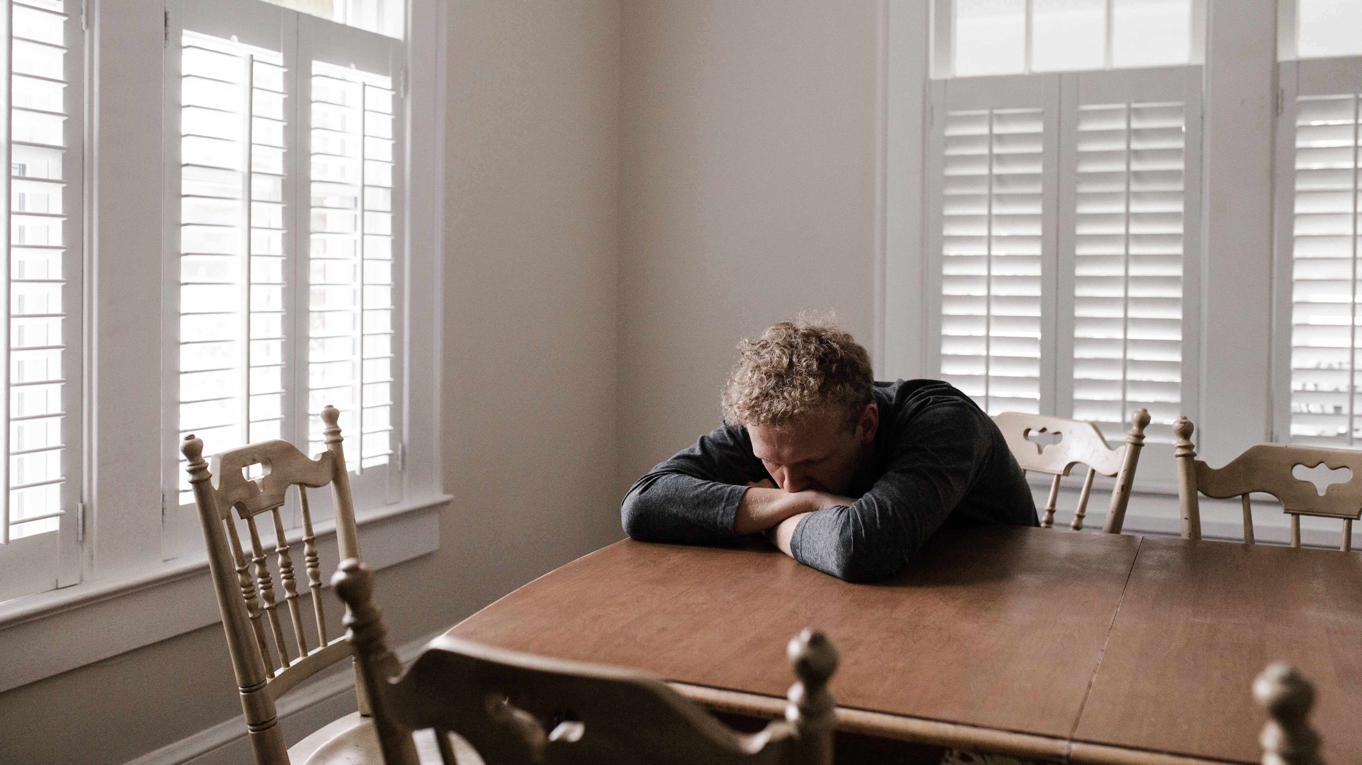

Slide 8
Symptoms of poor mental health
Mood changes – including increased feelings of anger.
Aggression and violence.
Physical symptoms, such as chronic headaches or stomach aches.
Restlessness and difficulty focusing.
Sleep deprivation or excessive sleeping.
Eating disorder.
Alcohol misuse or substance misuse.
Suicidal thoughts.
Appetite and weight changes.
High-risk activities.
Fatigue.
Obsessive thinking.

Slide 9
A
L
E
C
ASK
LISTEN
ENCOURAGE
CHECK IN
How are you feeling?
You haven’t been yourself lately –are you ok?
Ask twice if needed!
Trust your instinct.
Give your full attention.
Let them know you’re not judging.
Help focus on the simple things that could be done to help.
Low more than two weeks? Encourage going to a GP.
Arrange to catch up again soon (face to face is best).
Are things getting any better?
Developed by R U OK?

Slide 10
Additional things you can do to help
Listen and don’t judge.
Stay in touch.
Find out about any local services such as talking therapy or support groups.
Reassure that it’s ok to get professional help.
Take care of yourself.
CALM has a helpful web page about what to do if you’re worried someone might be suicidal.

Slide 11
What do you think are some ways to improve men’s mental health?

Slide 12
Additional things you can do to help
Be part of the conversation on mental health.
Take action early.
Open up.
Reframe your thinking about mental health.
Seek therapy.
Build strong connections.
Join an all-men support group.
Eating well, exercising and sleep (the powerful basics).

Slide 13



Website: http://www.thecalmzone.net
Phone: 0800 58 58 58
There is a webchat available on their page.
Emergency Contacts:
NHS – 999
Samaritans
116 123
Website: https://www.menshealthforum.org.uk/
The Men’s Health Forum is a great source of information of everything relating to men’s health.
Website: https://andysmanclub.co.uk/
Email: info@andysmanclub.co.uk

Slide 14
Session Objectives
By the end of the session you will be able to:
Identify the early signs of mental ill-health in men and boys.
Understand how to start a conversation about mental health.
Support men and boys to access appropriate help and support.
Understand the importance of helping men and boys to stay mentally healthy, build strong connections and take action early when times are tough.
Be a part of the conversation on men's mental health.

Slide 15
Steve Heath
Co-founder and Director,
Mental Health in Business
Website: http://www.mhib.co.uk/
Email: steve@mhib.co.uk
Mobile: 07814031793

