Slide 1




7 Habits of Highly Effective Negotiators in Insurance & Financial Services
by
Jeff Heasman MABP, PGCert CELTA, LL.B (Hons), LL.M
Certified Practitioner Member of the Academy of Modern Applied Psychology
Member of the Association for Business Psychology
linkedin.com/in/jeffheasman

Slide 2


Learning objectives
By the end of the session, participants will be able to:
understand the key elements of a negotiation process.
identify the 7 habits of a highly effective negotiator.
implement a strategy to negotiate with confidence in future business dealings.

Slide 3
The 7 Habits
Highly effective negotiators habitually:
prepare.
seize power.
control emotions.
thinking critically.
actively listen.
communicating clearly and effectively.
honour their word.

Slide 4
Preparation
Recognise when the process begins.
Creating and claiming value.
To engage in integrative negotiations, you need to identify your partner´s and your:
  needs
  interests
  goals
Trust is built through frequent communication and information sharing.

Slide 5
BATNA.
Reservation Point.
ZOPA.
Interests:
  distributed
  integrative
  common

Slide 6
Seizing power, handing over control
Anchoring.
Negotiating by diminishing scale.
MESOs.

Slide 7
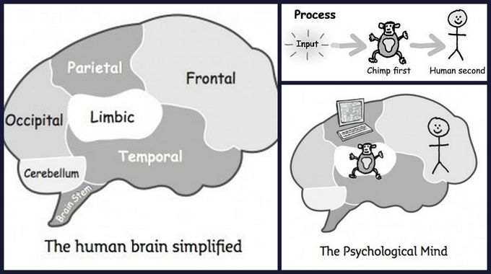
Controlling emotions

Slide 8
Critical Thinking
Focusing on obtaining the right solution rather than trying to prove they are right.
Not rushing the decision making process and weighing up the options.
Verifying information (listening out for phrases like, “it is generally accepted” etc.).
Critical thinking will lead to the need to make decisions. Each decision has four stages:
  Observe: what does the information from all sources reveal?
  Orient: analyse the information to update your situation.
  Decide: select the correct path to reach your goal.
  Act: implement the decision as soon as possible.

Slide 9
Active listening
The 4 levels of communication.
Mirror principle. Communication is a partnership.
Don´t ghost issues in emails.
The average rate of speaking is 125 words per minute. We have the capacity to understand up to 400 words per minute.
Don´t listen to reply!

Slide 10
Clear and effective communication
Plain language: paraphrase complex information.
Don´t use veiled threats (unless …).
Stick to facts rather than opinions.
The following statement expresses an opinion:
    I don’t think that is correct.
You can turn this into an observation based on fact:
    There are inconsistencies in what you have said because …

Slide 11
Honour your word
This habit really speaks for itself.
It creates a trusting and open environment.
Don´t use empty threats / ultimatums.
You must execute promises made and within the timescales agreed.

Slide 12
Restatement of the 7 habits
Preparation.
Seizing power.
Controlling emotions.
Critical thinking.
Active listening
Clear and effective communication.
Honouring your word.

Slide 13
Restatement of learning objectives
During this session, we have:
understood the key elements of a negotiation process.
identified the 7 habits of a highly effective negotiator.
learnt how to implement a strategy to negotiate with confidence in future business dealings.

