Slide 1



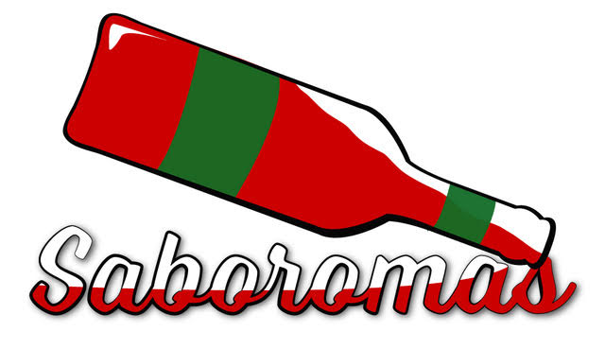

To Pair or Not to Pair: what wine pairings can teach us about forming high quality connections in our social and professional lives
Jeff Heasman
Member of the Society of Wine Educators
Specialist in communication, law and psychology
linkedin.com/in/jeffheasman

Slide 2


Learning outcomes
By the end of the session, participants will be able to:
identify the key cognitive functions that lead to stronger connections.
recognise the way in which we can harness emotional and cognitive functions for stronger connections.
implement a strategy to form high quality connections in our personal and professional lives.

Slide 3

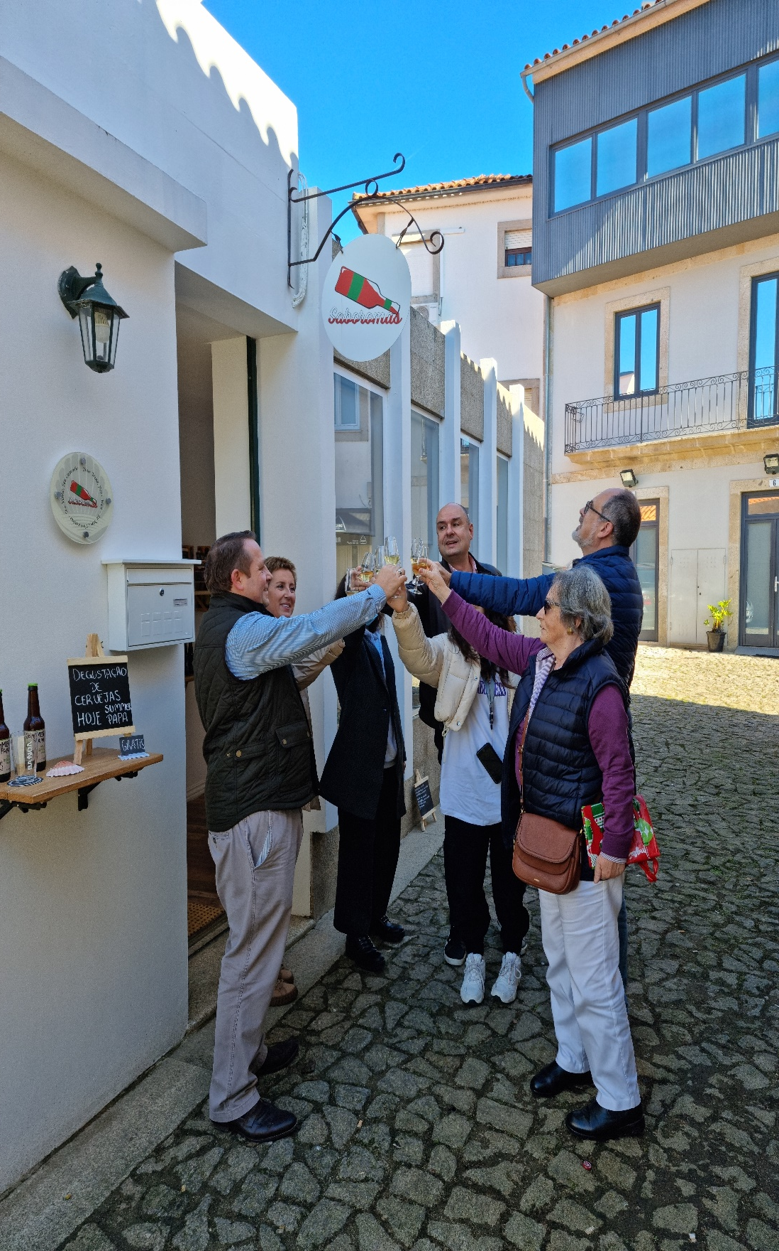
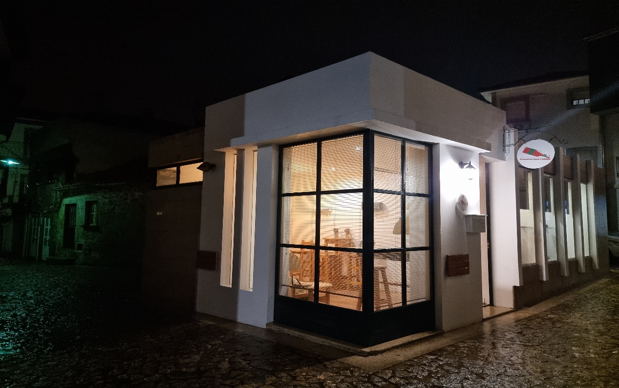

Slide 4
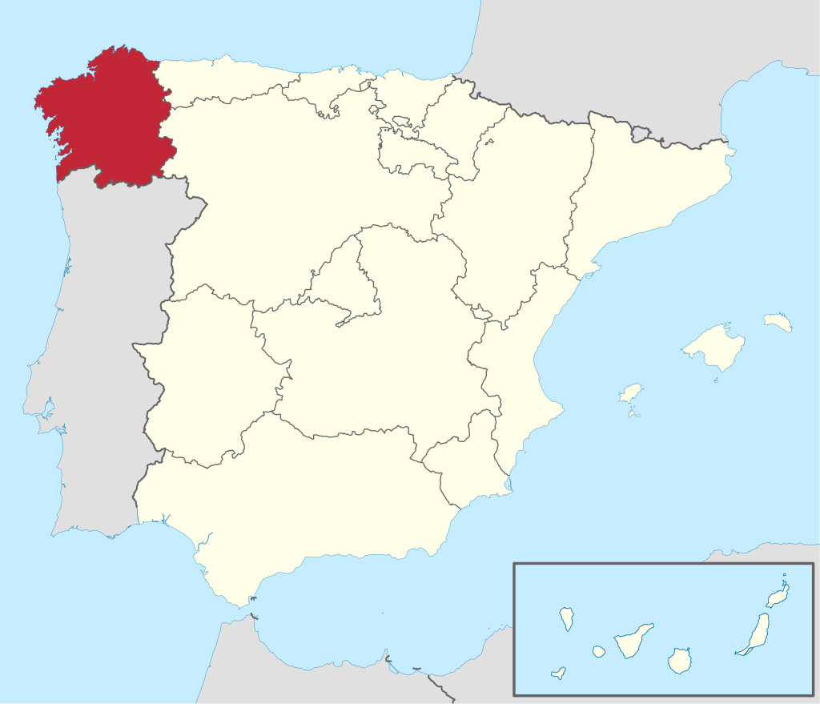
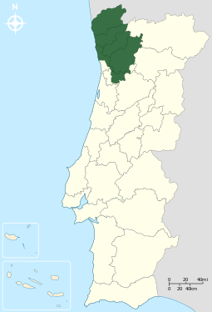

Slide 5
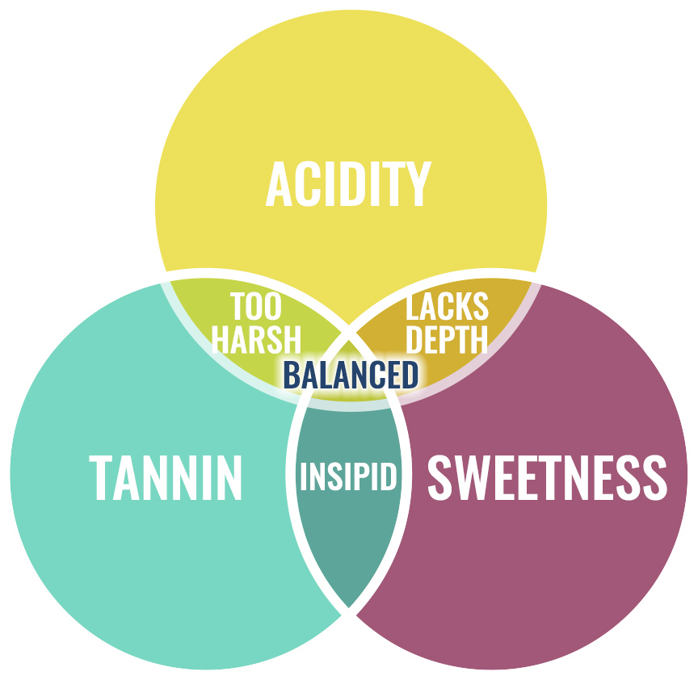

Slide 6
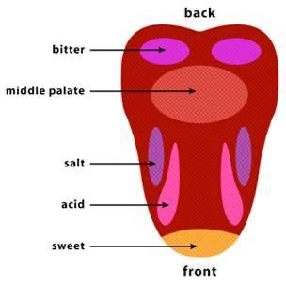

Slide 7
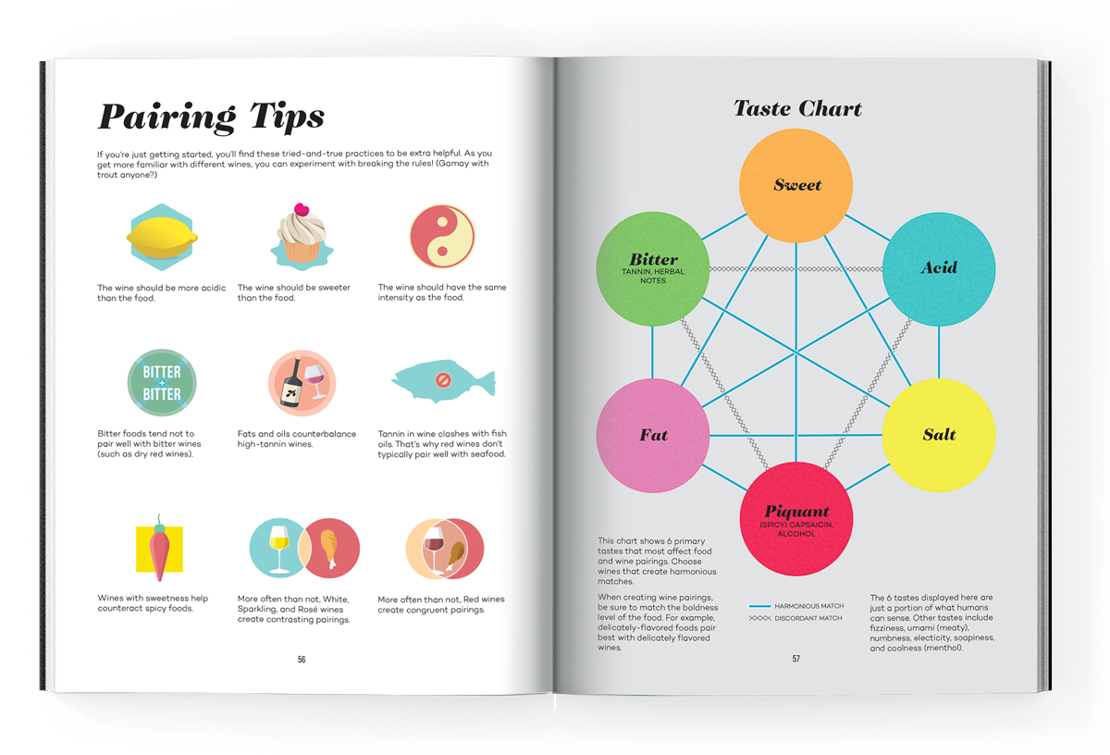
Source: Wine Folly, The Master Guide

Slide 8
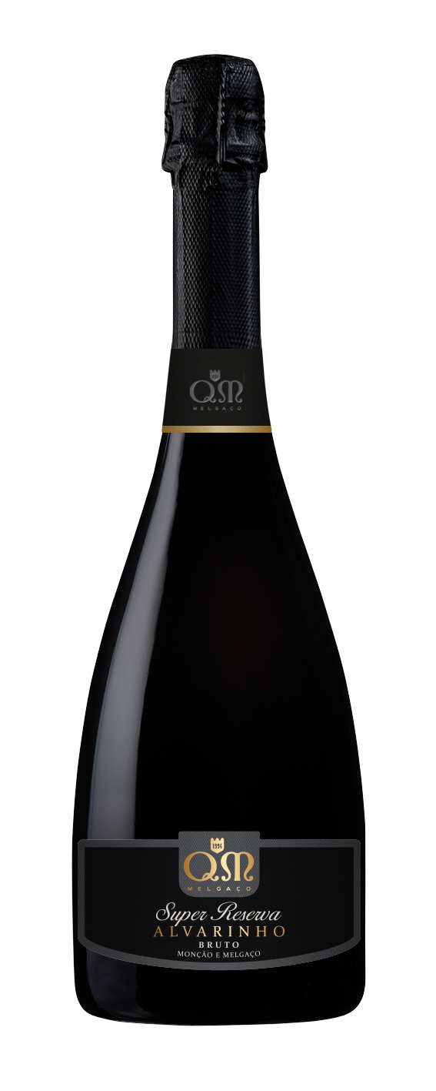
QM Sparkling Super Reserva.
Alvarinho 2021.
D.O. Vinho Verde.
Top 50 sparkling wines of the world.
Notes: citrus and tropical fruits.
Food Pairing: aperitivo, fish and shellfish.
Human Pairing: think HOW, not IF you connect (you need to be astute).
Notes:
Acidic food = fruits,

Slide 9
The sparkling wine paradox
What do people typically see as a luxury combination?
Chocolate and sparkling wine! Fruit bowl and sparkling wine!
The wine must be sweeter than the food! The wine must be more acidic than the food!
They will pair but you need to strike the balance. It is tricky!
Search for the How and not the IF!

Slide 10
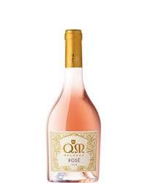
QM Rose.
Alvarinho Vinhao. 2020.
D.O. Vinho Verde.
Winner Gold Brussels World Wine Awards 2021.
Notes: red fruits, citrus peel and mint.
Food Pairing: aperitivo, fish and shellfish.
Human Pairing: uniqueness is a fine balance and is embedded over time.

Slide 11
The balance necessary in rose wine
The balance between acidity and tannin and sweetness is crucial here, as is the removal of the skin.
The balance is a careful calculation of time. Too much either way in the case of QM rose and the wine can be too high in tannin or too acidic.
If we try too promote our uniqueness too early on in the process it can be seen as narcissistic. It takes time. Be patient and strike the right balance.

Slide 12
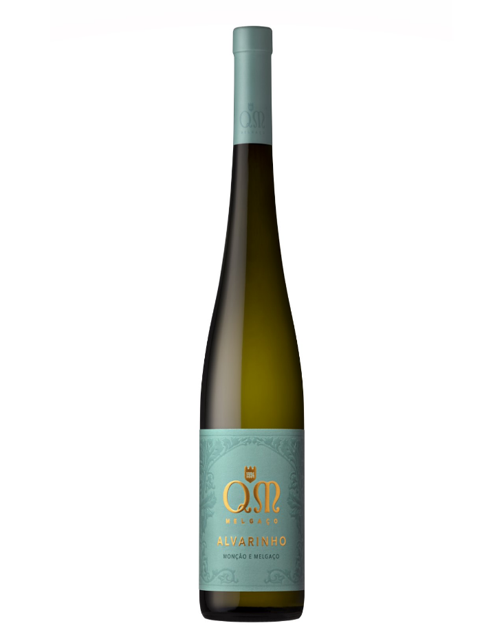
QM Alvarinho.
100% Alvarinho 2021.
D.O. Vinho Verde.
Sakuri wine awards. Best pairing with sushi.
Notes: citric fruits.
Food Pairing: fish, shellfish.
Human Pairing: opposites rarely attract, it is about complementing.

Slide 13
Complement not opposites
Freshness. Wine needs the same intensity as the food.
For example, the tannins don´t go well with the oil from fish.
Sushi and this wine complement so well, through the freshness from the acidity and cleanliness of the fish.
Opposites rarely attract (R.J. Winch). There will sometimes be relationships that simply don´t work.
If opposites do initially attract it rarely leads to a long-term relationship.

Slide 14
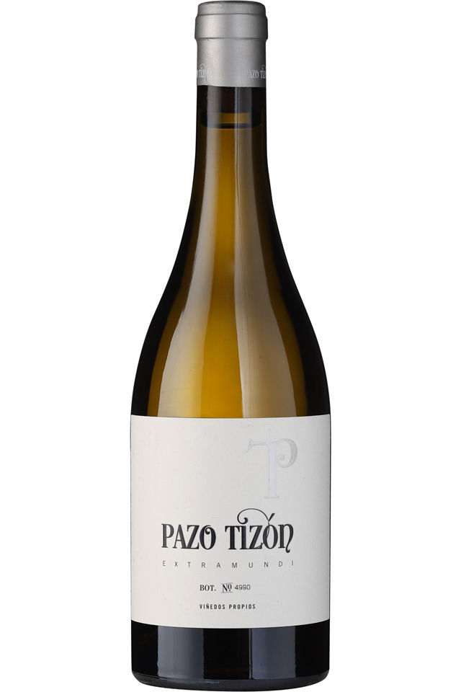
Pazo Tizon Blanco.
Albariño, Loureira, Treixadura
D.O. Ribeiro.
Gold medals at the Brussels World Wine Awards 2021.
Notes: pears, green apples, floral and citrus.
Food Pairing: Fish and seafood and white meats.
Human Pairing: diversity in networks is crucial.

Slide 15
Diversity
Grape blends in the world of wine is akin to diversity in our human world.
Grape blends are easier to pair, generally. They´re more open to pairings and you can diversify the food you have with it.
Diversity in networks is important to avoid echo chambers.
Convenors v brokers (Social Chemistry by Marissa King).
Creativity and innovation leads to results and people are more open-minded.

Slide 16
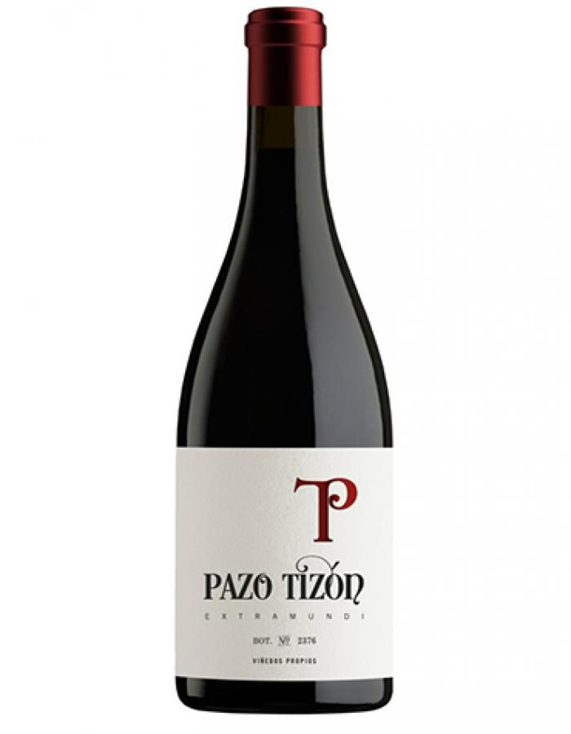
Pazo Tizon Tinto.
Arauxa, Mencia, Garnacha.
D.O. Ribeiro.
Notes: Blackberry, strawberry and raspberry.
Food Pairing: Fish, rice based dishes, red meats.
Human Pairing: not everything matures well with age.

Slide 17
Red wines and networks
Do all red wines get better with age? Do all networks get better with age?
Relationships fade. Only 15% end because of a disagreement.
Between the age of 25 and 50, men´s networks shrink by 35%, whereas women´s by 35%. By the age of 40, women´s networks are than men´s.
Convenors = tannin, they help the wine age better. Convenors maintain relationships for longer but they are not diverse.
Brokers = have stronger relationships overall (easier to pair) but they don´t have the long game of convenors (tannins).
Pazo Tizon Tinto is a broker.

Slide 18
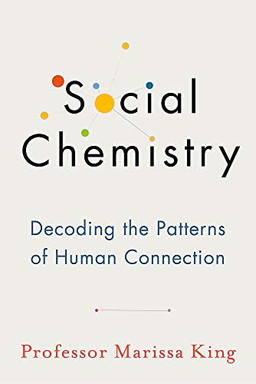

Slide 19
Summary
As a rule of thumb, wine tasting is about seeking balance and relationships that complement. It is the same in our human relationships.
How not if.
Balance and time.
Diversity.
Not everything is better with age. Like some relationships, good wines also fade.
Are you more like a high tannin wine (convenor) or a balanced blend (broker).

Slide 20
