Slide 1
Winchester Action on the Climate Crisis
The Insurance Institute of Southampton
Sustainability Webinar
16 January 2023

Slide 2
WinACC - promoting actions to create net zero carbon environment in Winchester District/Hampshire Working with communities: community action network; home retrofit projects climate assemblies; Winchester Food Partnership; renewable energy campaigning Influencing systemic change: Lobbying Councils and other authorities - on renewable energy generation; low carbon transport; building and materials standards; responsible investment Presenters:
Hugh McNaughtan – Trustee/Director & Treasurer
Jo Crocker – Executive Director

Slide 3
OBJECTIVES FOR THIS SESSION:
To help build a shared appreciation of why climate change is of fundamental importance to all of us, not least to the insurance sector.
To try to address the question: “What has this got to do with me?” - how you can make a difference in everything you do, as an industry, in your firms/offices and as individuals.
In particular, to share thoughts on how as individuals working in the insurance sector you may be able to help business become more sustainable.

Slide 4
What is Climate Change? Why is it Important?
1. Royal Society of Arts minimate – Climate change and the future of humanity – by David Wallace-Wells (NY Times journalist; “The Uninhabitable Earth”)
https://www.thersa.org/video/animates/rsa-minimate/2020/climate-change-future-humanity
Over 50% of fossil fuel emissions since 1995 - today’s damage, not old legacy
Will transform every aspect of life – over $600 trillion in damages by end of century!
Rapidly approaching +1.5°c temperature rise above pre-industrial levels; on existing trends could approach + 4°c by end of century – hotter than any point in human history; UN estimated potential 1 billion climate refugees.
The challenge is in our hands – view as ‘Empowering’!

Slide 5
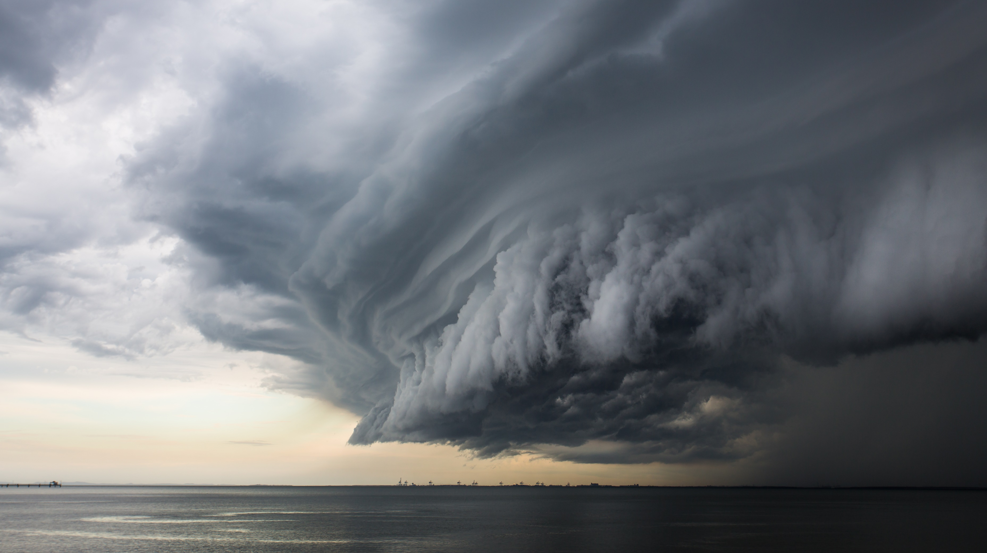
What is Climate Change? Why is it important?
Human-related activity causes more GHGs to enter the atmosphere than the biosphere naturally removes. We are “changing the climate in unprecedented and sometimes irreversible ways”.
CO₂ concentrations now at 418 ppm* and rising — highest level in human history. We need to get below 350ppm!
2015 Paris Agreement - to avoid catastrophic ecological, environmental and social damage “countries should limit warming to 2°c and pursue efforts to limit it to 1.5°c” (we are currently at over 1.1°c*). A global target of net zero by 2050 was determined.
But IPCC’s landmark 2021 study warned of increasingly extreme heatwaves, droughts, crop failures, wildfires and flooding.
“A Code Red for Humanity!”

Slide 6
What is Climate Change? Why is it Important?
“The Earth may have left a ‘safe’ climate state beyond 1°c global warming.”
Risk of triggering climate tipping points becomes high with 2°c of global heating. Many CTPs are interlinked.
The world is heading towards ~2°c to 3°c global warming unless all net zero pledges achieved.
“UK banks and insurers will end up shouldering nearly £340 billion worth of climate-related losses by 2050, unless action is taken to curb rising temperatures and sea levels.”
Climate Tipping Points (CTPs):
Collapse of Greenland/West Antarctic ice sheets
Die-off of low-latitude coral reefs
Melting of Northern permafrost
Barents Sea ice loss » ‘Atlantification’
Labrador Sea current collapse
“CTPs are conditions beyond which changes in a part of the climate system become self-perpetuating – they lead to abrupt, irreversible and dangerous impacts with serious implication for humanity.”

Slide 7
But the Insurance Sector knows all this!
“No matter where you are, there’s absolutely no disagreement in the insurance industry that climate change is a core risk. There’s not one outlier in terms of recognising the problem, but there are still some people who are reluctant.”
So why are we speaking to you today? - the Insurance Sector can/should play a vital role in guiding/leading society and businesses to achieve a sustainable future:
You are the experts on risk, risk modelling and pricing risk
You take the long-term view
You have a trusted position as advisers
You have the scale and power to influence.

Slide 8
Actions the Sector is already taking
But,
Climate commitments are being challenged by Governments struggling to shore up energy security
See Insure Our Future’s October 2022 report (next slide)
In the broader corporate world,
Gaps between what companies say and reality - emissions sources omitted, reliance on offsetting
And
Carbon footprint a mystery to many small businesses, let alone measuring it.
Most businesses don’t fully understand ‘net zero’ and many have yet to seek advice or information to develop a net zero roadmap or improve sustainability.
Net-Zero Asset Owner Alliance and Net-Zero Insurance Alliance – transitioning investment and underwriting portfolios to carbon neutral by 2050
Task Force on Climate-Related Financial Disclosures
The Geneva Association’s study - Climate Change and the Insurance Industry: Taking Action as Risk Manager and Investors
Joint Government/Insurance industry Flood Re scheme’s Build Back Better
Commitments by some insurers to support ending investment in agricultural commodity-driven activities linked to deforestation by 2025
ABI’s Climate Change Roadmap

Slide 9
Actions the Sector is already taking
Insure Our Future issued 2022 Scorecard on Insurance, Fossil Fuels and the Climate Emergency in October 2022
“The economic cost of climate inaction is increasing”. Munich Re estimates natural disasters caused losses of $280 billion in 2021. “A broken global energy system … continues to expand fossil fuel production, despite its destructive impact”. “Insurance companies play a crucial role in facilitating this madness.”
Worldwide, most large insurers have now backed away from insuring new coal projects – there remain some key laggards
Only 14 of 41 insurers scored committed to phase out cover for existing coal operations
Momentum just starting in shift away from oil and gas – tar sands exclusions rise from 14 to 22 and restrictions on conventional oil and gas increased from 3 to 13 in the last year. But restriction quality is uneven
“The climate buck stops with the CEOs”

Slide 10
What does all this mean for you?
“The entire insurance industry value chain of insurers, reinsurers, brokers and agents, along with insurance associations and insurance regulators have to make sustainability an integral part of their decision-making …. you have no choice, this is the only way to secure your business.”
The ABI Climate Change Roadmap’s Pillar Four – Helping Society Adapt – refers to key ‘touchpoints’ with customers, clients and stakeholders – making these as sustainable as possible.
It refers to some examples:
ABI member firms offering homeowners chance to install Property Flood Resilience measures
Pension providers integrating climate change and ESG factors into default funds and developing tailored sustainable funds; ESG online tools and calculators to aid informed decisions about carbon impact of investments
Tailored insurance products for Electric Vehicles; incentives for sustainable driving within motor insurance policies; incorporating ‘Green Parts’ when settling motor claims
Providing tailored information on EPC ratings and how homes may be made more energy efficient; provision of smart devices/sensors to help in energy reduction
Risk management tools aimed at SME customers.
But sustainability ought to be embedded in your everyday jobs, lives, thinking.

Slide 11
What does this mean for you?
The UK Government’s target - to reduce the UK’s greenhouse gas emissions to net zero by 2050. Applies to individuals and businesses, large and small.
Industry sector associations and individual businesses can help to achieve net zero, not only through their own direct actions, but also by:
leading the way in delivering positive examples and sharing good practice
lobbying governments, regulators and other industries to deliver legislation, infrastructure, technology and operations to significantly reduce carbon emissions
influencing and, ideally, working in partnership with, value chains
educating, involving and actively encouraging good green behaviours amongst management, employees and communities (including clients and business networks)
Understanding your clients and providing proactive support to smaller businesses and individuals on their net zero journey.
The insurance sector is particularly well placed to positively influence its business partners and customers, as well as householders, towards net zero.

Slide 12
What are YOU doing to help?
Sufficient guidance, support, encouragement from your employer on climate change initiatives? Have you asked?
Are you confident about the issues, the terminology?
Do you understand the sustainability needs and challenges of your customers and partners?
Are the products you offer appropriate/credible/priced sensibly? Are you collecting the right information?
When talking to your customers/value chain partners, do you consider their responses to the climate crisis?
How can you positively influence business customers and partners?

Slide 13
What brings you fulfilment?
Sources of satisfaction/enlivenment
What work needs doing?
Climate & justice solutions
What are you good at?
Your knowledge, skills, resources & networks
What help would you like to deliver?
From concept developed by Ayana Elizabeth Johnson, co-founder of Urban Ocean Lab and The All We Can Save Project climate initiative.
Your Climate Action!

Slide 14
Our asks of you
Don’t underwrite fossil fuel exploration and extraction, pipelines, etc!
Incentivise renewable energy, sustainable solutions (including green building)
Work harder on your ESG products
If you view it as better to stay invested in portfolios including fossil fuel or carbon-intensive companies, please use your power to make them change!
Accelerate your transition to net zero – by 2040? Be bold!
Use your sector’s power and influence to lobby aggressively for change
Think about climate change actions and solutions in everything you do; use your own skills and knowledge to help clients and partners
Work with the volunteer sector – we’d like to work with you – mutual benefits from working towards the same goals.

Slide 15
Get involved! Make Climate Change actions a priority! Deliver!
Winchester Action on Climate Change Ltd.
contactus@winacc.org.uk
www.winacc.org.uk
01962 827083
Main Campus, University of Winchester, Sparkford Road, Winchester SO22 4NR
@WinACC @WinACC @WinACC_
Winchester Action on Climate Change (WinACC)
Thank you for listening

