Slide 1
ABI Climate Change Roadmap
Ben Howarth, Chief Sustainability Officer

Slide 2
Insurance and long-term savings:
Our commitment to Net Zero by 2050
Through the ABI’s Climate Change Roadmap, the UK Insurance and Long-term Savings sector aims to:
reach Net Zero by 2050
achieve a 50% reduction in emissions by 2030
reach Net Zero in our directly controlled operations by 2025
incorporate supply chain emissions within our Net Zero targets by 2030
The ABI was accredited as a Race To Zero accelerator in March 2022 – the only financial services body in the world to achieve this status.
The ABI has its track record on Climate Change assessed annually against the Cambridge Institute for Sustainability Leadership’s ClimateWise principles
89%
of UK long-term savings market has joined Race To Zero
54%
of the UK general insurance market has joined Race To Zero
Find out more about the ABI’s Climate Change Roadmap:
First Annual Review – published June 2022:
https://www.abi.org.uk/about-the-abi/sustainability/climate-change-roadmap/

Slide 3
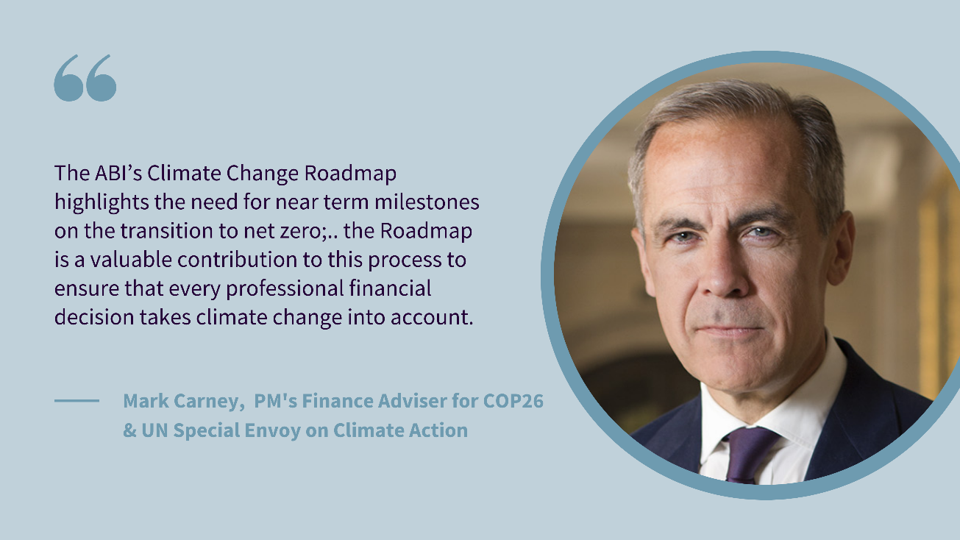
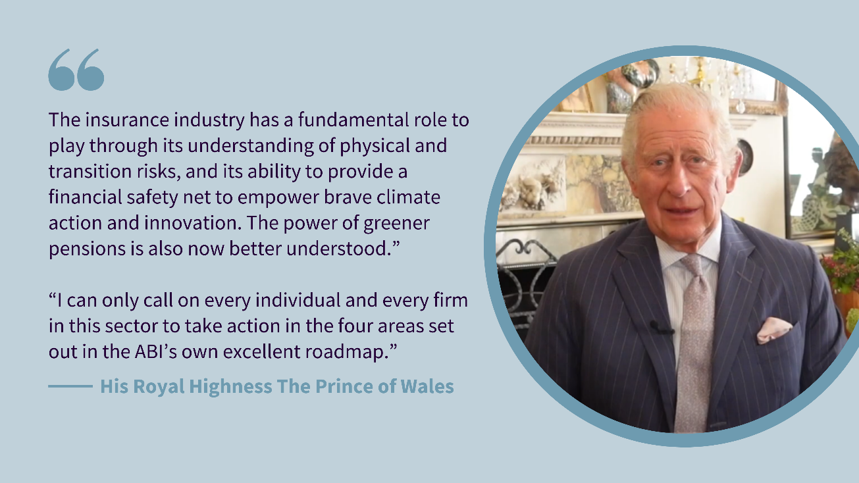
Endorsements

Slide 4
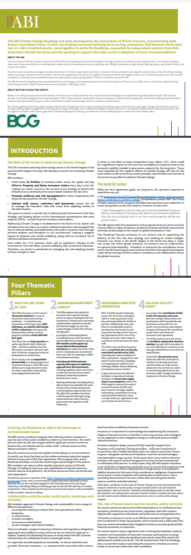
ABI Climate Roadmap: Four Pillars
1.
Meeting Net Zero by 2050
Milestones for 2025 leading to targets for 2030/2050 and support for the ‘Race To Zero’
2.
Unleashing Investment Capacity
Creating the right environment to finance the UK’s Net Zero ambitions
3.
Sustainable Industry Operations
Internal operational footprint and good practice on supply chains
4.
Helping Society Adapt
Where can our industry change to help customers and stakeholders with the transition

Slide 5
What we offer
Large pools of investable assets
ABI members hold assets of £1.7trn – and these increasingly go into alternative assets – we can provide ‘patient capital’ to scale up proven technologies
Insurance and long-term savings is an ideal partner for Net Zero
ABI members could contribute c£0.9trn of investment in Net Zero transition up to 2035 – one third of the total required (according to analysis by Boston Consulting Group).
Government action to increase the supply of UK-based investment opportunities, reduce complexity in the investment process and make these opportunities financially attractive would unlock substantial, long-term investment, which insurers can support with risk management services.
The credible Net Zero commitments ABI members have already made require us to prioritise Net Zero investments and underwriting portfolios.
Risk management expertise
Alongside investment capacity, insurers offer a range of tailored risk management solutions –including for investment risk linked to outages/underperformance
Customer demand
Demand is growing rapidly – 23% would be prepared to pay more for a car insurance policy that is tangibly environmentally friendly (Consumer Intelligence research)
Find out more about how to unlock our investment capacity:
Pillar Two of the ABI Climate Roadmap:
https://www.abi.org.uk/pillar-two-unleashing-investment-capacity/

Slide 6
Issues ‘bubbling up’
1.
Push for ‘Nature positive’ (as well as Net Zero)
2.
Rapid roll-out of new technology and services (all needing insurance)
3.
Showing ‘Stewardship’ has an impact
4.
Greenwashing – credibility of marketing claims; reliance on ‘carbon offsets’; quality of Transition Plans
5.
Insurability and the role of public/private partnership

Slide 7
More information
For more information: https://www.abi.org.uk/about-the-abi/sustainability/climate-change-roadmap/
Or contact Ben.Howarth@abi.org.uk

