Slide 1
ANNUAL CONFERENCE 2022
WELCOME

Slide 2
Housekeeping
Mobile Phones to silent please
Fire exits as marked – no fire drills planned
Facilities
CPD Certificates
Questions
  We will have a ‘roving-mic’, so please feel free to ask questions at the end of each presentation.

Slide 3
Agenda
9.00 a.m. John Walker, President Insurance Institute of the Isle of Man
9.10 a.m. Dr Alex Allinson – MHK, Treasury Minister
9.55 a.m. John Lester & Jake Moeller – Square Mile Consulting & Research
10.40 a.m. Break – Tea/Coffee
11.00 a.m. Bernard Wood – Housing Matters Charity
11.10 a.m. Bettina Roth – CEO, IOM Financial Services Authority
11.55 a.m. Audrey Christian - IOM Government, Deputy Tax Assessor

Slide 4
John Walker
President, Insurance Institute of the Isle of Man

Slide 5



Draft Economic Strategy
Building a better future together

Slide 6
Insurance Sector Contributions
Largest individual sector by GDP contribution
  £1.03bn , 19% of total economy
  Strong growth compared to wider economy
Significant employer of people
  1,900 jobs directly in insurance
Cross-over with other financial services sectors
Insurance Institute

Slide 7
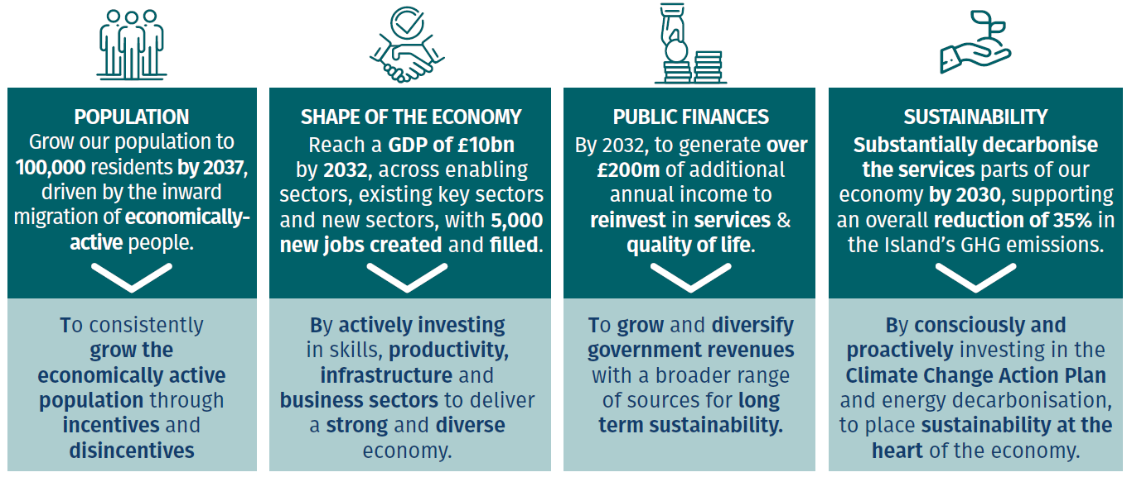
Economic Aspirations & Economic Shifts
Insurance Institute

Slide 8
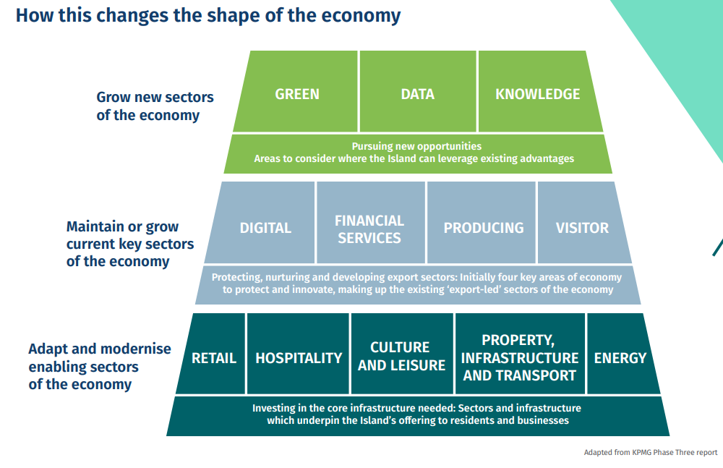
Shape of the Economy
Insurance Institute

Slide 9
The Economic Strategy and Insurance
Recognised as one of the main sectors driving our current economic growth – importance of protecting and innovating (Current Key Sector)
Strategy looks to grow personal and business prosperity, potential around
  Productivity improvements
  New products and markets
Making the Island a more attractive place for skilled workers and businesses to locate
Insurance Institute

Slide 10
CII CPD Workshop
Isle of Man
Trends in Responsible Investing
Jake Moeller
Senior Investment Consultant

Slide 11
Learning objectives
At the end of this session, delegates should be able to articulate:
What new regulations will mean for advisers and their clients
How ESG and Responsible Investment is evolving and its importance to investors
What factors are important to consider when researching RI funds

Slide 12
Market Update

Slide 13
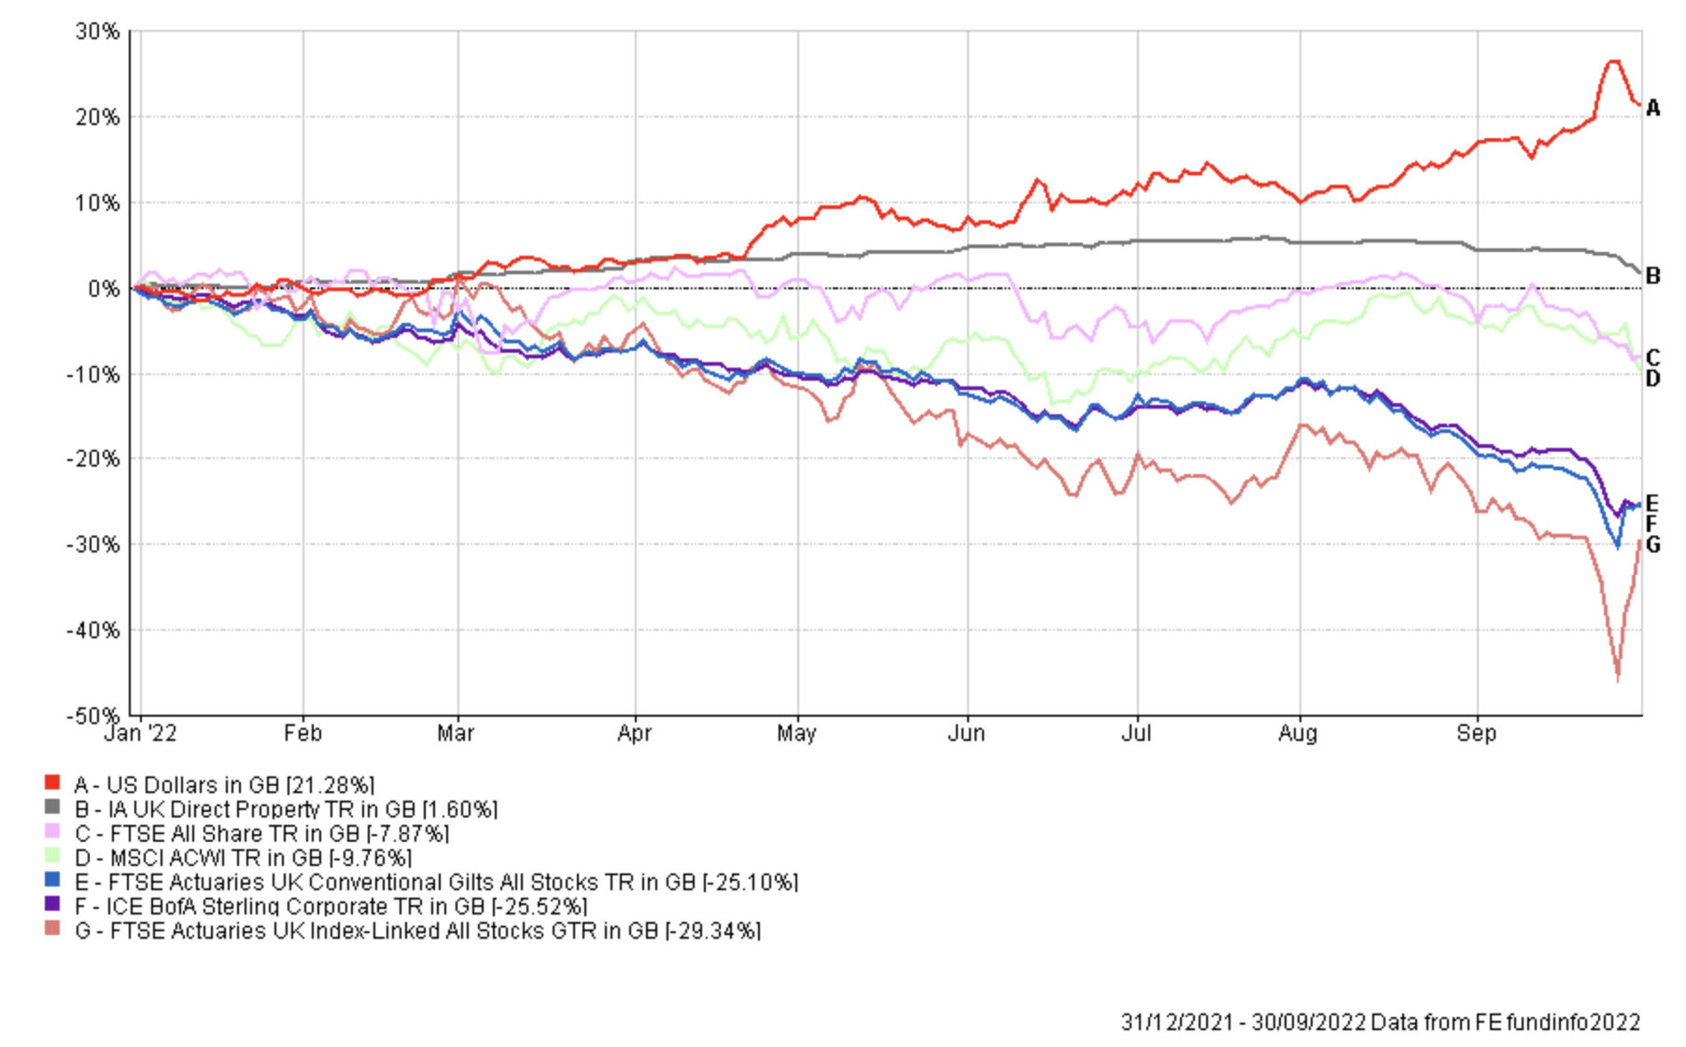
Asset Class and Currency Returns – Year to Date
Sources: FE Fund Info. Data as at 30th September 2022
Past performance is not an indication of future results.

Slide 14
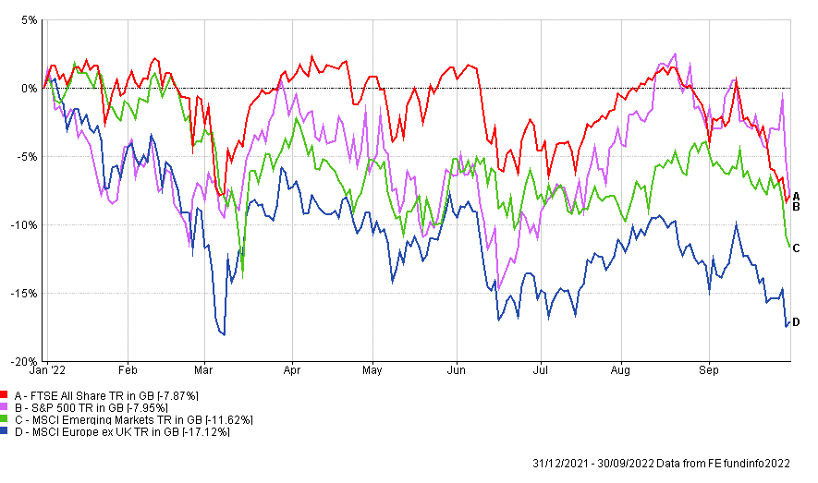
Equity Returns – Year to Date
Sources: FE Fund Info. Data as at 30th September 2022
Past performance is not an indication of future results.
Notes:
This is all in GBP

Slide 15
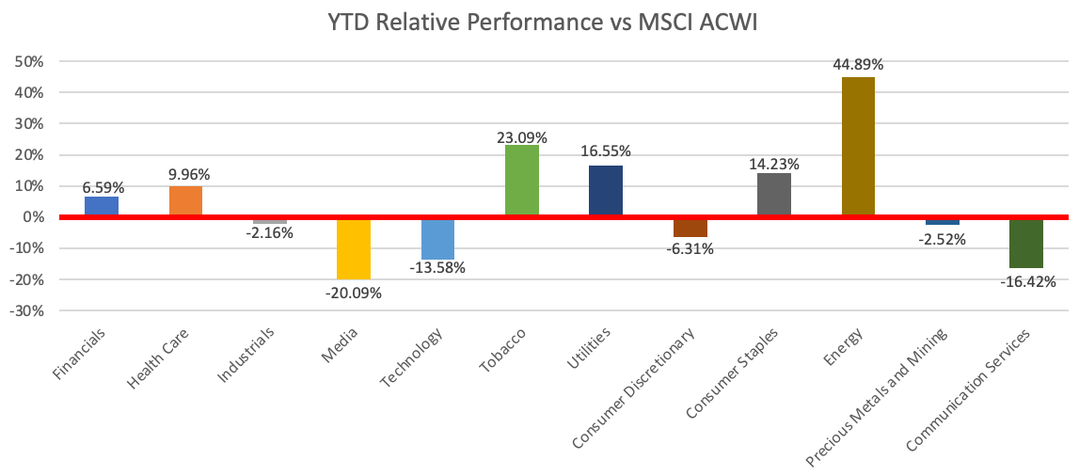
Global Equity Sector Returns – Year to Date
Sources: FE Fund Info. Data as at 30th September 2022
Past performance is not an indication of future results.
Notes:
Move to appendix & change communication services

Slide 16
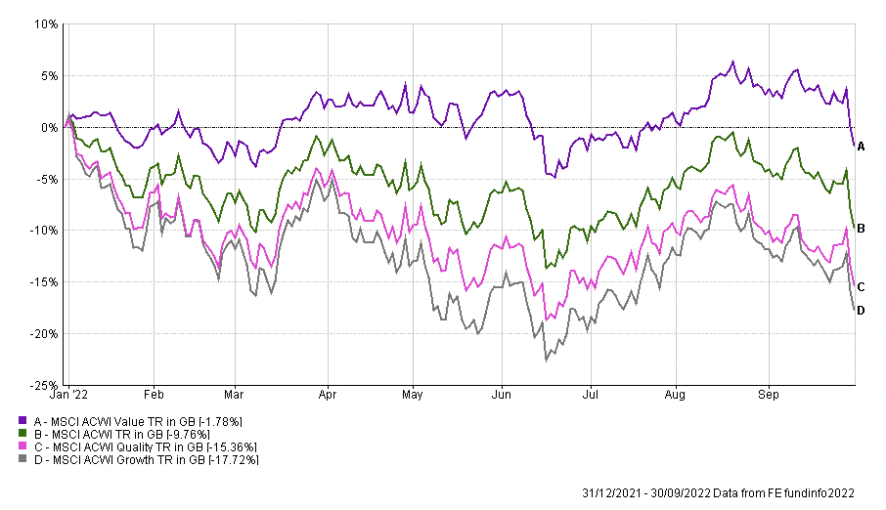
Growth vs Value – Year to Date
Sources: FE Fund Info. Data as at 30th September 2022
Past performance is not an indication of future results.
Notes:
Move to appendix

Slide 17
What new UK regulations will mean for advisers and their clients

Slide 18
Sustainability Disclosure Requirements (SDR)
The next step in putting the UK’s finance sector in a better position to achieve the
goals of the Paris Agreement
1
2
3
4
Designed to broaden the sustainability reporting across corporates and financial institutions in the UK
It will have regulatory disclosure requirements and impact all funds for sale in the UK
A more formal framework surrounding Responsible Investment
A labelling system and is expected to go further than SFDR in Europe
SDR should eventually give asset owners deep insight into the environmental and social impacts of firms in their portfolios
Notes:
Yet more evidence of the government and regulator expecting the industry to change what and how it does things will be found in the Sustainability Disclosure requirements, for which we are currently awaiting the consultation paper. The government has realized the only way to get companies to meet the Paris Agreement goals is to force the company owners (ie Asset managers on your clients behalf) to publish where they are on the responsible spectrum of capital. The new rules will broaden and enhance sustainability reporting through a more formal structure, a labelling system to make it clear to investors what they are investing in and will be backed up by regulatory disclosure requirements.

Slide 19
How is ESG and Responsible Investment evolving and its importance to investors?

Slide 20
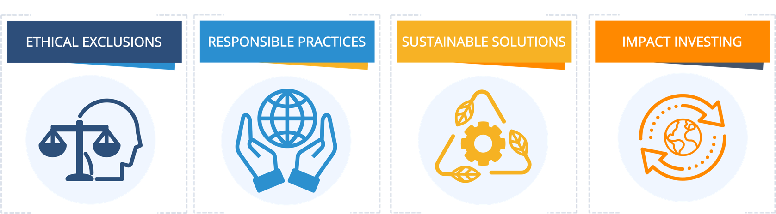
What is Responsible Investment (RI)?
RESPONSIBLE INVESTMENT
Where managers actively and intentionally seek to do good, avoid doing harm and lead change by investing in companies which are helping to meet the world’s most pressing challenges. We see this an umbrella term which stems a spectrum of investment approaches:

Slide 21

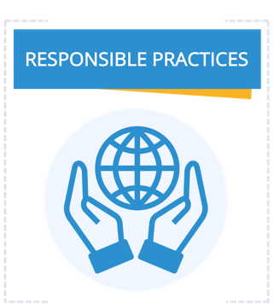
What type of investor are you?
An ethical exclusions fund manager seeks to avoid industries and company practices that cause harm to people and/or the planet.
A responsible practices fund manager considers the operational practices of the companies in which they invest and supports 'best practice' in their respective industries, as well as encouraging them to improve their environmental and social performance.

Slide 22
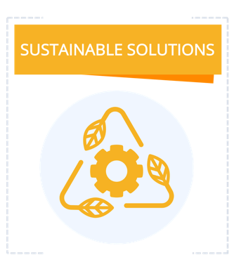
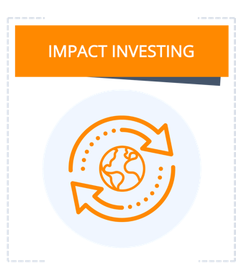
What type of investor are you?
A sustainable solutions fund manager seeks to invest in companies that are providing solutions to social and environmental challenges through their core products and services in the belief that this will realise long-term financial benefits.
An impact fund will have clear intent to make a wider positive social or environmental impact. The fund will be substantiated by investment in companies providing solutions to social and/or environmental challenges through their core products and services, with evidence provided of the social and environmental impact.

Slide 23
Spectrum of Capital
Source: Stylised adaptation from OECD (2019), “Social Impact Investment, the Impact Imperative for Sustainable Development.”

Slide 24
RI Company Report: An Overview
To gain a better understanding of how RI is being embraced across the industry, we asked asset managers to complete a short survey. We received responses from 59 fund groups, each answering 20 questions, providing insight on:
This data was collected over March and April 2022.
1
2
1
How RI is embedded at a company level
How RI is integrated into propositions
Reporting on RI propositions

Slide 25

How is RI embedded at a company level?
98.3% of respondents claimed RI was one of the main strategic priorities
Being a responsible financial actor means our investment approach must support, and not undermine, the long-term sustainability of capital markets, economies and society.
The responsible allocation of capital
[is required] to address pressing environmental and social challenges, and deliver shared prosperity.”
Shareholder rights to drive companies to improve their governance, their carbon footprint and their human capital management.
Notes:
The importance of RI at a company level was demonstrated throughout the survey – with 98.3% claiming RI was the main strategic priority. There was an emphasis on the role the industry plays

Slide 26
Where are fund groups on their RI journey?
There is a shift to the higher end of the scale and further along the RI journey.
Fund groups are focusing on strengthening their teams and internal processes.
We have invested heavily in both tools and analytics, and specialists to help us integrate RI across our global business.
Source: Square Mile. Data as at April 2022.

Slide 27
How is RI integrated into propositions?
Over half of respondents felt RI was a risk management tool, essential to meet evolving client preferences and fundamental to achieving financial outcomes.
The majority of respondents either offer funds/strategies with a sustainable outcome, or Article 8 (72.9%), or exclusion based funds (67.8%).
Source: Square Mile. Data as at April 2022.

Slide 28
How is RI integrated into propositions?
88.1%
apply a minimum level of screening
59.3%
stated this was driven by company policy
55.9%
apply a strict or partial screening to all products
64.4%
Have exclusion criteria related to human welfare (human rights, military weapons) as part of their investment process
Source: Square Mile. Data as at April 2022.

Slide 29
The direction of travel
Continuing trend in fund groups transitioning existing strategies to RI, with 79% stating they believe that offering Article 8 or 9 funds to be essential.
In most cases, this is a evolution of investment processes rather than a complete overhaul.
46.2% transitioning to Article 8
28.2% transitioning to Article 9
This transition will involve a formalisation of our approach to climate and an evolution of existing processes.
Enhanced ESG governance will be put in place, including an enhanced baseline policy and commitment to net zero targets.
Source: Square Mile. Data as at April 2022.

Slide 30
Echoed in Square Mile’s Research
This is reflected in Square Mile’s ESG Fund Assessments, which allocate one of seven grades to all rated funds depending on how deeply ESG considerations are integrated at a fund level.
Increase in funds receiving a score of 3:
  October 2019 – 2.5%
  May 2022 – 11.7%
The number of funds scoring a 0 has decreased but still demonstrates that this shift will continue.
Please note, since launch, the gradation have expanded from four (0-3) to seven.
Source: Square Mile. Data as at 30th September 2022

Slide 31
Growth in views of RI funds:
Views of RI funds in Square Mile’s Academy of Funds
Source: Square Mile. Data as at 30th September 2022

Slide 32
RI: Asset Manager flows
RI Net Retail Sales
Net flows into RI were the lowest they have been since Feb ’21 through June and July, amid wider market outflow.
RI make up 6.4% of total industry funds under management, up from 2.6% in January 2020
‘Responsible Investment’ uses Global Sustainable Investment Alliance (GSIA) definitions and includes funds which are pursuing one or more of: negative screening; positive screening; norms-based screening; sustainability themed investing and impact/ community investing. ‘Other’ = Total Net Retail Sales – RI
Source: The Investment Association. Data as at July 2022.

Slide 33
What factors are important to consider when researching RI funds

Slide 34
The jargon jungle
UN Sustainable Development Goals
Carbon footprint
Environmental, Social and Governance
Responsible investing
Exclusions
Stewardship Code
Sustainable change
SFDR
Transition
ESG Integration
Greenwashing
Sustainable investing
Thematic
Diversity
Climate change
Positive impact
Carbon Neutral
Green
Impact investing
Governance
Circular economy
Net Zero
Reporting
Ethical investing
Voting
UN PRIs

Slide 35
The need for greater transparency
As RI continues to evolve, as does the need for greater clarity and transparency through reporting, as well as consistency across the industry.
A range of internal metrics were highlighted, but this is expected to improve:
Reporting on the number of engagements undertaken and their relative progress
Mapping portfolios to existing frameworks, such as the UN SDGs
Water waste, energy and carbon intensity

Slide 36
How is RI embedded at a company level?
Square Mile’s ESG Company Assessments, which evaluate how deeply ESG considerations are integrated at a firm level.
Since launch there has been a shift to the higher end of the scale, scoring a 2 or above:
  October 2019 – 58.0%
  May 2022 – 68.0%
There has been a 76.7% decrease in fund groups scoring a 0.
Please note, since launch, the gradation have expanded from four (0-3) to seven.
Source: Square Mile. Data as at 30th September 2022

Slide 37

Through the 3D Investing lens
Assess RI funds against the 3D framework of ‘do good’, ‘avoid doing harm’ and ‘lead change’.
An evidence-based approach, with all fund managers undergoing a detailed examination of their holdings, policies and practices, as well as:
    Approach
    Validation & Data
    Exclusions
    Influence
    Environment and Social Metrics
    Impact Outcomes
Do Good
Investment in companies offering solutions to global social and environmental challenges and evidence of impact
Avoid Harm
Avoidance of investment in companies making a significant negative contribution to society and the environment and those exposed to controversies.
Avoid Harm
Lead Change
Advocacy and engagement with investee companies (individually and through co-operation with other investors) to encourage best practice and inform opinion.

Slide 38
Academy of Funds ESG Analysis
Company ESG Definitions
Fund ESG Definitions
0 | The company does not have an explicit or discernible approach to the consideration of ESG factors.
0+ | The company has begun work to identify the methodology to be used for introducing ESG factors.
1 | The company has some, but limited, consideration of ESG factors across some of its investment teams but these are not a formal part of its investment process.
1+ | The company has made ESG factors available to the investment teams as an input to their analysis, but they are not compelled to consider them as a factor when making investment decisions.
2 | ESG factors are considered formally but are not instrumental within all of the company's investment processes.
2+ | Demonstrable steps are being taken to fully integrate ESG factors into all of the company's investment processes.
3 | ESG factors are fully integrated and are instrumental to the company's investment processes.
0 | There is no discernible approach to or consideration of ESG factors in the fund's investment process.
0+ | The fund manager has begun to evaluate how they may incorporate ESG into their investment process.
1 | ESG factors may be considered by the fund's manager as an input into their analysis but are not a formal part of the investment process.
1+ | ESG factors are available to the fund managers as an input to their analysis, but they are not compelled to consider them as a factor when making investment decisions.
2 | ESG factors are actively considered by the fund's manager as an important part of the investment process , but do not drive the final investment decision.
2+ | The manager is taking demonstrable steps to fully integrate ESG into the management of the strategy.
3 | ESG factors are fully integrated and are instrumental to the management of this strategy.
Source: Square Mile. Data as at 31st July 2022

Slide 39
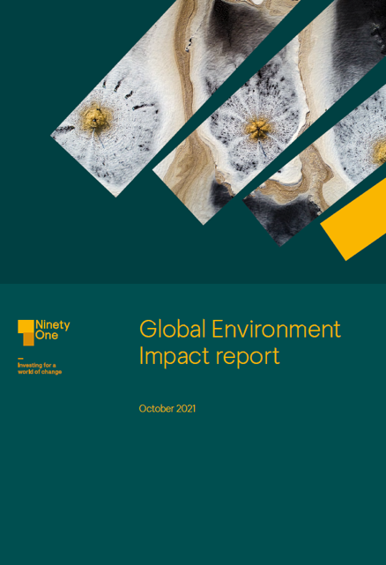
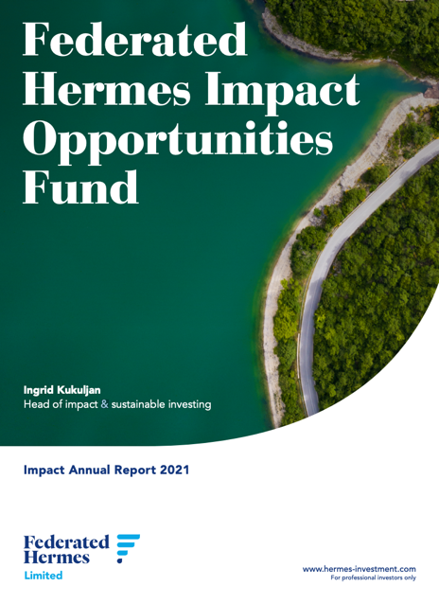
What does good look like?
Ninety One
https://ninetyone.com/en/united-kingdom/funds-strategies/global-environment-impact-report#DownloadReport
Federated Hermes
https://www.hermes-investment.com/uk/en/intermediary/insights/impact/impact-opportunities-fund-annual-report-2021/

Slide 40
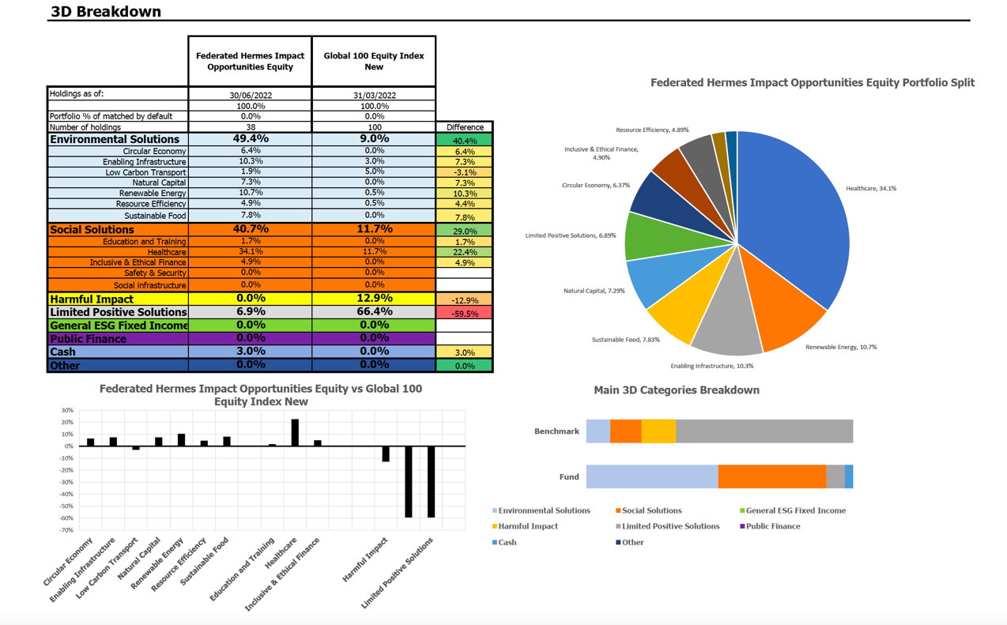
What does good look like?
Federated Hermes
Source: Square Mile Research/ Refinitiv

Slide 41
Greenwashing & the virtuous circle of learning
Boohoo
Drax
Schroders & Sainsburys
Federated Hermes

Slide 42
A final word
RI is a journey, not a destination.
RI will always evolve and we are committed to continually reviewing and developing its approaches further.”

Slide 43
Learning objectives
At the end of this session, delegates should be able to articulate:
What new regulations will mean for advisers and their clients
How ESG and Responsible Investment is evolving and its importance to investors
What factors are important to consider when researching RI funds

Slide 44
Coffee Break

Slide 45



Slide 46



Slide 47


BETTINA ROTH
Chief Executive of the Financial Services Authority

Slide 48




TOPICAL ISSUES
Change is becoming the new normal
Re-energising engagement and building networks
Being small and nimble can be our superpower
Cost of living pressures forcing people to make tough decisions
Helping consumers to future-proof their finances

Slide 49


OPEN FOR BUSINESS
Insurance sector is one of our biggest success stories
Highlighting the factors that set us apart from
other jurisdictions
Gatekeeper to the financial services sector
Striking the right balance as a risk-based regulator
New applicants in authorisations pipeline

Slide 50

UPDATED FRAMEWORK
New risk-based solvency and capital framework
in operation
Changes to qualifying criteria for Class 12 insurers
Most non-life insurers remain ‘lower risk’
Changes being made as a result of funding
feedback
Two-way dialogue vital in months ahead

Slide 51

OPERATIONAL RISK
Thematic review of cyber risk frameworks
Operational resilience will be a focus
Engagement on Policyholder Compensation Scheme
Improving practical aspects of our relationship
Collecting better data to inform risk-based approach

Slide 52

INSURTECH ACCELERATOR PROGRAMME
Remaining open to fresh thinking
Better outcomes for companies and consumers
Seven Insurtech scale-up businesses in programme
Live pitch event at the Villa Marina in January 2023
Showcase solutions to meet needs of Isle of Man PLC

Slide 53

CHANGES AT THE AUTHORITY
Driving transformational change
Clear focus on data management and analytics
Transition to new funding model
Phased introduction to allow firms time to plan
Your input helps to shape our thinking

Slide 54

A MORE PROACTIVE APPROACH
Thematic review of Politically Exposed Persons
Help to identify best practice and any weaknesses
Stepping up preparations for MONEYVAL
evaluation
Focus will be on effectiveness
Outcome crucial for Island’s well-being

Slide 55

ENFORCEMENT TOOLKIT
Enforcement powers help us to fulfil objectives
Wide range of remediation tools
Will take action where proportionate and appropriate
Civil penalties of £472,000 levied in past 12 months
Mitigating risks requires top-down culture

Slide 56


ESG
Tackling the challenges associated climate change
Achieving positive change through market-led solutions
Consumers thinking about outcomes of their investments
Stepping up our engagement with firms
ESG risks integrated into our supervisory work

Slide 57

ANY QUESTIONS

Slide 58
National Insurance
Audrey Christian
October 2022

Slide 59
Agenda
The current system and how it works
Recent consultation
UK Government Actuary reviews
Future challenges

Slide 60
The Current Scheme
Beveridge report published in 1942
Started on the 5th July 1948
New Health Service also came in to existence
Payment of contributions in return for benefits
Some of the contributions were to go to funding new Health Service
Different contributions for employed, self-employed and those paying on a voluntary basis.

Slide 61
Classes of NI
The current scheme of contributions introduced from April 1975
Class 1 paid by
  Employees (primary)
  Employers (secondary)
Class 2 paid by self-employed
Class 3 paid by those not in work (voluntary)
Class 4 paid on profits of the self-employed

Slide 62
Operation of the current scheme
The NI scheme operates on a pay-as-you go basis.
  Operating Account
  Investment Account (the Fund)
Annual contributions in most years exceed expenditure on benefits
Surplus is invested in to the investment account
Fund is currently worth around £920 million

Slide 63
Where is Fund income from?
NI only liable to be paid by those in employment or self-employment
Only paid on earnings from employment and profits from self employment
Employers liable to pay contributions for all employees
Only liable to pay between the ages of 16 to 66
For 22/23 estimate for NI income is £234 million
Further £42 million from UK (Agency Settlement)

Slide 64
What do we spend it on
NI is not part of General Revenue – legislation determines what it funds
Each year SSD pays benefits and state pensions and for 22/23 this totals 225.7 million
£41.1 million towards health service, 14.5% of budget

Slide 65
NI Consultation
In 2020 Treasury engaged PWC to review the current scheme
Report identified several areas where reform was possible –
  Rates
  Thresholds
  Income subject to NI
  Employer NI
  Workers over SPA

Slide 66
Comparison
Salary £30836
8298.68
4841.20
2667.60

Slide 67
NI Consultation
Consultation finished 7th October.
Over 300 responses received
Asked questions on
  Owner managed businesses
  How the self-employed should pay NI
  Aligning definitions across NI and Income Tax
  legislation
Next steps – Treasury will publish a response in the new year

Slide 68
UK Actuary Review
Every 5 years the UK Government Actuary’s Department (GAD) review the operation of the Fund
Treasury use this to shape future policy around benefits, state pensions and NI contributions
Prior to 2007 report Fund was always shown to be healthy
Since 2007 each report has shown fund reaching zero within review period

Slide 69
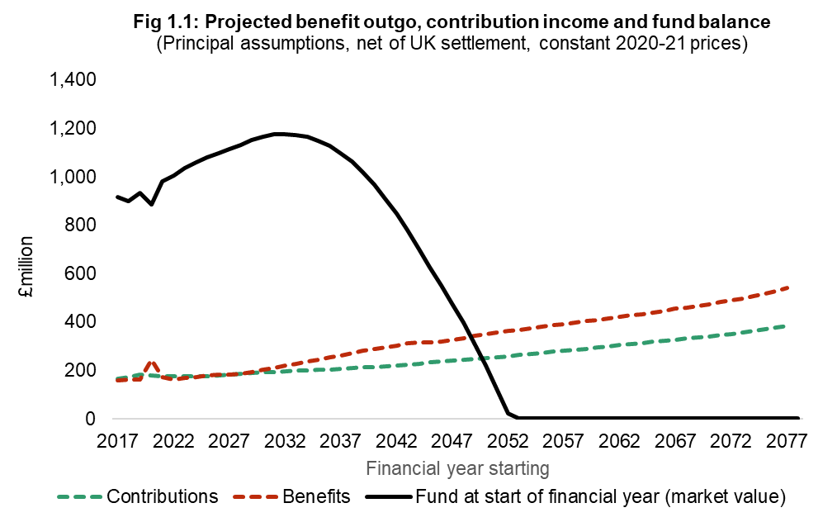
NIF Report 2017
Notes:
So what did the report show.

Slide 70
Future Challenges 2022 Review
First review where Treasury has control of future policy
2022 Review due early 2023
Treasury will look at
  Policies on future contribution rates
  Policies on future SPA increases
  Policies on investment strategy for the fund

Slide 71
Future Challenges
Economic recovery following COVID
Changes to the economy – emergence of home working and a potential shift to other employment structures
External pressures – OECD/EU
Population growth – working population
Increased NHS spending including long-term care

Slide 72
National Insurance
Questions

Slide 73
Limits and Thresholds
Lower Earnings Limit - £123 pw (£6396 annual)
  Point at which employee starts to accrue entitlement to benefits.
Primary Earnings Threshold - £138 pw (£7176 annual)
  Point at which employee starts paying Class 1 NI.
Secondary Earnings Threshold - £138 pw (£7176)
  Point at which employer starts paying Class 1 NI.
Upper Earnings Limit - £823 pw (£42796)
  Earnings above this point employee pays the additional rate.
  Employer continues to pay at 12.8%

Slide 74
Rates of NI
Class 1
  Employee with earnings above ET to UEL pays 11% (main rate)
  With earnings over UEL 1% (additional rate)
  Employer pays 12.8% on all employee’s earnings over ET
Class 2 weekly rate £5.40 (£280.80 annual)
Class 2 share fisherman weekly rate £6.70 (£348.40)
Class 4 main rate 8%
Class 4 additional rate 1%

Slide 75
Exception level and limits
Small Earnings Exception - £7176 (annual)
  Level of profits where the payment of Class 2 must be paid.
Lower Profits Limit - £7176 (annual)
  Profits over this amount liable to Class 4 main rate.
Upper Profits Limit - £42796 (annual)
  Profits over this amount liable to Class 4 additional rate.

