Slide 1

The Insurance Institute of
Sheffield
Credit Hire –
The What? Why? How? And Who?
10 May 2022
Please wait for the session to commence at 11.00
Bernard Thornton FCII
Chartered Insurance Practitioner

Slide 2
The Insurance Institute of
Sheffield
Credit Hire –
The What? Why? How? And Who?
10 May 2022
Bernard Thornton FCII
Chartered Insurance Practitioner

Slide 3

Learning Objectives
At the end of this event, the delegate will be able to identify and understand:
The background and development of the credit hire market
Important test cases which have steered its operation
The ABI General Terms of Agreement and how it works in practice
The approach to replacement vehicles by different players
Ideas for client communication

Slide 4
What is Credit Hire?
‘a means of providing a like-for-like replacement vehicle to an innocent victim of an RTA, with the least possible inconvenience and cost’

Slide 5
Who are the Participants?
Claimant (‘hiree’)
Credit Hire Company (CHC)
Third Party Insurer (TPI)

Slide 6
How Does It Work?
CHC ‘underwrites’ the risk
Credit Hire Agreement in name of ‘Hiree’
Hiree’s obligations:-
No misrepresentation
No fraud
Co-operation with recovery efforts

Slide 7

What are the Criteria?
Liability
Need
Impecuniosity
Utilisation

Slide 8
Credit Hire vs Courtesy Vehicles
FAULT OR NON-FAULT?
‘Like for Like’?
Cost?

Slide 9
Reasons for Cost Differential
Bad debt
Compromise settlements
Concessions for early settlements
Litigation costs
Uninsured TP
Additional insurance premiums
Unrecoverable damage costs
Settlement delays
‘Free’ upgrades
Admin costs
Collection & delivery

Slide 10
What is the ABI GTA?
‘The General Terms of Agreement for Insurers and Credit Hire Companies sets the standards for the credit hire industry, ensuring smoother processes and more productive relationships’.
-GTA Website

Slide 11
How Much?
VEHICLE TYPE | EXAMPLE | CH RATE PER WEEK | TYPICAL ‘SPOT’ HIRE
S1 | Vauxhall Corsa | £262.15 | £166.40
S5 | Nissan Qashqai | £426.93 | £316.00
P4 | BMW 320 | £821.38 | £349.93
PV4 | Ford Transit SWB | £404.11 | £231.00
B5 | 125cc Motor Cycle | £296.80 | £195.00
CS4 | Mitsubishi Shogun 7 | £731.99 | £511.00

Slide 12
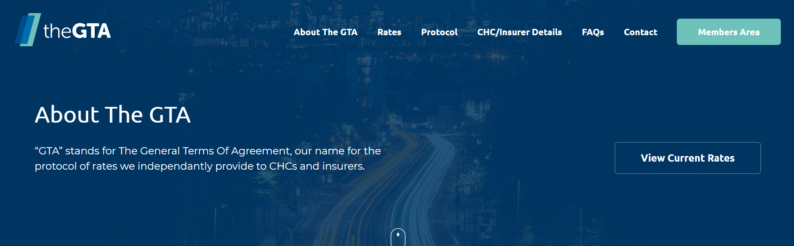
The ABI General Terms of Agreement
Website:
https://www.gtacredithire.com

Slide 13
Who are the GTA Signatories?
CHCs
Insurers (and their agents)

Slide 14
Why Does Credit Hire Exist?
Increasingly Assertive Claimants
Insurers Slow off the Mark?
Opportunist CMCs

Slide 15

The Good, the Bad & The Ugly
Ugly
Bad
Good

Slide 16

Who is the Celebrity Credit Hire Claimant

Slide 17

WINNER!

Slide 18
The Ugly
Bent v Highways & Utilities Construction Ltd (2011)
Costly stand-offs
Eye-watering costs
Who pays?

Slide 19
The Bad
Scramble for ownership
>9 different approaches
Little thought for claimant’s best interests
Claimant innocent but confused!
Poor service

Slide 20
The Good
Non-standard vehicle
Lateral thinking
Minimum disruption
Co-operation
Everyone happy!

Slide 21
Harries v Baguley (2019)
Liability dispute
£400,000 hire charges over 3 years
Mitigation attempted but refused

Slide 22
Who Regulates?
No legal regulation
Most CHCs have other regulatory controls, e.g. FCA
Credit Hire Organisation
  Full members (CHCs)
  Associate Members (mainly law firms)
CMA Investigation 2014

Slide 23
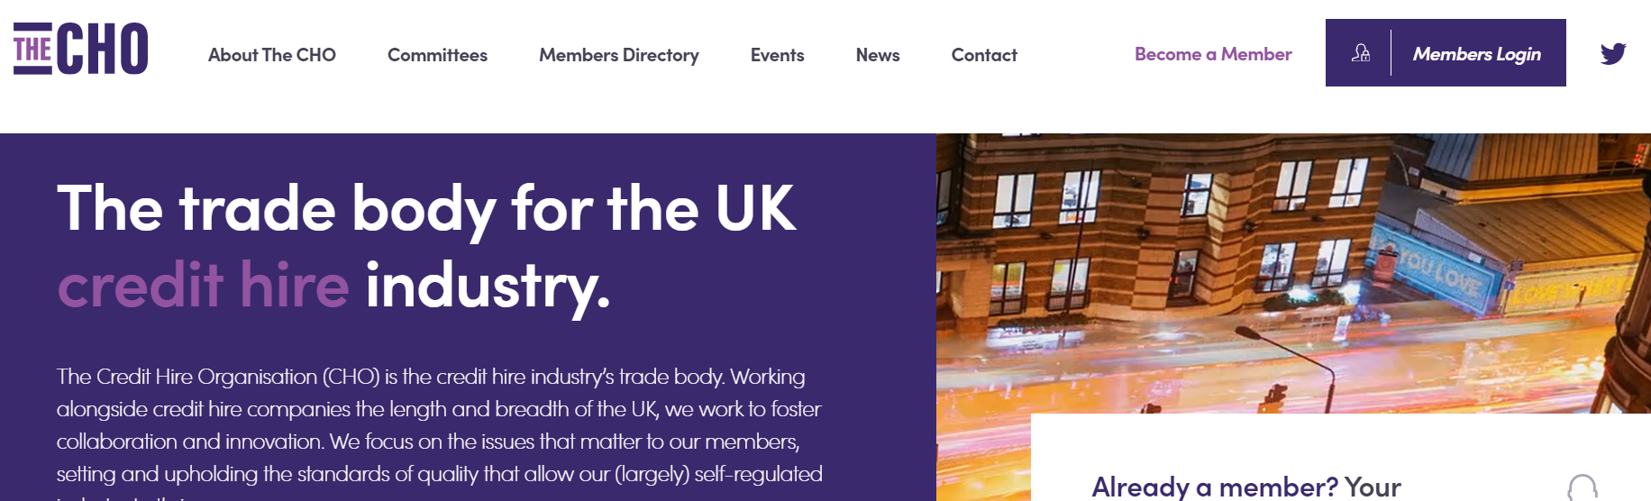
The Credit Hire Organisation
Website:
https://thecho.co.uk

Slide 24
What are the Topical Issues?
The Covid-19 Effect
The Supply Chain
Civil Liability Act
Greater Co-operation?

Slide 25


Comments & Questions

