Slide 1

The Insurance Institute of Bristol
The Highway Code Changes 2022 and the Implications for Motor Insurance
3 March 2022
Please wait for the session to commence at 10.00
Bernard Thornton FCII
Chartered Insurance Practitioner

Slide 2
The Insurance Institute of Bristol
The Highway Code Changes 2022 and the Implications for Motor Insurance
3 March 2022
Bernard Thornton FCII
Chartered Insurance Practitioner

Slide 3

Learning Objectives
•Have a comprehensive knowledge of the 2022 Highway Code.
•Understand how the changes might affect Motor liability decisions.
•Further appreciate the longer term effects on motor claims experience and underwriting implications.
•Develop ideas on communication to clients.

Slide 4
Agenda
What’s Happening?
Why?
The Changes in Detail
What does it all mean for Insurance?
Communication
Quiz

Slide 5
What’s Happening?
49 changes from 29 January 2022
Highway Code is ADVISORY only but….
Can be used as evidence in court proceedings
Concerns over public awareness

Slide 6
Why?
Changing times, changing expectations, changing behaviours
Protection and encouragement of pedestrians and cyclists
Benefits to climate, environment, public health
Miles cycled in UK rose by 45% in 2020
Public consultation
20,000 responses
75% from cyclists
60% from motorists

Slide 7
The Changes in Detail
A Hierarchy of Road Users
Priority at Junctions
Positioning of Cyclists
Awareness of Cyclists
Pedestrian Crossings
Use of Mobile Phones
Penalty Fines for Minor Offences
The ‘Dutch Reach’

Slide 8

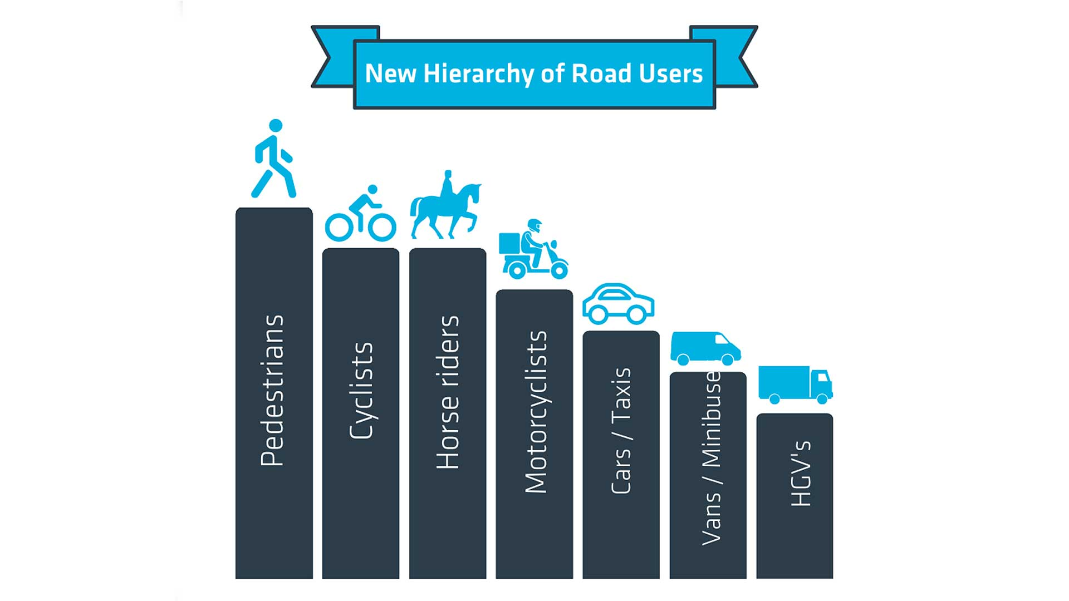
A Hierarchy of Road Users

Slide 9
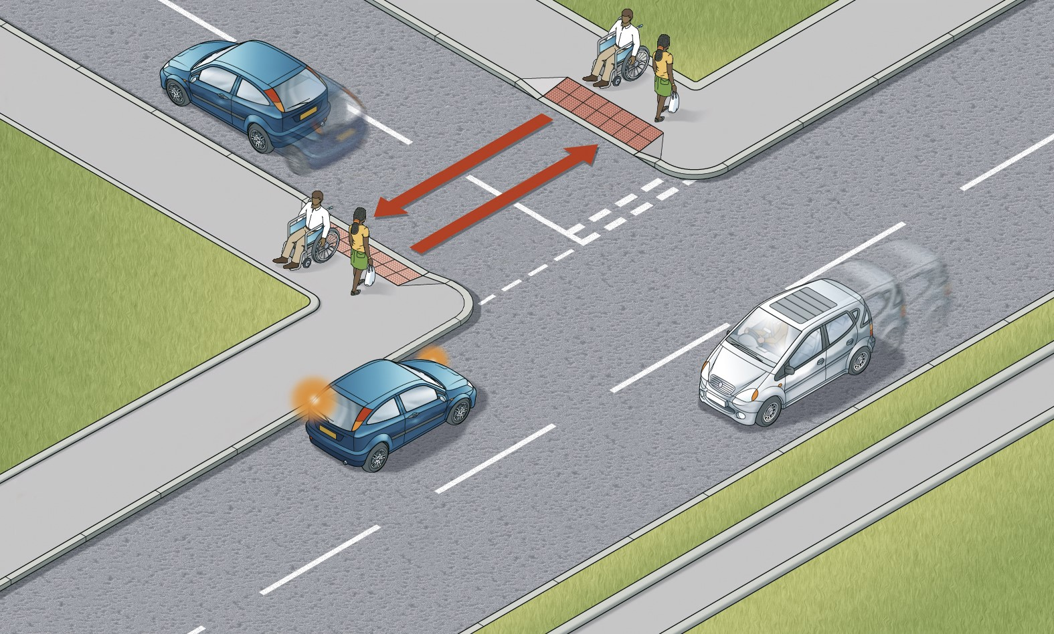
Priority at Junctions

Slide 10
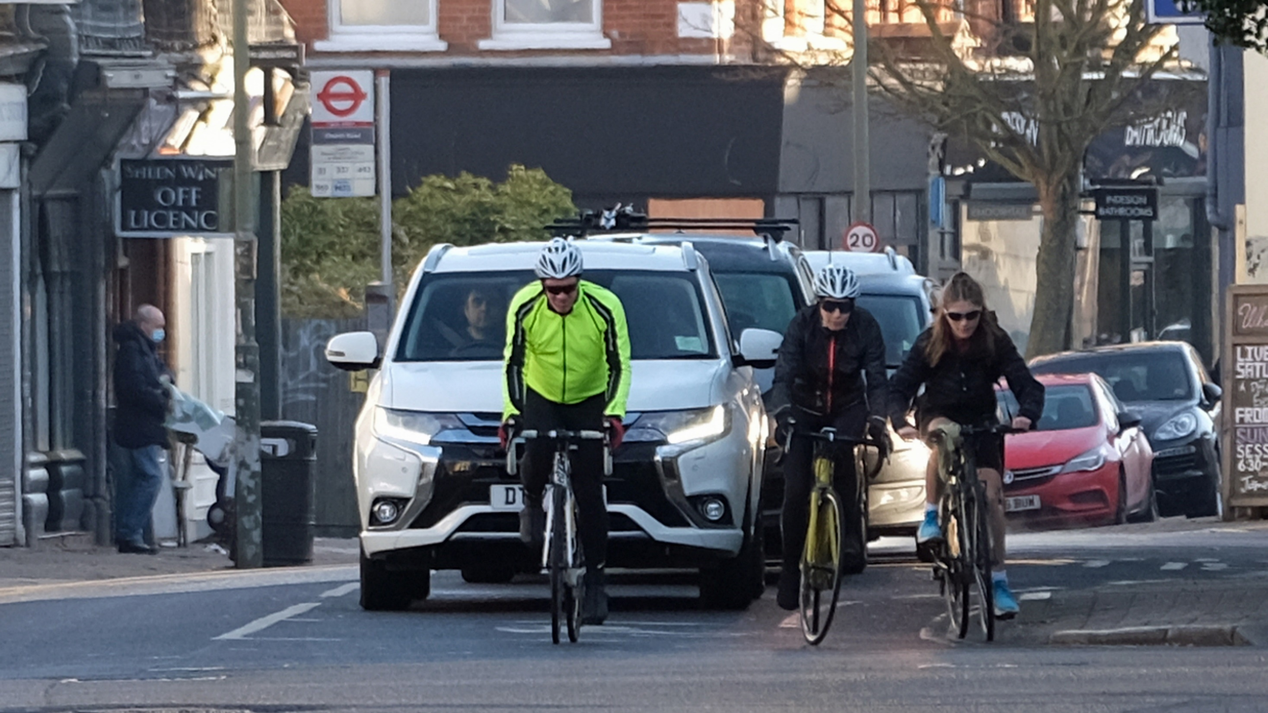
Positioning of Cyclists

Slide 11
Positioning of Cyclists
Cyclists can ride in the centre of a lane in some circumstances
Cyclists should keep 0.5m from the kerb
Cyclists can ride 2 abreast
Cyclists should be aware of vehicles behind and allow to pass
Cyclists should leave at least 1m when overtaking a vehicle
Motorists should leave at least 1.5m when overtaking cyclists
Motorists may cross a double white line to overtake a cycle or horse travelling at <10mph
Within reason cyclists can position themselves where they are most visible and feel safest
Except on the pavement!

Slide 12
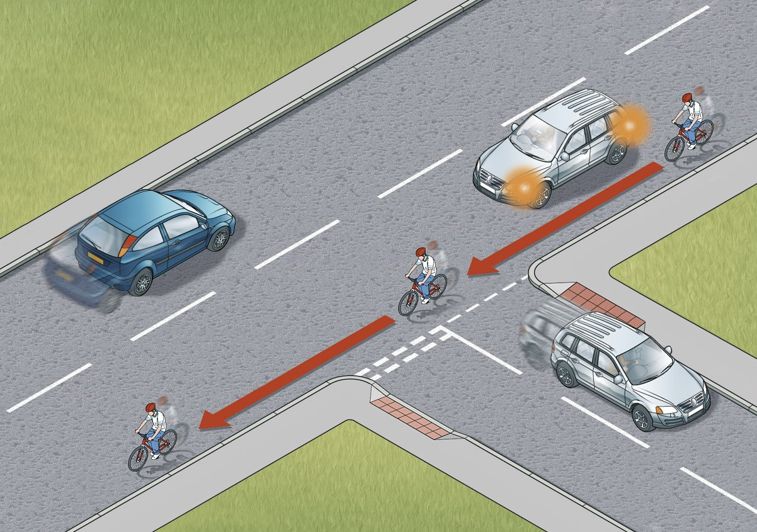
Awareness of Cyclists

Slide 13
Awareness of Cyclists
Cyclists have priority when passing a vehicle turning left or right, whether on the inside or outside
Cyclists can overtake on the inside
On a roundabout, do not overtake a cyclist in the same lane
Allow cyclists to change course on a roundabout
When joining a roundabout, all users must give way to traffic already established

Slide 14
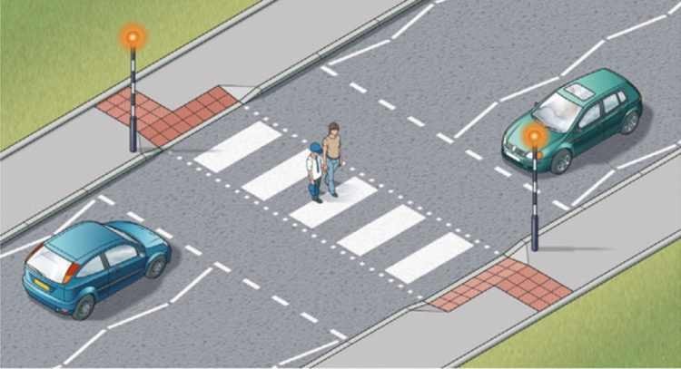
Pedestrian Crossings

Slide 15
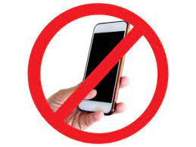
Ban on ANY use of mobile phones

Slide 16
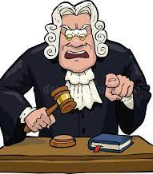
Penalty fines for minor offences

Slide 17
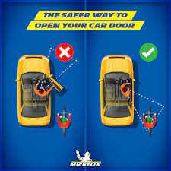
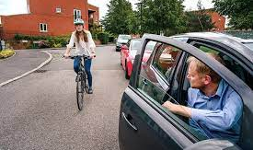
The ‘Dutch Reach’

Slide 18




IT’S POLL TIME!

Slide 19
The Consequences for Motor Insurance
More responsibility = more claims?
Offset by
  Lower speeds?
  Fewer collisions as awareness increases?
  Less severe injuries?
Lack of Awareness
Resistance

Slide 20
Communication
Public awareness. <33% are oblivious
Many more have minimal knowledge
“The Government …… have been far too silent in promoting (the changes)” – The AA
“The changes will improve safety for cyclists, pedestrians and horse riders, and were announced to the national press.” - DfT
Role of Insurers?
Responsibility of employers?
https://www.highwaycodeuk.co.uk/
https://www.parkers.co.uk/car-news/2022/highway-code-2022-updates/

Slide 21
IT’S QUIZ TIME!

Slide 22
HIGHWAY CODE QUIZ
1. In any interaction between road users, which group has the greatest responsibility to reduce the danger or threat they pose to others?
a) Motorists
b) Those who can cause the greatest harm
c) Those without right of way
d) Those with right of way.
2. Mobility scooters are allowed on the pavement. True or false?
3. In which of these situations do cyclists have priority?
a) On a roundabout
b) When using a cycle lane that goes across a junction
c) When going straight ahead at a junction
d) All the above.
4. At a junction, a car on the main road is indicating to turn onto a side road. On the side road, a pedestrian is waiting to cross the road. Who should go first?

Slide 23
HIGHWAY CODE QUIZ
5. In the hierarchy of Road Users, which of these has greater priority (or the lesser responsibility) – a van or a taxi or do they have equal priority?
6. In the hierarchy of Road Users, which of these has greater priority (or the lesser responsibility) – a horse rider or a cyclist or do they have equal priority?
7. When Driving at a speed of up to 30mph how much space should a motorist leave when overtaking a cyclist?
8. Whilst driving, is it permissible to use a hand held mobile phone to make an emergency call? Yes or no.
9. What is the name of the technique now recommended to open a car door in order to protect cyclists?
10. On what date did the latest version of the Highway Code come into effect?

Slide 24
Learning Objectives
•Have a comprehensive knowledge of the 2022 Highway Code.
•Understand how the changes might affect Motor liability decisions.
•Further appreciate the longer term effects on motor claims experience and underwriting implications.
•Develop ideas on communication to clients.

Slide 25
Contact Details me
www.linkedin.com/in/bernardthornton
email: bernie.thornton@outlook.com

Slide 26


Comments & Questions

