Slide 1

Interview Skills
With Susan Heaton-Wright

Slide 2


Slide 3
What are we going to cover
Quick information about videos when applying
The 5 ‘w’s
Preparation
Tips for the big day
Being in the moment
The follow up after an interview
Receiving feedback
Face to face and virtual interviews

Slide 4

Video
On a phone or lap top
Say your name
Look at the screen
You might be asked to say something about yourself
If not asked to include a video – do so to introduce yourself!

Slide 5
5 ‘W’
Question | Example
What | Are you applying for
When | When is the interview
who | Are you meeting
why | Are you applying (what is the why for you)
where | Face to face or virtual
HOW | Will the interview be conducted? Series of interviews, tests

Slide 6

What?
Chat

Slide 7
When?

Slide 8
Who?
Q2

Slide 9
Why?
Why are you applying?
What is special about this role?

Slide 10
Where?
How to you check?

Slide 11
How?
Q3

Slide 12

Preparation

Slide 13

practice

Slide 14

Planning your journey

Slide 15

What to wear?

Slide 16

Handshake?
Chat?

Slide 17

Notes:
Do you recognize these postures.

Slide 18

Eye contact

Slide 19

Listen

Slide 20
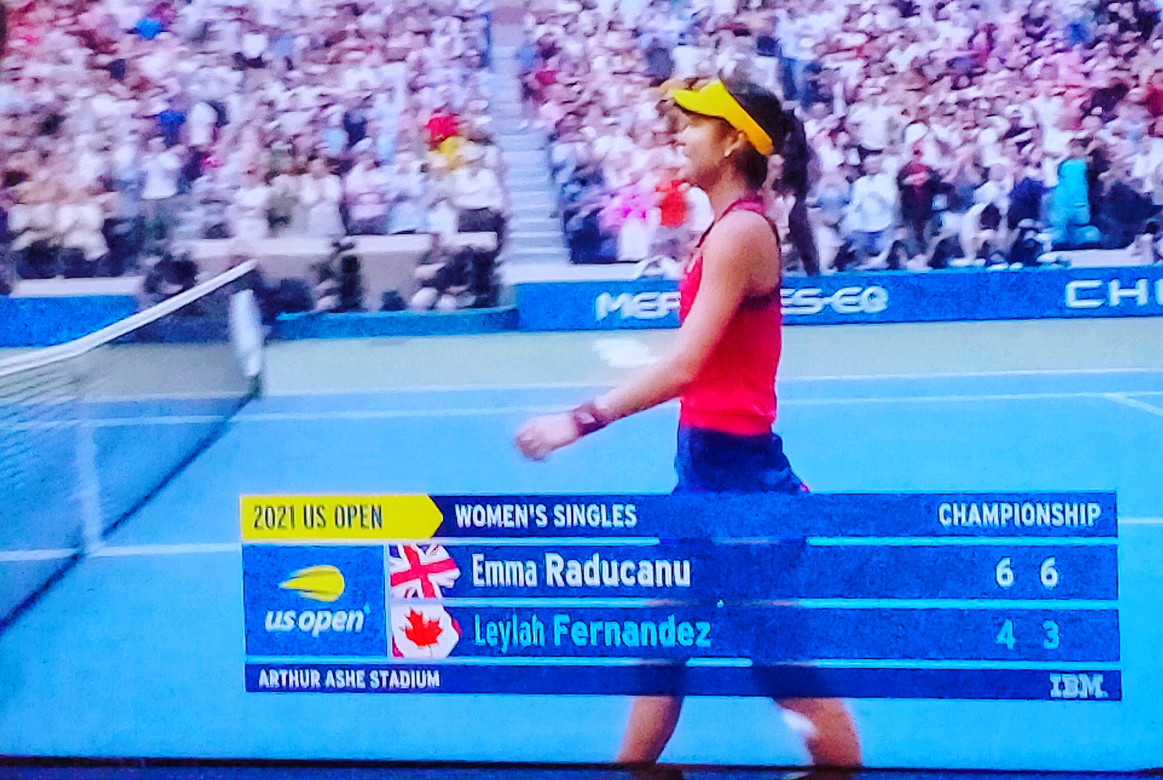
Be in the moment
Q4

Slide 21
What are you going to say?

Slide 22


Slide 23

I think
I believe
The Truth is

Slide 24

Job Description V your experience
Chat – how to illustrate this

Slide 25

p6

Slide 26
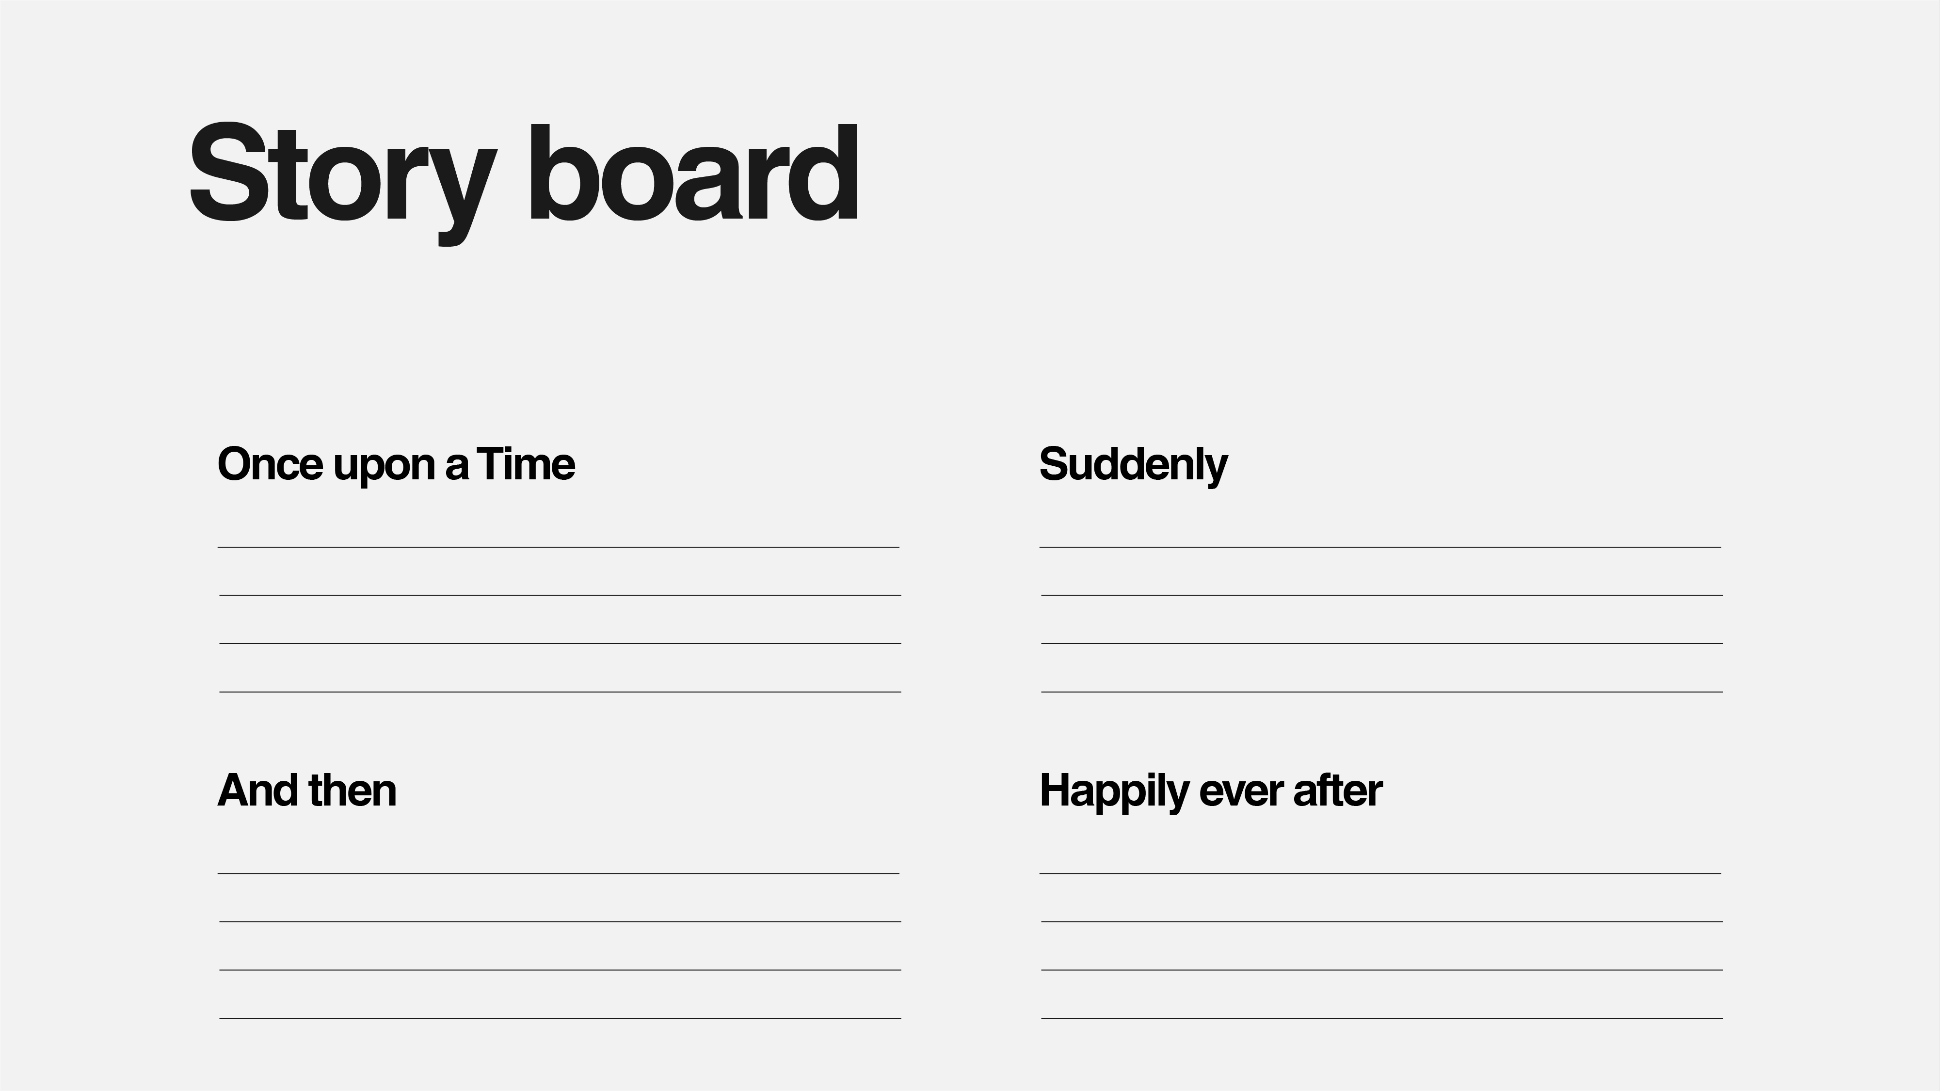

Slide 27

Directions Story

Slide 28


Slide 29
Tips for answering questions
Repeat the question
Look at the interviewer
Keep on message
Use examples
Any other ideas?

Slide 30

Consider some questions to ask

Slide 31

Virtual interviews

Slide 32
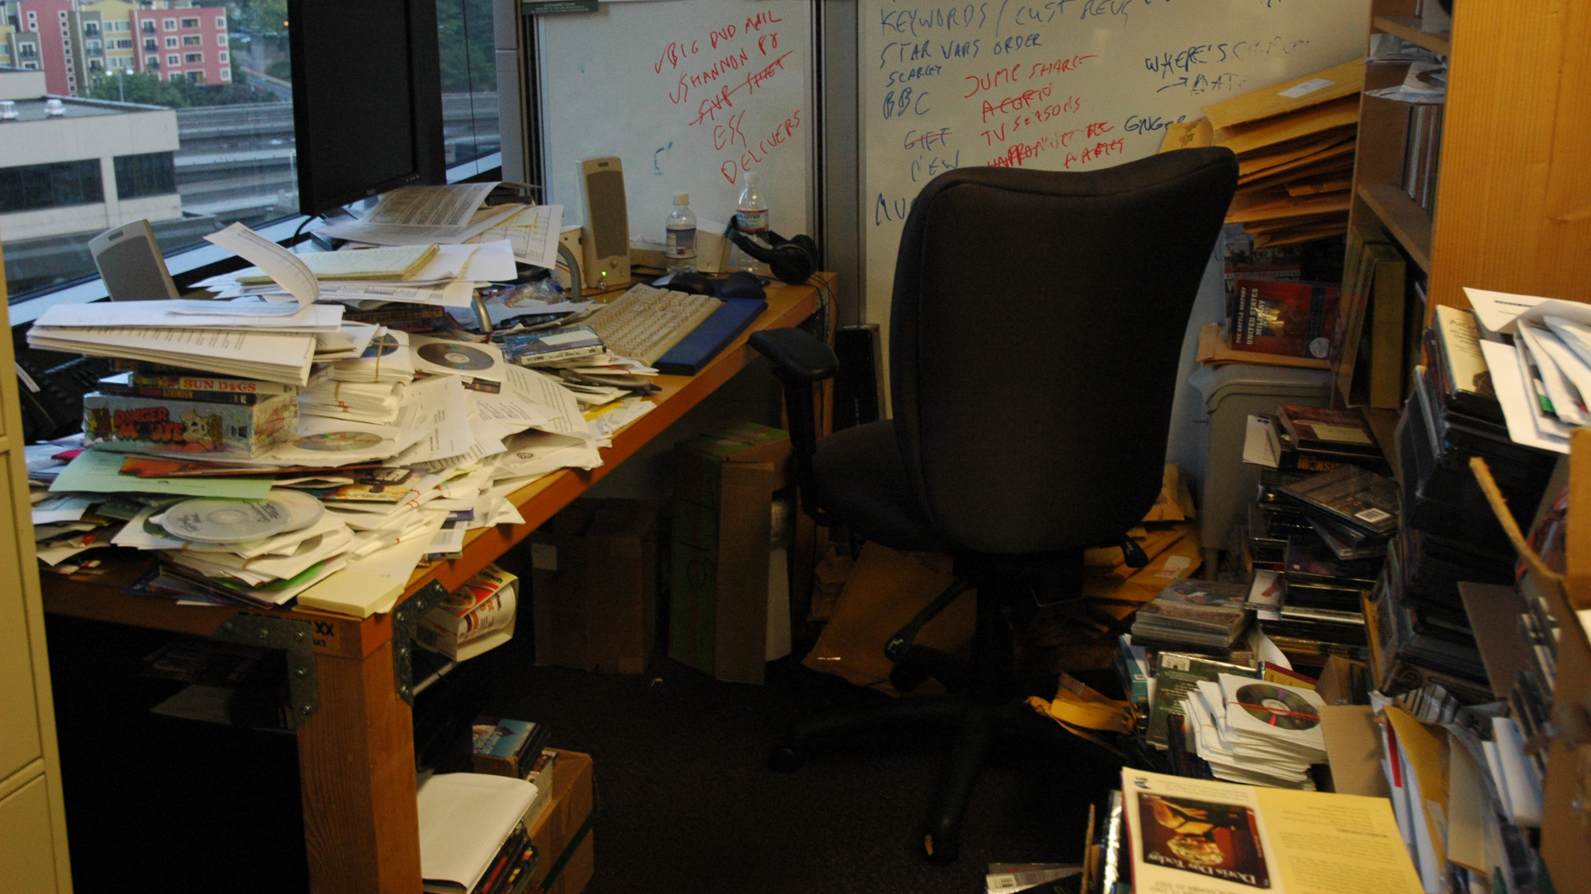
Messy room!

Slide 33

Sound and microphone

Slide 34

Lighting

Slide 35

After the interview

Slide 36

Asking for feedback

Slide 37

First action as a result of this workshop

Slide 38


Slide 39

Superstar Communicator APP
https://bit.ly/2Wza2gO
Available on Apple and Google play
Go to ‘Slides, notes. Learning’
NXT GEN

Slide 40


