Slide 1
Claims: how to identify potential recoveries & not miss an opportunity
A legal perspective
Presented by, Claire Collings, Legal Director & Jacqueline Dickinson, Associate 29 October 2021

Slide 2
Learning objectives:
By the end of this session attendees will be able to:
identify the main causes of action;
understand the basics of each cause of action;
understand what is required in order for a claim to succeed;
know what to look out for when dealing with claims in order to identify potential recoveries;
spot opportunities to recover insurers’ outlay!

Slide 3
Cause of Action
It is important to consider the facts of each claim to determine what the cause of action is and what has to be proved. The relevant causes of action are:
Contract
Negligence
Nuisance
Consumer Protection Act 1987
Water Industry Act 1991

Slide 4
CONTRACT (1)
A breach of contract occurs when one party to the contract fails to perform any term of the contract.
A contract need not be in writing and can be made orally or by conduct.
Terms can be expressly agreed within a contract or implied through common law or statute.
Commonly implied terms:
Satisfactory quality;
Fit for purpose;
Must match the description;
Must be undertaken with reasonable care and skill.

Slide 5
Contract (2)
Limitation – within 6 years of the date of the breach (knowledge irrelevant).
Remedies – to put the Claimant in the position that they would have been had the contract been performed correctly (distinguishable from remedy found in tort).
Common law remedies include the ability to claim damages, the remedies available under statute are more limited.

Slide 6
Breach of Contract In sUMMARY
Three key steps to consider:
Is there a contract in place?
Has the contract been breached (and is there evidence of it)?
Has damage occurred as a result of that breach?

Slide 7
Case study
Scenario
Mr and Mrs Brown had their boiler serviced on 2 June 2021.
On 24 August 2021 they noticed that the carpets in the hallway were wet. An independent plumber was called who found that the boiler was leaking from the pressure valve due to the pressure in the boiler being too high.
The independent plumber carried out the necessary repairs.
Cause(s) of Action
Breach of contract
Negligence
Questions / Information / Considerations
Is there a report from the independent plumber determining the case?
Has the part been retained for forensic examination (if required)?

Slide 8
Negligence (1)
Elements:
Is there a duty of care?
Has there been a breach of the duty of care?
Has the breach caused the loss?
Duty of care – judged by the standard of the “reasonable man”.
Causation – the Defendant’s negligence must have caused the Claimant to suffer loss.
Foreseeability – the loss must have been reasonably foreseeable to be recoverable.
Damages – to put a person back into the position they would have been in.
Contributory negligence – has there been any?

Slide 9
Negligence (2)
Ignis suus
Historically this rule held an occupier of a property responsible for any act which causes his neighbour’s house to be burned whether or not the fire was started accidentally.
BUT an Act of Parliament and recent case law has established that ignis suus will not apply where there has been no negligence.

Slide 10
NEGLIGENCE (3)
Product Liability and Negligence
Manufacturing defect – where the product has left the manufacturer with something unintentionally wrong with it.
Design defect – when a product is manufactured as intended but the design itself provides some unforeseen danger.
Res ipsa loquitur – the thing speaks for itself.

Slide 11
Negligence (4)
Limitation
A claim must be brought within 6 years from the date the damage is suffered; or
3 years of the date of knowledge if that period expires later than the 6 years referred to above.
Subject to long stop of 15 years from the negligent act or omission.

Slide 12
Case study
Scenario
The insured’s neighbour lit a bonfire towards the rear of their garden to burn some paperwork.
The bonfire burnt out of control and the fence between the neighbour’s property and the policyholder’s property caught fire. The fire spread to the policyholder’s shed destroying the shed and its contents.
Cause(s) of Action
Negligence /Ignis Suus
Questions / Information / Considerations
Where was the bonfire i.e. was it too close to the fence / combustible materials?
Did the fire service attend? If so, obtain the Incident Report
Was it left unattended?
What, if any, precautions were undertaken e.g. hose nearby.

Slide 13
NUISANCE (1)
Nuisance - usually caused by a person doing something on his own land which he is lawfully entitled to do but which becomes a nuisance when the consequences of his act extend to the land of his neighbour for example, by causing physical damage.
As a result the Claimant must have an interest in the land but the Defendant need not.
Common nuisances:
Tree root encroachment or high hedges;
Flooding nuisance;
Invasive species of plants;
Excessive noise;
Fumes,
Interference with a right to light;
Anti-social behaviour.
An occupier of land owes a general duty of care to the neighbouring occupier in relation to a hazard occurring on his land, whether natural or man-made. Leakey v The National Trust (1981).

Slide 14
Nuisance (2)
Test – assessed on the effect on a reasonable Claimant.
Remedies – compensation, injunction, or a combination of the two.
Limitation – within 6 years of the date the cause of action accrued, that is when the actual loss has been suffered.
Where there is a continuing nuisance a new cause of action accrues each day and the Claimant can recover loss for the preceding 6 years (subject to there being no delay in bringing the claim).

Slide 15
Case study
Scenario
Mr and Mrs Smart noticed cracking in their property and notified insurers.
Site investigations were undertaken and roots from a Birch tree and a cherry tree were found in the trial pits.
The Birch tree is on the pavement at the front of the property and owned by the Local Authority. The cherry tree is in the neighbour’s back garden.
Cause(s) of Action
Negligence
Nuisance
Questions / Information / Considerations
Local Authority should have inspection / maintenance regime in place – request records.
Was the neighbour aware / put on notice of damage? If so, did they fail to take any action?
Does an arboricultural report need to be obtained?
Does a drainage survey need to be undertaken?

Slide 16
Consumer Protection Act 1987 (1)
Designed to protect consumers and give them rights when buying goods.
The main aim of the act is to place legal liability on the producers of defective goods rather than on the sellers of the goods.
What needs to be established?
Was there a defect in the product?
Is the defendant the relevant person who can be held liable?
Is there a defence available under the Act?
Did the defect cause the damage?
A product is defective for the purposes of the Act if it can be shown that the safety of the product is not such as persons are entitled to expect (not a very high test).

Slide 17
Consumer Protection Act 1987 (2)
Who can be held liable?
Manufacturer
Apparent manufacturer
Supplier (in certain circumstances)
Strict liability under the Consumer Protection Act (“the Act”) means where a product is defective, then in most cases, the producer (i.e. manufacturer) of that product is liable for any harm caused by the defect.

Slide 18
Consumer Protection Act 1987 (3)
Although the Act contains a strict liability test, defences may be raised against a claim if the defendant can prove any of the following:
The producer didn’t sell or supply the product. For example, if the only version of that product had been stolen and had never been intended for public sale.
The product wasn’t defective when the producer supplied it.
At the time of production the level of scientific and technical knowledge wasn't advanced enough to have known about the defect in the product.
The defect is present because of a need to comply with legal requirements.
Limitation –claim must be brought within 3 years of the date of the damage but subject to a long stop date of 10 years.

Slide 19
Case study
Scenario
Mr and Mrs Smith purchased a toaster in June 2021.
On 7 July 2021, Mrs Smith got up in the morning, put some toast in the toaster and went upstairs to make the bed.
On returning downstairs, Mrs Smith noticed smoke coming from the toaster and discovered a fire. She evacuated the property and called the Fire Service who attended to extinguish the fire.
Cause(s) of Action
Consumer Protection Act 1987
Negligence
Res ipsa loquitur
Questions / Information / Considerations
Has evidence been retained for forensic examination?
Fire Report?
Does a forensic expert need to be instructed?

Slide 20
Water Industry Act 1991
The Water Industry Act 1991 imposes strict liability on water undertakers for escapes of water.
Section 209(1) states “Where an escape of water, however caused, from a pipe vested in a water undertaker causes loss or damage, the undertaker shall be liable, except as otherwise provided in this section, for the loss or damage”
If the leak is due to a damaged water pipe, or if the pipe bursts, responsibility for fixing it depends on which section of the pipe is damaged.

Slide 21
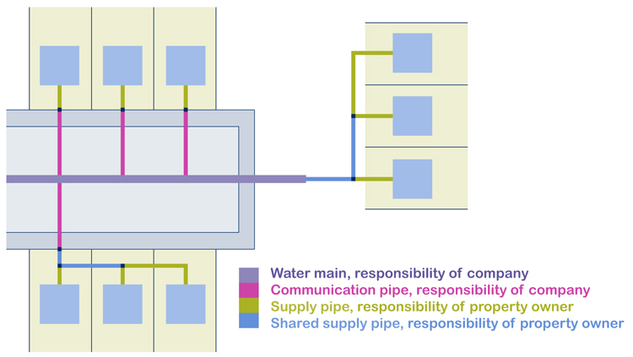
Who owns what?

Slide 22
Case study
Scenario
Mr and Mrs White’s property was flooded with water.
After trace and access was carried out the cause was determined as a burst water main laid in the public highway.
Cause(s) of Action
Negligence
Water Industry Act 1991
Questions / Information / Considerations
Who is responsible for the pipe?
Does strict liability apply?

Slide 23
EVIDENCE
It is vital to preserve evidence at the outset.
Do not assume that someone else has retained the evidence and do not leave the evidence with the insured to preserve.
If it is a small item (e.g. a flexible hose) ask the loss adjuster to take it away during the initial visit and either retain it or pass it to you.
If a large item (e.g. washing machine), arrange for it to be collected and stored by forensic experts for forensic examination.
If the evidence is disposed of then this does not automatically rule out a recovery and it will depend on the facts of each individual case but it will make a recovery much more difficult. In smaller claims, if the evidence has been disposed of, then it is usually not worth incurring the costs of attempting to pursue a recovery.

Slide 24
Learning objectives:
identify the main causes of action;
understand the basics of each cause of action;
understand what is required in order for a claim to succeed;
know what to look out for when dealing with claims in order to identify potential recoveries;
spot opportunities to recover insurers’ outlay!

Slide 25
Any questions?
THANK YOU – for listening! We hope you found the session informative

Slide 26
Claire Collings
Legal Director
DDI: 023 8083 7745
M: 07764 968278
E: clairecollings@bdbpitmans.com
Jacqueline Dickinson
Associate
DDI: 0118 957 0351
M: 07701 284375
E: jacquelinedickinson@bdbpitmans.com

