Slide 1
Insurance Institute of Bristol
Exploring Inclusion and Diversity
21st Sept 2021 - Session 1

Slide 2
What does Inclusion mean?
Learning objectives:
You will leave the session knowing how to,
Identify your own responses to bias
Initiate conversations with colleagues on how they can identify their personal responses to bias
Understand the protected characteristics, whilst acknowledging that there is still a need for inclusion beyond them
Identify intersectionality and its implications

Slide 3
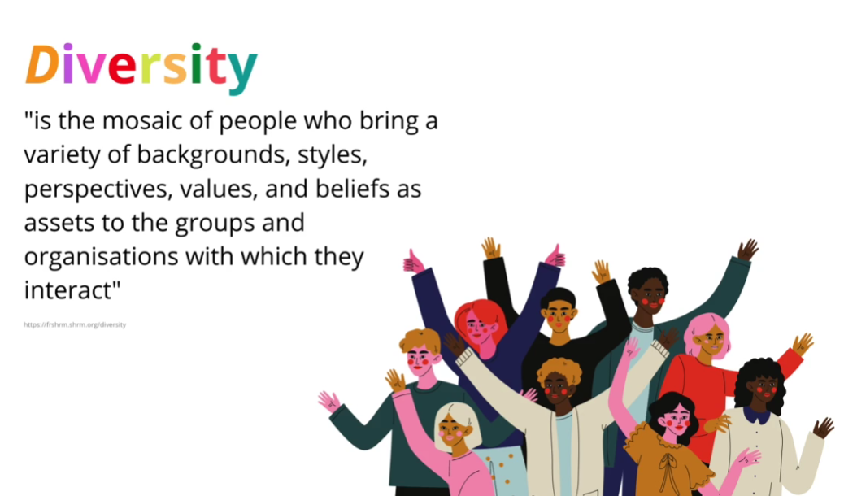
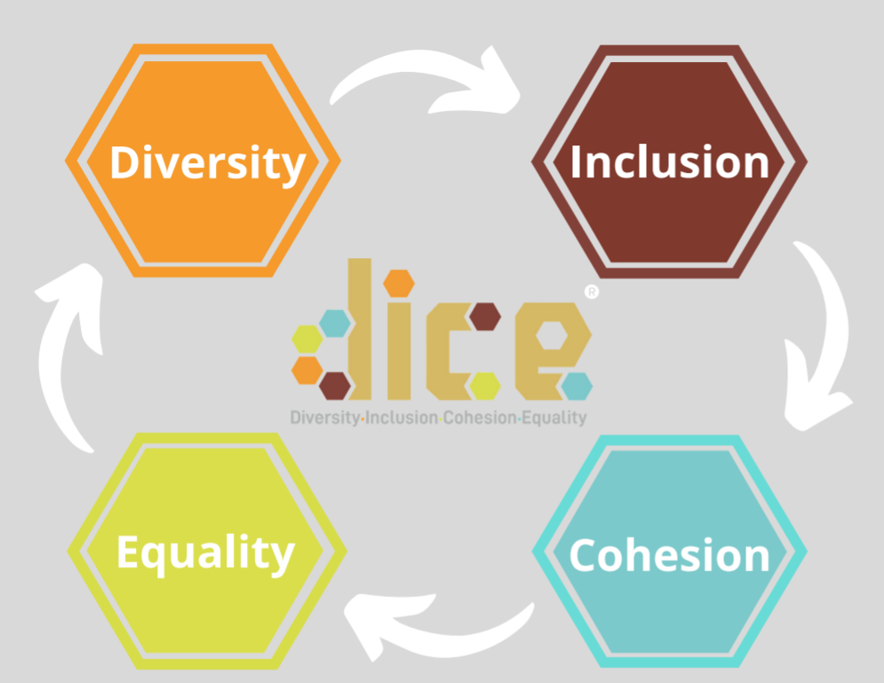
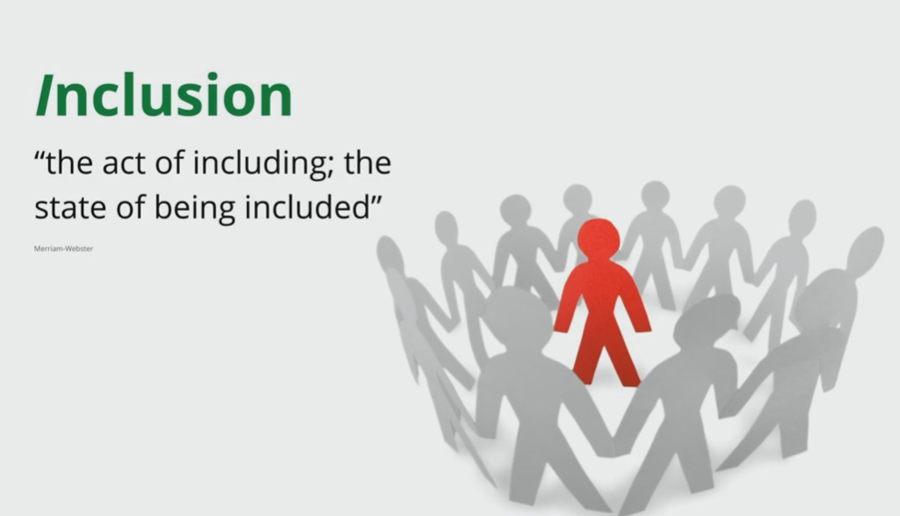
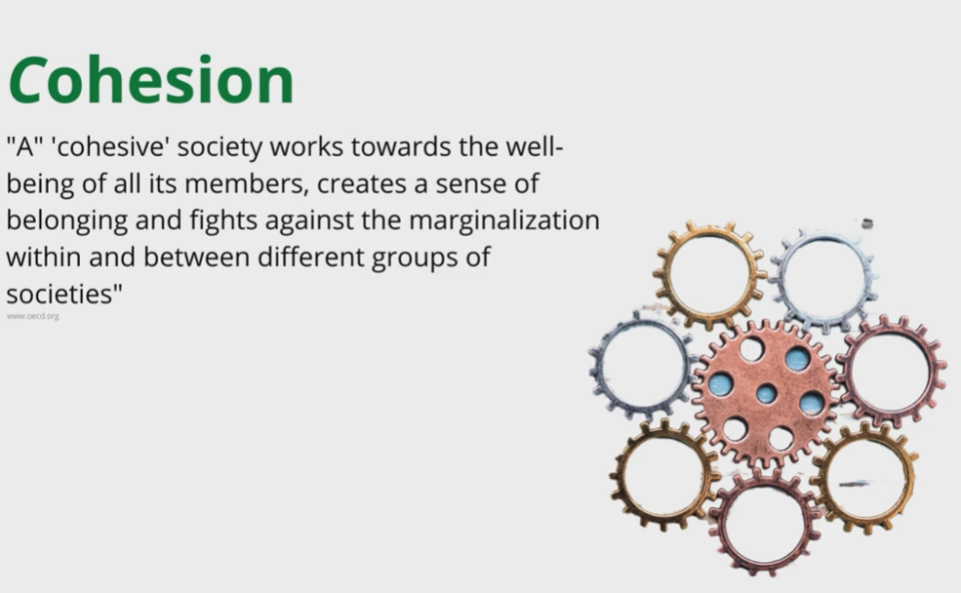
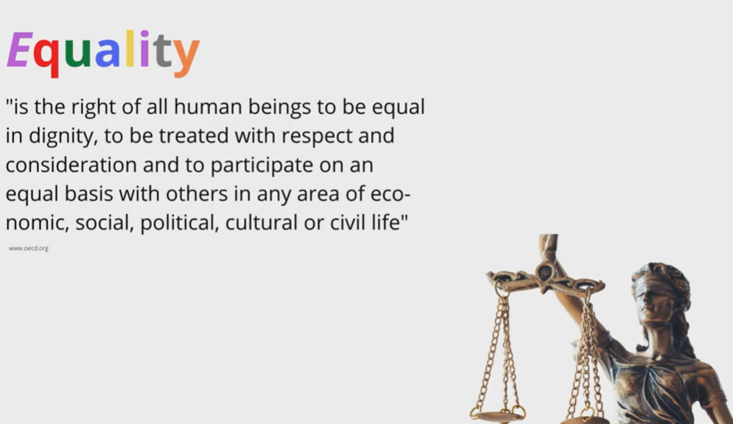
What is Diversity and Inclusion?

Slide 4

What does bias feel like?

Slide 5

Why do we have biases?
Environment
Experiences Direct/
Indirect
Patterns
Upbringing
Short cuts
Society Stereotypes
Media
Association

Slide 6

Perception
Affinity
Conformity
Confirmation
Height
Gender
Types of Bias
Attribution
Attractiveness
Name
Halo
Horns
Contrast
Ageism

Slide 7


Prejudice and Discrimination
A negative attitude or feeling towards certain groups, based on faulty, inflexible generalisations
The restrictive treatment of a person or group, based on prejudiced assumptions of group characteristics, rather than individual judgements
Attitude
Action

Slide 8
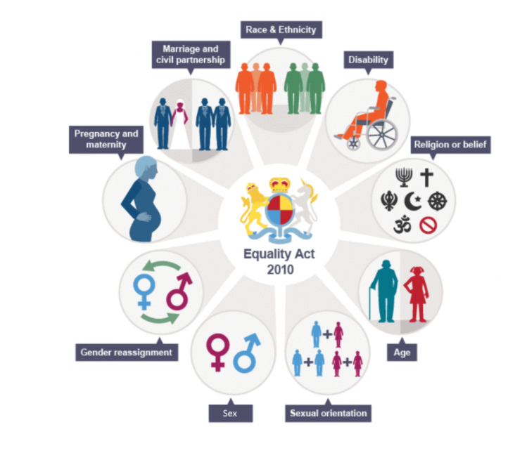
9 Protected characteristics

Slide 9
Microaggression | Instead say…..
You’re soooo articulate | Nothing. You can commend people on their specific ideas or insights, but commenting on how people speak is unnecessary.
You're transgender? Wow, you don't look like it at all | Nothing
Oh, sorry, wrong person | Learn your co-workers' names. It's a pretty basic concept.
Oh, you're gay? You should meet my friend Ann. She's gay, too! | Nothing. If your co-worker of any sexual orientation wants your help meeting new people, they'll ask you.
My boss is crazy | Try to understand your colleague's viewpoint rather than ascribing her actions as illogical. If you still don't agree, you could say: "I don't understand her perspective on this" — then ask her for her insights.
Where are you actually from | Nothing. If the person in question wants to discuss their identity, they can bring it up at their own discretion
Your name is so hard to pronounce | If you can't pronounce a colleague's name, just ask them how to say it. Don't point out that it's foreign or unfamiliar to you.
I think you're in the wrong room — this is the programmers' meeting | Nothing. Don't assume people don't belong or make them feel as if they're outsiders
The way you've overcome your disability is so inspiring | Nothing
Do you even know what Snapchat is? | Nothing
Are you an intern? You look so young! | Nothing. There's no reason to comment on a coworker's appearance. If you genuinely want to know their job title, look it up in a company directory.
Is that your real hair? | Nothing. A person's natural hair, regardless of their ethnicity, should be accepted as professional and workplace-friendly.
(Interrupting) 'Well, actually, I think… | Wait for the person to finish their thought. And if you like their idea, give them credit
Why do you wear that | Nothing. If you're curious about why religious people choose to wear certain articles of clothing, read articles or books by those who do it. Don't go around asking random colleagues about their life choices.

Slide 10
Intersectionality
“Intersectionality was a prism to bring to light dynamics within discrimination law that weren’t being appreciated by the courts. In particular, courts seem to think that race discrimination was what happened to all black people across gender and sex discrimination was what happened to all women, and if that is your framework, of course, what happens to black women and other women of color is going to be difficult to see.”
Kimberlé Crenshaw

Slide 11
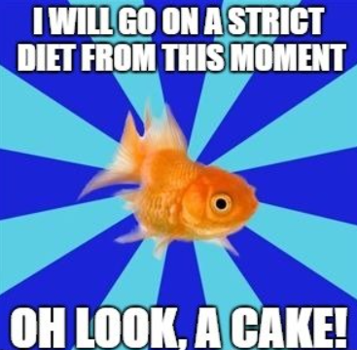
It’s easy to change this….isn’t it?

Slide 12
Resources
Origins of Intersectionality
https://www.vox.com/the-highlight/2019/5/20/18542843/intersectionality-conservatism-law-race-gender-discrimination
Mena Fombo – Bristol Tedx
https://www.ted.com/talks/mena_fombo_no_you_cannot_touch_my_hair
Implicit Bias Test
https://implicit.harvard.edu/implicit/takeatest.html
Micro-aggressions and mosquito bites
https://www.youtube.com/watch?v=hDd3bzA7450
https://www.bcohco.com/improve-your-social-footprint-with-dice-essentials?coupon=INSURANCE-INSTITUTE-OF-BRISTOL
REMEMBER! Do the short online tutorial, free to you for attending the session!

Slide 13
