Slide 1
TEDX, DAVOS and G20 Presentations: what can we learn for our own presentations and speeches
With Susan Heaton-Wright

Slide 2

Q1

Slide 3
What we are covering
Why these types of short speeches are so effective now
What is the purpose of your speech; for you and your audience?
Discover how to structure a speech or presentation so it is impactful and memorable
The use of stories – and how to use them, to engage and be memorable
How to deliver the “Golden Nuggets”
How to prepare for a speech so it is natural – like a conversation, including practicing

Slide 4

What are Davos/ted Style Talks?
Q2

Slide 5

What sort of events?

Slide 6
Characteristics
Simple. The message needs to be straight forward.
Clear. Focused, concise, on message (BRIEF SPEAKING)
Original. Challenging thoughts
Relevant. 'Ideas worth spreading' - either going viral, being referred to or even quoted
Entertaining

Slide 7

Limited Time
Trends

Slide 8
Chris Anderson: Head of TED
What can I talk about?
Techniques to make the talk engaging
Preparation: including rehearsing
The performance on stage
The lasting legacy of your talk

Slide 9

Ideas for a talk

Slide 10

What do you want your audience to go away with?
Q3

Slide 11

We remember how we feel

Slide 12

storytelling

Slide 13
Story board
Once upon a Time | Suddenly
And then | Happily ever after
Notes:
A very simple story board

Slide 14

Simplifying challenging concepts

Slide 15

Talk going viral: influencing others

Slide 16

Take my breath away!
Q4

Slide 17


Slide 18
Great Starts to your speech or contribution
A statement
A question
A Statistic

Slide 19

Notes:
Call to action. The audience needs to know what to do – finish work, speak to you, arrange a call etc.

Slide 20

Slides or no slides?
Q5

Slide 21

Remembering what you will say

Slide 22

Practice
P6

Slide 23

Perform

Slide 24


Slide 25

What makes a voice easy to listen to?
Q7

Slide 26
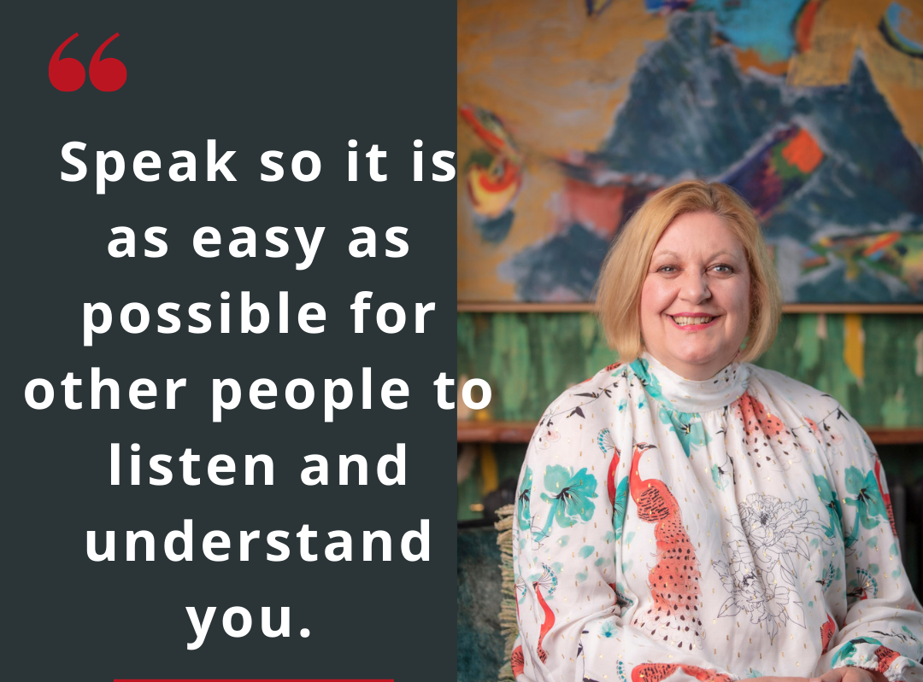

Slide 27

Afterwards

Slide 28

Discussions

Slide 29

Questions

Slide 30


Slide 31

How could we relate this to presentations at work?
Chat and first thing

Slide 32
What we are covering
Why these types of short speeches are so effective now
What is the purpose of your speech; for you and your audience?
Discover how to structure a speech or presentation so it is impactful and memorable
The use of stories – and how to use them, to engage and be memorable
How to deliver the “Golden Nuggets”
How to prepare for a speech so it is natural – like a conversation, including practicing

Slide 33


Linkedin Susan Heaton-Wright
Twitter @superstarcomms
Instagram @susanheatonwright1
iTunes Superstar Communicator
www.superstarcommunicator.com
susan@superstarcommunicator.com
Notes:
I am always at hand if you have some questions. Please link with me on Linkedin; feel free to drop me a message if you need any advice! And thank you.

