Slide 1
Protecting the Digital Frontier
Interactive Data Breach

Slide 2
Agenda
Breach Scenario
Cyber Security
Cyber Coverages

Slide 3
Ccb insurance brokers

Slide 4
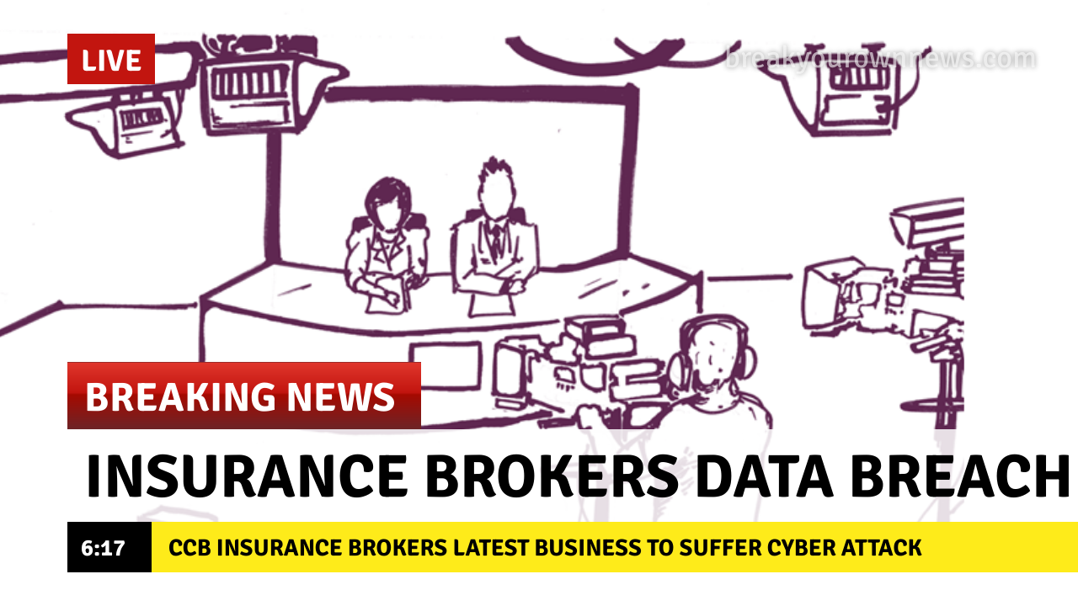

Slide 5
So what do we know?
Threat Actors have exploited a vulnerability in our corporate website, giving them access to client records.
Hackers have then immediately notified press of what has happened, and are threatening to release the records they have access to.
Unsure of scale – but it could potentially be our entire client database, which contains 3,000 records.

Slide 6
What information could have been accessed?
Names
Addresses
Bank Details
Credit Card details (PCI)
Health Information (PHI)
Driving License Numbers
Criminal Convictions

Slide 7
WHAT IS A DATA BREACH?
A personal data breach means a breach of security leading to the accidental or unlawful destruction, loss, alteration, unauthorised disclosure of, or access to, personal data transmitted, stored or otherwise processed.
Article 4 (12) - GDPR

Slide 8
OR TO THINK ABOUT IT ANOTHER WAY…
Confidentiality
Integrity
Availability

Slide 9
DO WE HAVE TO TELL ANYONE?
And who are they?
Article 33 (reporting to the ICO)
If breach is likely to result in a risk to the rights and freedoms of data subjects notification is mandatory …not later than 72 hours.
Article 34 (reporting to data subjects)
If breach is likely to result in a high risk to the rights and freedoms of data subjects notification must occur without undue delay

Slide 10
WHO DO WE GO TO FOR HELP?

Slide 11
Legal
What will our legal team do?
Investigate – What? How?
Notify ICO
Notify Police
Notify data subjects
Pull together other vendors (retaining privilege)
Provide advise on any regulatory issues – are we in breach of GDPR / other regulations?
Can handle any third party claims for damages if they arise in future
Any overseas clients? Multi jurisdictional issues

Slide 12
IT Forensics
What will our forensic team do?
Identify threat vector
Close down vulnerability, removing hackers from network
Analyse the scope of the breach (how far into the network did they get?)
Support Legal on database review (what has been accessed?)
Offer assistance with regulatory notification
Mitigation
Future improvement

Slide 13
CCB CEO: THE INSURANCE TIMES WANTS AN INTERVIEW!!!! What is going on….??!!

Slide 14
PR Consultants
What will the PR team do?
Determine key messaging
Review impact on all stakeholders (employees / suppliers?)
Manage / handle media
Draft notifications
Issue press releases
Handle social media
Advise on future reputational enhancement

Slide 15
Some “go to” tips for interviews:
Refer to “criminal act”
“Working together” with our customers
Full investigation underway
Confirm the data loss, but size not yet known
Co-operating with the ICO
Sorry for concern our customers are feeling
Ongoing police investigation – cannot comment further

Slide 16
3 days later….

Slide 17
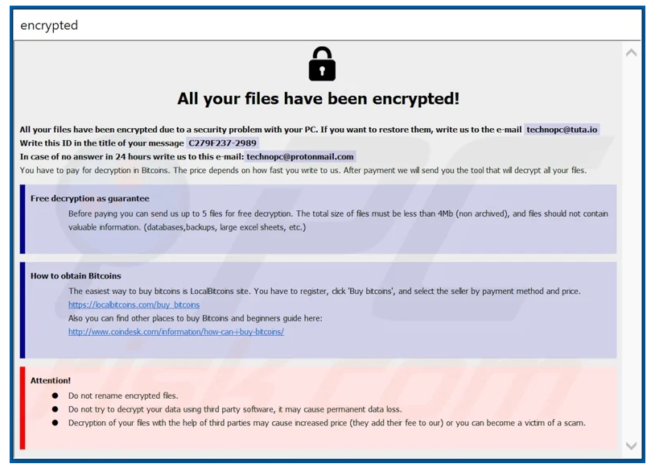
20 BITCOIN OR WE DATA DUMP. YOU HAVE 24 HOURS

Slide 18
What can our IT team tell us?
All 3,000 records have been accessed by hackers which contains:
Addresses
Health information
Credit card data
Ransomware has encrypted all of our servers
All back ups also encrypted

Slide 19
CCB CEO: What have we spent so far? (ignoring any ransomware payment)

Slide 20
Some extra costs we haven’t considered yet…
First Party Costs:
Cost of sending email notifications (can’t simply do this via Outlook – specialist solutions exist)
Customer helpline to be set up
Outsourced staff (telephone / social media responders)
Call logging / note taking system
Business Interruption – during incident and reputational loss going forward
Potential Third Party costs:
Dark web / credit monitoring to be offered to customers
3rd party claims for damages
Regulatory Fines

Slide 21
CCB CEO: what are we looking at all in?

Slide 22
How did we arrive at this figure?
Article 82 of GDPR allows claims from impacted data subjects
TLT v SOS Home Department & Google v Vidal – Damages between £2.5k - £12.5k
Breach involving 3,000 data subjects
10% seek damages (300 people)
Reserve each at £5.5k per claim (taking a low -mid point of the damages and including costs)
Total 3rd party claim cost - £1.65m
Plus costs already discussed = £1.8m

Slide 23
Cyber Security Stats
of organisations worldwide have suffered a data breach as a result of a cyberattack in the past 12 months
94%
94%
$133k
Average cost of ransomware attacks in 2019
Between 1st Jan 2005 to 18th April 2018 there were 8,854 recorded breaches, in the first half of 2019 there were 3,800 recorded breaches
6 MONTHS
Average time to detect a breach
EVERY 14 SECONDS
Time businesses fall victim to ransomware attacks
In March 2020, ransomware attacks increased 148% over baseline levels from February 2020 amid the COVID-19 outbreak.
92%
Attacks launched by phishing emails
86%
Of UK businesses will suffer a phishing attack in 2020
43%
Of cyber attacks aimed at small businesses
45 MINUTES
Length of time cyber criminals can go from initial entry to ransoming the entire network

Slide 24
Cyber Security Tips
1
Educate employees
and implement
staff training
2
Secure your networks and
limit access to authorised
personnel only
3
Regularly update your
computer software, systems
and create weekly backups
4
Purchase a cyber-insurance
policy to help transfer the
financial risk away from
your business
5 Prepare a data breach
response plan including
step-by-step actions and
test frequently
6 Keep privacy policies and
security controls up to date
committing to readiness
and resilience

Slide 25
Our Key Responsibilities
Passwords
Set different passwords for each account
Use long passwords
Mix letters, numbers and symbols
Change on a regular basis
Emails
Report any suspicious emails. Do not click links or respond to anything you are not expecting. Even if it looks like it is from a recognised sender.
Take extra care when sending personal/sensitive data. Double check recipients and make use of delay functions.

Slide 26
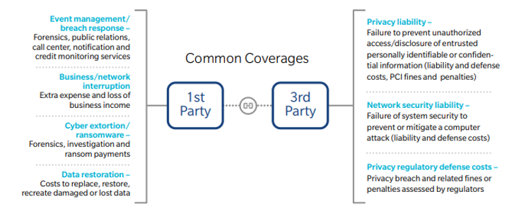
A CYBER INSURANCE POLICY WOULD HAVE BEEN MONEY WELL SPENT:

Slide 27
TO SUMMARISE
Cyber attacks are fast moving and multi faceted events
Involves a huge amount of time and effort by C-suite and several operational areas to work through
External assistance is almost always necessary
Costs quickly ramp up
Cyber Insurance policies can and do step up to the plate to help businesses respond to these matters – service lead offering

Slide 28
Questions?
Please use the chat function in Teams (not Slido!)

