Slide 1
Managing workplace mental health in a pandemic and beyond
6th July

Slide 2
Shamira Graham
Director of Corporate Clinical Solutions, CBT Practitioner, Efficacy Ltd
James Harvey
Head of Broker & Corporate Sectors and Executive Board Member, BLM Law
Prof. Marcantonio Spada
Clinical Academic Researcher and Consultant CBT Practitioner, Efficacy Ltd
Julian Cox
Head of Employment Law, London, BLM Law

Slide 3
The case for action
Work related stress and mental ill health claims are increasing
We know there is a four-fold reason for organisations to protect staff’s mental health: moral, reputational, economic and legal.

Slide 4
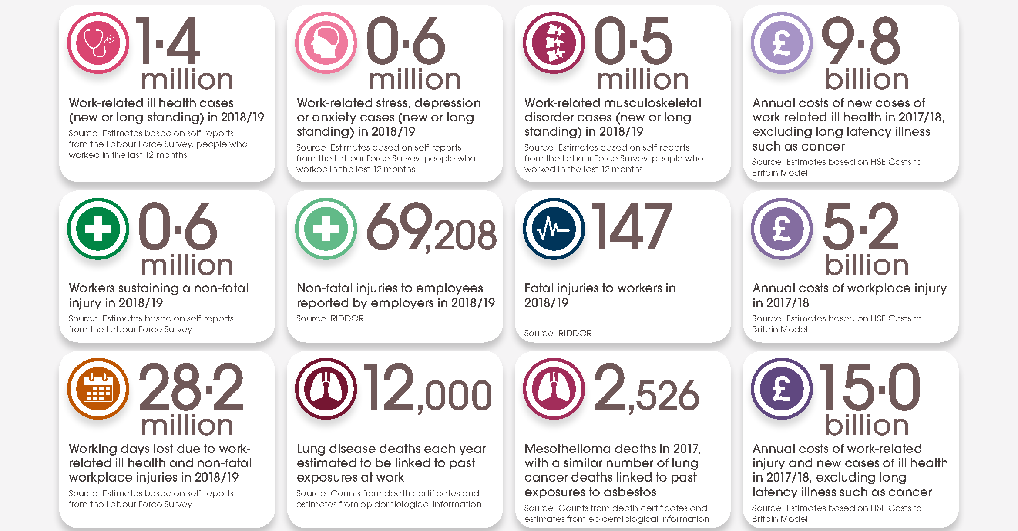
Key facts
Source: Health & Safety Executive (HSE)

Slide 5
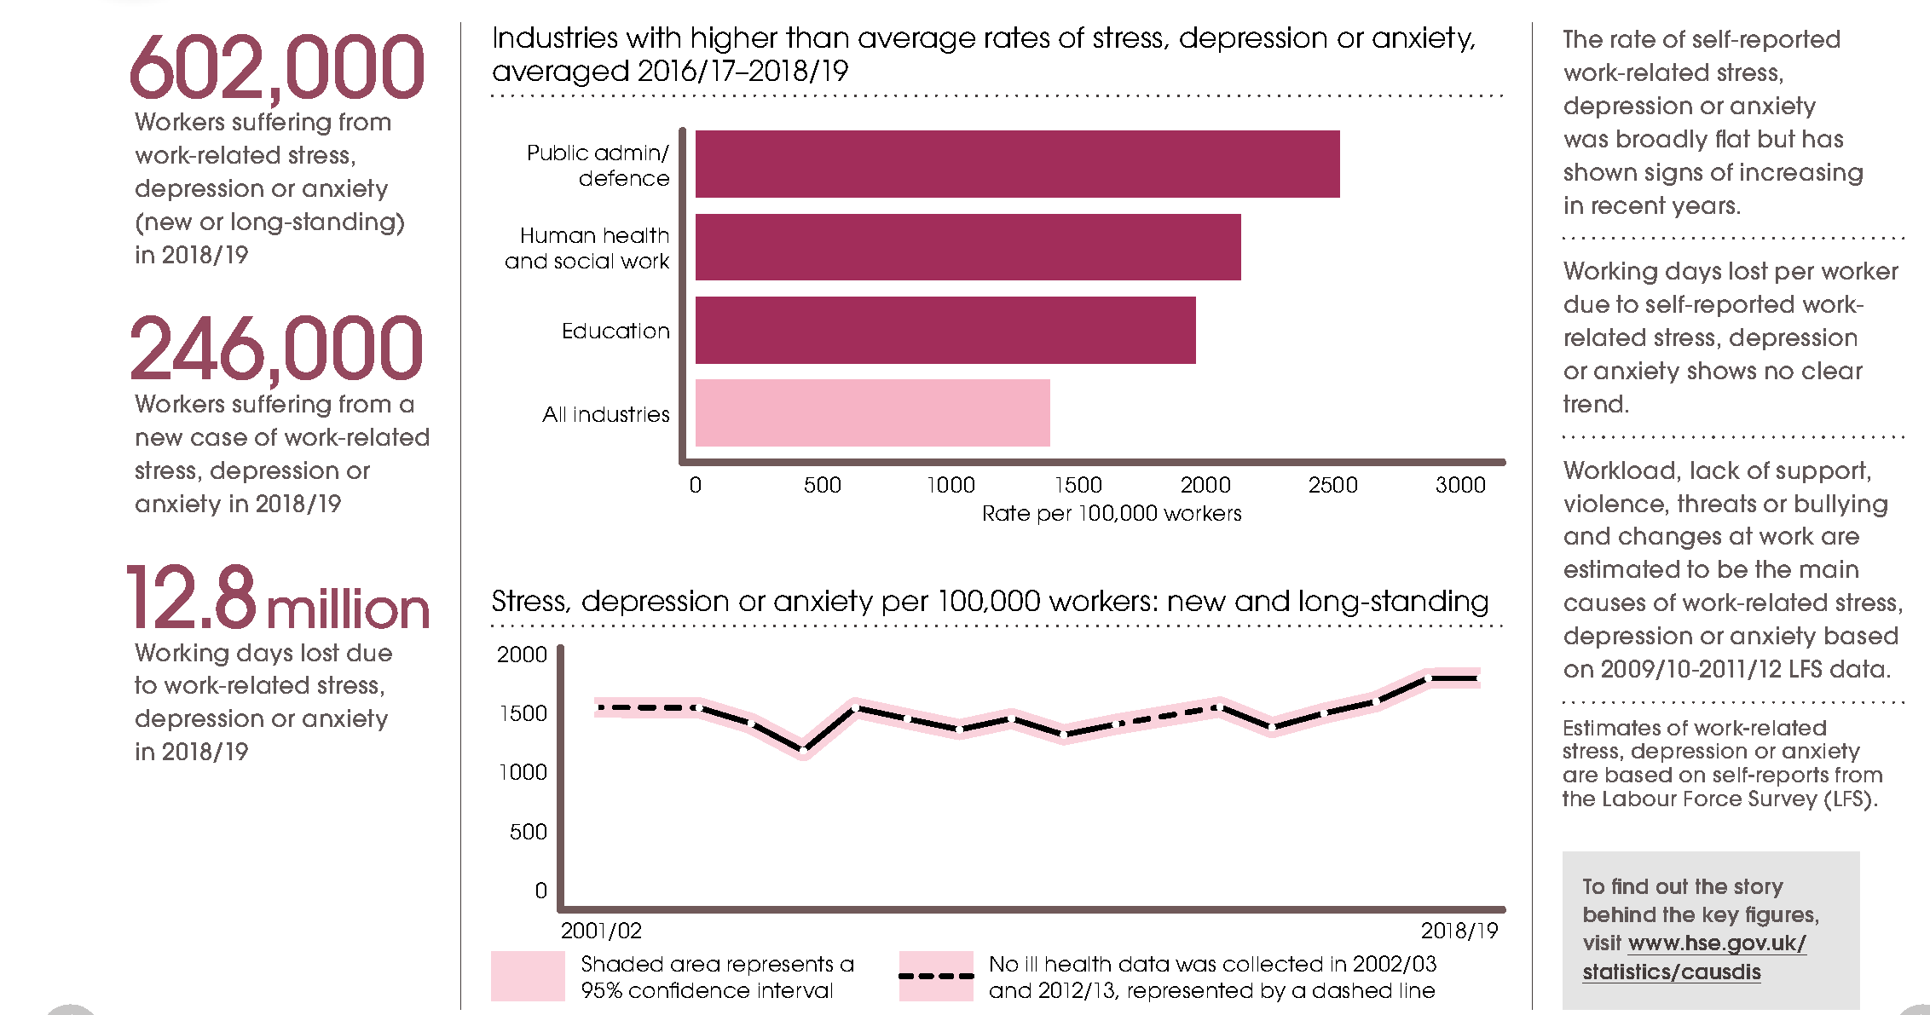
Work-related stress, depression or anxiety
Source: Health & Safety Executive (HSE)

Slide 6
The cost of poor mental health in the workplace is high and rising
The economic cost of mental ill health continues to rise
High quality training represents the most cost effective corporate response
Cost to UK economy of mental ill health p.a., £bn
2017-20
Return on investment of different corporate mental health interventions Average ROI, 2020
5.3% p.a.
Expert mental Health training delivers a 5-6x measurable ROI
2017-20 trend
Absenteeism
~£8bn
~£7bn
Presenteeism
~£20bn
~£27bn
Therapy only
Awareness Training
Training
Screening/ Diagnostics
Turnover cost
~£8bn
~£9bn
Source: Deloitte (2020): The Case for Investment

Slide 7
The Need

Slide 8
Continuum of mental health and wellbeing
Step 0
Full health
Step 1
Wellness
Step 2
Compromised health
Step 3
Ill health
Step 4
Complex Ill health
Excelling
Thriving
Unsettled
Struggling
In crisis

Slide 9
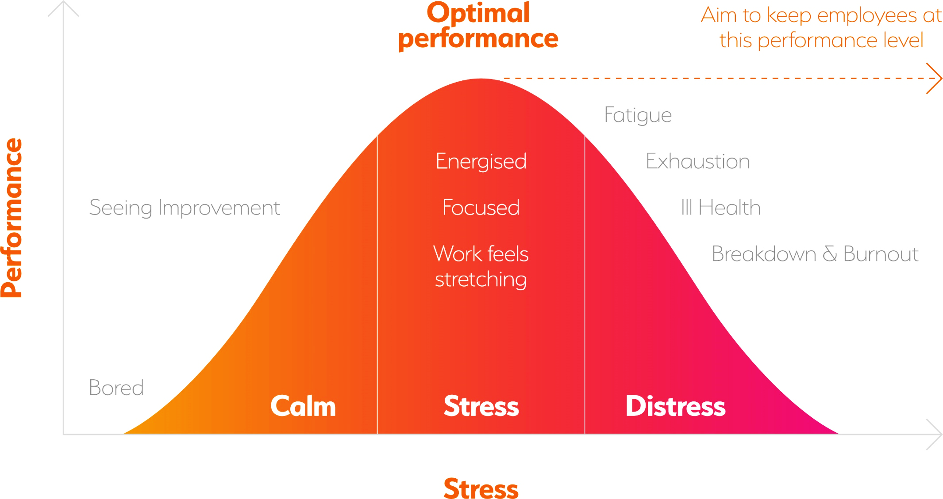
What to look out for

Slide 10
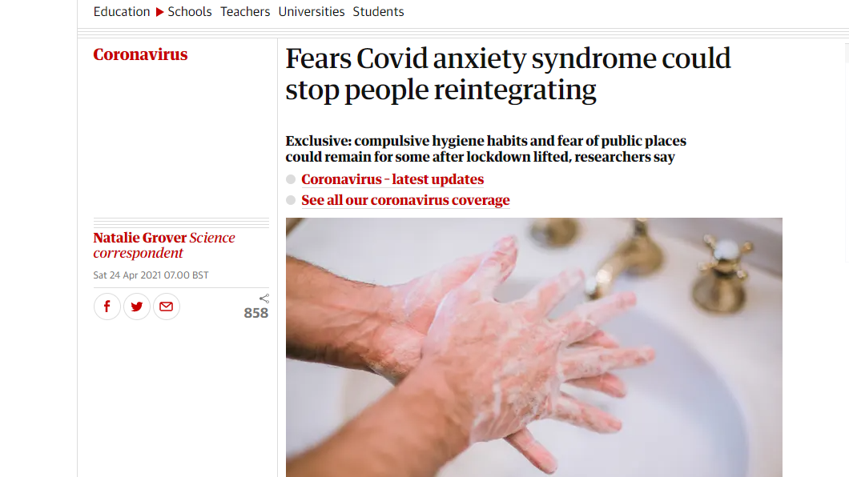
Tell-tale signs that rumination and worry are becoming a problem
Being at risk
Being younger
54% avoidance public transport
38% avoidance public places
14% paying close attention to others displaying symptoms
49% avoidance of touching things
IT WILL BE TEMPORARY FOR THE MAJORITY
https://www.theguardian.com/world/2021/apr/24/fears-covid-anxiety-syndrome-could-stop-people-reintegrating

Slide 11
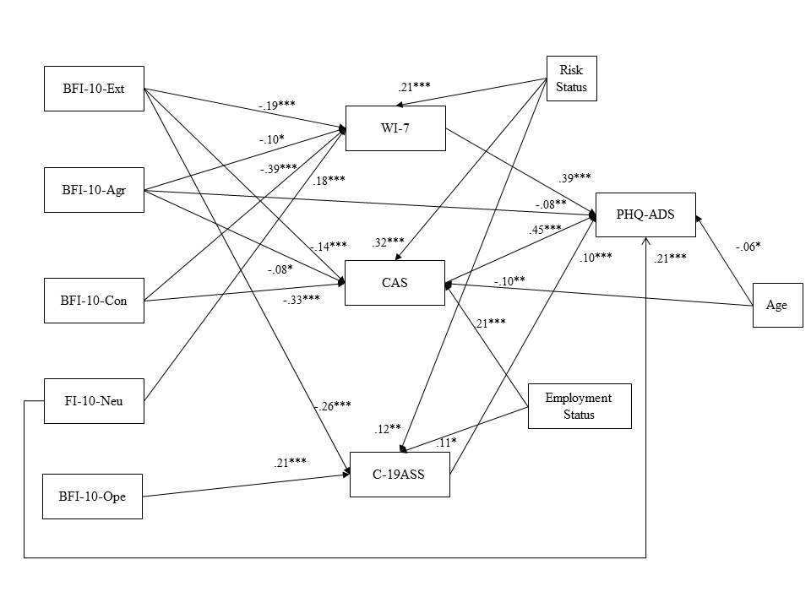
Mental health: magnification of anxiety and depressive symptoms during the pandemic
Nikčević, A. V., Marino, C., Kolubinski, D. C., Leach, D. & Spada, M. M. (2020). Modelling the contribution of the Big Five personality traits, health anxiety, and COVID-19 psychological distress to generalised anxiety and depressive symptoms during the COVID-19 pandemic. Journal of Affective Disorders.

Slide 12
.39***
Mental health: magnification of anxiety and depressive symptoms during the pandemic – Health anxiety
PHQ-ADS
Nikčević, A. V., Marino, C., Kolubinski, D. C., Leach, D. & Spada, M. M. (2020). Modelling the contribution of the Big Five personality traits, health anxiety, and COVID-19 psychological distress to generalised anxiety and depressive symptoms during the COVID-19 pandemic. Journal of Affective Disorders.

Slide 13
.39***
Mental health: magnification of anxiety and depressive symptoms during the pandemic - Neuroticism
PHQ-ADS
.21***
Nikčević, A. V., Marino, C., Kolubinski, D. C., Leach, D. & Spada, M. M. (2020). Modelling the contribution of the Big Five personality traits, health anxiety, and COVID-19 psychological distress to generalised anxiety and depressive symptoms during the COVID-19 pandemic. Journal of Affective Disorders.

Slide 14
````
.39***
Mental health: magnification of anxiety and depressive symptoms during the pandemic – COVID-19 anxiety
.45***
PHQ-ADS
.21***
Nikčević, A. V., Marino, C., Kolubinski, D. C., Leach, D. & Spada, M. M. (2020). Modelling the contribution of the Big Five personality traits, health anxiety, and COVID-19 psychological distress to generalised anxiety and depressive symptoms during the COVID-19 pandemic. Journal of Affective Disorders.

Slide 15
.39***
Mental health: magnification of anxiety and depressive symptoms during the pandemic – COVID-19 anxiety syndrome
.45***
PHQ-ADS
.10***
.21***
Nikčević, A. V., Marino, C., Kolubinski, D. C., Leach, D. & Spada, M. M. (2020). Modelling the contribution of the Big Five personality traits, health anxiety, and COVID-19 psychological distress to generalised anxiety and depressive symptoms during the COVID-19 pandemic. Journal of Affective Disorders.

Slide 16
Solutions: Early Identification, Prevention, Promotion and Treatment

Slide 17
Framework for pre-claims landscape
Health and Wellness Promotion
Stress Prevention
Relapse Management
Wellness Action Plans
Resilience Management
Prevent, Education, Support
Mental health Awareness
HR/Employment law legal health check
Specialist skills workshops
PROMOTE
PREVENT
Reduce mental health distress
Drive up performance & productivity
TREAT
DETECT
Evidence based interventions and treatment
Right treatment, right time, right clinician
Specialist clinical support to recovery
Mental Health and Wellbeing Screening
Early identification of employees at risk of compromised mental health
Wellbeing Analysis

Slide 18
Case Study: Employer dealing with senior executive suffering from anxiety who refuses to return to work due to Covid-19
The hedge fund are keen to get staff back into the office.
Senior Manager for a leading City hedge fund.
Anxious of the risk of infection given his underlying health issues.
Manages a team of 8 staff.
Concerns about social distancing, in particular floor planning and elevator access
The hedge funds offices are on the 10th floor and staff tend to hot desk.
The Head of HR frustrated and threatens disciplinary action
Well regarded and highly successful
Anxious and depressed he is signed off as unfit to work for a month.
Suffered from anxiety and depression for many years, of which his employer is aware.
With the help of solicitors he raises a formal grievance against his employer

Slide 19
Mental health and employment law – the key considerations
Mental health and the protection this affords employees and workers under the Equality Act 2010
Assessing what reasonable adjustments ought to be made in relation to employees and workers suffering from mental health issues compliant with an organisation’s obligations under the Equality Act 2010
Handling complaints from employees and workers suffering from anxiety which is Covid-19 related
Handling complaints in the workplace relating to anxiety and stress
Handling capacity dismissals
Managing short and long term absenteeism due to mental health issues

Slide 20
Claims to which employers are exposed if they get it wrong
Discrimination claims pursuant to the Equality Act 2010 including harassment
Unfair dismissal
Automatic unfair dismissal for health and safety/ whistleblowing reasons.
Constructive dismissal
Psychiatric illness

Slide 21
Case Study: Employer dealing with senior executive suffering from anxiety who refuses to return to work due to Covid-19
Grievance fully investigated and resolved
home working three days a week
Employee returned to work after four weeks
Own office provided away from the open plan area
Grievance fully investigated and resolved
2 days in the office to oversee team
Up to date medical report obtained to better
Increase in productivity and loyalty
understand John’s mental health issues
Staggered work arrival and departure to avoid peak commuting time and lift congestion
Reasonable adjustments identified

Slide 22
Managing the risk and legal defensibility
Employers state of readiness
Best Practice Framework
What can employers be doing now?
Mental Health in the insurance environment
Legal Issues and defensibility

Slide 23
Organisations that proactively manage mental health mitigate risk and derive benefits
Talent Attraction
Talent Retention and employee advocacy
EMPLOYEE
BENEFITS
ORGANISATIONAL
BENEFITS
Reduction in absenteeism
Increase in presenteeism
Safer, more empathetic working environment
Minimise claims and improve claim defensibility
Increased Employee Engagement
Increased productivity
Reduction in poor mental health and psychological distress
Increased performance
Organisations that proactively manage mental health mitigate risk and derive benefits

Slide 24
Good Practice risk, rehab and legal toolkit
Wellness Maintenance and Promotion, Compliance and Defensibility
Treatment
Legal Support
Detect
Mitigate &
Promote
Treat
Support
Detection & Early Intervention
Wellness Maintenance and Promotion
Access to treatment
Legal Support
Legal Health Check
HR & Legal Review
All staff Mental Health Pulse check surveys
Specialist Mental Health Training: Webinars and Workshops
Specialist Legal skills workshops
Legal defensibility training
Online self-guided CBT
Access to Evidence based therapy*
Legal support for HR through treatment
Handling Grievances
Managing dismissals
Defending employment tribunal proceedings
Strategic HR advice and support

Slide 25
Q&A

Slide 26
Further information
Shamira Graham, Efficacy Shamiragraham@efficacy.org.uk 07932 909 369
James Harvey, Partner BLM james.harvey@blmlaw.com 0121 633 6622
Jacqui Beasley, CBT Clinics jacquibeasley@cbtclinics.co.uk 07882 744 317
Julian Cox, Partner BLM julian.cox@blmlaw.com 0207 865 8453

