Slide 1
An Overview of Commercial Package insurance
By Alan Chandler, Chartered Insurer

Slide 2
Alan Chandler, Chartered Insurer e mail alanchandler@uwclub.net Linkedin Alan Chandler
I have trained more than 2,000 individuals to become ACII qualified
I have trained over 50% of the individuals in the last 8 years that have gone onto achieve the highest ACII pass in the whole of the UK.
I train to a pass rate of more than 96% in all CII qualification levels. Certificate , Diploma and Advanced Diploma.
I have delivered the Allianz scholarship and academy programmes in both the UK and Ireland and the Ask Alan facility for Zurich.
I have delivered training throughout Europe for many major brokers and insurers.
I have trained students who have won national prizes in almost all ACII subjects including Insurance Law (MO5), Liability (M96), Commercial Property and BI (M93), Personal Lines Insurance (P86), Business and Finance (M92), Underwriting Practice (M80), Advanced Underwriting (960), Claims Practice (M85), Advanced Claims (820), Marketing (945), Advanced Broking (930) and Advanced Risk Management (992).

Slide 3
Learning Objectives
Delegates will be able to understand:
The history of commercial package insurance.
The cover provided by each of the main sections of a package policy.
How to guide customers in setting correct sums insured under a commercial package policy.

Slide 4
The purpose of Package insurance
TO BE A ONE STOP INSURANCE SOLUTION FOR SMALL to MEDIUM COMMERCIAL BUSINESSES IN THE UK

Slide 5
Small businesses can comprise.
Sole Trader
Partnership
Limited Company

Slide 6
Many more small businesses starting up
There were a record 5.9 million private sector businesses at the start of 2019 and they all need insurance.
This is an increase of 2.4 million more than in 2000 !!!

Slide 7
Businesses in the UK
5.82 million businesses were small (0 to 49 employees)
35,600 businesses were medium-sized (50 to 249 employees)
7,700 businesses were large (250 or more employees)

Slide 8
Businesses in the UK
The UK private sector business population comprised 3.5 million sole proprietorships (59% of the total),
2.0 million actively trading Limited companies (34%)
405,000 ordinary partnerships (7%)
1.1 million companies were employers, as were 239,000 sole proprietorships and 108,000 ordinary partnerships
3.3 million sole proprietorships, 910,000 companies and 296,000 ordinary partnerships did not employ anyone aside from the owner(s).

Slide 9
Major Employment trend: Many more small businesses starting up
Three main reasons
Some want to be their own boss
Some want the perceived tax advantages
The main driver is in fact ‘they have no choice’ – because to secure the work they want they are told to become ‘freelance’

Slide 10
The History of Packages.
To understand how packages started we have to go back to the 70’s where Insurance like many other things were different.

Slide 11
Key Features of Package insurance
1. Package Policies are about Consolidating Cover.
2. Packages are designed to meet the needs of the majority of Small Businesses – they are not tailored made.
3. Motor Insurance is normally excluded from a Standard Package Policy.
4. The typical package policy, will always include cover for:
a) Damage to business contents (including theft, money and glass).
b) B I
c) EL, PL and products liability.

Slide 12
Why do Insurers and Brokers love commercial package policies?
Insurers want to put more and more onto a package basis
Brokers can offer a one stop solution mostly on line.

Slide 13
The main Covers – Note offerings vary so always check first
Buildings (not automatic as many do not own their building)
Stock and Contents
Loss of rent
Money
Deterioration of stock
Goods in transit
Business Interruption
Employers Liability
Public Liability
Products Liability

Slide 14
Buildings
Not automatic as many policyholders do not own their building
How should the Sum insured by set?
Make sure they are index linked/maybe also day one to allow for inflation?

Slide 15
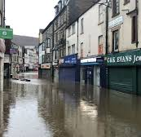
Stock and Contents
All Risks cover
Contents will usually cover stock and other contents ?
How do we help the policyholder set the correct sum inured for contents which will usually include co?

Slide 16
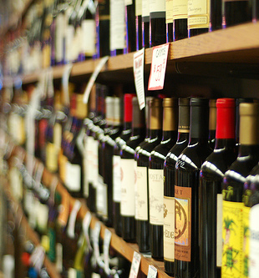
Target Stock
Insurers will impose a small inner limit here, e.g. £1,000 to ensure the policyholder declares the correct information.

Slide 17
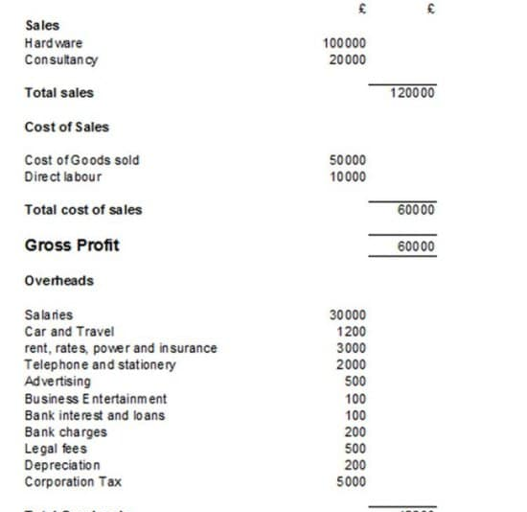
Setting correct sums insured
Accountants figures differ from what insurers require in respect of:
Buildings
Stock
Contents
Gross Profit (may have an automatic limit in package)

Slide 18
Theft Cover
Standard Theft Cover is for:

Slide 19
Loss of Rent
Rent liability to meet continuing liability to pay rent by the tenant even if premises are damaged.
Cover up to 25% of contents SI for up to 2 years rental liability, some insurers provide a specific sum insured.
LOR covers temporary alternative accommodation if owner, with the cover usually being based on a percentage of the Building Si (e.g.,20%).

Slide 20
Money.
Cover is All Risks.
Definition of money is what?
Cover also includes:
2. Personal Accident / Assault lump Sum £10,000, weekly benefit £100 per week maximum 104 weeks.

Slide 21
Deterioration of Stock
Loss of freezer contents following accidental change of temperature
Limit often around £2,000

Slide 22
Goods in Transit
All Risks cover
Unattended vehicles must be locked, some insurers put harsher terms on
Limits around £2,500

Slide 23
Business Interruption
Cover is Gross Profit or Gross Fees – what is the difference?
Cover will automatically include economic ICW.
Insurance Bi is different from accountants Bi.

Slide 24
Bi extensions
Suppliers
Public Utilities
Damage denial of access
Murder, suicide, pests, food poisoning and maybe some specified disease cover.
Book debts

Slide 25
Employers Liability
What does this cover?
Cover is for £10m any one occurrence.
Legally required.

Slide 26
Public Liability
What does this cover?
Limits between £2m and £5m any one occurrence.
Work away may be restricted to clerical, delivery or collection work unless specifically declared.

Slide 27
Products Liability
What does this cover?
Limits of indemnity between £2m and £5m in the AGGREGATE – what does this mean?

Slide 28
Optional extensions - a few may come automatically
Buildings
Legal expenses
Fidelity insurance
Terrorism
Portable equipment away from the premises (this would not be stock)
Computer Breakdown
Personal accident
Loss of licence – non renewal or withdrawal of licence due to circumstances beyond the insured’s control
Cyber Liability

