Slide 1
The Drivers, Obstacles and Opportunities of a Hardening Market

Slide 2
Welcome

Slide 3
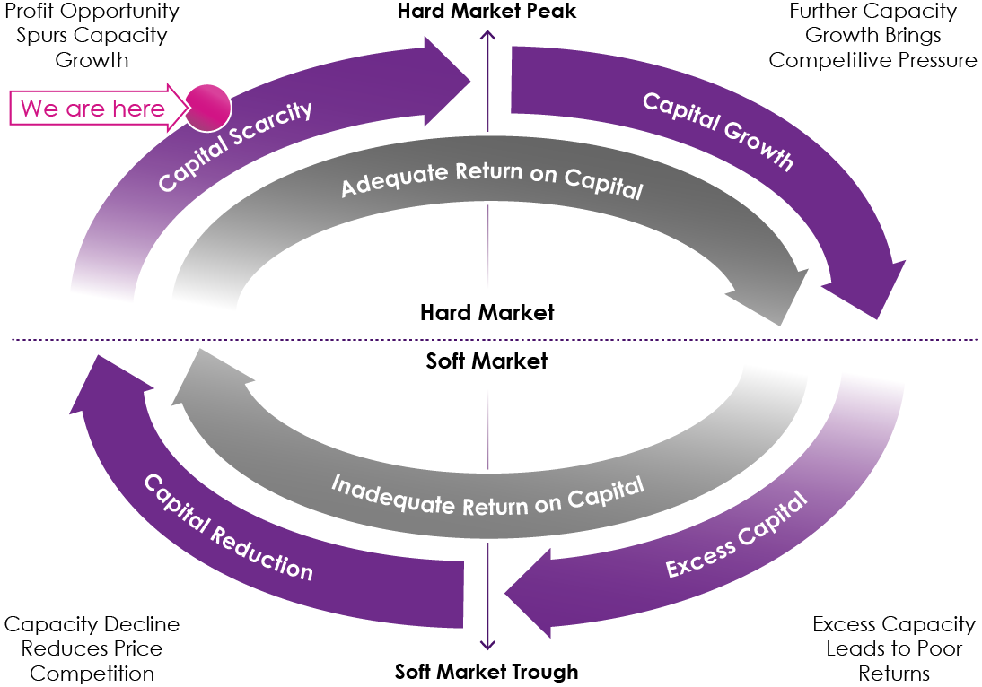
The market continues to harden

Slide 4
What has led to this position?
Societal & Environmental Pressures
Economic Pressures
Political Pressures
Technology Pressures

Slide 5
What can we do together?
Timely Renewal Conversations
Understand Needs & Tailor Solutions
Client Education
Risk Information & Risk Management
Opportunity Knocks

Slide 6
Thank you.
Any questions?

