Slide 1
Technology Week Programme of Events
More details on our upcoming CPD Festival Week
Week commencing: 19th April 2021
All bookings to be made via the website HERE.

Slide 2
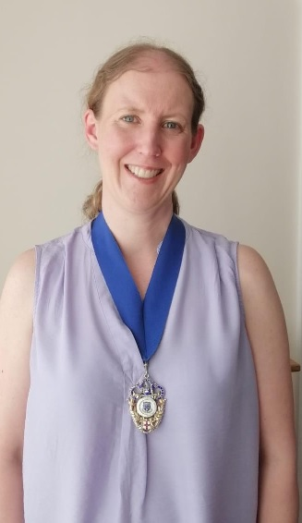
A festival of CPD at the push of a button
In September 2020 the Insurance Institute of Leeds took the innovative step of hosting a ‘festival of CPD’, embracing the new virtual world to provide a range of key learning and development sessions on a common theme.
The week proved so successful we have arranged another edition for the week commencing 19th April 2021, hosting seven CPD webinars covering a wide range of topics on a common thread: Technology, and its impact and importance in the insurance profession.
There is something for everyone across the week, with our key speakers covering essential topics such as insurance fraud, hacking, data storage and cyber security.
This brochure provides details of all webinars and links to book your place at the virtual table. Events are likely to prove popular, so please act quickly to secure your place.
Melanie Jordan FCII President, Insurance Institute of Leeds

Slide 3
The Future of Insurance and Your Place in it
David will draw on his 35 years of experience in technology, strategy and futures roles, much of which has been focussed on the insurance industry, to illustrate how IT is set to change not just how we do things but the very substance of what we do.
He will look at both new and emerging technologies to illustrate this point. His foresight is gathered through Global Futures and Foresight by their in-house research team and through many engagements with Insurance firms both in the UK and abroad.
His purpose is to inspire his audience to embrace change and by so doing better prepare for the future.
Learning objectives By the end of the session, attendees will:
Learn how technologies will increasingly disrupt the Insurance sector.
Learn how to run a 3 Horizon exercise to understand how technologies will impact the insurance sector in the long, medium and short-term and how they will likely impact your own firm.
Understand what is required to personally thrive and be a positive contributor in a dynamically changing insurance sector.
Speaker biography David Smith is the Chief Executive and Futurist at Global Futures and Foresight, a futures research firm, based in London, which he has led for the past 14 years. He has over 35 years of marketing, leadership and strategy experience, in global IT and IT services firms and was responsible for the strategy of a $2bn global financial services business focussed on Insurance.
He is a regular speaker at Business Schools, associations and industry events and on a number of occasions for the CII across the UK, addressing over 40 conferences a year and publishes a number of forward -looking reports each year (www.thegff.com). In May last year he reported on the likely long-term consequences of COVID-19 on 40 industry sectors, including the insurance sector and insurance brokers, on consumers across 12 sectors and on the economy.
He is currently a member of the IT Lab of the US Professional Insurance Agents association. He also worked with ACORD for 8 years to raise the strategic importance of data in Insurance firms and last year undertook research with CIO’s of the top insurance firms in the city.
Monday 19th April 12:00 – 14:00
David Smith
BOOK HERE

Slide 4
Digital Data Storage Its role in the FS and General Insurance Sectors, Vaccination Programme and Covid Passports
This webinar will give a detailed insight into data storage and how people and organisations can keep their data safe in new and innovative ways, while also allowing it to be used for the creation of products and services of genuine value to the consumer. It will cover areas such as the capture and storage of data during the Coronavirus Vaccination programme, how data storage will enable the development and use of Covid passports. The seminar will also include the challenges and opportunities that are presented to insurance businesses and individuals in a post Covid world.
Learning Objectives By the end of this session, attendees will: - understand how people and organisations can keep their data safe - understand how the link between data access and product / service provision works - understand how secure data provision facilities can be used as a USP in insurance product offerings - gain an insight into the use, storage and benefits of innovative data storage within the Covid Vaccination programme and subsequent movement of populations
Speaker biographies Ben Martin graduated with a Bachelor of Science degree from the University of London, and began his career with Bayer, the international chemical and pharmaceutical company. He moved into the IT sector in the early 1980s, and he has been involved in electronic document management since the middle of that decade. He has held sales director roles with innovative leading companies in that sector, including Anite and Spescom Software. He has been responsible for sales and business development management in the UK, Europe, the USA and South Africa. Ben is now responsible for sales and channel development activities in the UK and internationally for S4Encrypt and is MD of their associate company Safe 4 Information Management.
Paul Stallard, a key figure in the formation and development of S4Encrypt, Paul is also a stakeholder in the associated business Safe4 Information Management. Paul is a highly experienced progressive, practical and no-nonsense sales and marketing professional who helps clients address the key challenges currently facing FCA regulated businesses, namely: • Using data to create insight, customer personas and strong propositions • Building sustainable customer experiences • Creating digital marketing excellence Paul is a Fellow of the Chartered Institute of Marketing and a Fellow of The London Institute of Banking and Finance
Tuesday 20th April 12:30 – 13:30
Ben Martin
Paul Stallard
BOOK HERE

Slide 5
Insurance Fraud Using technology to fight back
This session looks at how the Insurance Fraud Bureau and the insurance profession uses technology in counter fraud.
Learning Objectives At the end of this webinar delegates will be able to identify: • Insight into how the IFB and insurance industry use technology in counter fraud. • Insight into how fraudsters are using technology. • Considerations about the use of technology in fraud investigations. Speaker John Davies has been with the Insurance Fraud Bureau for 8 years, working with the insurance industry to disrupt organised insurance fraud. He has an interest in developing counter fraud strategies to tackle emerging fraud threats and has recently been working with the industry to understand how fraud may manifest in business interruption claims. John has a Masters in Counter Fraud and Counter Corruption from the University of Portsmouth and has had research published in the International Journal of Law, Crime and Justice. He is currently undertaking a Law master’s degree part time at the University of Birkbeck.
Tuesday 20th April 15:00 – 16:00
John Davies
BOOK HERE

Slide 6
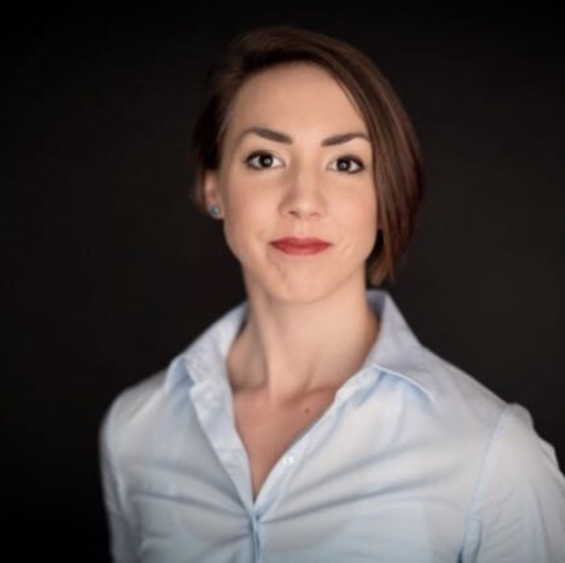
Risk Management and Cyber Security
‘Differentiating Cyber Risks’ is a core group training provided by Cyber Claire to ensure a nuanced understanding of cyber risks and how this relates to cyber insurance coverage. After this training practitioners will be able to tailor their discussion with clients to be risk-led and specific to the exposures they face, as opposed to being insurance-sales driven.
Learning objectives
By the end of this session attendees will be:
- Cognisant of the main triggers for cyber insurance coverage, and be equipped with a claims examples that can be drawn upon in future discussions.
- Able to articulate how cyber risk corresponds/overlaps with other lines of coverage.
- Aware of how cyber risk has changed in light of COVID-19.
Speaker Biography
With a proven track record of seven-figure new business generation across an annual period, Claire was one of the London market’s most prominent brokers specialising in cyber risk. Claire has a decade’s experience working in financial services, helping large, global clients understand, mitigate and transfer cyber and contractual technology risks. She now designs and delivers training programmes for cyber security and risk management professionals, alongside bespoke consulting engagements.
Wednesday 21st April 11:00 – 12:00
Claire Davey
BOOK HERE

Slide 7
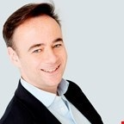
RegTech, Risk Management and The Future of Regulation
Date & Time: Thursday 22nd April 13:00 – 14:00
Speaker: Chris Davies
Book here
Chris will provide a review of the direction that the FCA and other regulators are taking and their application of technology to governance, risk and compliance requirements. Chris will also explain how to identify, manage and monitor risk and increase accountability and governance in line with the regulators’ direction, as well as providing insight into tech based solutions.
Learning objectives
By the end of the session, attendees will:
- Understand how regulators are applying technology
- Know what Reg Tech is and its presence / role in the current FS / GI markets
- Know how RegTech applies to businesses and can assist in streamlining regulatory reports as well as reducing your carbon footprint.
- How to ensure that risk and compliance is managed by embracing the principles of Reg Tech
Speaker biography
Chris Davies has 27 years experience in retail financial services both in the UK, and internationally in Asia and Australia.
In 2017 Chris launched “Model Office”(“MO®”) a RegTech and strategic development platform that allows firms to self audit, identify problems early, cut through the noise and receive tailored tasks and resources to manage risk, improve professional practice and save time and costs.
This allows firms to benchmark their professional development against The FCA rules, their papers, key directives such as KYC, AML, TCF, IDD, Suitability, MiFIDII, The GDPR and SM&CR and their peers plus gain a regulatory dashboard with digital strategies and resources to improve compliance scores.
Effective Virtual Communication
Date & Time: Friday 23rd April 10:00 – 11:00
Speaker: Harriet Glover
Book here
Over the last 12 months our communication has been almost entirely virtual as a result of the ongoing pandemic. This webinar will help you develop new ways to enhance your communication skills, and overcome the barriers that are presented when communicating with different individuals. How you say something is just as important as what you say, and the session will empower your interpersonal skills to enable you tackle difficult conversations.
Learning Objectives
By the end of this session, attendees will:
- Understand the impact of good communication in the virtual world
- Understand the different ways people interact
- Have a greater understanding of the best ways to tackle difficult conversations
Speaker Biography
Harriet Glover is an CIPD qualified Learning & Development Business Partner, with six years’ experience in the financial services industry. Harriet’s current role is managing the Personal & Professional Development School of Excellence at Marsh. She supports leaders to coach and develop their teams to success, and has taken an active role in delivering virtual training across the company during the pandemic.

Slide 8
Hacking – the new “STING”
Hacking is a very real threat for businesses of all sizes: cybercrime is estimated to cost business more than £21bn a year. You wouldn’t leave your car unlocked. Yet we do with our most important business assets all the time – whether it’s compromising data through unlocked computers or open files accessible to un-vetted contractors. Professional hackers use seven steps, some of which terrorists use to get to know an organisation. Understanding these, training your staff on how they can be hacked, is the best way to defend yourself.
Learning objectives At the end of the sessions, attendees will be able to identify: - the 7 key steps used by hackers, including a live demonstration hack - technological defences that are available - areas of professional exploitation and its consequences
Speaker biography
Steve McLaughlin’s background is in IT, security and financial services, serving ten years in the Royal Air Force in the field of telecommunications, IT and security then moving into financial services, working for HSBC until 2004. He set up his first financial services company in 2005 and in 2011 saw a niche market in IT security as he noticed IT companies were not paying particular attention to IT security. He and his firm (Steve Mac Media Ltd) have gained certification in the industry qualifications: • Certified Forensic Investigation Practitioner (CFIP) • Certified Security Testing Associate (CSTA) Steve believes IT security is not about spending thousands of pounds on Anti-Virus, firewalls etc; he believes it is about investing in education and training. “The more we educate our staff, family and friends the better protected we all will become and this will allow us to quickly identify when something appear not to be right”.
Friday 23rd April 12:00 -13:00
Steve McLaughlin
BOOK HERE

Slide 9
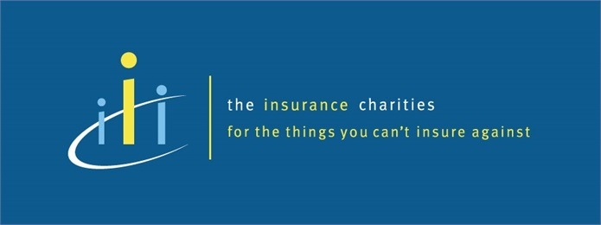
During 2021, we are raising money for The Insurance Charities and the President’s Chosen charity Touchstone.
Your contribution goes a long way! Please donate via the link below.
https://uk.virginmoneygiving.com/IILPresident

