Slide 1

The Insurance Institute of Southampton
Credit Hire -
The What, Why, How and Who?
25 November 2020
Please wait for the session to commence at 13.00
Bernard Thornton FCII
Chartered Insurance Practitioner

Slide 2
The Insurance Institute of Southampton
Credit Hire -
The What, Why, How and Who?
25 November 2020
Bernard Thornton FCII
Chartered Insurance Practitioner

Slide 3
What is Credit Hire?
‘a means of providing a replacement vehicle to an innocent victim of an RTA, with the least possible inconvenience and cost’

Slide 4

Who are the Participants?
Claimant (‘hiree’)
Credit Hire Company (CHC)
Third Party Insurer (TPI)

Slide 5
What are the Legalities?
CHC ‘underwrites’ the risk
Credit Hire Agreement in name of ‘Hiree’
Hiree’s obligations:-
No misrepresentation
No fraud
Co-operation with recovery efforts

Slide 6

What are the Criteria?
Liability
Need
Impecuniosity
Utilisation

Slide 7
Credit Hire vs Courtesy Vehicles
FAULT OR NON-FAULT?
‘Like for Like’?
Cost?

Slide 8
Reasons for Cost Differential
Bad debt
Compromise settlements
Concessions for early settlements
Litigation costs
Uninsured TP
Additional insurance premiums
Unrecoverable damage costs
Settlement delays
‘Free’ upgrades
Admin costs
Collection & delivery

Slide 9
What is the ABI GTA?
‘The General Terms of Agreement for Insurers and Credit Hire Companies sets the standards for the credit hire industry, ensuring smoother processes and more productive relationships’.
-GTA Website

Slide 10
How Much?
VEHICLE TYPE | EXAMPLE | CH RATE PER WEEK | TYPICAL ‘SPOT’ HIRE
S1 | Vauxhall Corsa | £262.15 | £166.40
S5 | Nissan Qashqai | £426.93 | £316.00
P4 | BMW 320 | £821.38 | £349.93
PV4 | Ford Transit SWB | £404.11 | £231.00
B5 | 125cc Motor Cycle | £296.80 | £195.00
CS4 | Mitsubishi Shogun 7 | £731.99 | £511.00

Slide 11
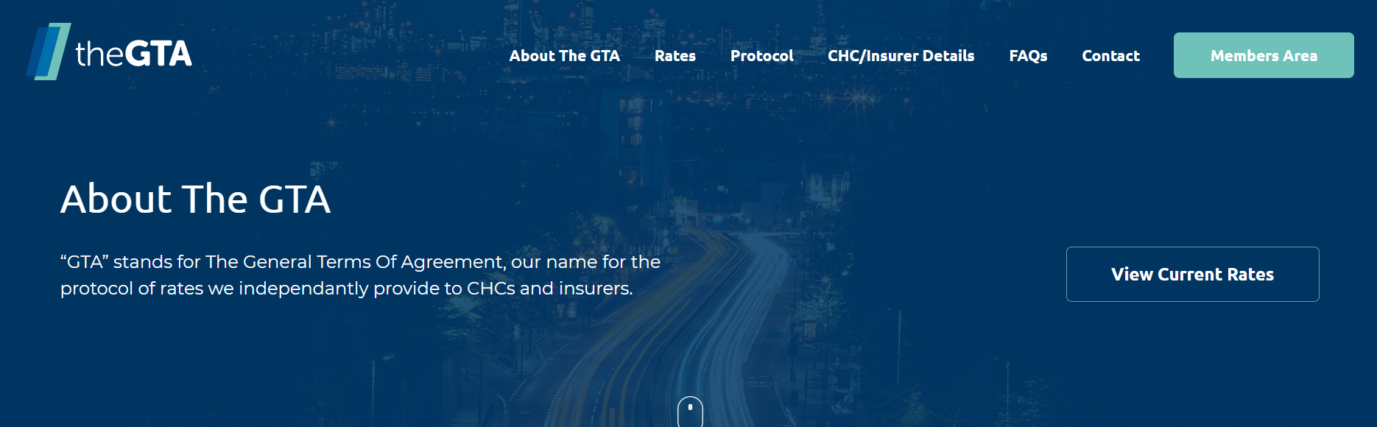
The ABI General Terms of Agreement
Website:
https://www.gtacredithire.com

Slide 12
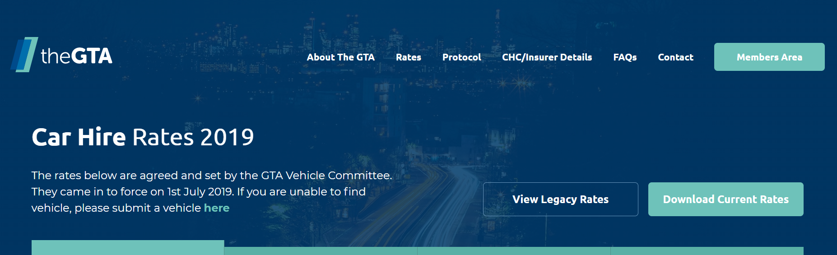
GTA Rates
Website:
https://www.gtacredithire.com/rates/car-hire

Slide 13
Who are the GTA Signatories?
CHCs
Insurers (and their agents)

Slide 14
Why Does Credit Hire Exist?
Increasingly Assertive Claimants
Insurers Slow off the Mark?
Opportunist CMCs

Slide 15

The Good, the Bad & The Ugly
Ugly
Bad
Good

Slide 16

Who is the Celebrity Credit Hire Claimant

Slide 17

WINNER!

Slide 18
The Ugly
Bent v Highways & Utilities Construction Ltd (2011)
Costly stand-offs
Eye-watering costs
Who pays?

Slide 19
The Bad
Scramble for ownership
>8 different approaches
Little thought for claimant’s best interests
Claimant innocent but confused!
Poor service

Slide 20
The Good
Non-standard vehicle
Lateral thinking
Minimum disruption
Co-operation
Everyone happy!

Slide 21
Harries v Baguley (2019)
Liability dispute
£400,000 hire charges over 3 years
Mitigation attempted but refused

Slide 22
Who Regulates?
No legal regulation
Most CHCs have other regulatory controls, e.g. FCA
Credit Hire Organisation
  Full members (CHCs)
  Associate Members (mainly law firms)
CMA Investigation 2014

Slide 23
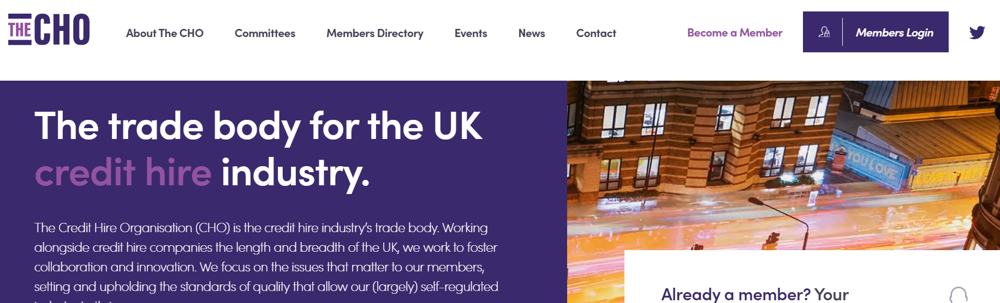
The Credit Hire Organisation
Website:
https://thecho.co.uk

Slide 24
What are the Topical Issues?
Covid-19 Mitigation
Brexit – Supply Chain and Potential Delays
Liaison with Personal Injury Solicitors
New LiP Portal

Slide 25


Comments & Questions

