Slide 1
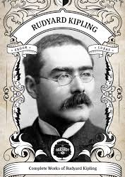
How to maximise opportunities in a Hard market
By Alan Chandler, Chartered Insurer
‘If you can keep your head when all about you are losing theirs and blaming it on you. If you can trust yourself when all men doubt you, then yours is the hard insurance market and all the distressed clients within in it.

Slide 2
Alan Chandler, Chartered Insurer
I have trained more than 2,000 individuals to become ACII qualified
I have trained over 50% of the individuals in the last 8 years that have gone onto achieve the highest ACII pass in the whole of the UK.
I train to a pass rate of more than 96% in all CII qualification levels. Certificate , Diploma and Advanced Diploma.
I deliver the Allianz scholarship and academy programmes in both the UK and Ireland, provide the Zurich Ask Alan facility and I have been a Cii examiner.
I have trained students who have won national prizes in almost all ACII subjects including Insurance Law (MO5), Liability (M96), Commercial Property and BI (M93), Personal Lines Insurance (P86), Business and Finance (M92), Underwriting Practice (M80), Advanced Underwriting (960), Claims Practice (M85), Advanced Claims (820), Marketing (945), Advanced Broking (930) and Advanced Risk Management (992).

Slide 3
LEARNING OBJECTIVES
Delegates will be able to:
Understand the characteristics of a hard market.
Understand what is currently causing the hard market in the UK.
Understand how to communicate clearly to clients in a hard market.
Understand and be able implement the ten key factors on how to maximise opportunities in a hard market, and therefore become extremely successful, by growing their business in a difficult time.

Slide 4
So what is a Market Cycle in insurance
Higher Profits
This leads to higher prices.
This attracts higher capacity for that class
This means Insurers withdraw capacity
This leads to lower prices.
Lower profits.

Slide 5
Supply decreases in a hard market

Slide 6
Consequences of a hard market
1. Premium increases.
2. Coverage reductions.
3. Harsher interpretation of claims - including TIA.
4. Fewer options for brokers to be able to get quotes.
5. In some cases there may be no cover available at all for certain clients.

Slide 7
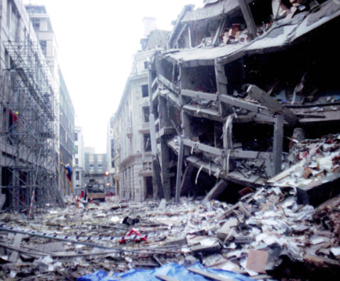
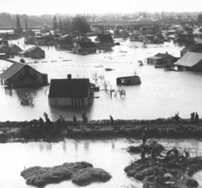
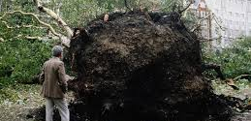
Bad times have hit the UK insurance industry before
1953 North sea storm surge through the Thames Estuary
1987 Great storm
1992 Baltic Exchange
2001 Independent go under and 9/11

Slide 8
It is being shouted from everywhere
Coronavirus will be the largest loss on record for insurers, as per John Neal CEO Lloyd’s of London
In a broader economic assessment report on the impact of Covid-19 for the non-life insurance industry, Lloyd’s of London estimated that the 2020 underwriting losses covered by the industry will hit $107 billion (on par with the worst ever losses like Katrina in 2005) BUT Add to the claims the loss of investment income of $96 billion and the overall bill will be $203 Billion, almost double the worst previous event ever!
“The chances of the market making anything other than a notable loss in 2020 are zero.”
Oliver Bate CEO Allianz ‘ virus has hit insurers like a Meteorite’

Slide 9
Seven reasons why 2020 will be a hard market
Solvency II.
Ogden rate is for the foreseeable future going to be in negative territory.
Coming into 2020 the property insurance market was already running at loss making rates.
Storms Dennis and Ciara could cost the industry in excess of £500M.
Covid -19 will cause extensive losses to insurers.
Reinsurance rates will be rising considerably.
Interest rates are at an all time low meaning investment income cannot be relied upon by Insurers.

Slide 10
The market will get very hard
Take a look at Ireland to see what happens when a market gets very hard.
Almost 250 insurers have pulled out of the market in the last six years, half of those in the last two years.
The UK insurance market will face significantly reduced capacity.

Slide 11
Not all classes of insurance will be affected by a hard market. It is possible that motor accidents in the UK are going on a permanent downward curve.

Slide 12
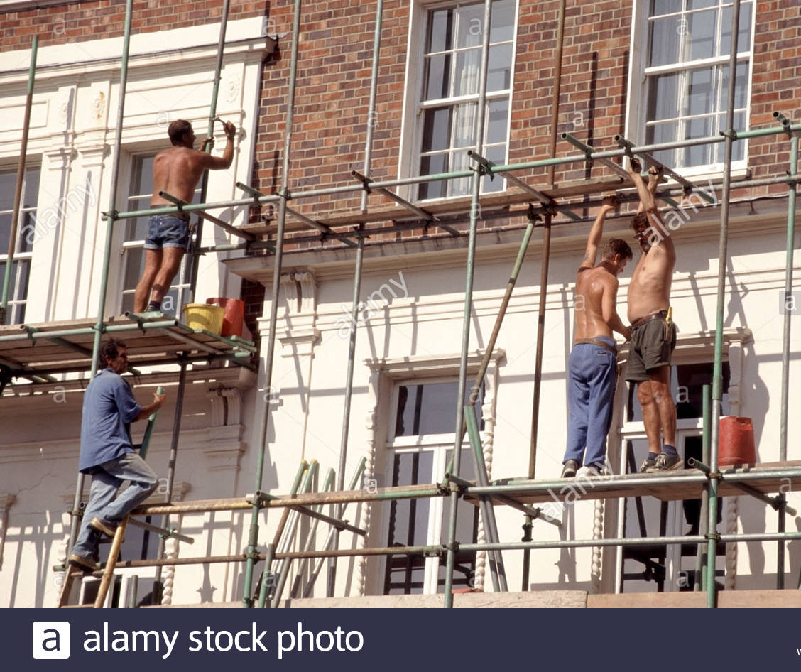
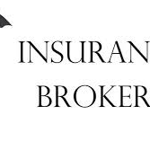
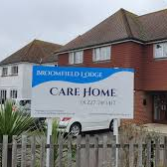
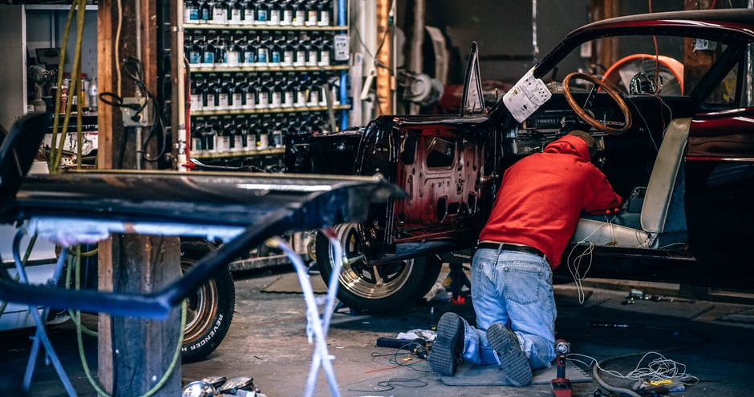
Covers under threat

Slide 13
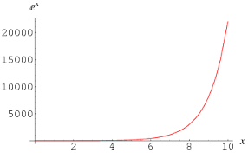
Ten Factors on how brokers and underwriters can maximise opportunities in a hard market
During difficult times businesses that are well structured and have highly trained staff grow exponentially – many highly successful brokers attribute 2001 as a major turning point in their business.
Businesses that have been based on selling cheap without any investment in training lose market share, because their lack of knowledge gets exposed in a hard market – these brokers and underwriters will not be viewing this presentation!!!
The growth will not be based on new entrants, it will be based on redistribution.
We will now go through the ten factors on how to maximise growth opportunities in a hard market.

Slide 14
Clients are not impressed!
To quote a large client
‘’The minimum I expect from an underwriter, a senior underwriter, an underwriter who’s the head of financial lines, is that if he’s going to give me a 4000% increase, reduce my capacity, and give me some significant restrictions in cover, then he is able to articulate why he’s doing that’’

Slide 15
So how can brokers and underwriters maximise opportunities in a hard market? FACTOR ONE
Factor One Educate Clients about what a hard market is and the many factors causing it.
Do not say your premiums have increased due to Covid- 19 as it is only one of many factors, and the client probably did not get paid out on Covid-19 ! - so change the narrative.
Do quote John Neal that worldwide losses will be in excess of $200 Billion, making it the worse underwriting loss ever.
Create expectations of the new norm.

Slide 16
FACTOR TWO – Do be sympathetic
Most clients are facing some of the biggest challenges of their business lives. Do NOT be the carefree broker saying its 50% uplift take or leave it – nothing else out there for risks like yours!
Most clients have never needed a premium decrease more, yet their hopes will be dashed as they will be getting the opposite.
Tact and understanding will go a long way.

Slide 17
Factor Three - Start renewal negotiations EARLY
Do not follow your normal renewal time cycle, look to always be ahead on renewals during this forthcoming year. This could mean thinking 3 or 4 months ahead.
Well in advance, look to identify all the renewals where there could be a problem with placement.
Challenge reserves where appropriate.
Start sounding out possible alternatives even before terms have come through, if you anticipate issues with the holding insurer. The hard market will mean specialist markets will be inundated, so the earlier you start the alternative quote procedure the better.

Slide 18
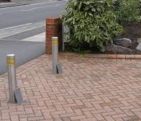
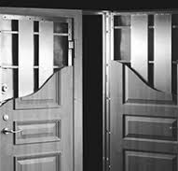
Factor Four – Engage the holding insurer early on risk improvements
Have an early pre renewal meeting with the holding insurer.
What are their views on the risk , is there anything that the client could do that will have a positive influence on the renewal terms.
Do talk about what risk management actions they might like to see, remember you can include survey recommendations that were previously not implemented in your discussions, would these now be worth doing?

Slide 19
Factor five – do get a range of alternatives quotes at renewal
Do not assume past performance will be the same in the future says your IFA – this will also apply to clients who in the past have seen uninterested in their insurances.
Irish brokers were inundated by people they had not heard from for years!
Work out which risks you need to pre-empt by providing a range of alternatives, show them you have been doing your job so they do not need to look elsewhere – take away that temptation!
A list of alternatives can put the exiting insurers terms in context.

Slide 20
Factor Six – Establish the right contacts at each insurer who can deal with a hard market
Great underwriters come into their own during a hard market, make a point of identifying these individuals in each of your key insurers.
Find ways of avoiding having to deal with no quote Nigel and risk averse Rita! – ask to change your underwriting focal point if you have to – this applies to new business too!
In a hard market there will be less alternatives, so do not let the Nigel’s and Rita’s stop you accessing an otherwise good insurer.

Slide 21
Factor Seven – Use BOLD in presentations
For both renewals and new business you need to ensure that your presentations stand out, so that they will not end up in the amber or red piles!
Make them professional, including all relevant information, and do use bold where appropriate.

Slide 22
Factor Eight – Be innovative use Zoom or Teams with your prospects and clients
For new and existing clients – show them you have embraced the new world.
All of a sudden you have a meeting with a prospect that previously would not have been viable, or a pre renewal meeting that again would not have been traditionally viable.
The world has changed – think outside the box
Remember the saying if you always…………………

Slide 23
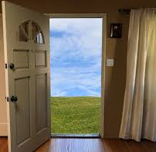
Factor Nine – Dust off that prospect list – the door of inertia opens wide in a hard market!
In a hard market that is happening at the same time as a recession, prospects will be more interested than ever in getting alternatives!
OPPORTUNITY KNOCKS FOR THE HARD WORKING

Slide 24
Factor Ten – Do persuade existing clients and prospects not to act in a rash way
The temptation for businesses who are struggling will be to reduce expenditure by cutting coverage.
Clearly articulate the risk of reducing or removing these covers and follow this up in writing.
Do remind the purchaser of insurance of their own personal increased D&O risk by making this decision without board agreement.

Slide 25
Summary of the Ten factors of how brokers can maximise opportunities in a hard market
Educate clients about a hard market.
Be sympathetic.
Start renewal negotiations early.
Engage the holding insurer early about risk improvements.
Get a range of alternative quotes to establish context.
Establish the right contacts at each insurer.
Use Bold in presentations to beat the traffic lights.
Be innovative in your use of Zoom and Teams.
Dust off those prospects lists – you are pushing against open doors.
Persuade clients against acting rashly.

Slide 26
Alan Chandler’s Training Courses Technical Training Courses
These can be run for a day, half day or a lunchtime presentation and the content tailored to meet your needs.
D&O in a plain English nutshell
GDPR/Data Protection a year on
Insurance Distribution Directive
Vulnerable Customers
The perfect storm - Understanding how solvency margins and Ogden are changing your insurance market place
How broker E&O claims are increasing and how these can be mitigated
The missed opportunity – how UK employments trends are changing yet the financial services sector is lagging behind
Bi in plain English
Financial awareness for account executives and handlers
Leadership in insurance
Examination Techniques workshop

Slide 27
Alan Chandler’s Training Courses Technical Training Courses
Commercial property insurance
Business interruption insurance
Construction insurance
Liability insurance (EL, PL and Products)
Professional Indemnity insurance
Motor Trade insurance
Directors and officers insurance
Motor Fleet insurance
Engineering insurance
Package insurance
Legal Principles of insurance
Household insurance
Private Motor insurance
How liability can arise under the law of tort
Builders Performance Bonds (1/1/2 hour course)

Slide 28
Training courses for Cii Examinations
At Certificate Level
IF1 Insurance legal and regulatory
IF2 General insurance products
IF3 Insurance underwriting process
IF4 Insurance claims handling process
IF5 Motor insurance products
IF6 Household insurance products
IF8 Packaged commercial insurances
At Diploma Level
MO5 Insurance Law
M92 Insurance Business and Finance
M93 Commercial property and business interruption insurance
M96 Liability insurances
M80 Underwriting practice
M85 Claims practice
M86 Personal Lines insurance
At Advanced Diploma Level (ACII)
530 Economics and business
820 Advanced claims
930 Advanced broking
945 Marketing insurance products and services
960 Advanced underwriting
992 Advanced risk management
Basically I can set up an entire training programme to take people from nothing to fully ACII qualified.

Slide 29
LEARNING OBJECTIVES
Delegates will be able to:
Understand the characteristics of a hard market.
Understand what is currently causing the hard market in the UK.
Understand how to communicate clearly to clients in a hard market.
Understand and be able implement the ten key factors on how to maximise opportunities in a hard market, and therefore become extremely successful, by growing their business in a difficult time.

