Slide 1
The Insurance Institute of Southampton
Personal Injury Claims
Where Next?
9 September 2020
Please wait for the session to commence at 13.00
Bernard Thornton FCII
Chartered Insurance Practitioner

Slide 2
The Insurance Institute of Southampton
Personal Injury Claims
Where Next?
9 September 2020
Bernard Thornton FCII
Chartered Insurance Practitioner

Slide 3
Agenda
Background and Development of the Injury Claims Market
Civil Liability Act 2018
Other Topical Influences
Effects, Opportunities and Communication
Comments & Questions

Slide 4
Background & Development
Pre-1988
Legal Aid Act 1988
Access to Justice Act 1999
LASPO Act 2012
Civil Liability Act 2018

Slide 5
Insurance Fraud
ABI Motor Fraud Figures for 2019:-
58,000 Fraudulent claim attempts (+6%)
Fraudulent claims valued at £605m (‘slight’ reduction)
75% of fraud attempts involve PI
Property fraud incidents up 30% (value up 8%)
Liability fraud down 14%
IFED
More Realistic Sentencing?

Slide 6
Background & Development
Pre-1988
Legal Aid Act 1988
Access to Justice Act 1999
LASPO Act 2012
Civil Liability Act 2018

Slide 7
Approximate valuations for a 3-6 month whiplash claim
STATUTE | DAMAGES | LAWYERS’ FEES
PRE-1988 | 0 | 0
LEGAL AID ACT 1988 | £1500 | HOURLY RATE
ACCESS TO JUSTICE ACT 1999 | £2000 | VARIABLE >£1200
LASPO ACT 2012 | £2250 gross | £500
CIVIL LIABILITY ACT 2018 | £450 | £0

Slide 8
Civil Liability Act 2018
Minimise fraud
Minimise ‘spurious’ claims
Speed up the claim process
Reduce legal costs
Eliminate fear of being sued
Reduce premiums
Objectives:

Slide 9
CLA 2018 - Provisions
Increase Small Claims Limit
Definition of ‘Whiplash’
Introduce Tariff of Damages
New portal for Litigants in Person
Ban on pre-medical offers

Slide 10
Small Claims Limit
3 channels for injury claims– Small Claims, Fast Track, Multi Track
Small Claims limit currently £1000 for injury, £10,000 for most other claims
CLA will increase this to £5000 for RTAs and £2000 for most other injury claims
No recovery of legal costs for Small Claims
Over 90% of RTA claims will fall within Small Claims under CLA

Slide 11
‘Whiplash’ Claims
Whiplash is defined for the first time as:-
‘…a sprain, strain, tear, rupture, or lesser damage of a muscle, tendon or ligament in the neck, back or shoulder, or
…an injury of soft tissue associated with any of the above’

Slide 12
Tariff of Damages
Applies only to ‘Whiplash’ Claims where symptoms persist for up to 2 years
Current Judicial College Damages Guidelines –
3-12 months = negotiable from £2,300 to £4,080
New Tariff –
3-6 months = flat £450
‘Special category’ claimants fall outside the tariff

Slide 13
New Portal
Effective April 2021
For Litigants in Person
For whiplash claims with symptoms lasting <2 years only
Runs alongside current portal, which continues for other injury claims
Site available to browse at www.officialinjuryclaim.org.uk

Slide 14
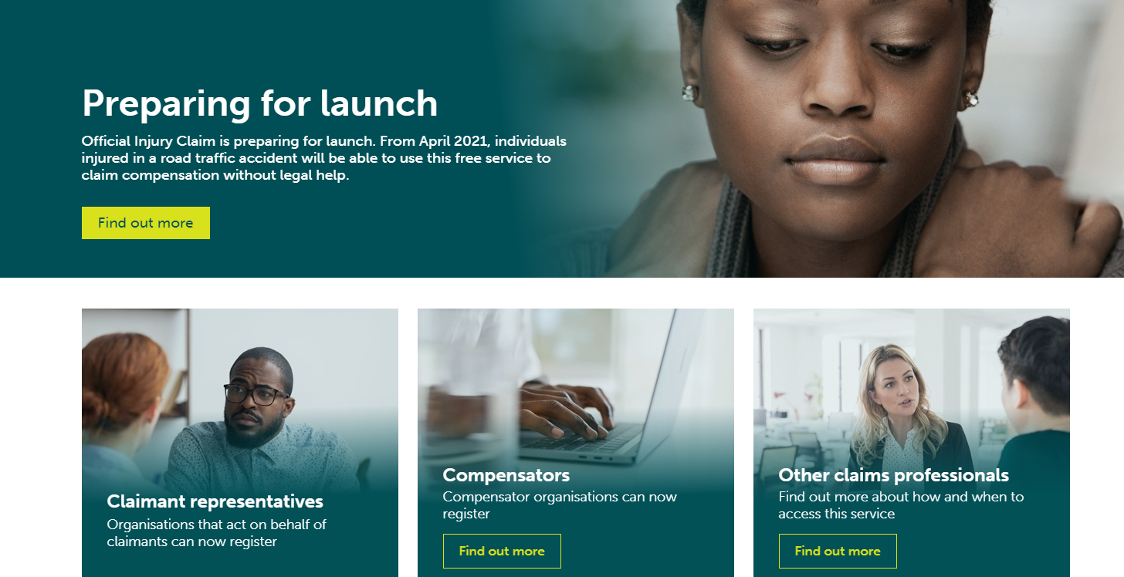
New Portal Website www.officialinjuryclaim.org.uk

Slide 15
Medical Examinations
Ban on pre-medical offers
MEDCO
Panel of examiners
Report allows for a challenge if appropriate

Slide 16
Other Topical Influences
Ogden Discount Rate
Claims Inflation
Climate Change
COVID-19

Slide 17
Ogden Effect
Female aged 20
Annual Costs, e.g. Physio £2,000
Payable for Life
Pre-August 2019 (-0.75%) £189,980
Post-August 2019 (-0.25%) £155,880
Assumed rate (+0.50%) £118,820

Slide 18
Insurer reserves impact post-Ogden August 2019
INSURER | ESTIMATED IMPACT
Admiral | -£50-60m
QBE | -£51.1m
Direct Line | -£15.9m
RSA | -£15m
LV | -£13m
Allianz | -£11m
Hastings | -£8.4m
Zurich | ‘No material adverse effect’
Ageas | ‘Undisclosed release of reserves’
Sabre | +£300,000

Slide 19
Other Topical Influences
Ogden Discount Rate
Claims Inflation
Technology & Climate
COVID-19

Slide 20
Effects - Insurers
Ogden Effect
CLA Savings
Report to FCA by October 2023
LEI Sales Opportunities

Slide 21
Effects - Brokers
Client communication
Staff awareness & training
LEI Sales Opportunities

Slide 22
Effects - Law Firms
Market Exits
Job losses
Alternative markets
Claims Management Companies

Slide 23
Effects – Commercial Clients
CLA - Initial Reactions
Manage Expectations
Commercial Liability
Communication
Face to face
Newsletters
Seminars
Local media
Social media

Slide 24
Effects - Claimants
Shock/Dissatisfaction
DIY Portal
Children & Vulnerable Parties
Clients can be Claimants Too

Slide 25
Effects - Insuring public
Premiums???
Access to Justice
Public Reaction?

Slide 26
Predictions
Cost savings from CLA
One-off boost from COVID-19
Ogden – uncertainty
Technology – home working, traffic, repair costs, PAYD, driverless cars
Declining market/employment?
LEI opportunities
Unhappy would-be claimants
Bewildered clients
Opportunities for agile players

Slide 27
A Balancing Act for Insurers
Positives
CLA Savings
Covid-19
LEI Sales
Opportunities
Negatives
Ogden
Claims Inflation
Market conditions
Neutral
Traffic volumes
Driverless Cars

Slide 28
Comments & Questions

