Slide 1

Capacity for loss

Slide 2
Agenda
What it is
What it isn’t/poor practice
Why it’s important
Fact-finding
Analysis
Summary actions

Slide 3
Learning objectives
Understand capacity for loss
Consider good practice examples
Review your approach
Notes:
Forward-looking
Big picture

Slide 4
Whose role is it to assess the client’s capacity for loss?

Slide 5
What is capacity for loss?

Slide 6
Capacity for loss
“By‘capacity for loss’ we refer to the customer’s ability to absorb falls in the value of their investment. If any loss of capital would have a materially detrimental effect on their standard of living, this should be taken into account in assessing the risk that they are able to take”
FSA Finalised Guidance 11/5

Slide 7
What it isn’t/poor practice
Confusing with risk profile
Blending with risk profile to arrive at single risk level
Right question/wrong answer
No assessment
Assessment but then ignored
Unsubstantiated comment in suitability report

Slide 8

Why it’s important

Slide 9
Fact-finding
Don’t ask the client what they cannot answer, ask them what they can (or can with assistance)
Income needed to maintain standard of living
    Not just essential expenditure – lifestyle and discretionary too
How this will vary over time
    Income need typically decreases over time

Slide 10
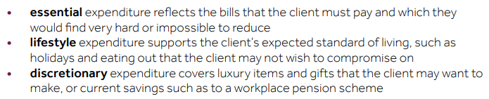
FCA taxonomy on income needs

Slide 11
COBS 19.1.6G
(3) A firm should only consider a transfer, conversion or opt-out to be suitable if it can clearly demonstrate, on contemporary evidence, that the transfer, conversion or opt-out is in the retail client’s best interests.
(4) To demonstrate (3), the factors a firm should take into account include:
  (a) the retail client’s intentions for accessing pension benefits;
  (b) the retail client’s attitude to, and understanding of the risk of giving up safeguarded benefits (or potential safeguarded benefits) for flexible benefits, taking into account the following factors:
    (i) the risks and benefits of staying in the ceding arrangement;
    (ii) the risks and benefits of transferring into an arrangement with flexible benefits;
    (iii) the retail client’s attitude to certainty of income in retirement;
    (iv) whether the retail client would be likely to access funds in an arrangement with flexible benefits in an unplanned way;
    (v) the likely impact of (iv) on the sustainability of the funds over time;
    (vi) the retail client’s attitude to and experience of managing investments or paying for
    advice on investments so long as the funds last; and
    (vii) the retail client’s attitude to any restrictions on their ability to access funds in the
    ceding arrangement;

Slide 12
Fact-finding: client views on security v flexibility
Secure income products (annuities):
• Provide secure, level or increasing pension for life
• Uses fund in exchange for income
• Can opt to include spouse’s pension on death (amount optional)
• Tax-free lump sum (up to 25%) available if you want
• Doesn’t require managing or reviewing
• Generally, benefits and taxation position less likely to change
• Higher income available if in poor health or have certain lifestyle (eg smoker)
Flexible income products (drawdown):
• No security of income; income depends on investment returns and charges
• Tax-free lump sum (up to 25%) can be taken without having to take income
• Flexibility to take further (taxed) lump sums
• Flexibility to increase, decrease, stop and start income
• Hence, need to review and manage income, lump sum and investment return levels to ensure income is sustainable throughout life
• Unused fund passed to beneficiaries on death (usually tax-free if taken as a fund)

Slide 13
Fact-finding: client views on security v flexibility
 | What is your view now? | What do you think your view will be in your later years, say 80s and 90s?
What is your view on the risks and benefits of having an annuity?
What is your view on the risks and benefits of having a flexible personal arrangement?
What is your view on the certainty of income in retirement?
You have outlined what additional amounts you will need in the future, over and above your regular income. Do you think there is the possibility that you will need to access further funds from a flexible personal arrangement? If so, please provide details
What is your experience of, and attitude towards, paying for advice on investments so long as the funds last?
What is your view on the limitations of access from an annuity (ie that you can have a tax-free lump sum and secure income but no further access or flexibility)
Would you like to leave assets to your children? If so, how much? Does this include the value of your pension scheme? How important is this given that this will reduce the level of benefit you can have in retirement?

Slide 14
Analysis
Younger clients
What’s their ‘ability to absorb falls in the value of their investment [and whether] any loss of capital would have a materially detrimental effect on their standard of living’?
Approaching/in retirement
For some, clearly have (or don’t have) capacity for loss
For most … cash-flow planning with stress testing

Slide 15
Cash-flow planning
Stochastic: stress testing built in
Deterministic: must stress-test solution

Slide 16
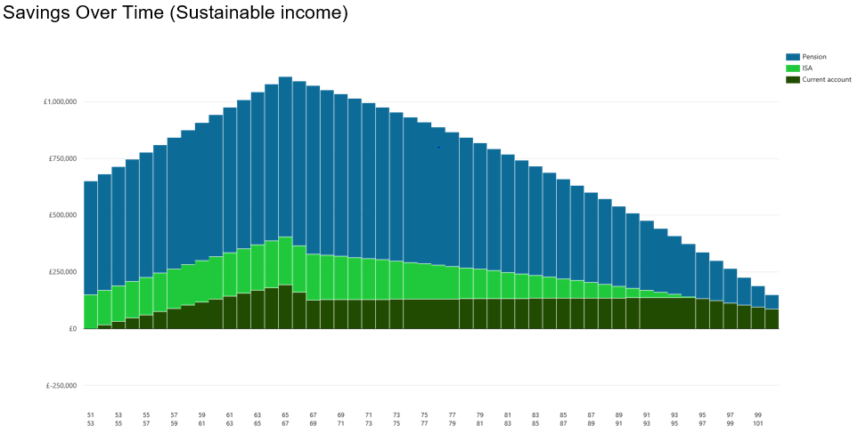

Slide 17
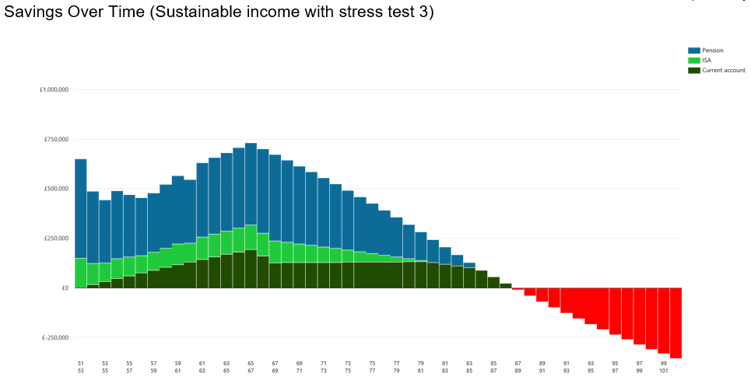

Slide 18
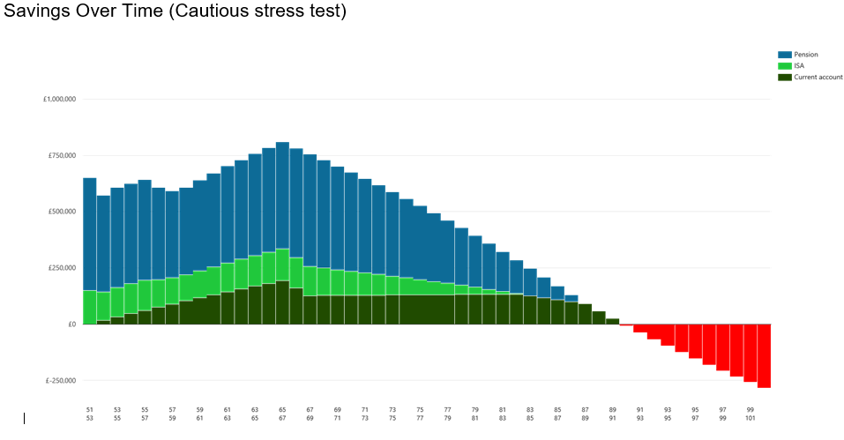

Slide 19
Stress-testing
Market crashes
Simulated crashes
Year one ‘maximum’ loss as per risk profile
Client-specific concerns (eg high inflation, prolonged recession)

Slide 20
Solutions (if plan A doesn’t work)
More cautious investments?
Save/invest more
Retire later
Part-time work
Scale down objectives
Take more risk …. or not

Slide 21
Centralised Retirement Proposition (CRP)
Safety first
Sustainable withdrawal rate (SWR)
Pots or buckets
Natural income
Security and flexibility

Slide 22
Summary actions
Ensure you are using an appropriate fact-finding approach
Use cash-flow planning to model client outcomes
Agree firm-level standard stress test(s)
Stress-test cash-flow plan to test capacity for loss

Slide 23
Questions

Slide 24


