Slide 1
Covid-19 Return to Work – Health and Safety
Employers’ obligations
Alan Davies
Partner

Slide 2
Introduction
The legal framework - Employers’ health and safety obligations during Covid-19
The implications of Covid-19 - Risk assessments - Control Measures - Personal Protective Equipment (PPE)
Covid-19 Guidance
Penalties for breach

Slide 3
The legal framework
As an employer, you must protect people from harm. This includes taking reasonable steps to protect your workers and others from coronavirus.
S.2 The Health and Safety at Work etc. Act 1974 dealing with duties to employees
S.3 dealing with other persons
Under the Management of Health and Safety at Work Regulations 1999, employers must undertake Risk Assessments of work activities that may have a risk of injury. The minimum you must do is:
identify what could cause injury or illness in your business (hazards)
decide how likely it is that someone could be harmed and how seriously (the risk)
take action to eliminate the hazard, or if this isn’t possible, control the risk

Slide 4
The implications of Covid-19: Risk Assessments
In order to take reasonable steps, conducting a Risk Assessment is imperative.
You do not need to eliminate all risks but you must do everything ‘reasonably practicable’ to protect your employees from harm. This means balancing the level of risk against the measures needed to control the real risk in terms of expense, time and resources.
Employers are required to consult with their workforce
Results should be published on the website if there are more than 50 employees

Slide 5
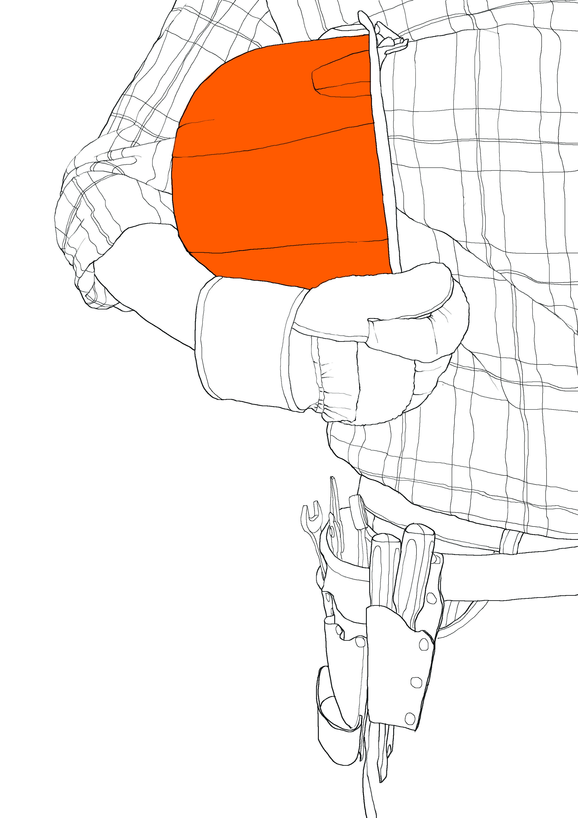
Identifying Potential Hazards
The clear potential hazard during Covid-19 is the exposure to, and spread of, the virus as a result of work activities.
Once potential hazards have been identified, control measures should be specific to the results of the risk assessment.

Slide 6
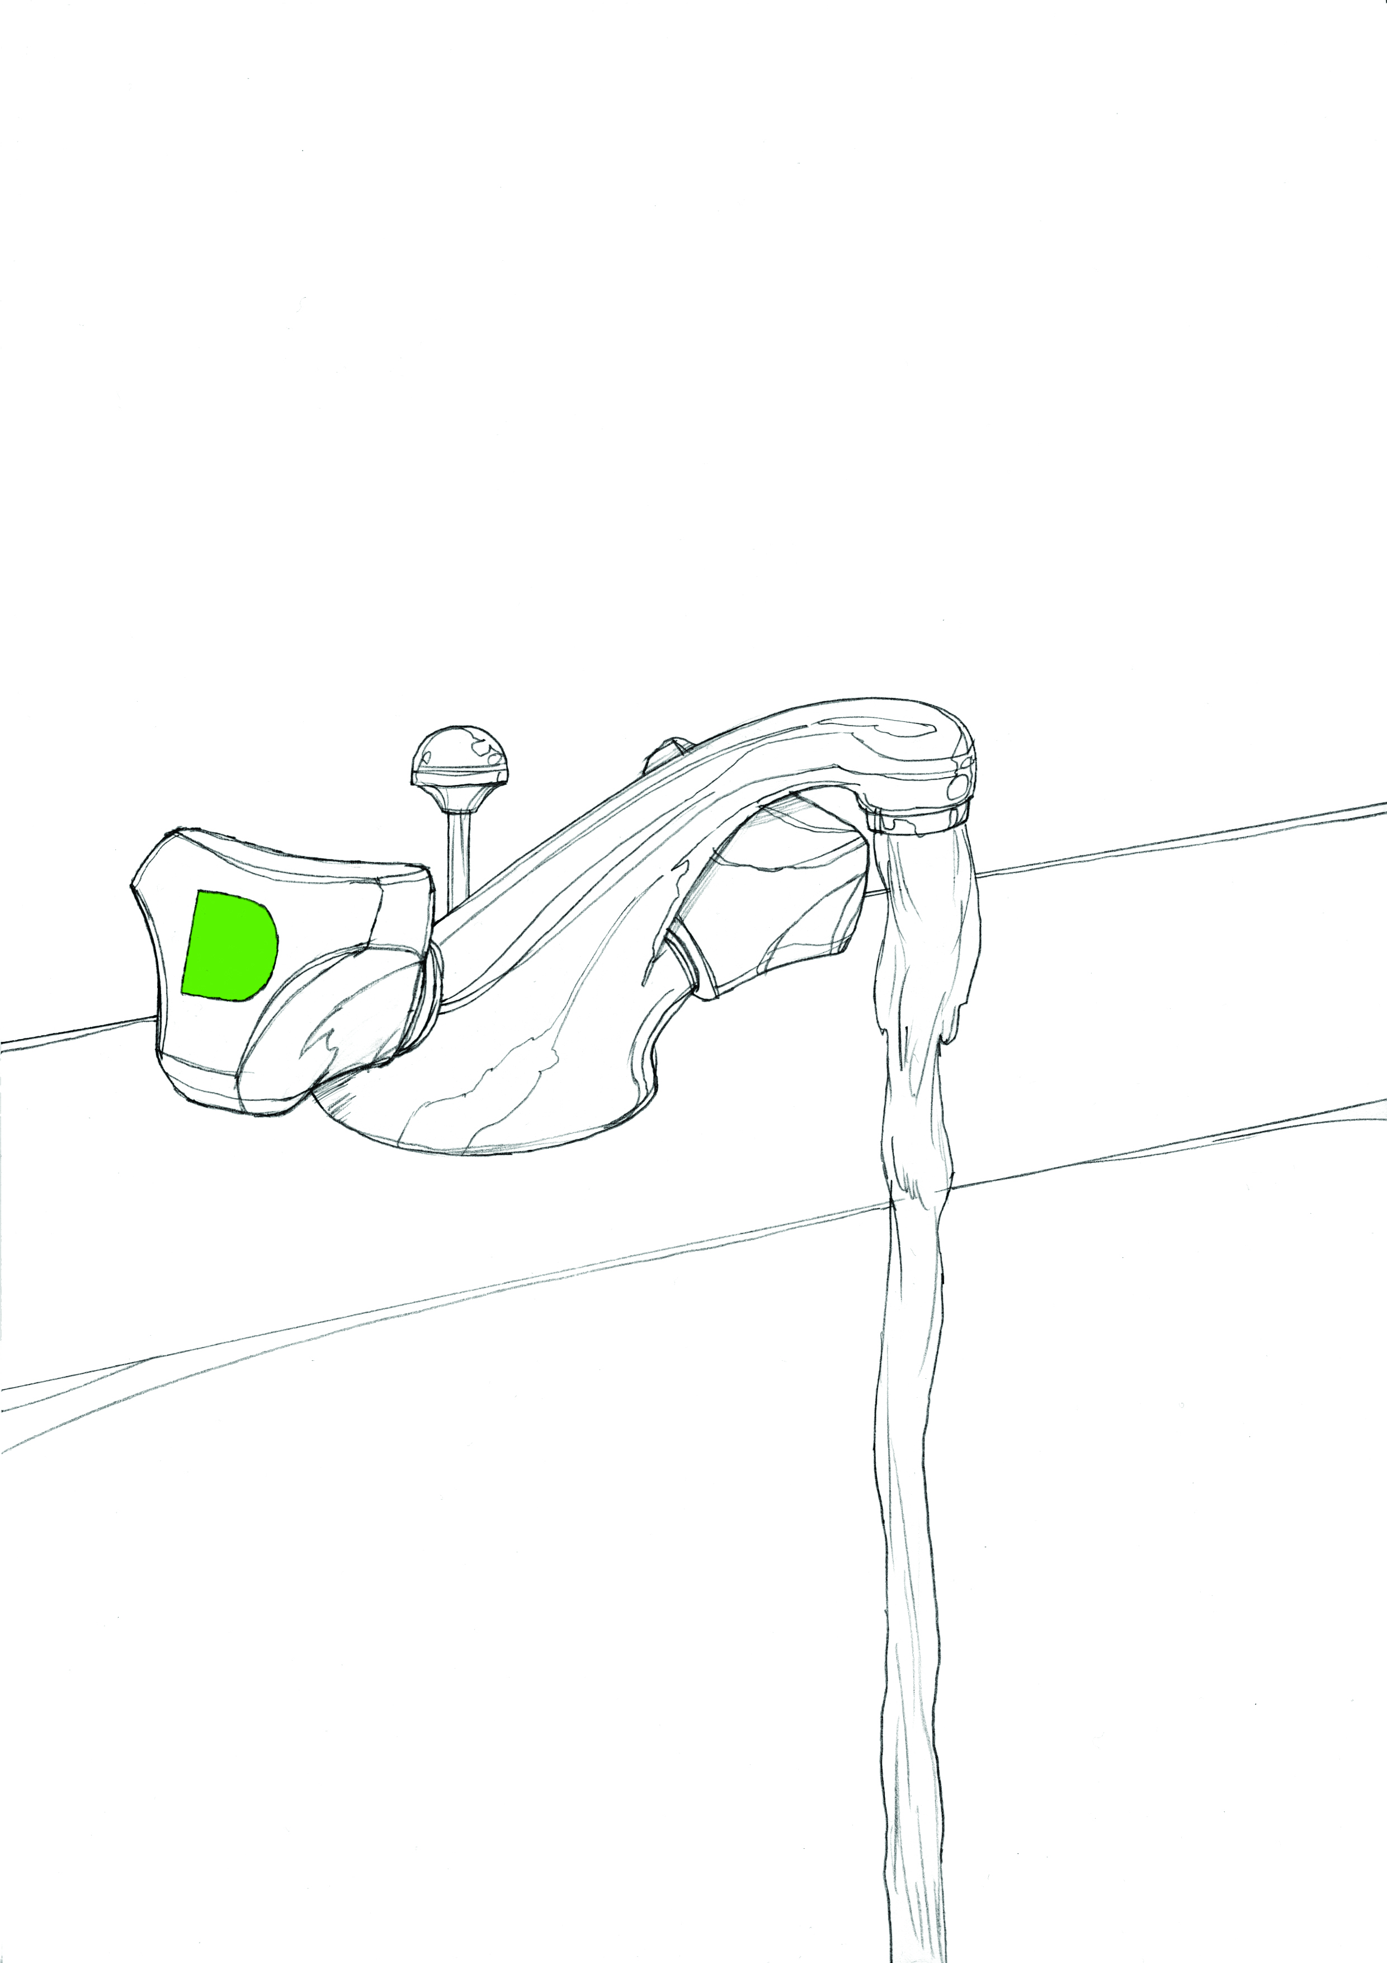
Control Measures
Examples of control measures include:
Ensuring handwashing in accordance with guidance, cleaning and disinfecting of equipment and surfaces
Increased hygiene practices; making hand sanitisers and tissues readily available
Clear and concise signage at all entrance/exit points detailing the health and safety procedures
Maintaining social distancing – 2m
Staggering shifts/reduced workers on site
Working from home
Providing information to employees in relation to Coronavirus
Introduce a reporting procedure for symptoms, sending any employees home immediately if they develop symptoms
Ensuring availability of appropriate PPE (usually as a last resort)

Slide 7
Potential generic Covid-19 workplace Risk Assessment
Potential Hazards | Potential Impact: Who might be harmed and how? | Current Control Measures | Risk Level | Action to be taken
Contamination through shared facilities | Risk of infection spread and/or contamination through staff, visitors, cleaners, contractors, drivers, vulnerable groups, anyone who physically comes into contact with the workplace | Hand Washing facilities with soap and water for 20 seconds, drying hands with disposable paper towels, alcohol gel sanitisers in any area where washing facilities are not readily available. Frequently cleaning and disinfecting equipment and surfaces that are touched regularly particularly in areas of high use Social distancing – reducing the number of persons in any work area to comply with the 2 metre gap recommended by Public Health England. |  | Employees to be reminded on a regular basis to wash their hands for 20 seconds with water and soap and the importance of proper drying with disposable towels. Also reminded to catch coughs and sneezes in tissues – Follow Catch it, Bin it, Kill it. Provide additional hand washing facilities to the usual welfare facilities if a large spread out workplace or a significant numbers of personnel are on site. Posters, leaflets and other materials to be displayed to remind everyone of public health advice

Slide 8
Risk Assessment Matrix
Key
L: Likelihood | 5 | 5 | 10 | 15 | 20 | 25 | High risk: 15-25 | High-risk activities should cease immediately. Further effective control measures to mitigate risks must be introduced.
 | 4 | 4 | 8 | 12 | 16 | 20
 | 3 | 3 | 6 | 9 | 12 | 15 | Medium risk: 8-12 | Medium risks should only be tolerated for the short term and only whilst further control measures to mitigate the risks are being planned and introduced.
 | 2 | 2 | 4 | 6 | 8 | 10
 | 1 | 1 | 2 | 3 | 4 | 5 | Low risk: 1-6 | Low risks are largely acceptable. Where it is reasonable to do so, efforts should be made to reduce risks further.
 |  | 1 | 2 | 3 | 4 | 5
 | S: Severity |  |  |  |  |  | RR: Residual risk

Slide 9
Potential generic Covid-19 workplace Risk Assessment
Potential Hazards | Potential Impact: Who might be harmed and how? | Current Control Measures | Risk Level | Action to be taken
Workplace Access | All employees, visitors contractors, etc. | Taking steps to review work schedules including start & finish times/shift patterns, working from home etc. to reduce number of workers on site at any one time. Also relocating workers to other tasks. Redesigning processes to ensure social distancing in place. Clear and concise signage at all entrance/exit points in the building detailing health and safety procedures Frequently cleaning and disinfecting objects and surfaces that are touched regularly, particularly door handles, light switches, reception areas. Designate walking routes and one way systems to help maintain social distancing Conference calls to be used Ensuring sufficient rest breaks for staff. |  | Employees to be reminded on a regular basis to wash their hands for 20 seconds with water and soap and the importance of proper drying with disposable towels. Also reminded to catch coughs and sneezes in tissues – Follow Catch it, Bin it, Kill it. Provide additional hand washing facilities to the usual welfare facilities if a large spread out workplace or a significant numbers of personnel are on site. Posters, leaflets and other materials to be displayed to remind everyone of public health advice

Slide 10
Personal Protective Equipment (PPE)
Using any form of PPE should be a last resort after you have assessed the risks.
You must provide any PPE to your employees free of charge
Choose products which are CE marked in accordance with the PPE Regulations 2002

Slide 11
If PPE is required, you must:
Ensure, if necessary, that PPE items are compatible
Instruct and train people how to use it (HSE have useful links)
Ensure the PPE is properly maintained and any defects are reported; and
Ensure PPE is properly cleaned or disposed of after use.

Slide 12
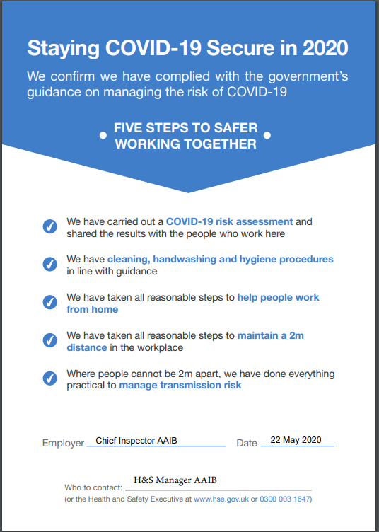
Staying Covid-19 Secure
HSE have made available a poster to be displayed in the workplace confirming compliance with Government guidance on follows

Slide 13
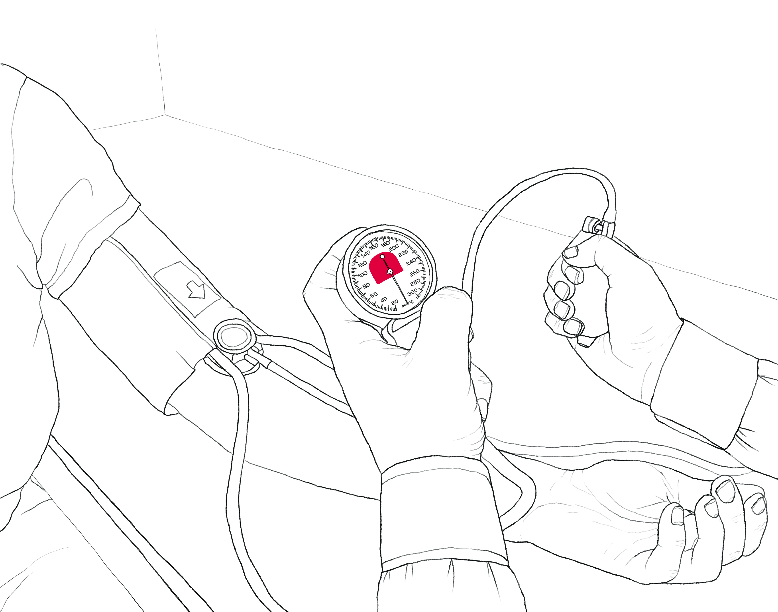
RIDDOR reporting
The Reporting of Injuries, Diseases and Dangerous Occurrences Regulations (RIDDOR) 2013 imposes duties on employers, the self-employed and people in control of work premises to report serious workplace accidents, occupational diseases, and specified dangerous occurrences

Slide 14
Updated RIDDOR reporting of Covid-19
The Health and Safety Executive has advised that there is no requirement under RIDDOR to report incidents of disease or death of members of the public, patients, care home residents or service users from Covid-19.
The reporting requirements relating to cases and deaths of Covid-19 under RIDDOR only apply to occupational exposure.

Slide 15
RIDDOR reporting of Covid-19: what to report?
An accident or incident at work has, or could have, led to the release or escape of coronavirus must be reported as a dangerous occurrence.
A person at work (an employee/worker) has been diagnosed as having Covid-19, attributed to an occupational exposure to coronavirus. This must be reported as a case of disease.
If a worker dies as a result of occupational exposure to coronavirus, this must be reported as a work-related death due to exposure to a biological agent

Slide 16
Health and Safety for Remote Working
By law, employers are responsible for the health and safety of all employees, including those working from home on a temporary or permanent basis.
HSE have advised that employers should consider: - How they will keep in touch with employees - What work will the employees be doing and for how long? - Can that work be done safely? - Whether they need to put control measures in place to protect employees

Slide 17
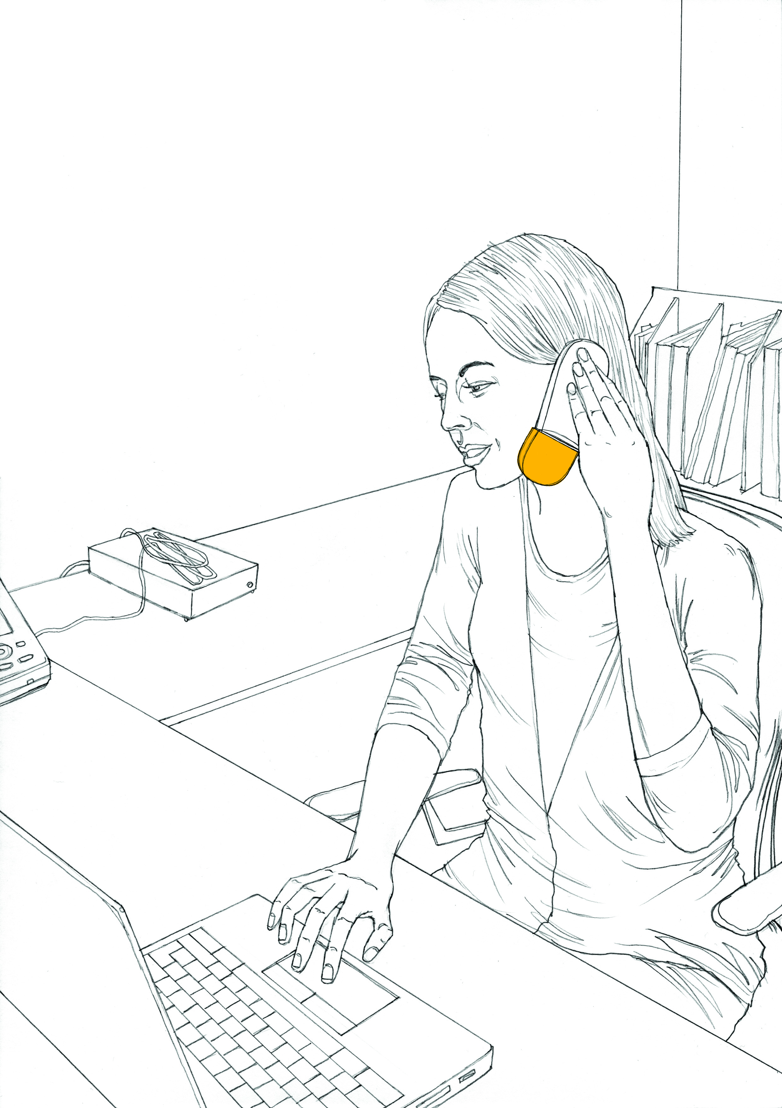
Remote Working
Employers should continue to remind employees of the Public Health England advice, particularly hygiene and cleaning procedures of equipment and home working surfaces
Keep in touch with home workers and ensure regular contact to make sure they are healthy and safe.
Put procedures in place so you can keep in direct contact with home workers so you can recognise signs of stress as early as possible.
For those working at home permanently or on a long-term basis using display screen equipment (DSE), employers should engage with them about carrying out homeworking and home workstation assessments.

Slide 18
Remote Working with use of DSE
There are some simple steps employees can take to reduce the risks from display screen work such as breaking up long spells of DSE work with rest breaks (at least 5 minutes every hour) or changes in activity
Employers should have regular discussions with employees and discuss whether additional steps are needed e.g. where the employee reports aches, pains, etc. related to their temporary DSE arrangements
Where employers decide to make working from home arrangements permanent, they should provide information on how to carry out full workstation assessments and provide employees with appropriate equipment and advice on control measures.

Slide 19
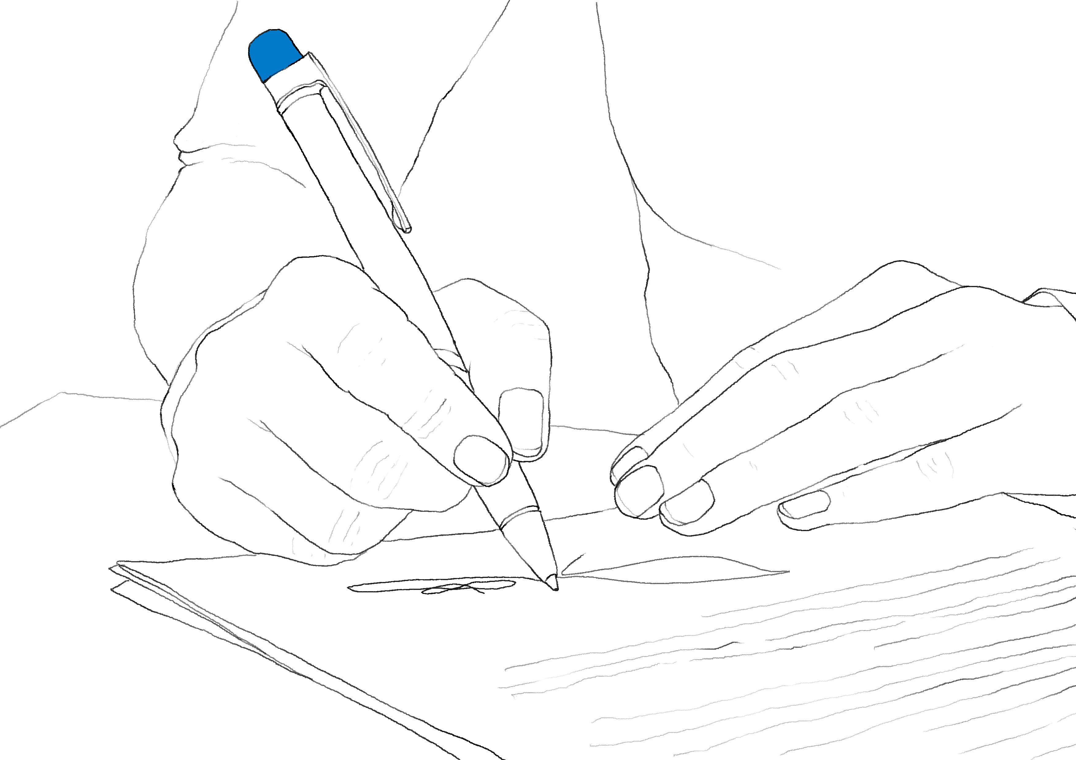
Guidance from the UK Government
Carry out a Covid-19 risk assessment
Develop cleaning, handwashing and hygiene procedures
Help people to work from home
Maintain 2m social distancing, where possible
Where people cannot be 2m apart, manage transmission risk. E.g. using screens to separate employees, stagger arrival and departure times, reduce the number of people in the work place

Slide 20
Retail
Latest advice to retailers includes:
Limiting opening hours
Limiting the number of customers in store to comply with social distancing requirements
Encouraging customers to use hand sanitiser or hand washing facilities, and to avoid touching products whilst browsing.
Continuing to keep customer restaurants and cafes closed until further notice, apart from when offering hot or cold food to be consumed off the premises.
Fitting rooms should be closed wherever possible. Where fitting rooms are essential, for example to support key workers buying critical protective clothing, they should be cleaned very frequently, typically between each use.
Restricting restocking shelves outside of opening hours.

Slide 21
Advising Insurers
Employers should notify their Insurers of significant changes to their work for example; restaurants now only providing home deliveries to ensure policy coverage.
If Insurers are considering a claim presented during Covid-19 they may consider if Health and Safety practices have been complied with in accordance with guidance and good practice before granting policy indemnity

Slide 22
Enforcement Actions
HSE and Local Authority action
Notice of material breach
Improvement Notice
Prohibition Notice
Prosecution of company and/or directors
Penalties
Reputational damage
Fees for Intervention

Slide 23
Useful links
https://www.gov.uk/guidance/working-safely-during-coronavirus-covid-19
https://www.hse.gov.uk/news/riddor-reporting-coronavirus.htm
https://www.hse.gov.uk/news/social-distancing-coronavirus.htm
https://www.hse.gov.uk/news/using-ppe-at-work-coronavirus.htm
https://www.hse.gov.uk/toolbox/workers/home.htm
https://www.hse.gov.uk/simple-health-safety/risk/risk-assessment-template-and-examples.htm
https://www.gov.uk/government/publications/guidance-on-shielding-and-protecting-extremely-vulnerable-persons-from-covid-19

Slide 24
Questions?

Slide 25
How we can help
Drafting Health and Safety policies and statements;
Providing advice and representing clients in Health and Safety investigations;
Reviewing Health and Safety compliance in work practices;
Providing advice and assist with workplace Risk Assessments;
Providing industry specific advice;
Defending civil claims for damages;
Advising on insurance cover and disputes.

Slide 26
For further questions and advice please contact:
Alan Davies
Partner
DDI: (0)118 957 0300
M: (0)7881 825 803
E: alandavies@bdbpitmans.com

