Slide 1

Southampton Insurance Institute - MGAs and their place in the UK insurance Market
Peter J Staddon & Norman Hughes
Date 28th May, 2020
SHAPING THE FUTURE OF DELEGATED UNDERWRITING
1

Slide 2
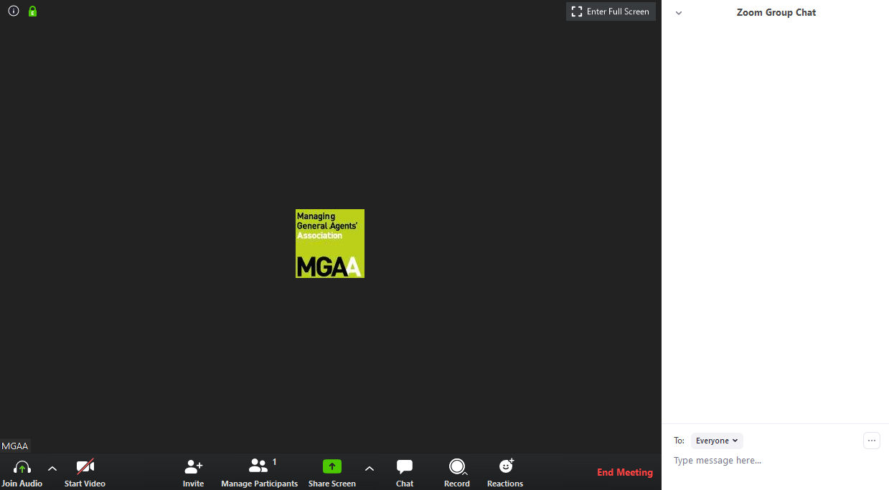
During the Webinar…
All participants are automatically
muted
To ask a question…
The webinar is being recorded
Feedback forms

Slide 3
Agenda and Learning Objectives
What is an MGA – their unique benefits
The Role of an MGA – within the UK insurance market
Where MGAs sit between the broker and the insurer
Why use an MGA?
Regulation & Compliance – as an intermediary, but not a broker
The MGA Market, its size and M&A activities
The MGAA as a bespoke trade association
2

Slide 4
What is an MGA
Regulated Insurance Agency
Agency that acts as an intermediary between the Insurer and a producing party – i.e. retail broker, wholesale broker or direct to insureds (policy holder).
Underwriting services may include but not be limited to product development, marketing, distribution, underwriting, pricing, claims management, complaints management and actuarial analysis.
SHAPING THE FUTURE OF DELEGATED UNDERWRITING
3

Slide 5
The Role of an MGA
Performs many of the functions normally undertaken by Insurers, acting as their agent under a contractual “delegation of authority”
Combined Operating Ratios
Rare for MGAs to take a share of individual insurance risks (however can take risk-based commissions). Risk-bearing stays with the Insurer
SHAPING THE FUTURE OF DELEGATED UNDERWRITING
4

Slide 6

The MGA Market
Estimated to be worth £6.1bn in UK market – over 10% of general market’s premium
Estimated to be in excess of 300 separate MGAs in the UK
Write over 100 different lines of business from Professional Indemnity to Nuclear Energy
SHAPING THE FUTURE OF DELEGATED UNDERWRITING
5

Slide 7
Where do MGAs sit in the Market?
All MGAs are coverholders but not all coverholders are MGAs!
Broker
MGA
Insurer
SHAPING THE FUTURE OF DELEGATED UNDERWRITING
6

Slide 8
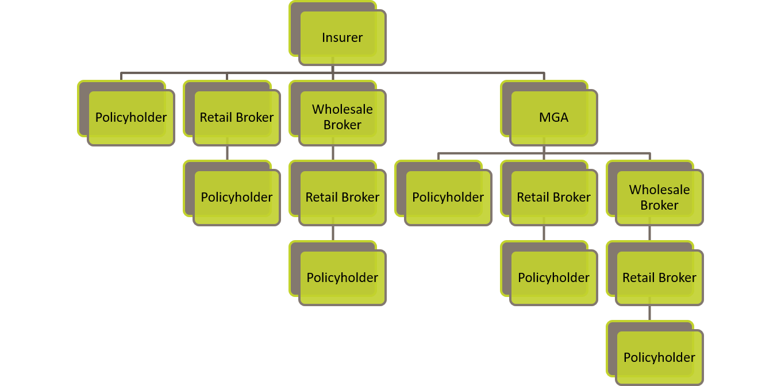
Where do MGAs sit in the Market?
7

Slide 9
Fiduciary Duty
The MGAA has defined an MGA as:
“an agency whose primary function and focus is the provision of underwriting services and whose primary fiduciary duty is to its Insurer principal”
SHAPING THE FUTURE OF DELEGATED UNDERWRITING
8

Slide 10
Why an MGA?
But only if MGA maintains balance between underwriting profit and their own financial return
Underwriting Profit
Financial return
SHAPING THE FUTURE OF DELEGATED UNDERWRITING
9

Slide 11


We all Need to Recognise that Change is Coming!
10

Slide 12

Norman Hughes, ACII
Managing Director

Slide 13



How does the FCA classify MGAs?
From an FCA Handbook perspective, as insurance intermediaries (there are no sub-classifications)
From an FCA Supervision perspective, as a distinct type of intermediary
Except for TPAs, which are (usually) unregulated

Slide 14



Are their FCA regulatory permission profiles the same?
In most respects, yes.
But an MGA may not require:
Permission to give advice (i.e. make a product recommendation)
Permission to hold client money

Slide 15

Are they subject to the same FCA rules as brokers?
Yes, because both are classed as insurance intermediaries.
However, for customer-facing MGAs, there is a requirement to tell customers that the MGA is acting on behalf of the insurer when selling a product.

Slide 16

Are insurers’ responsibilities for MGAs any different?
Yes, if the MGA is customer-facing. Insurer will have regulatory responsibility for the disclosures made by the MGA when selling the product.
Insurer will not be responsible for brokers making appropriate disclosures where they are acting for the customer.

Slide 17

The big issue for brokers with binders:
Conflicts of interest
FCA requires brokers to manage conflicts in a way that does not cause detriment to customers
This includes:
  - Having an effective Conflicts of Interest Policy
  - Maintaining a Conflicts of Interest Register (also showing mitigations and monitoring)

Slide 18
What is Driving the Emergence of MGAs?
“Brokers interested in alternative distribution opportunities may look to acquire digital MGAs in 2018-2019. MGAs are authorised to perform certain functions ordinarily handled only by Insurers - binding coverage, underwriting and pricing, appointing retail agents within a particular area and settling claims – which are attractive to small-to-medium businesses that don’t want to buy insurance through traditional brick-and-mortar brokers. Acquiring an MGA can be less expensive for a broker to offer these services than develop them in-house”
Deloitte Insurance Outlook 2018
11

Slide 19

The Foundation of a Successful MGA
“Your reputation is more important than your paycheck, and your integrity is worth more than your career”
Ryan Freitas
Founder, Second Verse
SHAPING THE FUTURE OF DELEGATED UNDERWRITING
12

Slide 20
Development of the MGA Market
MGAs as % of market have dramatically increased (factor of 3)
    Since the industry became regulated in 2005, the number of FCA authorised entities has almost halved
    In the same period, MGAs have increased by over 50%
    Wholesale broker numbers have remained static
With kind permission of IMAS
SHAPING THE FUTURE OF DELEGATED UNDERWRITING
13

Slide 21
M&A ACTIVITY
MGA M&A activity has been increasing, but not as fast as for brokers generally.
    Broker M&A activity has significantly increased, whilst targets have decreased
    MGA negligible increase in M&A activity, whilst numbers increasing
    MGA numbers continue to increase?
With kind permission of IMAS
SHAPING THE FUTURE OF DELEGATED UNDERWRITING
14

Slide 22
A Brief History of the MGAA…
Formed in 2011 the Association was principally founded to:
    Represent MGAs specifically and lobby on their behalf
    Communicate the benefits of MGAs
    Drive best practice
    As a not-for-profit organisation, the MGAA, and its board of directors and specialist committees focus 100% on shaping the future of delegated underwriting in the UK
SHAPING THE FUTURE OF DELEGATED UNDERWRITING
15

Slide 23
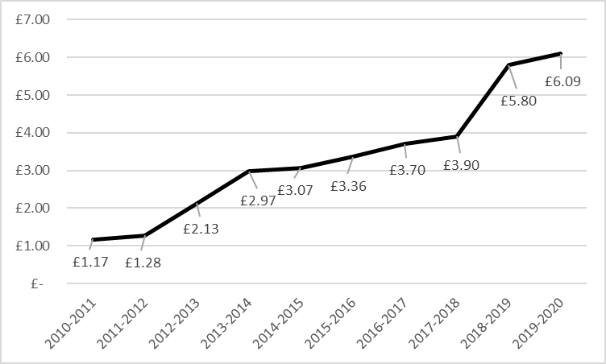
Membership of the MGAA
    In 2011, we started out with just 40 affiliated members… now we have over 240!
Written GWP £bn
Year
SHAPING THE FUTURE OF DELEGATED UNDERWRITING
16

Slide 24
The Role of the MGAA and it’s Objectives
Convey
the views of its members to various bodies
Represent
members’ views in negotiations
Set
best practice guidelines
Assist
insurance carriers who work with MGAs
Work
proactively to improve the MGA sector
Create
a technical centre to inform regulators
Seek
opportunities to improve standards in the sector
SHAPING THE FUTURE OF DELEGATED UNDERWRITING
17

Slide 25
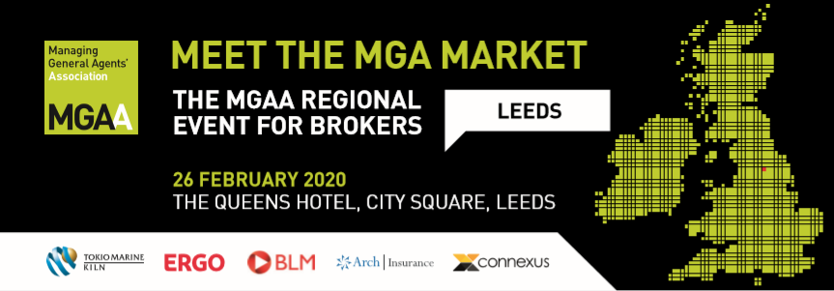
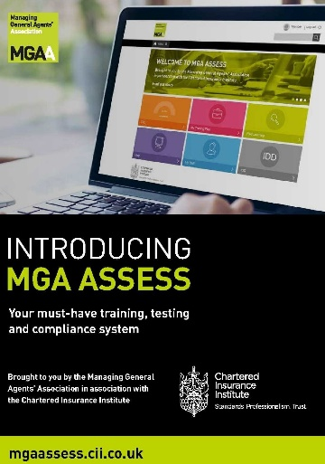
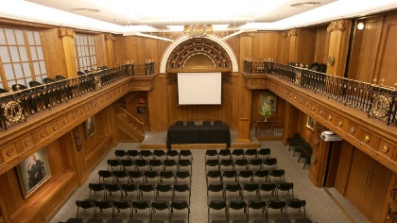
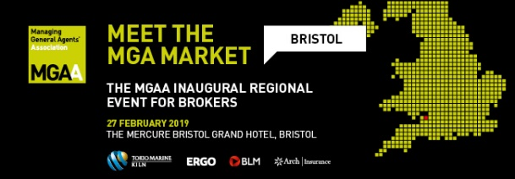

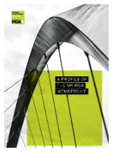
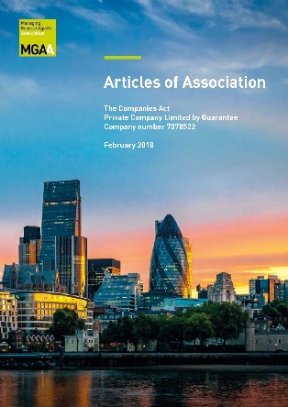
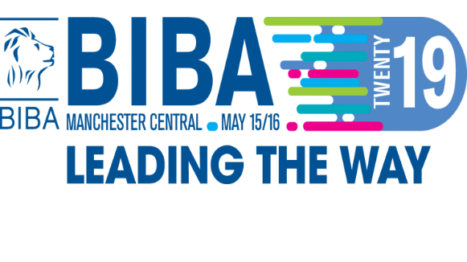
Current Activity of the MGAA
SHAPING THE FUTURE OF DELEGATED UNDERWRITING
18

Slide 26








Who else do we Work in Partnership with?
SHAPING THE FUTURE OF DELEGATED UNDERWRITING
19

Slide 27
Q&A
Peter J Staddon Norman Hughes ACII
Chartered Insurance Underwriting Agent Managing Director
MGAA Compliance Management Services
peter.staddon@mgaa.co.uk normanh@compliancemanagement.co.uk
020 7617 4442 020 8645 2660
www.mgaa.co.uk
SHAPING THE FUTURE OF DELEGATED UNDERWRITING
20

